Slide 1
⏰ BUILD A TIME MACHINE
YOUTH MAP LAB WORKSHOP
NATIONAL 4-H GEOSPATIAL TEAM

Slide 2
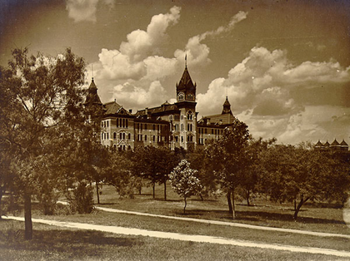
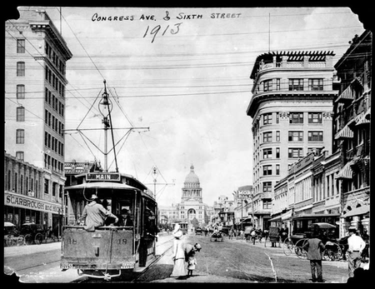
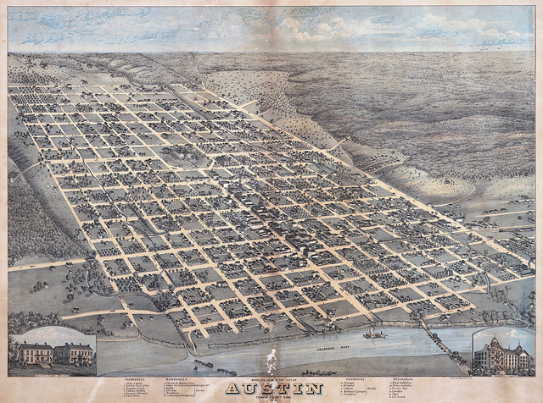
Austin 1900s
What’s different from today?

Slide 3
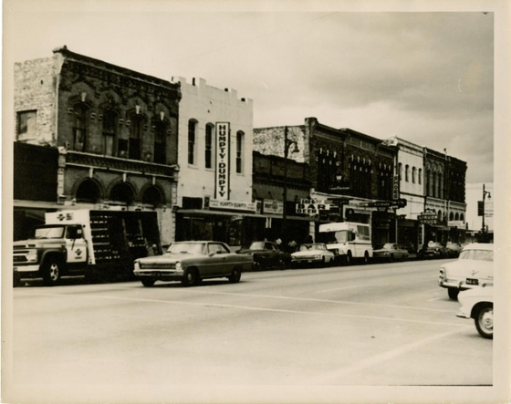
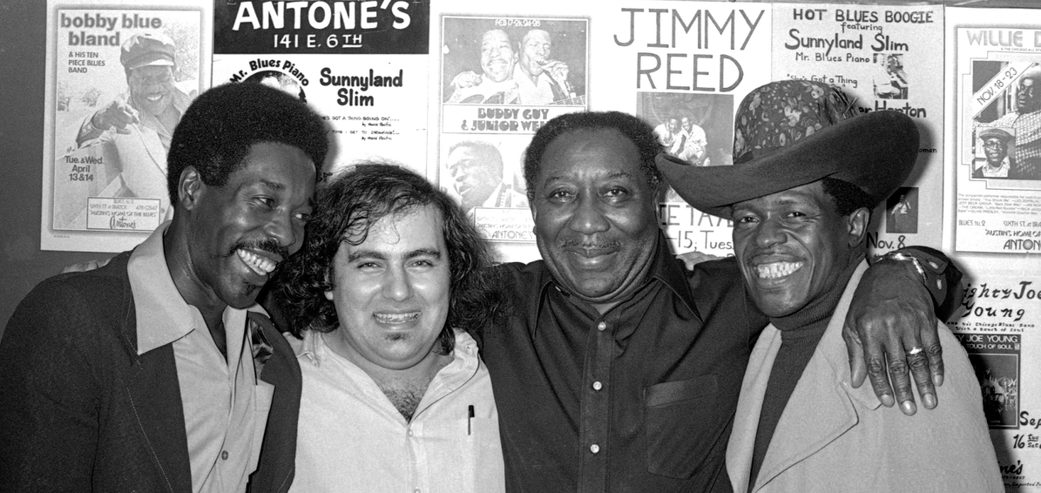
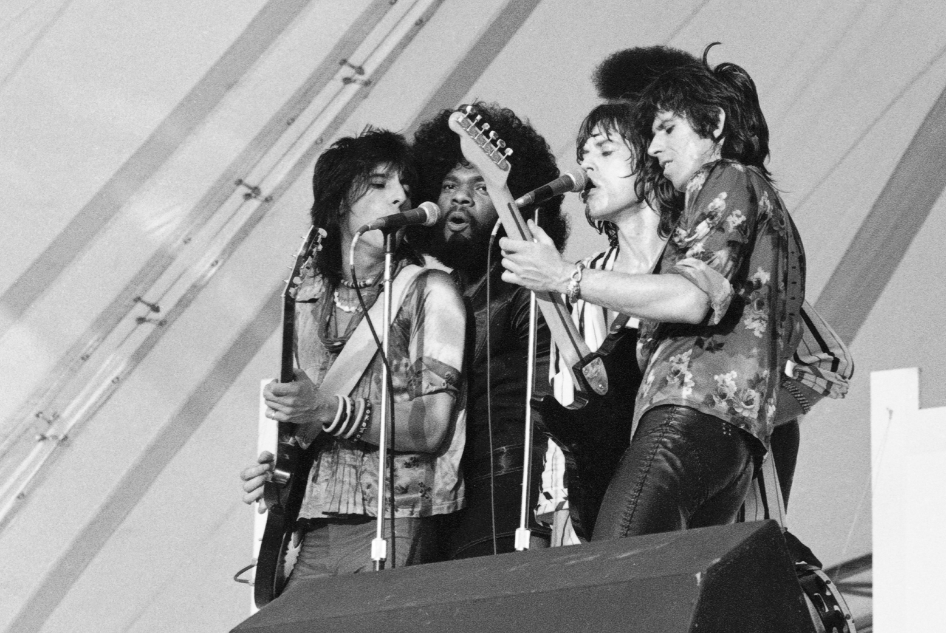
Austin 1970s
What stayed the same? What changed?

Slide 4
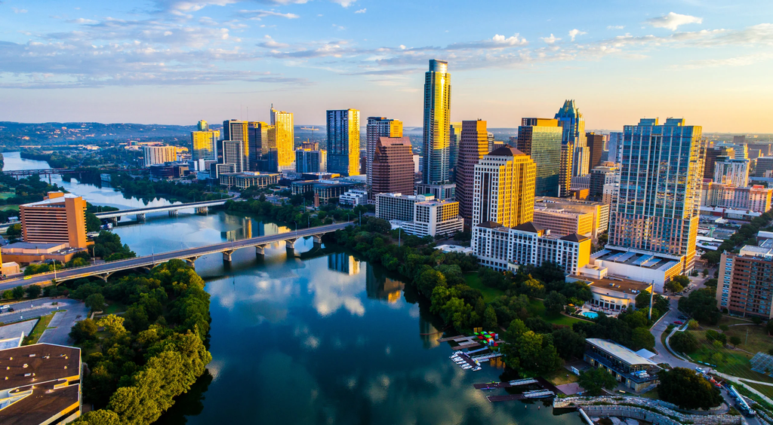
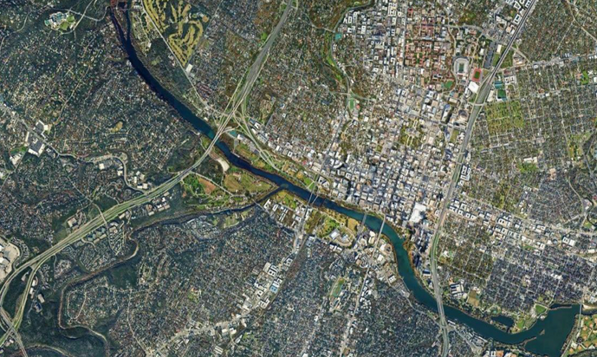
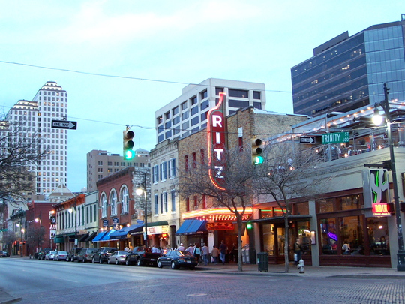
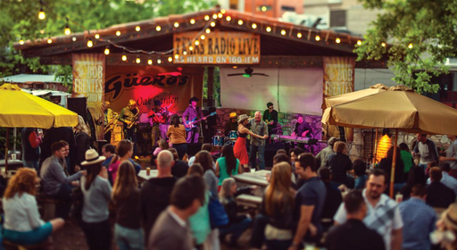
Austin 2020s
What patterns connect back to the past?

Slide 5
Activity! Mapping 1920
Prompt: It’s 1920. Where are farms, railroads, neighborhoods, music halls?
Use the blank outline maps!

Slide 6
Reflection!
What surprised you?
What would be hardest about living then?
What do we still see today?

Slide 7
Activity! Mapping 2070
Prompt: Jump to 2070. Add at least 3 features of Future Austin
Ideas to get you started..
AI
Green energy
Mass transit
Climate adaptations
Immigration

Slide 8

GIS Demo
Notes:
"GIS lets us see the past, analyze the present and plan for the future"

