Slide 1
Casual Rider Conversion
Creating Annual Subscribers
Brandon Gaiffe / February 16, 2026

Slide 2
Cyclictic Membership Conversion Overview
How do ride patterns differ between Casual Riders and Annual Members?
Casual riders ride longer
Casual riders show strong trends toward weekend rides
Ridership for both show similar seasonal trends
A subset of casual riders show similarities to annual members
  These riders are prime targets for conversion

Slide 3
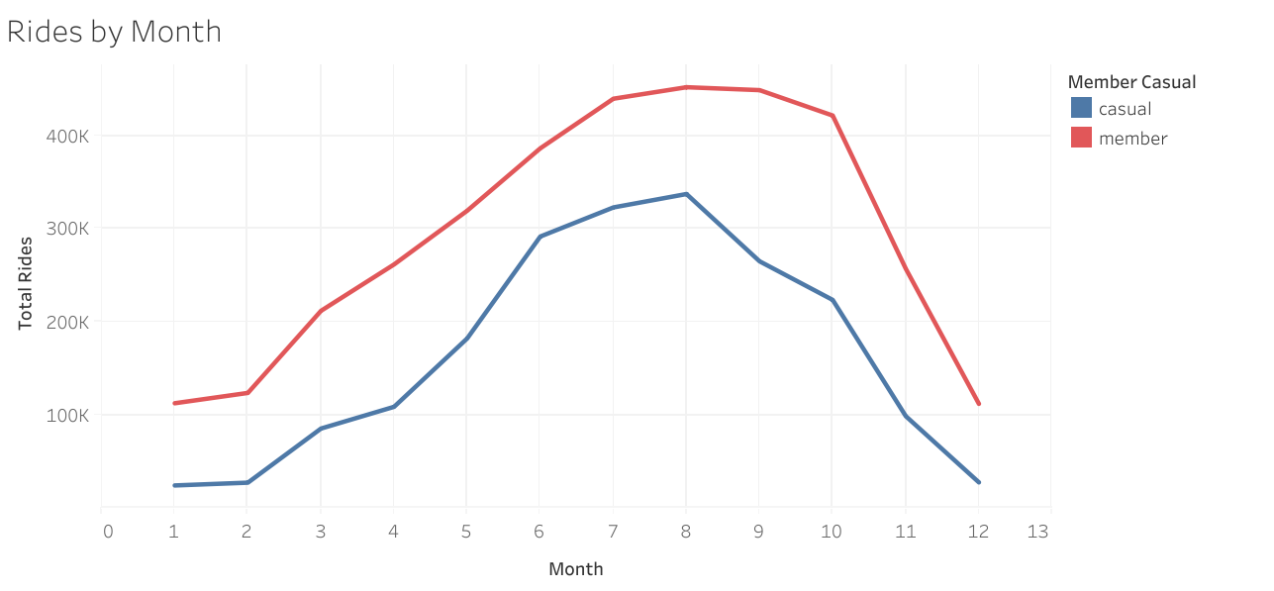
Seasonal Trends
Fewest riders in winter months
Casual riders decrease starting in autumn
Members ride steadily through summer and fall
Strongest similarities during the summer

Slide 4
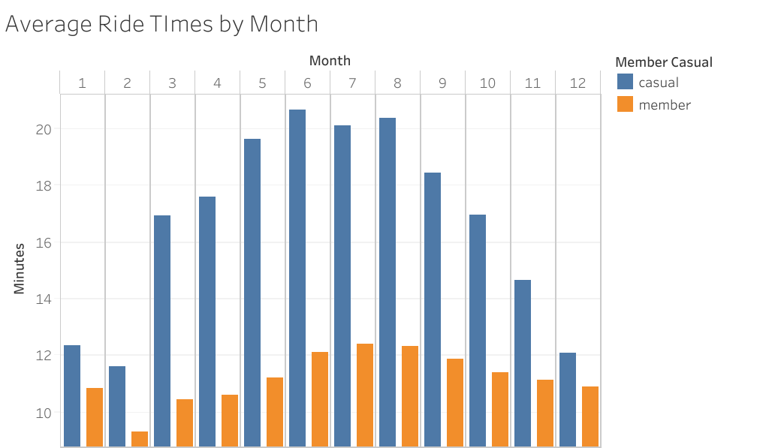
Monthly Trends
Casual riders take longer trips
Dramatic difference in the summer months
Shows preference toward leisure rather than commutes

Slide 5
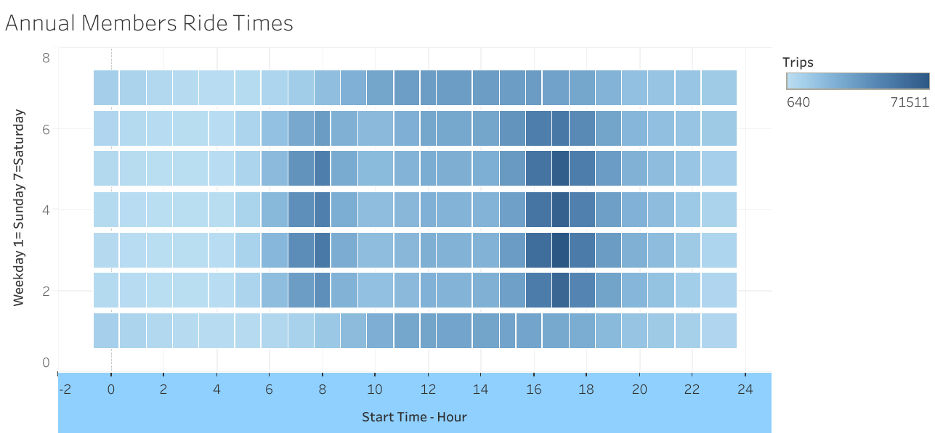
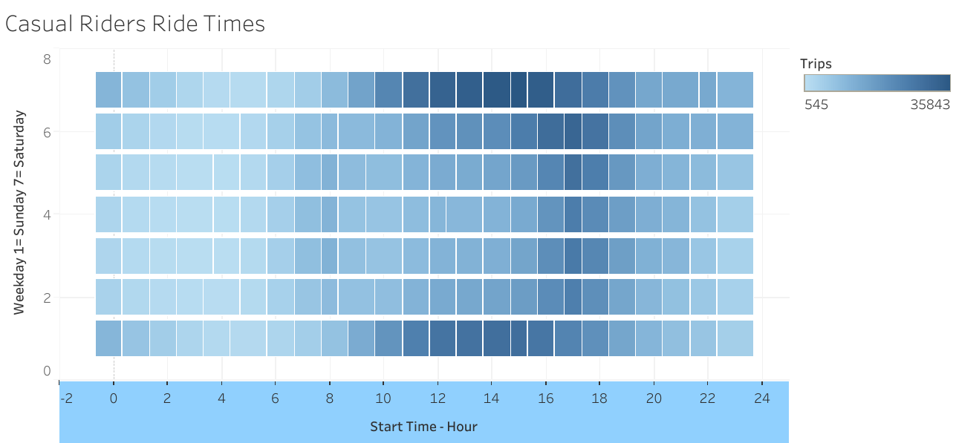
Daily Behaviors
Members ride at commute times
Casual riders skew toward weekend rides
Significant crossover during evening commute

Slide 6
Recommendations
Run promotional campaign during fall and winter months with discounted pricing incentivising conversion during slower months
Offer an option of lower priced seasonal memberships to capture casual riders who ride longer in the summertime
Dynamic pricing structure for casual riders while members pay a steady rate to convert casual riders during commute times to members

