Slide 1
Human Activity Recognition (HAR) Movement Tracker
IAB330 Applied Internet of Things – Assessment 2B: Demonstration Presentation
By Group 16:
Brandon Gan (n11381345),
David Ta (n11278340),
Haiden Williams (n12074705),
Maverick Sto Domingo (n12073873)

Slide 2
Project Overview
Problem: Many people struggle to accurately tracking their movement patterns and measure their exercise performance
Goal: To create a wearable system that tracks movement type (walking, jogging, running) and speed, helping users monitor progress and improve performance. The machine learning estimates how good the user’s movement per run.

Slide 3
How it works
Two Arduino devices collect motion and speed data
The Raspberry Pi gathers, processes, and displays performance insights
Machine learning analyse data to evaluate movement quality and efficiency
The system shows movement type, speed, estimated performance score, and a graph of progress over the full session

Slide 4
Hardware Devices Used
Arduinos:
Wrist Arduino: Detects arm motion to classify activity type
Ankle Arduino: Measures leg acceleration to calculate speed
Raspberry Pi: Acts as the central processing unit for data collection, ML model inference, and visualisation

Slide 5
Ankle Speed Monitor (Arduino Nano 33 IoT)
Goal: Measure how fast the user is moving (walking, running, idle)
How it works:
Reads acceleration data using IMU
Calculates total acceleration magnitude
Estimates speed based on motion intensity
Sends real-time data to Raspberry Pi for display

Slide 6
Wrist Movement Node
(Arduino Nano 33 IoT)
Operates as the “Movement Node” within the 3-tier IoT system:
Node (Arduino) → BLE → Edge (Raspberry Pi) → Cloud (MongoDB + ML).
Chosen for its sensitivity to motion and convenience for daily wear
Goal
Detect and classify user activity (Idle, Walking, or Running) in real time.
Use Arduino’s built-in IMU sensor to capture wrist motion data.
How It Works
Data Capture (IMU Sensor)
Measures acceleration and rotation at 100 Hz.
Streams continuous wrist motion data reflecting user activity.
On-Device Processing
Calculates mean, standard deviation, and step frequency from motion data
Classifies activity using tuned thresholds:
Walking: ≈ mean < 1.3 g, std ≈ 0.2–0.6 g
Running: ≥ mean 1.5 g & std ≥ 0.7 g
Idle: ≈ stable (1.0 g, < 0.05 g)
Output
Activity label → shown in serial monitor / sent via BLE to Pi.
Raw IMU data → stored for machine-learning analysis.

Slide 7
Raspberry Pi
Our Raspberry Pi acts as the brain of the whole setup. It connects to the wrist and ankle Arduinos over Bluetooth Low Energy (BLE), receives all their motion data, and handles the rest of the pipeline automatically.
Once connected, the Pi:
Listens to the live IMU streams from each sensor node.
Parses and buffers that raw accelerometer and gyroscope data into usable frames.
Runs our trained machine-learning model (final_HAR_model.joblib) locally to classify the current activity in real time.
Uploads each prediction and data frame to a MongoDB database for logging and later analysis.
In short, the Pi works like a small edge-AI server - it brings everything together, makes decisions on the spot, and keeps a full record of what’s happening without needing any cloud connection.

Slide 8
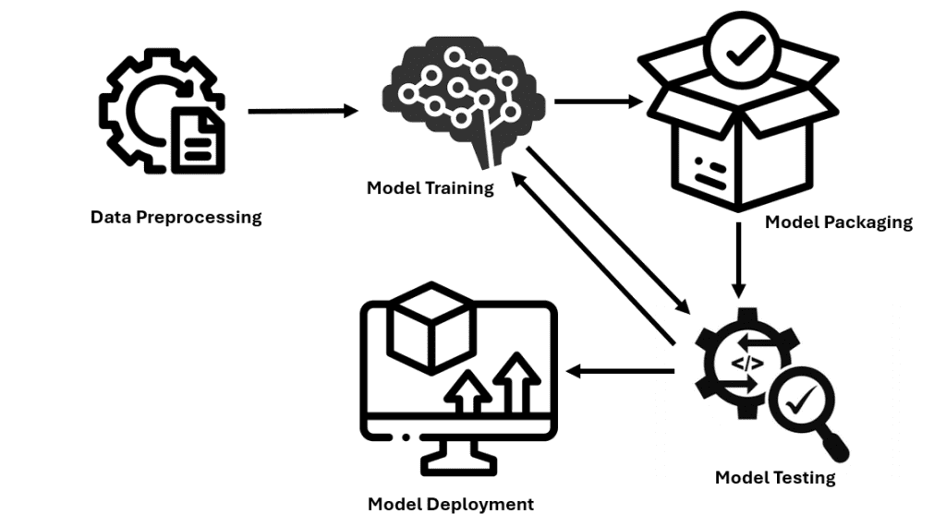
Machine Learning
Model Training (Offline – Development Stage)
Trained on labeled IMU datasets collected from Arduino devices
Features extracted from accelerometer and gyroscope data (mean, variance, RMS, FFT peaks)
Used K-Nearest Neighbors (KNN) classifier
Validated with Leave-One-Out Cross-Validation (LOO), ensures generalization to unseen users
Achieve > 85 % accuracy
Saved trained model as activity_model.pkl and scaler.pkl for later deployment
Deployment (Online – Raspberry Pi)
Raspberry Pi loads the pre-trained .pkl files
Incoming sensor windows are scaled and converted into feature vectors
Model predicts activity class and confidence score in real time
Results are displayed or logged for cloud upload and graph visualization.
Model Training (Offline)
Trained on labeled IMU data sets collected from Arduino devices
Features extracted from accelerometer and gyroscope data (mean, variance, RMS, FFT peaks)
Used K-Nearest Neighbors classifier
Validated with Leave-One-Out Cross-Validation (LOO), ensures generalization to unseen users
Achieved > 85 % accuracy
Saves trained model as activity_model.pkl and scaler.pkl for later deployment

Slide 9
Q&A

Slide 10
Thank You for Listening

