Slide 1
Proyect4
File created on: 12/15/2024 11:59:06 PM

Slide 2
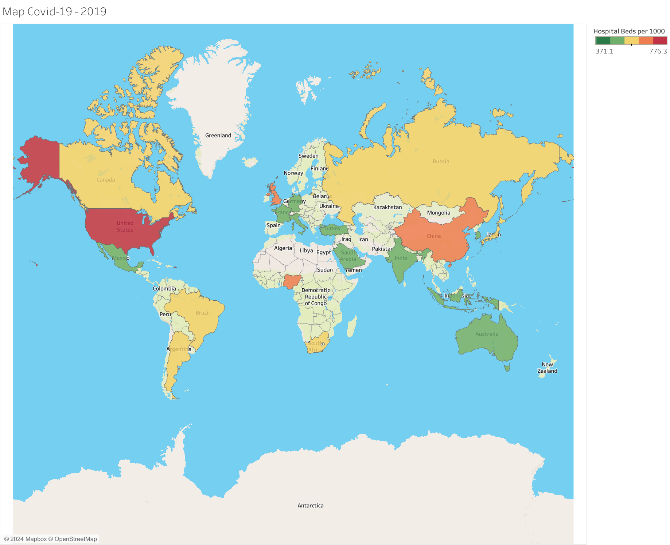

Slide 3
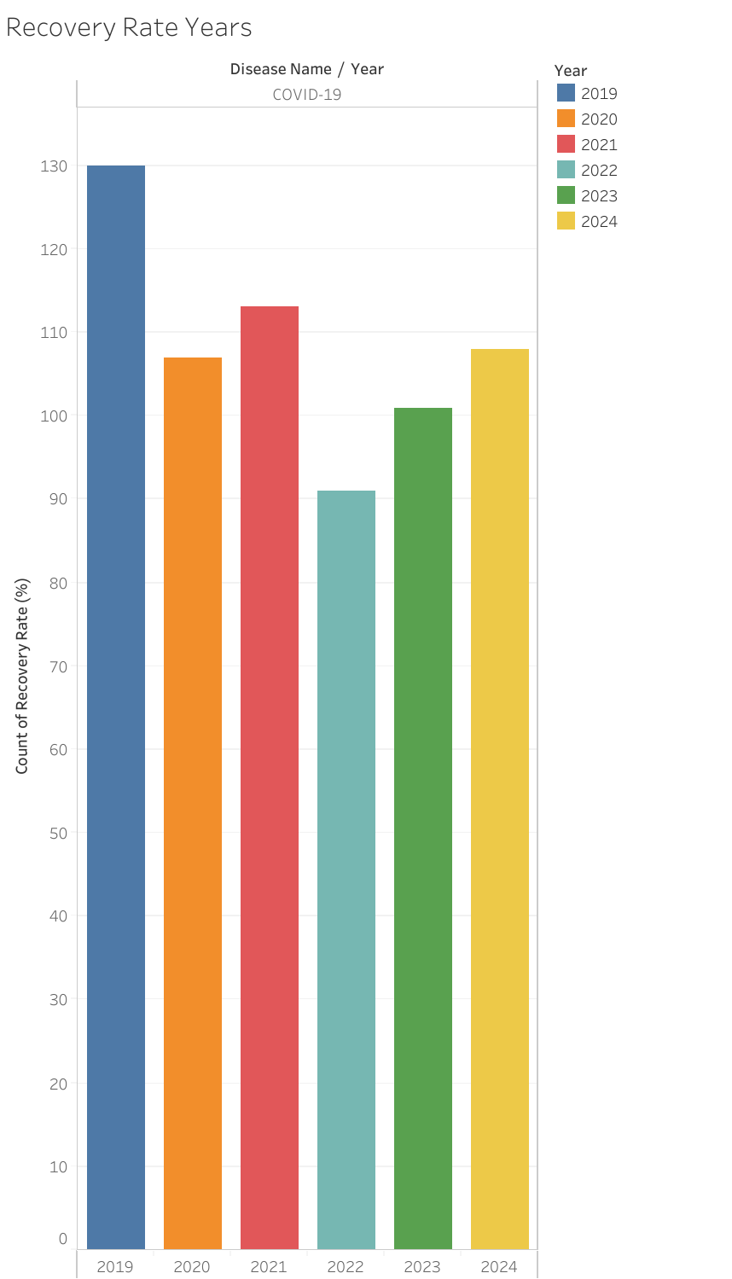

Slide 4
