Slide 1
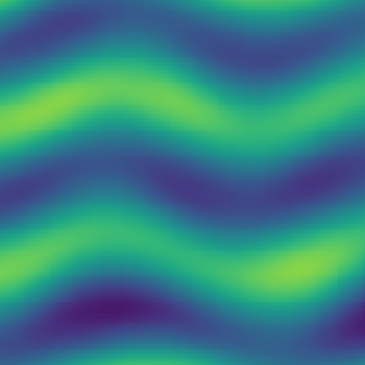


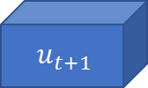

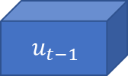


$$t−1$$
$$t−5$$
Conv.
$$u_{t−1}$$
Conv.
Conv.
Conv.
$$u_{t}$$
Conv.
$$t$$
Conv.
Conv.
Conv.
$$u_{t+1}$$
Conv.
$$t+1$$

