Slide 1
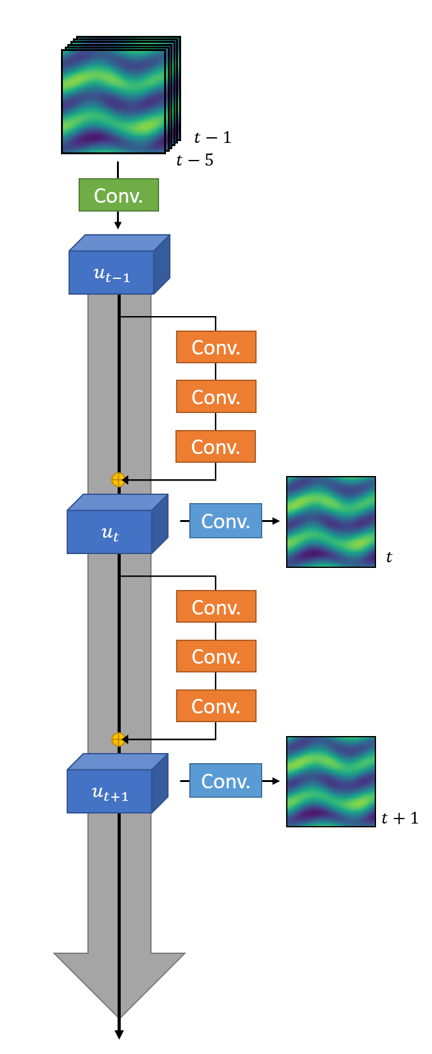
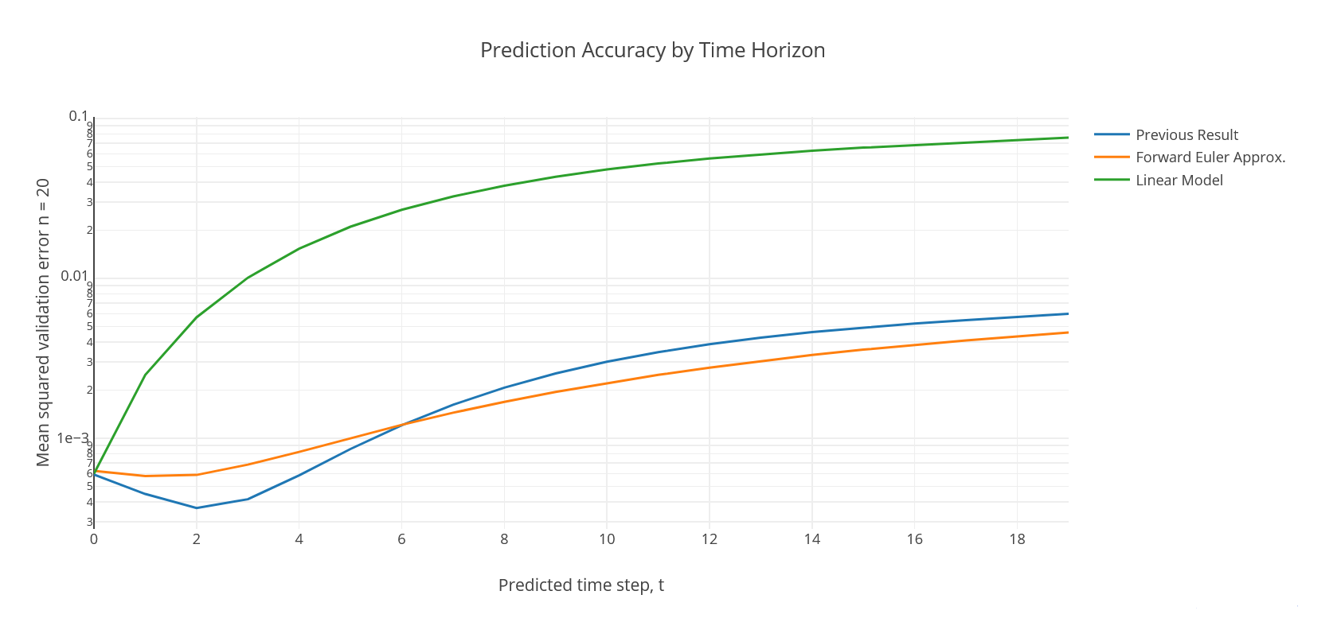
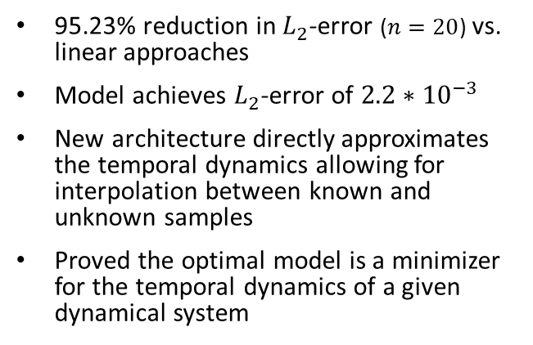
Major Results
New architecture (pictured left) models prediction using forward-Euler approximation leading to increased performance and interpretable models modeled in terms of partially differentiable equations
95.23% reduction in $L_{2}$-error ($n=20$) vs. linear approaches
Model achieves $L_{2}$-error of ${2.2∗10}^{−3}$
New architecture directly approximates the temporal dynamics allowing for interpolation between known and unknown samples
Proved the optimal model is a minimizer for the temporal dynamics of a given dynamical system

