Slide 1

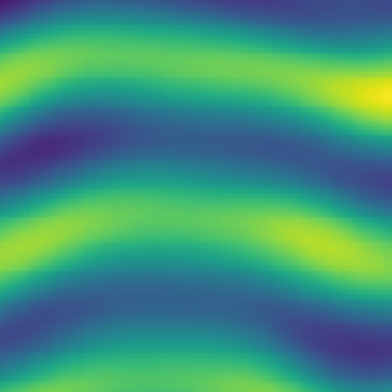
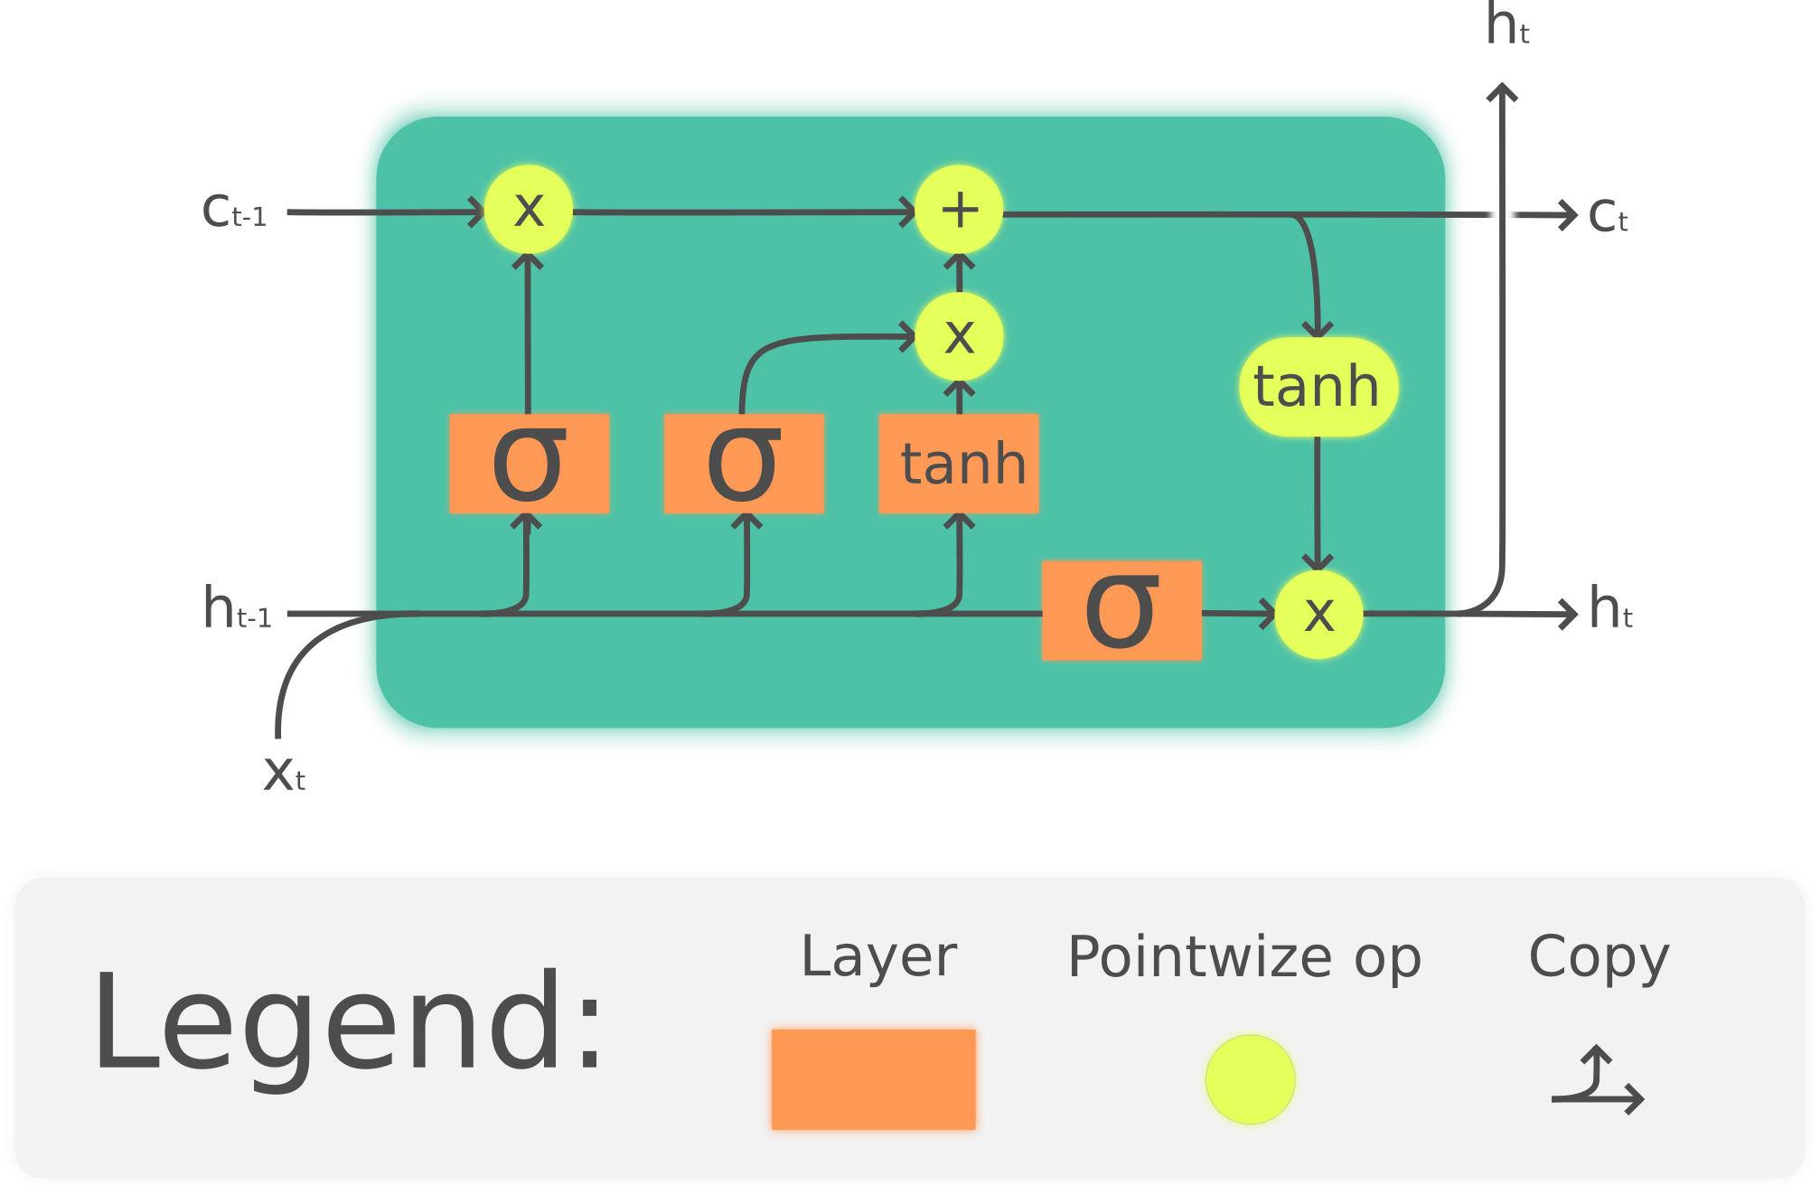
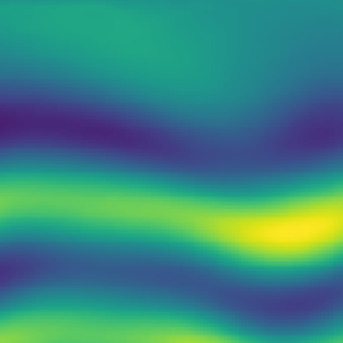
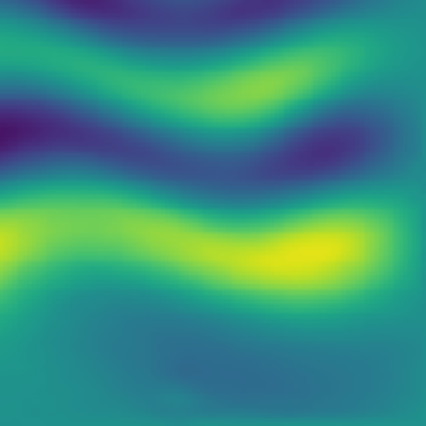
t
t+m
dense
dense
Embedding
t-n
t-1
Encoder
Decoder

Slide 2
t
t+m
dense
dense
Embedding
t-n
t-1
Encoder
Decoder

Slide 3


T + 0

Slide 4


T + 5

Slide 5


T + 19

Slide 6
