Slide 1


January 6, 2016
The 4 Rules of Simple Design
Applied to complex software
1
Notes:
Headline: Georgia, 47pt
Subhead: Georgia, 32pt
Right Aligned
Note: Feel free to adjust sizing to fit
Note: Delete “Confidential” if not needed

Slide 2

This is how we roll
Notes:
- Ruby/Rails
- Pair Programming
- TDD
- Remote Development

Slide 3
Complex Products != Complex Designs
“
Simple software design enables simple humans to maintain immensely complex systems.

Slide 4
What are the 4 rules?
Tests Pass
Expresses Intent
No Duplication (DRY)
Small
Understanding the 4 Rules of Simple Design – Corey Haines

Slide 5
It’s about humans
Tests Pass (gives me confidence)
Expresses Intent (informs me)
No Duplication (avoids confusion)
Small (fits in my head)
Beware of geniuses

Slide 6

TESTS PASS

Slide 7
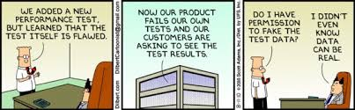
Applying the Rules – Passes Tests
Notes:
––

Slide 8
Applying the Rules – Passes Tests
Is this you?
Notes:
––

Slide 9
It’s easy to make tests pass. It’s harder (and more important) to make the passes and failures meaningful.
Applying the Rules – Passes Tests

Slide 10
What does that even mean?
Applying the Rules – Passes Tests

Slide 11
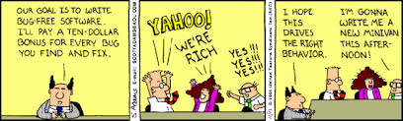
What does that even mean?
Applying the Rules – Passes Tests
It’s not just passing all tests, it’s passing the right tests
An empty test suite will pass, but isn’t very helpful
Testing the wrong thing may pass, but isn’t very helpful

Slide 12
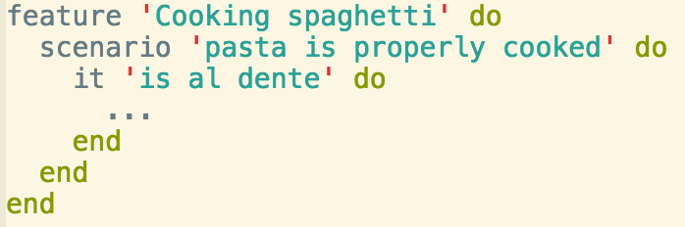
What does that even mean?
Applying the Rules – Passes Tests
Think about tests in advance and use them to help define ‘done’
makes ‘passing’ meaningful

Slide 13
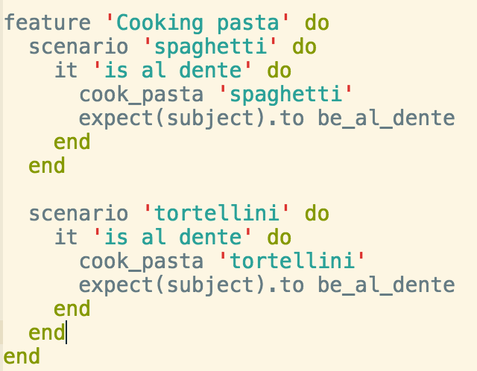
What does that even mean?
Applying the Rules – Passes Tests
Make your tests as adaptable as your code
makes them more likely to pass in the future

Slide 14
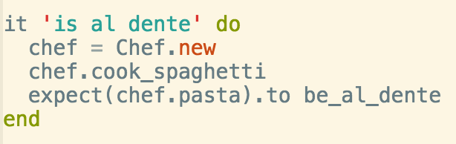
What does that even mean?
Applying the Rules – Passes Tests
Make your tests readable so you know you are testing the right things!

Slide 15

What does that even mean?
Applying the Rules – Passes Tests
Provide security to Future Developers
If you are a Future Developer, don’t break anything!
Yay! It’s green!

Slide 16
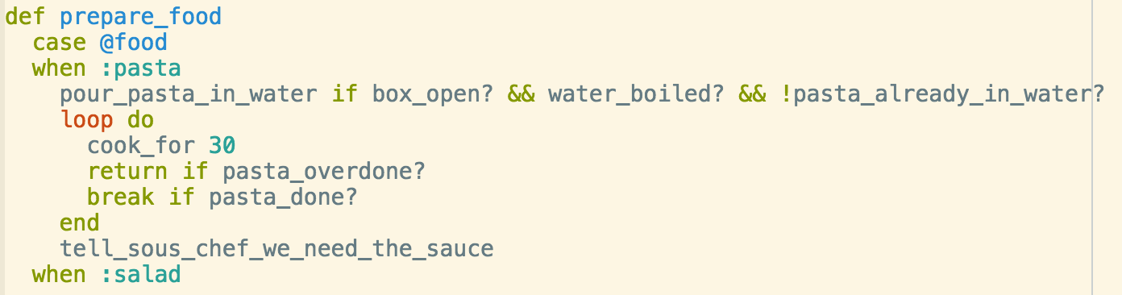
What does that even mean?
Applying the Rules – Passes Tests
If it’s hard to test, you built it wrong!

Slide 17
What are the right tests?
Applying the Rules – Passes Tests

Slide 18
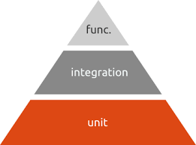
Applying the Rules – Passes Tests
There are many kinds of tests, and all should be incorporated
The testing pyramid.
Note how big the ‘unit’ portion is.

Slide 19
Unit tests…
Applying the Rules – Passes Tests
Provide security to future developers
first line of defense
Help you understand what you are building
Give you the best, and fastest, design feedback
are you building it right?

Slide 20
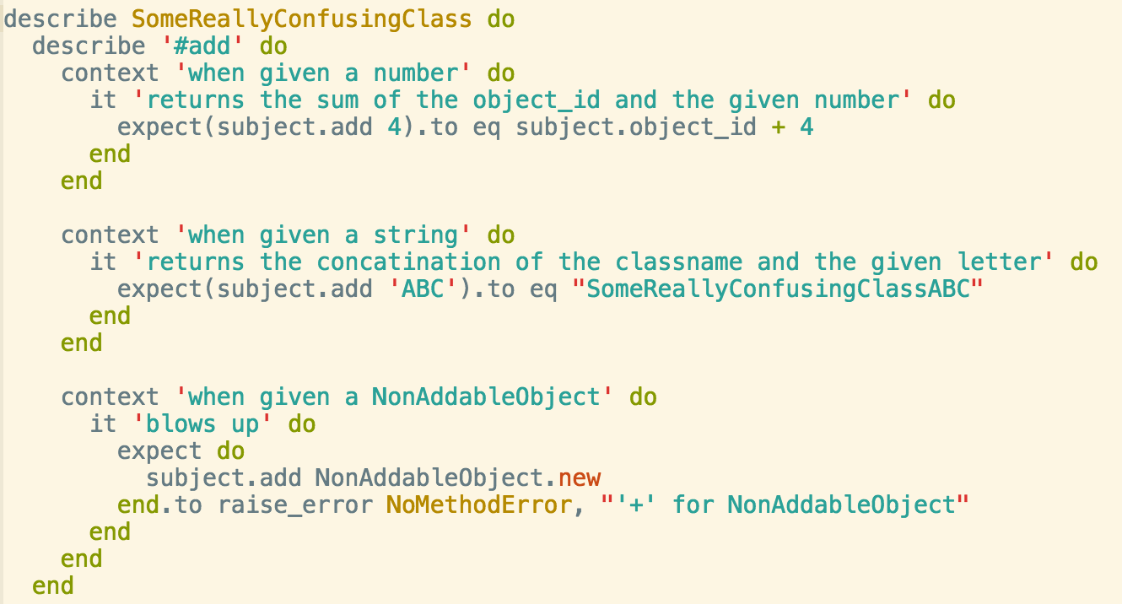
Unit tests…
Applying the Rules – Passes Tests

Slide 21
Function tests…
Applying the Rules – Passes Tests
Tell you when you’re done (acceptance tests)
Are generally more resistant to change than unit tests (more adaptable)
Become regression tests in the future
another layer of security for Future Developers

Slide 22
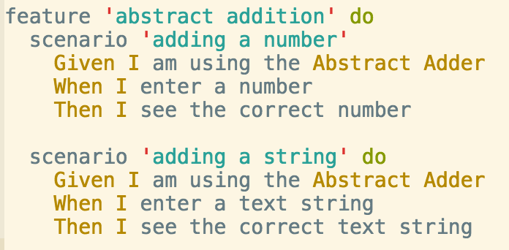
Function tests…
Applying the Rules – Passes Tests

Slide 23
How do we do it?
Applying the Rules – Passes Tests

Slide 24
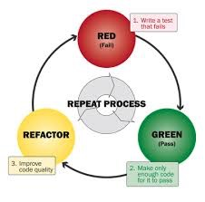
How do we do it?
Applying the Rules – Passes Tests
We use TDD (test driven development)
Write tests, watch them fail, add enough code to make them pass

Slide 25
How do we do it?
Applying the Rules – Passes Tests
We use TDD (test driven development)
Write tests, watch them fail, add enough code to make them pass
Makes things easier to test, leading to better design.
Also helps us define ‘done’.

Slide 26
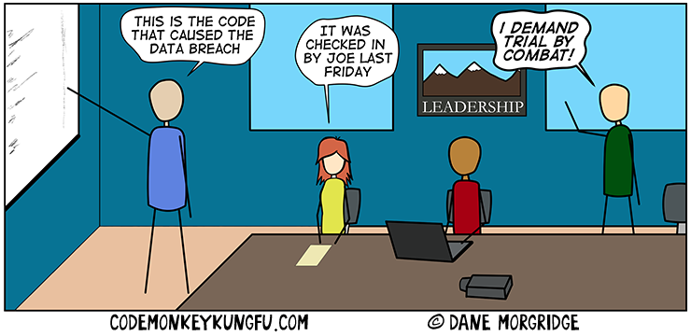
Applying the Rules – Passes Tests
How do we do it?
We evaluate the unit tests as part of the code review
Require tests for the core functionality of each class
Don’t forget negative test cases!

Slide 27
Applying the Rules – Passes Tests
How do we do it?
We evaluate the unit tests as part of the code review
Require tests for the core functionality of each class
Don’t forget negative test cases!
This helps make sure the tests are readable, and adaptable.

Slide 28

Applying the Rules – Passes Tests
How do we do it?
We make it a responsibility to keep our test suites green
If you see a failing test, fix it!

Slide 29
Applying the Rules – Passes Tests
How do we do it?
We make it a responsibility to keep our test suites green
If you see a failing test, fix it!
This provides security to Future Developers.

Slide 30
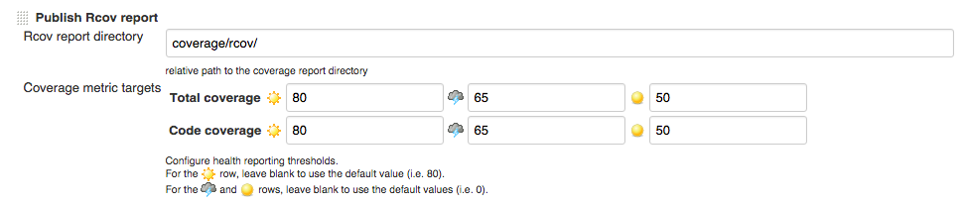
Applying the Rules – Passes Tests
How do we do it?
We make it a responsibility to keep our test suites full
Run code coverage metrics, and aim for 80% or higher
Our CI jobs will fail builds that don’t meet the code coverage standards

Slide 31
Applying the Rules – Passes Tests
How do we do it?
We make it a responsibility to keep our test suites full
Run code coverage metrics, and aim for 80% or higher
Our CI jobs will fail builds that don’t meet the code coverage standards
Make sure we have the right tests.

Slide 32
Applying the Rules – Passes Tests
How do we do it?
We run all unit tests prior to declaring our work done
actually usually Jenkins does it for us
We run full regression and function testing against a test environment
We run all function tests and a subset of regression tests post-deploy against production
We devote resources to making sure all tests can be run against all our environments
Test Engineers, not QA

Slide 33
Applying the Rules – Passes Tests
How do we do it?
We run all unit tests prior to declaring our work done
actually usually Jenkins does it for us
We run full regression and function testing against a test environment
We run all function tests and a subset of regression tests post-deploy against production
We devote resources to making sure all tests can be run against all our environments
Test Engineers, not QA
The actual ‘passes tests’ part.

Slide 34
Applying the Rules – Passes Tests
How do we do it?
We also have a suite of system integration tests that runs daily through a CI job
Sometimes it will find bugs inserted by other teams that they did not catch!

Slide 35
Applying the Rules – Passes Tests
How do we do it?
We also have a suite of system integration tests that runs daily through a CI job
Sometimes it will find bugs inserted by other teams that they did not catch!
Passing tests is important, so knowing when they fail is vital!

Slide 36
Conclusion
Applying the Rules – Passes Tests
Write the right tests, run them, make sure they pass. Do it often.
Make testing a priority and incorporate it into the design process to get the full benefits
if it’s hard to test, it’s written wrong
if the test is not clear, you either don’t fully understand the desired behavior, or don’t understand the code well enough to effectively test it
if it isn’t tested at all, it isn’t finished

Slide 37
Takeaway
Applying the Rules – Passes Tests
Passes tests => take tests seriously and use them to both inform your design and confirm that it works.

Slide 38

EXPRESSES INTENT

Slide 39
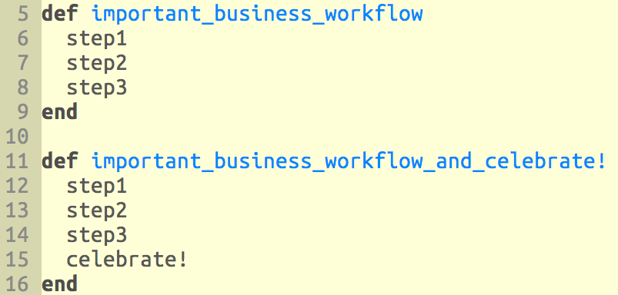
No Duplication (DRY)

Slide 40
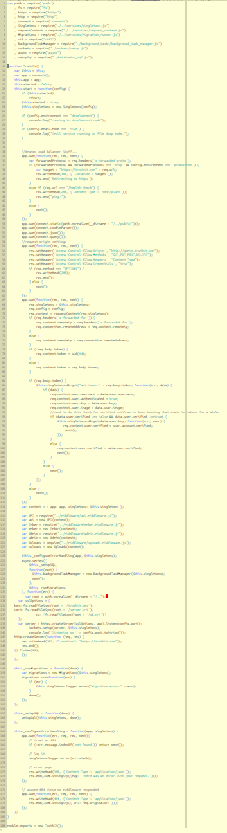
SMALL

Slide 41

Building a Complex Product
Day 1

Slide 42

Building a Complex Product
Is this Your Future?

Slide 43
Applying the Rules
Breaking down our spaghetti problem into smaller spaghetti problems.
Notes:
––

Slide 44
Apply the Rules
Organization
Systems
Code

Slide 45
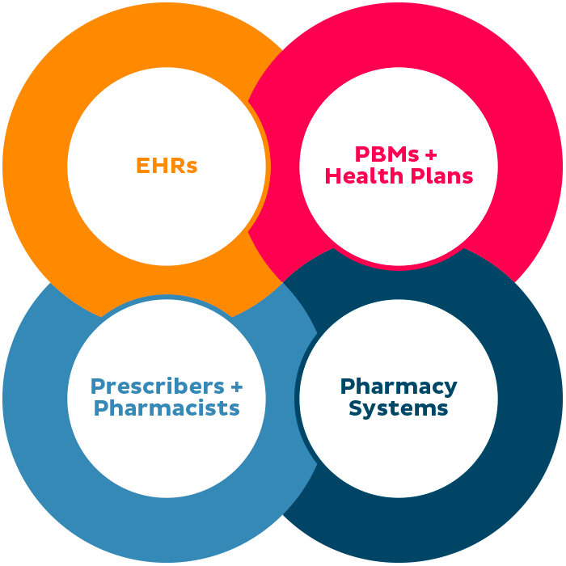
Applying the Rules - Organization

Slide 46

Applying the Rules - Systems

Slide 47
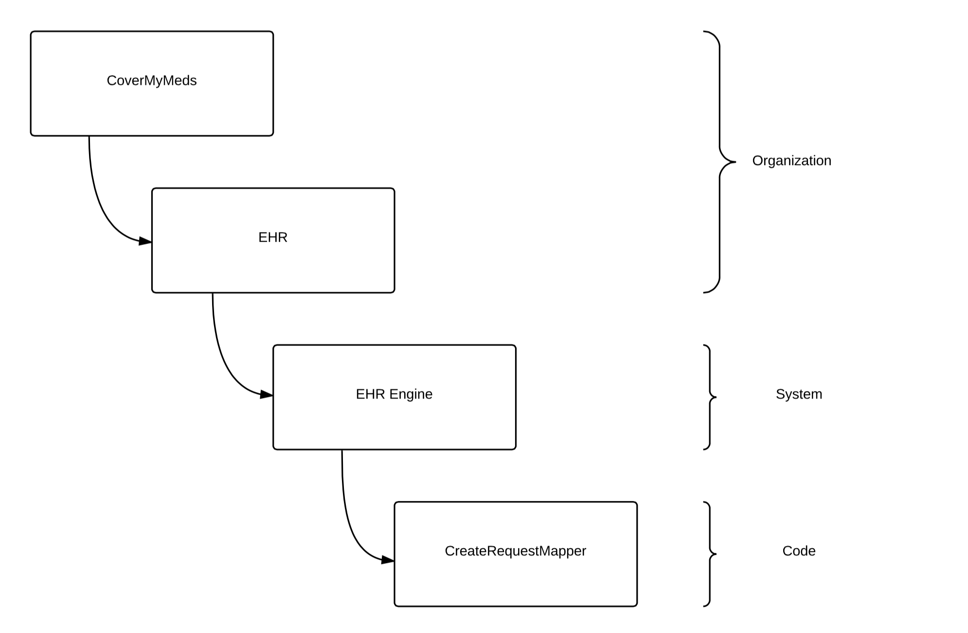
Applying the Rules - Code
Notes:
––

Slide 48
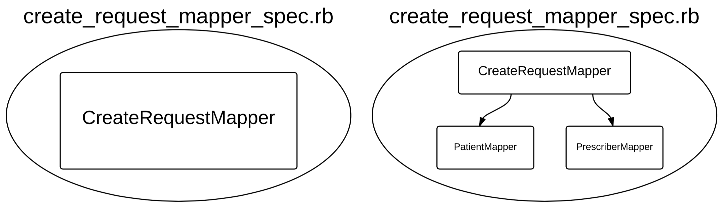
Applying the Rules – Passes Tests
Notes:
––

Slide 49
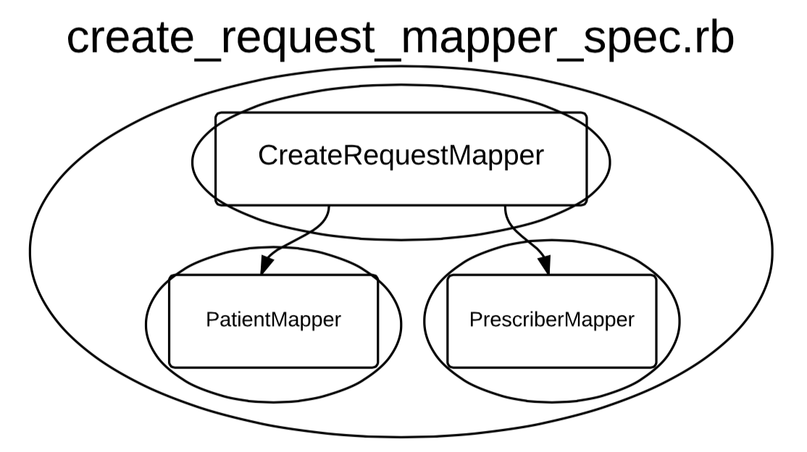
Applying the Rules – Passes Tests
Chasing the Implementation
Notes:
––

