Slide 1
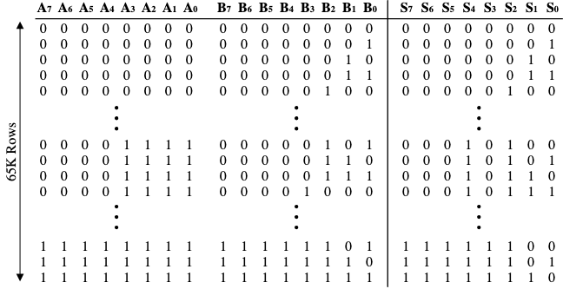

8-bit Full Adder Using NAND-Based Carry Look-Ahead Architecture
Project Task
An 8-bit full adder
Adds two 8-bit inputs plus a carry-in
Outputs an 8-bit sum and a final carry-out
Verified with LTSpice simulations and Microwind layout
Image 1: 8-bit full adder truth table [1]
Team Members: John Gellerup, Brandon Markham, and Cassidy Miskovitz

Slide 2
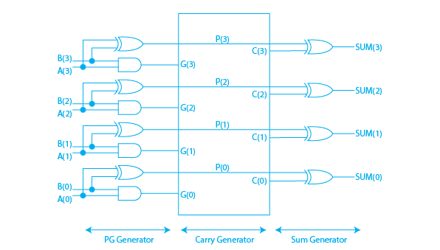
Goal: Design a high-speed digital adder that improves performance over traditional approaches.
Problem with RCA: Ripple Carry Adders suffer from sequential carry propagation, which slows down computation as bit-width increases​
​
Our Solution: Implement a Carry Look-Ahead Adder (CLA) that calculates carries in parallel​​.
Key Constraint: Build the entire system using only NAND gates, demonstrating their universality and enabling a uniform, reusable layout structure​​​
Image 2: Circuit layout for a carry lookahead adder. [2]
Notes:
Update the text at the very top on every slide to match your document content. It is a way of indicating where you are in the presentation. Same text but underline will change.

Slide 3
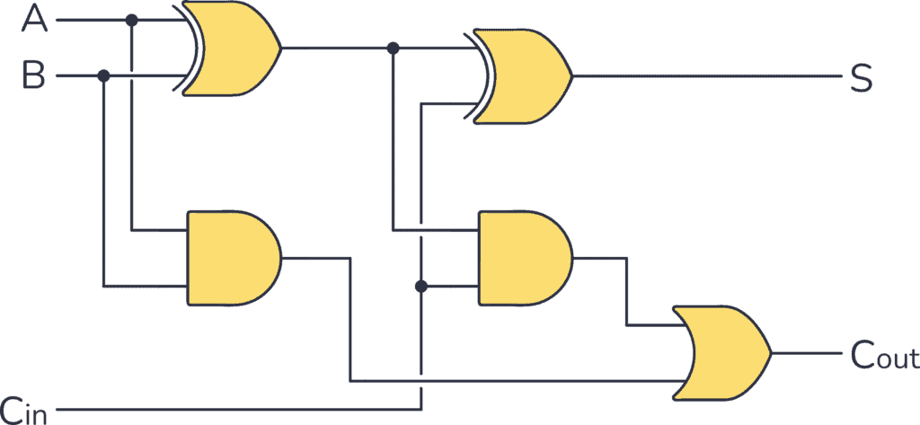
Function of a full adder:
Inputs: A, B, and Carry-In (Cin)​
Outputs: Sum and Carry-Out
Logic break down:
Sum Logic: XOR of A, B, and Cin.
Carry Logic: Combination of AND and OR gates.
Our Design: Implemented entirely using NAND gates​
Image 3: Full Adder Circuit. [3]

Slide 4
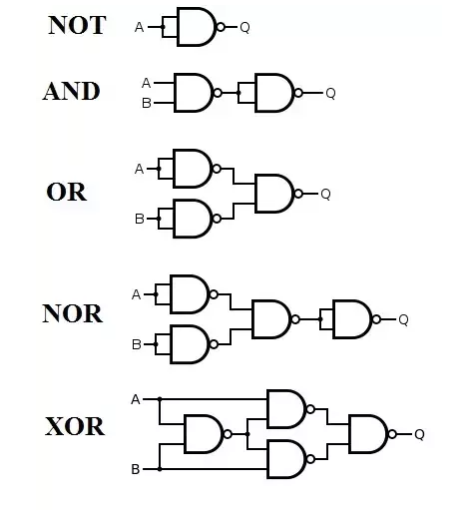
Pros | Cons
Standardized layout: Same basic gate shape and size | More gates needed compared to using mixed gates
Simplifies fabrication: Easier for uniform VLSI cell libraries | Increased power consumption (due to more transistors switching)
Compact design: Easier to fit into tight layouts | Could cause slightly slower individual gates (more stages for XOR, etc.)
Image 6: Nand Gate Conversion [6]
Notes:
This is your “prove it” moment. Summarize the major requirements, the results you have, and for each requirement prove it was met or describe what happened resulting in it not being met. Best format is probably a table: Do not claim to Pass without supporting data!

Slide 5
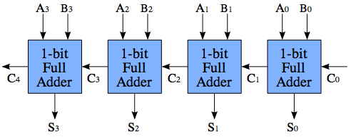
Simple Structure: Chains 1-bit full adders sequentially. (bit-by-bit)
Each carry-out feeds into the next adder's carry-in
Image 4: Block diagram of 4-bit Ripple Carry Adder [4]
Delay increases linearly with the number of bits​.

Slide 6
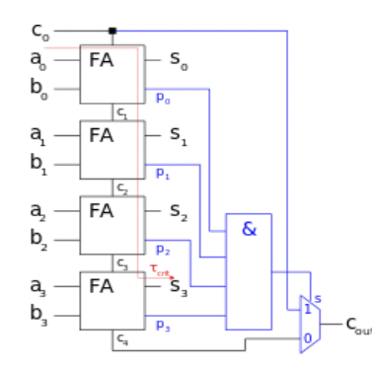
Each block has:
Full adders for sum and carry
AND gates to check propagate condition
OR gate for skip logic
Skip Logic: If all bits propagate, the carry skips the block.
CSA improves over Ripple Carry by skipping over blocks, but it still involves some serial computation.
Delay depends on:
Time to compute block propagate (AND gate chain)
Time to skip vs. ripple through the block

Slide 7
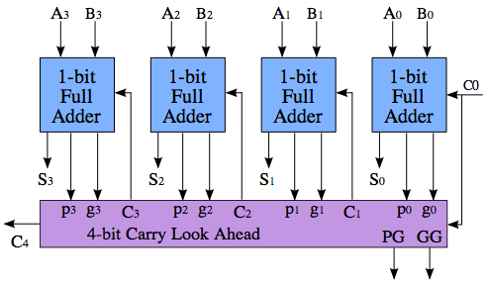
Computes carries in parallel using Generate (G) and Propagate (P) signals
Carry values predicted early instead of waiting stage-by-stage
Removes cumulative delay seen in Ripple Carry Adders. As early as the mid 1800's, Charles Babbage realized propagation delay would be a problem in RCA circuits
First Modern CLA Patent
Filed by IBM in 1957
Image 5: Block diagram of 4-bit Carry Look Ahead Adder [5]

Slide 8
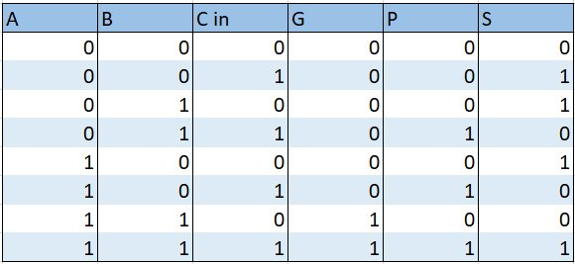
Generate signal (Gi)​ Creates a carry bit when... Gi= Aᵢ * Bᵢ
CLA Truth Table ​
Propagate signal (Pi)
Passes along an incoming carry when...​Pi=Aᵢ ⊕ Bᵢ
Carry-out equation​
All carries computed in parallel Ci+1 = Gᵢ + (Pᵢ * Cᵢ)
Image 6: Truth Table for Carry Look Ahead Adder
Final Sum​ Sᵢ = Pi ⊕ Ci = Aᵢ ⊕ Bᵢ ⊕ Cᵢ
Notes:
This is your “prove it” moment. Summarize the major requirements, the results you have, and for each requirement prove it was met or describe what happened resulting in it not being met. Best format is probably a table: Do not claim to Pass without supporting data!

Slide 9
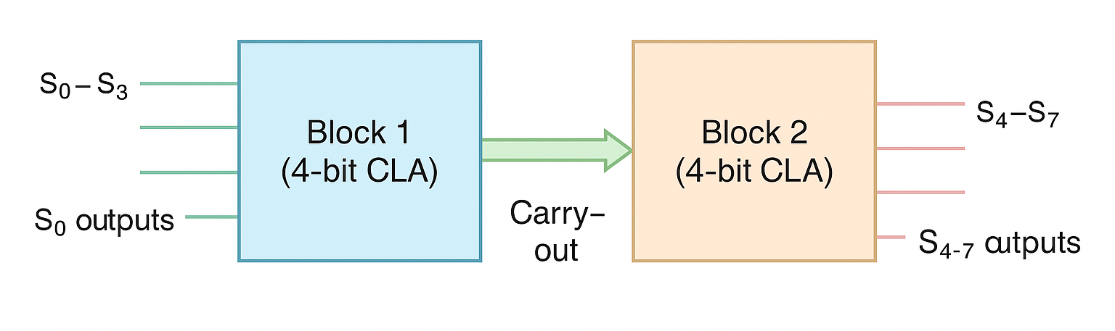
8-bit CLA divided into two 4-bit CLA blocks....Why?
Image 7: Block diagram of two 4-bit Carry Look Ahead Adders making an 8-bit adder
Simplifies design, simulation, and physical layout
Enables reuse of logic
Notes:
This is your “prove it” moment. Summarize the major requirements, the results you have, and for each requirement prove it was met or describe what happened resulting in it not being met. Best format is probably a table: Do not claim to Pass without supporting data!

Slide 10
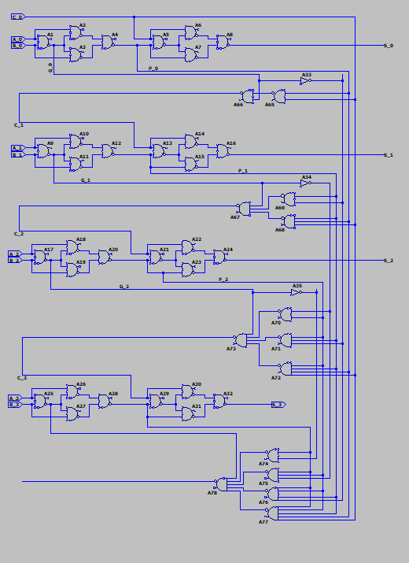
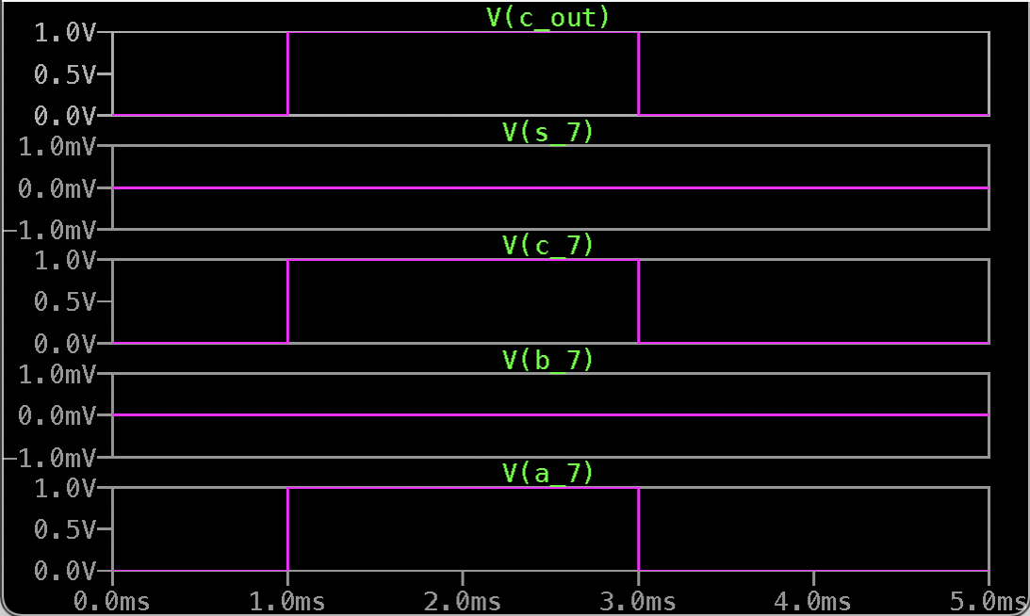
Bit | Delay (s) | Delay (ns)
S1 | 2.48E-09 | 2.48
S2 | 2.48E-09 | 2.48
S3 | 2.48E-09 | 2.48
S4 | 2.48E-09 | 2.48
S5 | 2.48E-09 | 2.48
S6 | 2.48E-09 | 2.48
S7 | 2.48E-09 | 2.48
Consistent delays across all sum (S₀–S₇) and carry (C₁–C₇) outputs.
Measured using .meas TRAN in LTspice simulations.
Uniform delay confirms balanced logic.​
Bit | Delay (s) | Delay (ns)
C1 | 2.48E-09 | 2.48
C2 | 2.48E-09 | 2.48
C3 | 2.48E-09 | 2.48
C4 | 2.48E-09 | 2.48
C5 | 2.48E-09 | 2.48
C6 | 2.48E-09 | 2.48
C7 | 2.48E-09 | 2.48
Notes:
This is your “prove it” moment. Summarize the major requirements, the results you have, and for each requirement prove it was met or describe what happened resulting in it not being met. Best format is probably a table: Do not claim to Pass without supporting data!

Slide 11
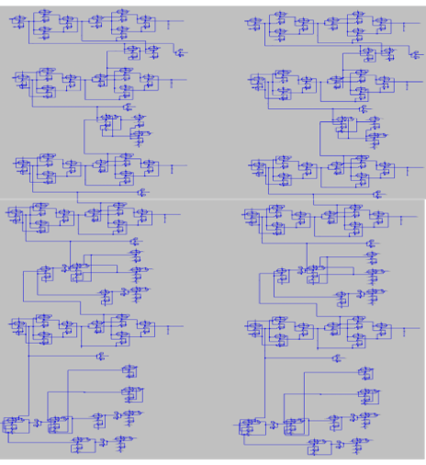
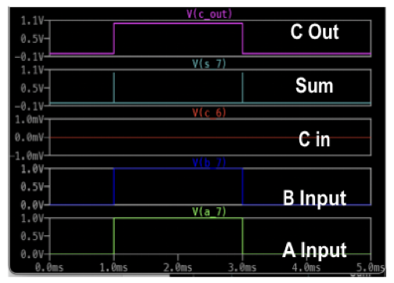
Sum Bit | Measured Delay (ns)
S₀ | 1.74 ns
S₁ | 1.78 ns
S₂ | 1.76 ns
S₃ | 1.73 ns
S₄ | 1.73 ns
S₅ | 1.76 ns
S₆ | 1.73 ns
S₇ | 1.73 ns
Carry Bit | Delay (ns)
C₁ | 1.31 ns
C₂ | 1.94 ns
C₃ | 2.06 ns
C₄ | 1.96 ns
C₅ | 2.00 ns
C₆ | 2.00 ns
C₇ | 2.00 ns
Delay variation across bits was observed:
Carry outputs ranged from ~1.23 ns (C₁) to ~2.06 ns (C₆),
Sum delays stayed between ~1.73–1.78 ns.
Variation is due to gate loading and fanout differences,
Notes:
This is your “prove it” moment. Summarize the major requirements, the results you have, and for each requirement prove it was met or describe what happened resulting in it not being met. Best format is probably a table: Do not claim to Pass without supporting data!

Slide 12
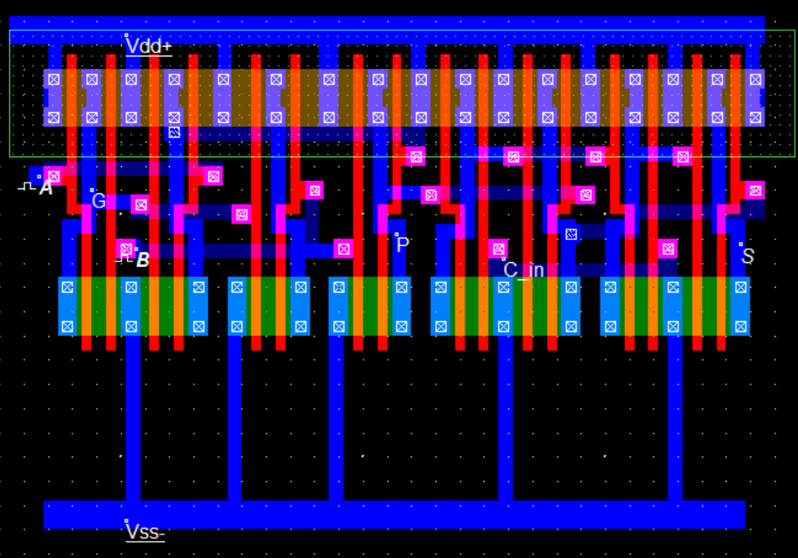
Two 2 input XOR gates converted to NAND.
Used in each stage
Optimized for layout efficiency
Notes:
This is your “prove it” moment. Summarize the major requirements, the results you have, and for each requirement prove it was met or describe what happened resulting in it not being met. Best format is probably a table: Do not claim to Pass without supporting data!

Slide 13
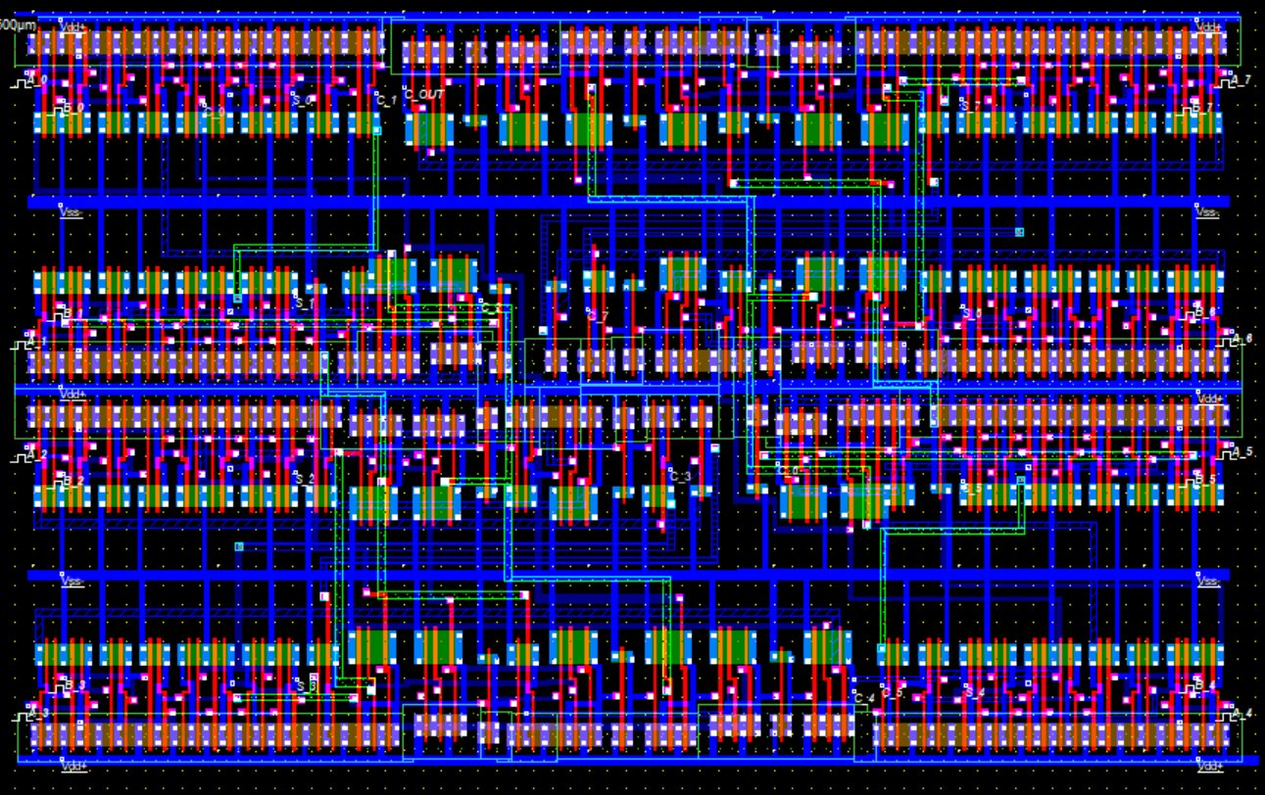
Reused standard cell layouts from previous labs for modularity and consistency.
Flipped Stages to reuse power rails; Mirrored and flipped the first block to create second block
DRC clean!
6 layers of metal
Notes:
This is your “prove it” moment. Summarize the major requirements, the results you have, and for each requirement prove it was met or describe what happened resulting in it not being met. Best format is probably a table: Do not claim to Pass without supporting data!

Slide 14
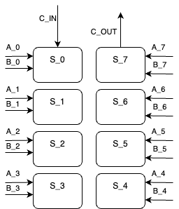
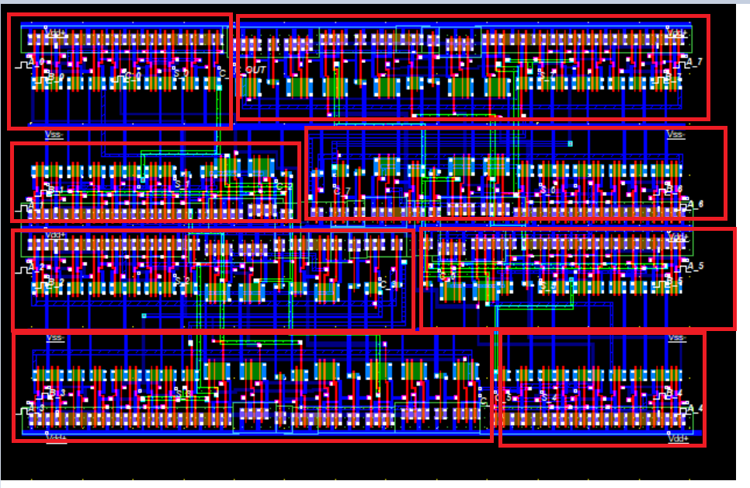
First 4 bits make up first block of CLA, next 4 bits make up second block
Starts at the top left and moves in a "U" pattern to end at top right
Notes:
This is your “prove it” moment. Summarize the major requirements, the results you have, and for each requirement prove it was met or describe what happened resulting in it not being met. Best format is probably a table: Do not claim to Pass without supporting data!

Slide 15
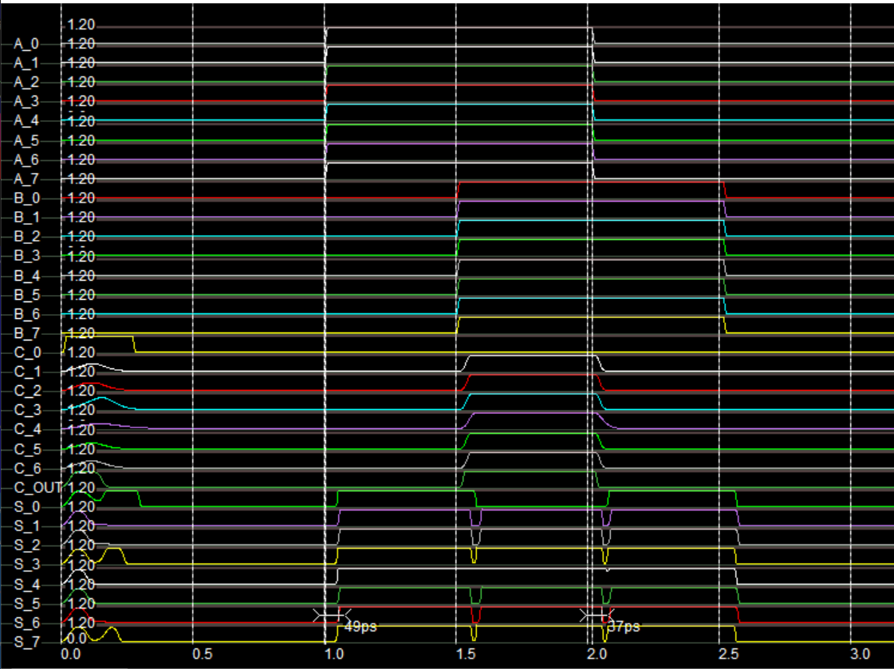
Expected results
Average delay from input to sum out of: 42ps
Sum out are all available at the same time; demonstrates advantage of CLA
Notes:
This is your “prove it” moment. Summarize the major requirements, the results you have, and for each requirement prove it was met or describe what happened resulting in it not being met. Best format is probably a table: Do not claim to Pass without supporting data!

Slide 16
Microwind CLA:
lower delays reflect an efficient and compact physical layout
Metric | Gate-Level CLA (20 fF) | Transistor-Level CLA (20 fF) | Microwind Level CLA (15fF)
Sum Delay (avg) | 2.48 ns | ~1.75 ns | 42ps
Carry Delay (avg) | 2.48 ns | ~1.92 ns | 58ps
Gate-level CLA:
Uniform delay due to symmetrical logic and balanced fanout.
Transistor-level CLA:​
Delay variations from internal parasitics
Notes:
This is your “prove it” moment. Summarize the major requirements, the results you have, and for each requirement prove it was met or describe what happened resulting in it not being met. Best format is probably a table: Do not claim to Pass without supporting data!

Slide 17
Conclusion:​
Accomplished goals and met all requirements
Successfully implemented 8 bit Carry Look Ahead Adder in an area-optimized layout
Main Challenges:
Gate count: ~125gates; ~500 transistors
Layout complexity
Carry logic requires some long traces
Future:​
Reduce parasitic capacitance from long traces to improve performance
Attempt improved CLA such as Kogge-Stone adder or Brent-Kung Adder - types of parallel-prefix CLA that allows less delay. [7]
Notes:
This is your “prove it” moment. Summarize the major requirements, the results you have, and for each requirement prove it was met or describe what happened resulting in it not being met. Best format is probably a table: Do not claim to Pass without supporting data!

Slide 18
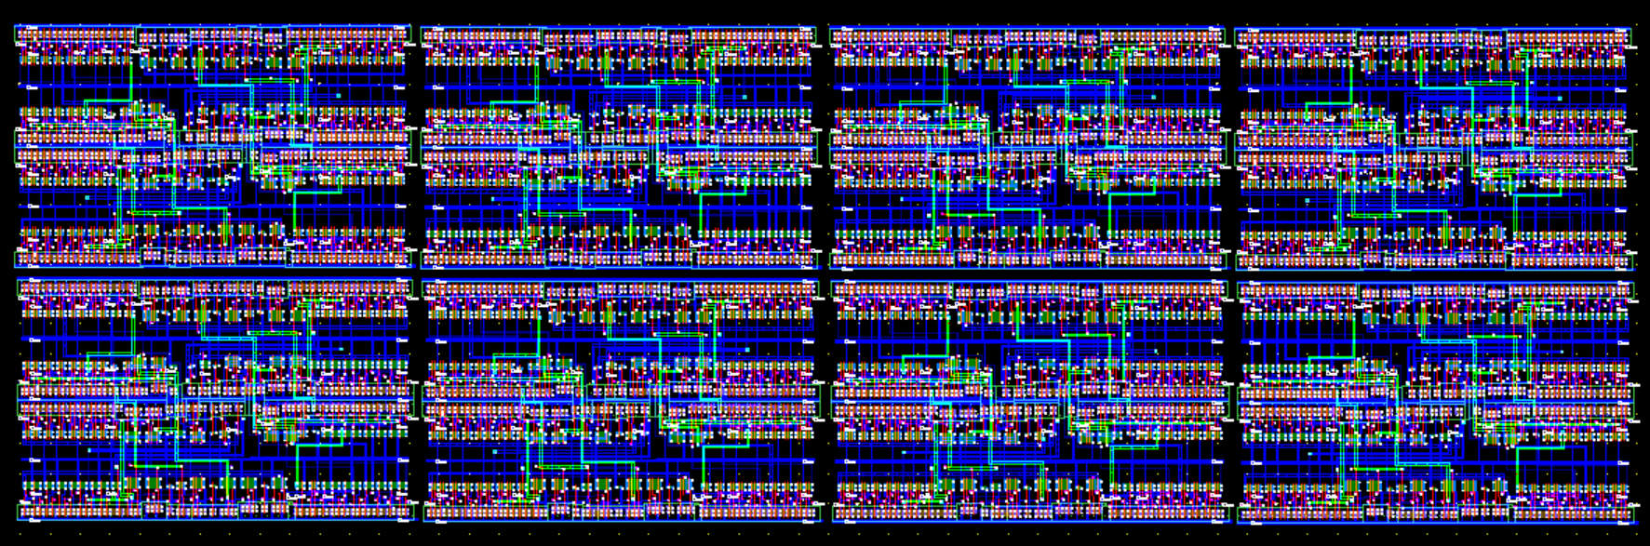
Notes:
This is your “prove it” moment. Summarize the major requirements, the results you have, and for each requirement prove it was met or describe what happened resulting in it not being met. Best format is probably a table: Do not claim to Pass without supporting data!

Slide 19

Questions & Comments
Notes:
This is not a slide to talk other than maybe “We like to thank the people listed here and will now take any questions” The main purpose is to show that you’ve concluded your presentation without going to a blank screen.

Slide 20
[1] Real Digital, "Carry Lookahead Adders," RealDigital.org. [Online]. Available: https://www.realdigital.org/doc/9eca319eb242a07d31574667ef02360a. [Accessed: 26-Apr-2025].
[2] PrepBytes, "Carry Look Ahead Adder," PrepBytes.com, 2022. [Online]. Available: https://www.prepbytes.com/blog/computer-network/carry-look-ahead-adder/. [Accessed: 26-Apr-2025].
[3] Ø. Holmeide, "Full Adder," Build-Electronic-Circuits.com. [Online]. Available: https://www.build-electronic-circuits.com/full-adder/. [Accessed: 26-Apr-2025].
[4] Virtual Labs, IIT Kharagpur, "Implementation of Adder Circuits," vlabs.iitkgp.ernet.in. [Online]. Available: http://vlabs.iitkgp.ernet.in/coa/exp1/index.html. [Accessed: 26-Apr-2025].
[5] Virtual Labs, IIT Kharagpur, "Carry Lookahead Adder," vlabs.iitkgp.ac.in. [Online]. Available: http://vlabs.iitkgp.ac.in/coa/exp2/content.html. [Accessed: 26-Apr-2025].
[6] user207421, "I am trying to implement a function using only NAND gates," Electronics Stack Exchange, 2022. [Online]. Available: https://electronics.stackexchange.com/questions/588189/i-am-trying-to-implement-a-function-using-only-nand-gates. [Accessed: 26-Apr-2025].
[7]Kogge-stone adder," Computer Science Wiki. https://computersciencewiki.org/index.php/Kogge-stone_adder (accessed Apr. 30, 2025).
Notes:
This is your “prove it” moment. Summarize the major requirements, the results you have, and for each requirement prove it was met or describe what happened resulting in it not being met. Best format is probably a table: Do not claim to Pass without supporting data!

