Slide 1
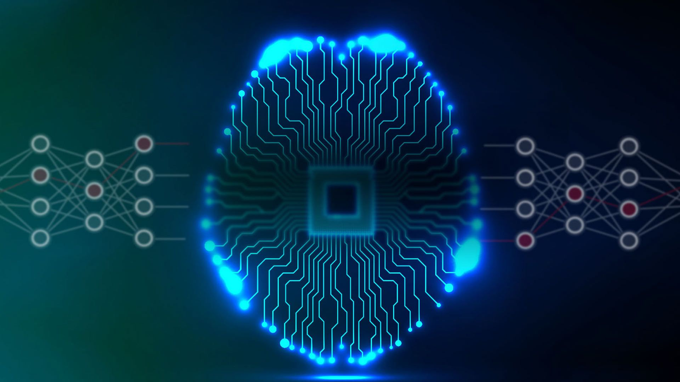
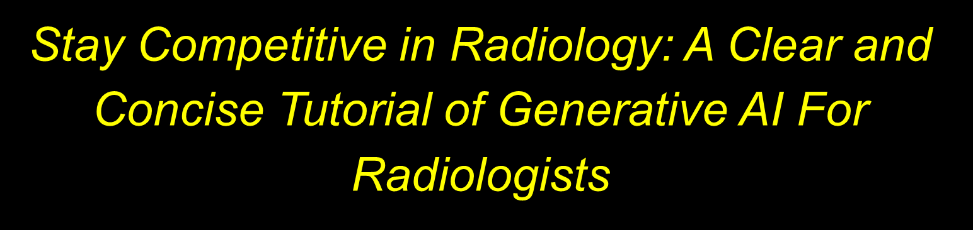
ED1032
Tulane University School of Medicine
Department of Radiology
Jeremy Nguyen, MD, FACR; Cynthia Hanemann, MD, FACR; Haley Gould, MD;
Gautam Dua, MD; Janis Park, MS; Brandon Nguyen
American Roentgen Ray Society (ARRS) Annual Meeting
April 12th – April 15th , 2026
Pittsburgh, Pennsylvania

Slide 2


OBJECTIVES
To describe the general principle artificial intelligence
To discuss the concept of machine learning and deep learning
To explain the architecture of a neural network and its elements, including the “artificial neurons”, and network layers.
To describe the core concepts of Generative AI with the emphasis on the model's ability to create new data (e.g., text, images, music) by learning from existing datasets.
To describe the general architecture and operations of Transformer networks and Attention Theory
To explain the importance and impact of Generative AI
To discuss some practical application of Generative AI
To maximize learning, please run the presentation as a slide show

Slide 3

Disclosures
We do not have any financial interest or financial relationship with a commercial organization that may have an interest in the content of the educational activity.

Slide 4


What is Artificial Intelligence (AI)?
Very simple!
Artificial Intelligence (AI) is a branch of computer science that is concerned with building computer systems capable of performing tasks that typically require human intelligence
Basically, we try to build computer systems that can simulate human intelligence

Slide 5

What are the major capabilities of artificial intelligence?
Some major capabilities of artificial intelligence include:
Reasoning and problem solving
Knowledge representation
Planning
Machine Learning
Natural language processing

Slide 6
What is machine learning?
MACHINE LEARNING is a SUBSET of artificial intelligence
MACHINE LEARNING is built upon an ALGORITHM that uses computational methods to “learn” information directly from data without relying on a predetermined equation as a model
MACHINE LEARNING algorithms adaptively improve their performance as the amount of data available for learning increases

Slide 7

What is Deep Learning?
Deep learning is a subset of Machine Learning
Deep learning utilizes neural networks built with artificial neurons connected together to simulate a neural network
The word "deep" in "deep learning" refers to the number of layers through which the data is processed
Deep learning algorithms propagate data through multiple layers of neurons
Deep learning algorithm is capable of learning from the input data to improve its performance

Slide 8

What is Generative AI?
Generative AI is a type of artificial intelligence that can create new content
  Traditional AI typically classifies or analyzes existing data
New content can be text, images, audio, video, or even programming code
The performance of a Generative AI is based on the data it has been trained on.
Key Features of Generative AI:
  Learns patterns in large datasets (e.g., language, images, music)
  Generates original outputs that resemble human-made content
  Can be multimodal – Generative AI works across multiple types of media (e.g., combining text and images)

Slide 9
Show some examples of data synthesis of generative AI system?
Generative AI can process a varieties of input patterns and generate a variety of output formats.
Some examples are shown on subsequent page

Slide 10


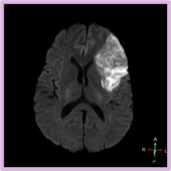



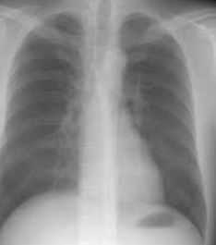
AI System
Text
Text
What does ARRS stand for?
American Roentgen Ray Society
Text
Image
Show ischemic stroke on DWI
Text
Drawing
Can you draw teddy bear?
Image
Text
This is a chest x-ray
Input
Output

Slide 11

Machine Learning is a subset of Artificial Intelligence
Deep learning is a subset of machine learning
Generative AI is a subset of deep learning
Artificial Intelligence
Machine Learning
Deep Learning
Generative AI models are built on neural networks and rely on deep learning techniques
Generative AI

Slide 12

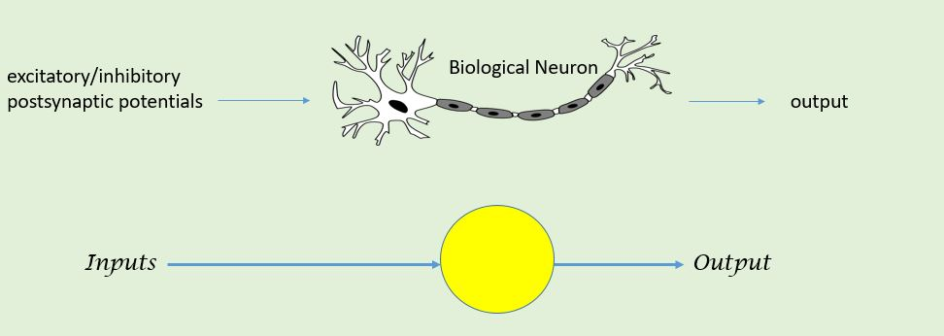
We will show how a deep learning neural network is constructed from its basic element
A basic element of the network is an artificial neuron, which is modeled after a biological neuron
An artificial neuron is an elementary unit of an artificial neural network
  It is a mathematical function that simulates the behavior of a biological neuron in the brain

Slide 13

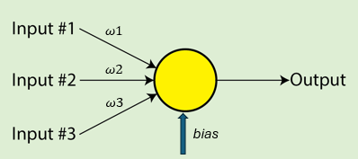


Artificial Neuron = The basic unit of computation in a neural network
Often called a node or unit
The neuron can receive multiple inputs from other neurons
The neuron combines the inputs and generates an output
(weight)
$$ω2$$
Each input has an associated weight (ω), which is a parameter assigned based on its relative importance to other inputs
Bias is a parameter in the neural network which is used to adjust the threshold of the output along with the weighted sum of the inputs to the neuron
$ω$31

Slide 14
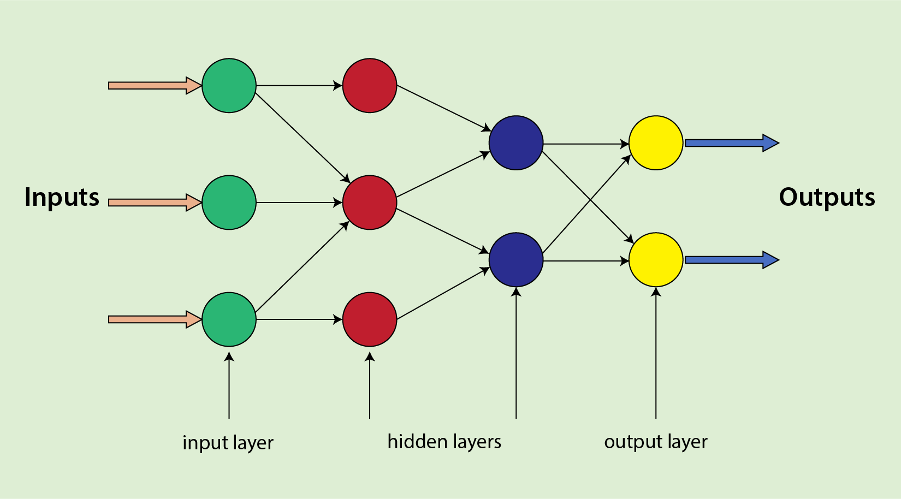

Basic Neural Network Architecture
A neural network combines multiple processing layers, using simple elements operating in parallel.
The network consists of an input layer, multiple hidden layers, and an output layer.
The layers are interconnected via nodes or neurons.
Each hidden layer uses the output of the previous layer as its input.

Slide 15

Can a neural network be utilized immediately after its construction is completed?
We must TRAIN a network before using it
An untrained neural network (newly designed and never been put to use) is like an inexperienced performer – It is essentially ignorant as it must learn to achieve satisfactory performance and yield desired results
The algorithms of the networks must have actual experience of the intended task through the exposure to a large amount of data

Slide 16

Are there different ways to train the network for learning ?
There are four major learning styles of an algorithm
Supervised learning – Input data is labeled, and specific expected outputs are known. The algorithm generates reasonable predictions for the response to new data
Unsupervised learning – Input data is not labeled, and outputs are not known. The algorithm generates results based on the analysis structure of the data
Semi-supervised learning – Input data is a mixture of labeled and unlabeled datasets. The algorithm generates results based on structure of the data
Reinforcement learning – Input data is unlabeled. The machine (algorithm) is trained to make specific decisions. The machine is exposed to an environment where it trains itself continually using trial and error through a feedback loop

Slide 17
By training a neural network on relevant datasets, we seek to improve its performance
The way we measure progress is by monitoring the error produced by the network each time it makes a prediction
Therefore, a very important goal of the network is to reduce the error of the output – This is equivalent to LEARNING to improve itself

Slide 18
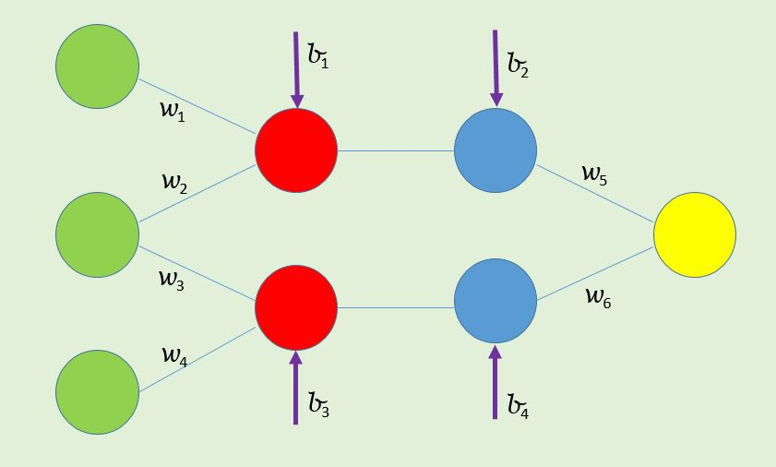
Neural Network operation
Input
Input
Output
Output neuron
Input
Input neurons
The dataset is first sent to the Input neurons
The data will propagate through the network
Each neuron is activated through the effects of the input + weight + bias
The interactions of neurons will yield a predicted Output

Slide 19
Neural Network operation
Input
Input
Output
Calculation of error
ERROR = True Result - Output
Input
The error is calculated → ERROR = True Result - Output

Slide 20
How neural network “learns” to improve itself
Input
Input
ERROR is sent back into the network
Input
The ERROR is sent back into the network
The ERROR propagates backward through the network
Updating the weights (w) and biases (b) to new values to minimize the ERROR
This is equivalent to the neural network LEARNs to improve itself

Slide 21
Why are neural networks important in Generative AI?
Neural networks are the “engines” for generative AI
Neural networks allow generative models to learn complex patterns from large datasets and use that knowledge to create new content like text, images, or sound.
These "engines" of generative AI can process unstructured data, adapt to changing information, and generate outputs that mimic human creativity, making them the foundational technology behind generative systems.

Slide 22
How do neural networks enable Generative AI?
Neural networks enable Generative systems to achieve the following functions
Pattern Recognition: identifying intricate relationships and patterns within data, which is crucial for generating new content.
Data-Driven Learning: Neural networks learn from vast datasets, enabling them to understand and replicate the underlying structure of the data they are trained on.
Content Generation: Once trained, these networks can produce entirely new data, such as text, images, or audio, that resembles the patterns they've learned from.
Deep Learning: Deep neural networks can capture complex, high-level abstractions from data, leading to more sophisticated content generation.
Adaptability: Neural networks can adapt and improve through iterative learning processes and thus becoming more proficient over time.

Slide 23
What are the building blocks of generative AI?
The building blocks of generative AI are Transformer Networks
Transformer networks are a type of deep learning neural networks
Just as Transformer networks are neural networks – they need training with a large amount of data to function properly

Slide 24
What are a some of the main uses of Transformer Networks?
Natural language processing
Computer vision
Drug discovery
Time series forecasting

Slide 25
What are the main system components of a Transformer network?
A Transformer network architecture is inherently complex, however, a Transformer can be described in terms of two main components:
Encoder to process the input and transfer the processed information to the Decoder
Decoder to process the data from the Encoder to yield final output
Encoder
Decoder
Input
Final Output
Transformer Network

Slide 26


What are the major operational features of a Transformer Network?
A Transformer Network has the following structural and operational features:
Encoder – Decoder architecture: Encoder and Decoder components working in tandem to process input data and generate final output
Attention Mechanism: Focusing on relevant parts of the input sequence

Slide 27
Why is it necessary to prepare the input data before feeding into the transformer network?
Preparation of the input is necessary for a transformer network
  It changes the input into a numerical format that the network can understand
  It captures the semantic relationship of the input data
  It captures the ordering of the input data structure the data
If input processing is inadequate, the model may fail to understand the data and yields erroneous results

Slide 28
What are the TWO critical steps in input data preparation?
There are two steps in input data processing:
  Embedding
  Positional Encoding

Slide 29
Please explain Embedding and Positional Encoding further
Embedding: Raw text or image data are not directly useful for deep learning models. Embedding converts the raw data into high-dimensional numerical representations call tokens called TOKENIZATION
  A token is the fundamental unit of data that the model processes.
Positional Encoding: Transformers do not inherently understand sequence order of a text string or relationship of pixels in image data. Positional encodings allows to the transformer to preserve relationship among the data

Slide 30
Please show an example on input data processing and applying Attention mechanism to the data
“Stroke can be caused by atherosclerotic disease”
Sure thing!
We can use an example above to show how a Transformer prepares the input data

Slide 31

Stroke can be caused by atherosclerotic disease
001
200
300
400
005
006
908
EMBEDDING
VECTORS
EMBEDDING technique
Dividing a sentence into constituent words
Creating a token for each word by assigning a numerical presentation
Each token (also call vector) now has specific numerical value

Slide 32
Stroke can be caused by atherosclerotic disease
001
200
300
400
005
006
908
EMBEDDING
POSITIONAL ENCODING
1
2
3
4
5
6
7
POSITIONAL ENCODING
Assigning a specific ordering to the input data
A numerical value is assigned to each token to indicate its position in the sentence
Positional encoding enables the network to distinguish between different positions and learns the relationships based on token order

Slide 33
What is Attention mechanism in transformer networks?
Attention mechanism is a technique that allows a model to focus on the most relevant parts of an input sequence for the task at hand

Slide 34
Please illustrate an example how Attention Mechanism works?
Input
Stroke can be caused by atherosclerotic disease
W1
W2
W3
W4
W5
W6
W7
Weights
We can use an example to illustrate Attention mechanism
Attention mechanism examines every token in the sequence
Attention mechanism computes and assigns weights (w’s) to the tokens based on their relationship among each other and relevance to the task at hand

Slide 35
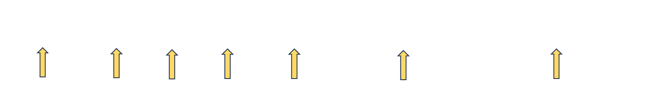
How is the weighting is determined for a particular token ?
The WEIGHT for each token is determined through training with a vast amount of data

Slide 36
Stroke
can
be
caused
by
atherosclerotic
disease
Stroke
can
be
caused
by
atherosclerotic
disease
The assigned weight of the word STROKE reflects its relevance and close relationship to the words ATHEROSCLEROTIC and DISEASE ( as illustrated by more heavy weighted arrows) than the remaining text in the sequence

Slide 37
Stroke
Atherosclerotic disease
The word STROKE is relevant and has a new context closely associating with ATHEROSCLEROTIC DISEASE
Application of Attention mechanism transforms the input into a rich contextualized representation of the input
The new representation contains all information of the input sequence plus the relevance of each token to other tokens

Slide 38
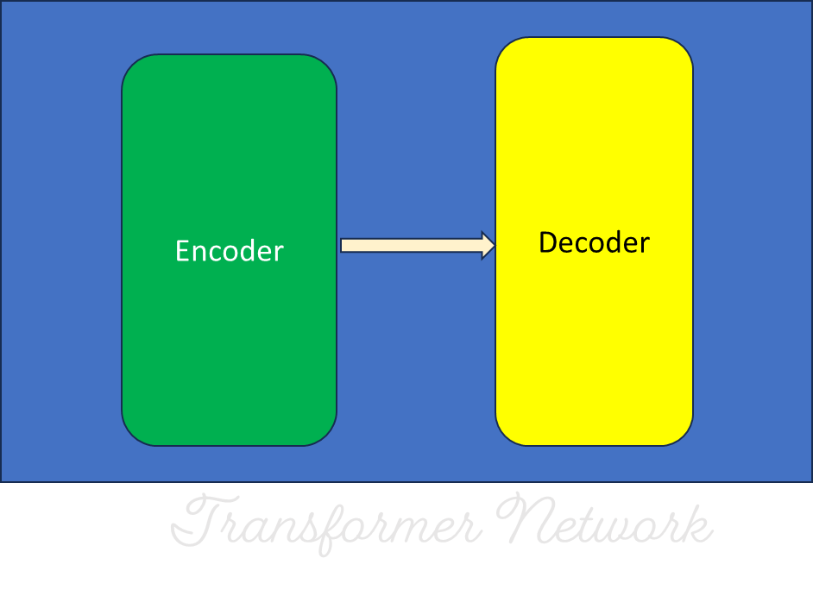
INPUT
Stroke can be caused by vessel vasospasm
Strone can be caused by embolism
Stroke can be caused by vessel dissection
Stroke can be caused by vessel transection
Stroke can be caused by hemorrhage
We can provide more inputs to the transformer to increase the contextualization of the word STROKE

Slide 39
Atherosclerotic disease
Vessel dissection
Stroke
Vessel spasm
Vessel transection
Hemorrhage
The word STROKE now has a richer contextualization as it is now associated with additional causes of stroke

Slide 40
What is Attention mechanism important in transformer networks?
Here is why Attention mechanism important
Capturing Long-Range Dependencies:
The attention mechanism allows transformers to relate any token to any other token in the input, no matter how far apart they are.
Understanding Context and Relevance:
By assigning different "attention weights" to tokens, the model can determine which pieces of information are most important for the current task and establish a contextual relationships among the tokens.
Enabling Parallelization:
The attention mechanism allows transformer models to process entire input sequences concurrently, significantly speeding up training
Holistic Data Understanding:
By considering the relationships between all parts of the input, the attention mechanism helps the model form a more complete and contextual understanding of the data.

Slide 41

The output is generated based on the learning of the contextualized word STROKE
Encoder
(Processing of input data)
Decoder
(The contextualized STROKE word is recognized by the network)
The cause of stroke can be atherosclerotic disease, vessel spasm, embolism, vessel dissection, vessel transection or hemorrhage
Processed data from Encoder is sent to the Decoder
Output
Input into the Encoder
Positional Encoding
We can illustrate the flow process of the transformer network in response to an INPUT PROMPT
Input Embedding
Input prompt = “The cause of stroke”

Slide 42
Are there pre-built transformers available to the public?
Yes, there are pre-built transformers available for public use. They are called GPT
GPT* stands for Generative Pre-trained Transformer.
Generative: The model can generate new content
Pre-trained: The model is trained on a massive dataset beforehand, allowing it to perform tasks efficiently without requiring training for each specific use.
Transformer: The model utilizes Transformer networks which is built on neural network architecture.
*GPT is a family of AI models built by OpenAI (an AI research company)

Slide 43
How can you utilize the GPTs?
You may utilize the GPTs in different ways depending on your goals. Some major utilizations include:
Chat-Based Interaction – interactive chatting with the GPTs
Build your own GPT – You can customize the GPTs to fit your specific needs
Writing computer applications with access to the GPT – This is for computer programmer who use the Application Programming Interfaces (API) to access GPT in order to perform a certain task
*GPT is a family of AI models built by OpenAI (an AI research company)

Slide 44
List some major AI models that utilize GPT
ChatGPT (OpenAI): A chatbot that uses natural language processing to create humanlike conversational dialogue. It can respond to questions and compose various written content, including articles, social media posts, essays, code and emails.
Copilot (Microsoft): An AI-powered assistant that integrates with various Microsoft applications and services. The model offers features like content generation, task automation, and data analysis to boost productivity and streamline workflows. .
DALL-E (OpenAI): An AI-powered model that generates images from text prompts. DALL-E can create a visual representation based on the text description. DALL-E can combine unusual concepts, create fantastical scenes, or even mimic specific artistic styles

Slide 45
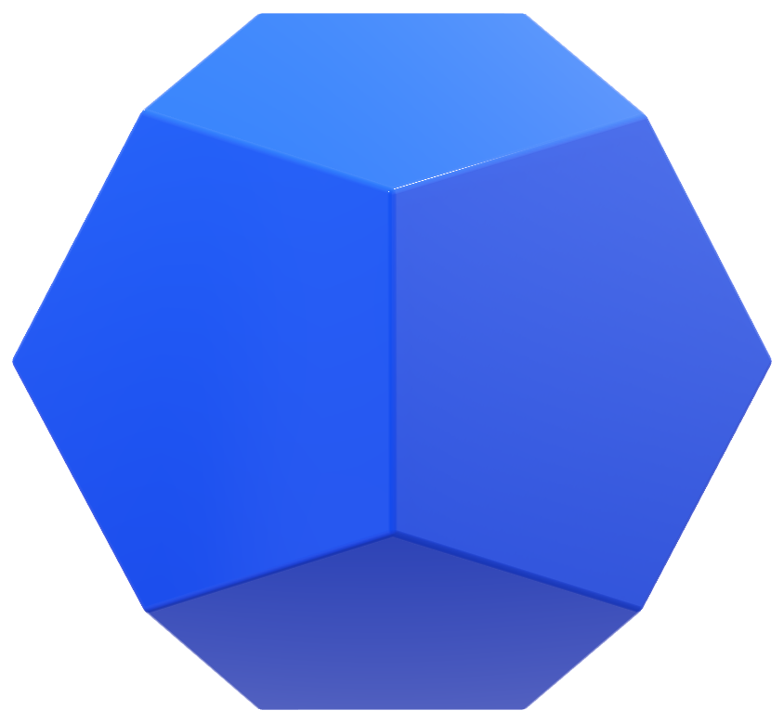
General structure of Generative AI system
Generative layer learns from massive datasets, process the data, and then produces novel results based on that learned information
Data Processing Layer
Deployment and Integration Layer
Generative Model Layer
This layer is responsible for making models operational and accessible in real-world applications. It ensures that AI systems are properly implemented into existing workflows, platforms, and infrastructure while maintaining efficiency, scalability, and security
Raw data – text, images, audio – must be transformed into a language that the model understands
Feedback layer ensures constant learning and improvement through a continuous feedback loop
Feedback and Improvement Layer
Four principal layers of a Generative AI system
Data Processing
Generative Model
Feedback and Improvement
Deployment and Integration
This layer ensures the ongoing performance, reliability, and continuous improvement of the system

Slide 46
List some major applications of Generative AI
Content Creation: Writing articles, blogs, poems, stories, or even generating ideas for creative project
Image Generation: Creating visuals, artwork, designs, or concepts from text descriptions
Chatbots and Virtual Assistants: Enhancing customer support, personal assistants, and conversational AI
Code Generation: Assisting developers by generating, debugging, or explaining code.
Video and Audio Production: Creating music, editing videos, generating voiceovers, or even producing synthetic voices.
Game Development: Crafting characters, game levels, and narratives to speed up the development process.
Healthcare: Simulating drug discovery, analyzing medical images, or assisting in clinical decision-making.
Education: Generating personalized learning materials, tutoring, or creating simulations for immersive learning experiences.
Science and Research: Modeling complex systems, visualizing data, or generating hypotheses for scientific inquiries

Slide 47
What are some major flaws of Generative models?
Nothing is perfect. Here are some possible flaws of a Generative model
Bias and fairness: If the model has been trained on biased data, it might unintentionally reflect those biases in its outputs.
Hallucinations: The model can fabricate facts, events, or details that have no basis in reality.
Misunderstanding context: The model might misinterpret a question or respond in a way that lacks nuance, especially with ambiguous prompts.
Inconsistent responses: If asked the same question multiple times, AI might provide differing answers without a clear reason
Data Privacy Risks: If a model is trained on sensitive or personal data, it might unintentionally release private information.

Slide 48
Show some real-life examples of generative AI?
We can try some real-life experience with Generative AI by posing a same question to the three popular Generative AI models:
  ChatGPT (OpenAI)
  Copilot (Microsoft)
  Gemini (Google)

Slide 49
We will use the following sequence as the input prompt
“ The cause of ischemic stroke”

Slide 50
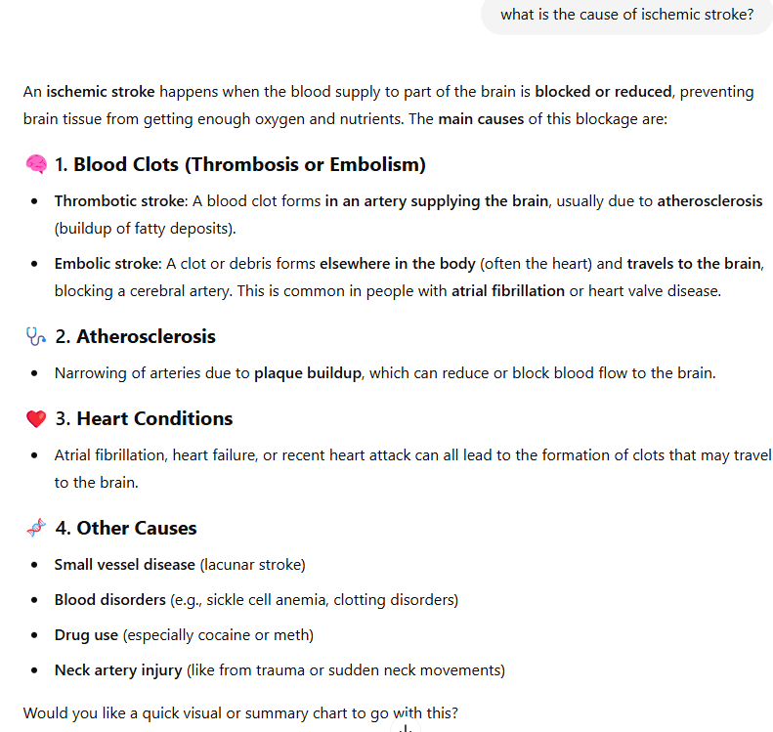
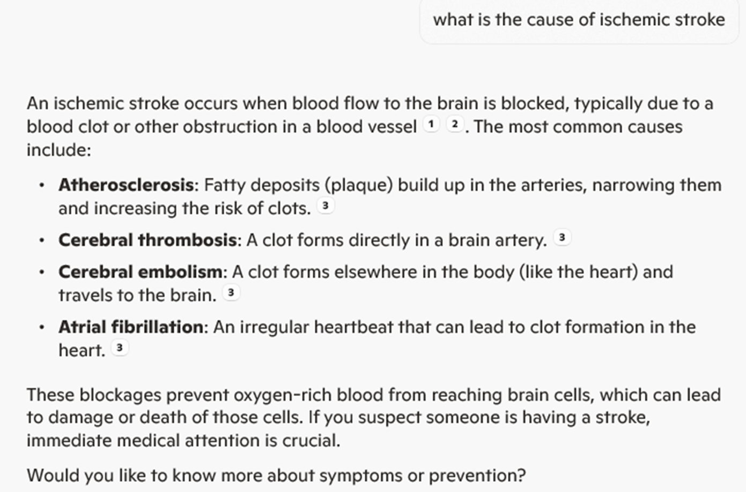
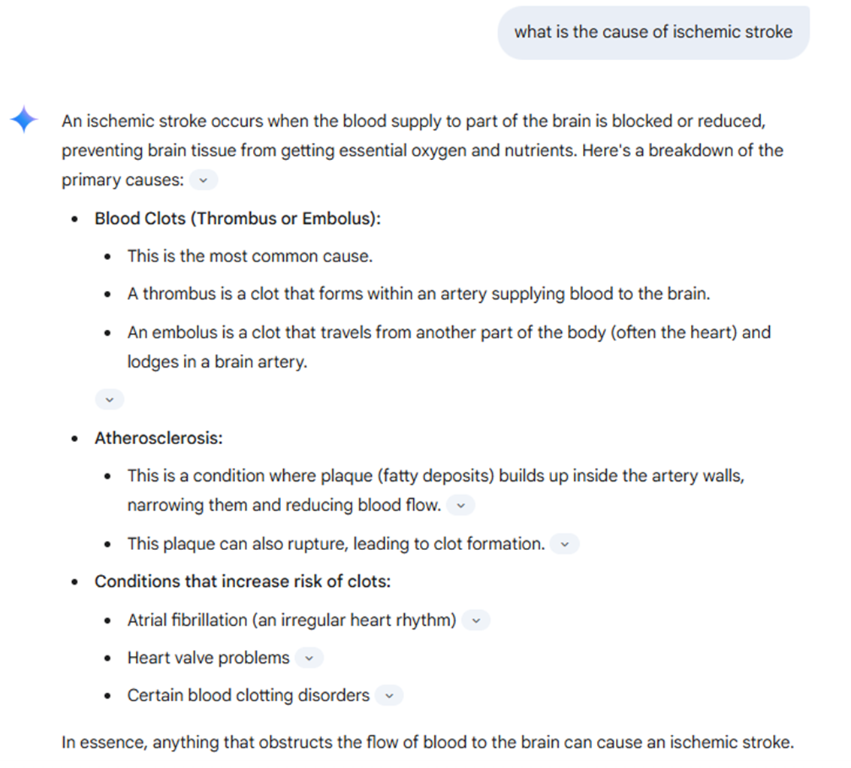
Response from ChatGPT
Response from Copilot
Response from Gemini
You can compare the similarities and differences among the responses from different models

Slide 51
Just in case you would like to know more about mathematical theory of Attention

Slide 52
History of theory of Mathematical Attention
The concept of Attention in AI gained prominence with the introduction of the Attention mechanism in neural networks.
A landmark paper titled "Neural Machine Translation by Jointly Learning to Align and Translate" by Bahdanau, Cho, and Bengio in 2014 introduced this idea. This work laid the foundation for subsequent advancements in attention-based models.
Later the publication of the research paper "Attention Is All You Need" by Vaswani et al. in 2017, which also introduced the new deep learning architecture known as the Transformer .
This paper presented the self-attention mechanism, which became a cornerstone of modern Generative AI models

Slide 53
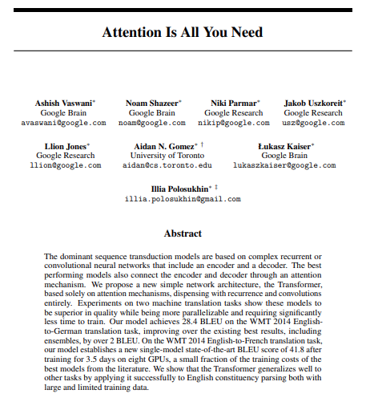
Here is the original paper on the mathematical foundation of Attention and Transformer model
Vaswani, A., Shazeer, N., Parmar, N., Uszkoreit, J., Jones, L., Gomez, A. N., Kaiser, Ł., & Polosukhin, I. (2017). Attention is all you need. arXiv preprint arXiv:1706.03762. Retrieved from arXiv.

Slide 54
Conclusion
Machine and deep learning are subsets of AI where models learn patterns from data to make predictions or decisions.
Generative AI is a subset of deep learning
Generative AI is a type of artificial intelligence that can create new content, like text, images, music, or videos, based on patterns learned from existing data
Generative AI typically has Encoder-Decoder architecture for data processing
“Attention” mechanism is a pivotal in generative AI. Attention gives generative AI models the ability to selectively focus on the most important parts of their input, leading to more accurate, coherent, and contextually relevant outputs.
Generative AI can be used for a wide variety of applications in various industries
Generative has its own flaws. Use it wisely!

Slide 55


References
ARTICLES
Chartrand G, Cheng P, Vorontsov E et al. “Deep Learning: A Primer for Radiologists”. Radiographics. 2017;37(7):2113-2131.
Suzuki K. “Overview of deep learning in medical imaging”. Radiol Phys Technol. 2017 Sep;10(3)257-273.
Vaswani, A., Shazeer, N., Parmar, N., Uszkoreit, J., Jones, L., Gomez, A. N., Kaiser, Ł., & Polosukhin, I. (2017). Attention is all you need. arXiv preprint arXiv:1706.03762. Retrieved from arXiv.
BOOKS
Aggarwal C. Neural Networks and Deep Learning: A Textbook. Springer, 2018. Print.
Musiol, M. (2023). Generative AI: Navigating the course to the artificial general intelligence future. AI Publishing.

Slide 56






Author Information
Jeremy Nguyen, MD, FACR.
Professor of Radiology
Tulane University School of Medicine
Cynthia Hanemann, MD, FACR, Professor of Radiology
Tulane University School of Medicine
Gautam, MD
PGY5 Radiology Resident
Tulane University School of Medicine
Haley Gould, MD
PGY3 Radiology Resident
Tulane University School of Medicine
Janis Park, MS,
3rd year medical student (MSIII)
Tulane University School of Medicine
Brandon Nguyen
1st year university student
Tulane University
Contact Information
Jeremy Binh Nguyen, MD, FACR, Email: jnguye2@tulane.edu

