Slide 1
Adaptive Gaussian Quadrature
Physics 77 Final Project
By Brandon Tran

Slide 2

How the Program Works
General Formula for Three Point Gaussian Integration of f(x) from a to b:
Integral Approximation $\int_{ a}^{b}{f\left(x\right)dx}\text{≈}$ (b-a)/2*(5/9*f((b-a)/2*-1*sqrt(3/5)+(b+a)/2)+8/9*f((b+a)/2)+5/9*f((b-a)/2*sqrt(3/5)+(b+a)/2))
This method by itself, however, has no regard for the accuracy of the integral.
So to achieve sufficient accuracy for a given tolerance, it computes the left and right half of the integral using the same formula above. It then compare the left and right half, to the integral on the entire interval. This has to satisfy:
abs(entire-(left+right))<tol*max(abs(entire), (abs(left)+abs(right)))
The Adaptive Part of the Program
If the above formula isn’t satisfied, the program implements a recursive function that subdivides the left and right half into even smaller intervals and repeats the whole process over until the tolerance is satisfied.
Once tolerance is satisfied, the program adds the computed sums that have sufficient accuracy to the value of the integral.

Slide 3
Why use Numerical Integration?
There are several reasons for carrying out numerical integration.
The integrand f(x) may be known only at certain points, such as obtained by sampling. Some embedded systems and other computer applications may need numerical integration for this reason.
A formula for the integrand may be known, but it may be difficult or impossible to find an antiderivative that is an elementary function. An example of such an integrand is f(x) = exp(−x²), the antiderivative of which (the error function, times a constant) cannot be written in elementary form.
It may be possible to find an antiderivative symbolically, but it may be easier to compute a numerical approximation than to compute the antiderivative. That may be the case if the antiderivative is given as an infinite series or product, or if its evaluation requires a special function that is not available.
Source-Wikipedia, Numerical Integration

Slide 4

Applications to Physics
Gaussian Integral $\int_{a}^{b}{e}$^{-ax^2} $dx$
has applications to kinetic theory, quantum mechanics, and any other part of physics that has a remotely statistical aspect. Typically appears as a probability density function.
Sinc Function $\int_{a}^{b}{\frac{\sin\left(x\right)}{x}dx}$
tons of applications to signal processing and optics. For example, intensity of light through a single slit diffraction
Gamma Function $\int_{a}^{b}{\sqrt{x}}e^{−x}dx$
applications in statistical mechanics, e.g. fermi and bose gases, what happens to a Bose gas at low temperatures
Another useful Integral $\int_{a}^{b}{\frac{x^{3}}{e^{x}−1}}dx$
is used to compute the total energy of a quantum gas, specifically photon gas
All of these integrals must be solved numerically and have no closed form.

Slide 5
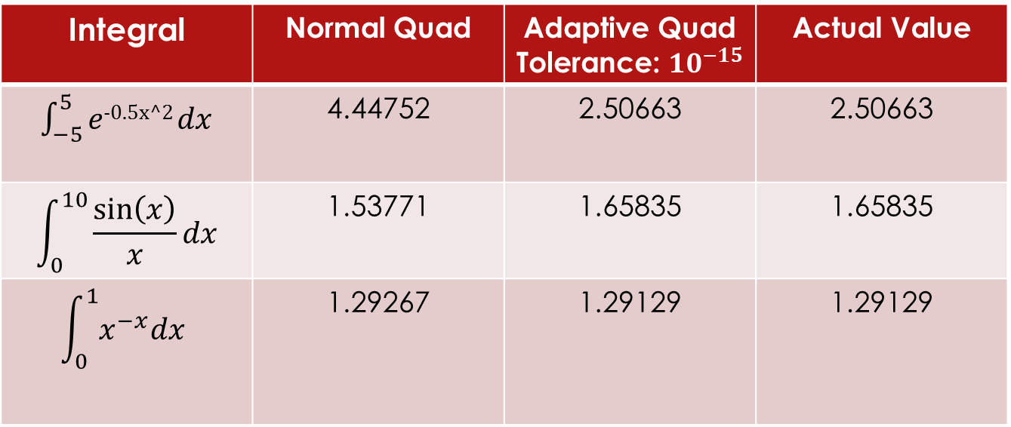
Regular Quadrature vs Adaptive Quadrature
Let’s compute some integrals
As you can see, the Adaptive Quadrature is a much more accurate method of numerically solving integrals.
Integral | Normal Quad | Adaptive Quad Tolerance: ${10}^{−15}$ | Actual Value
$\int_{−5}^{5}{e}$^{-0.5x^2} $dx$ | 4.44752 | 2.50663 | 2.50663
$$\int_{0}^{10}{\frac{\sin\left(x\right)}{x}dx}$$ | 1.53771 | 1.65835 | 1.65835
$$\int_{0}^{1}{x^{−x}dx}$$ | 1.29267 | 1.29129 | 1.29129

Slide 6
Now for a demonstration.

