Slide 1
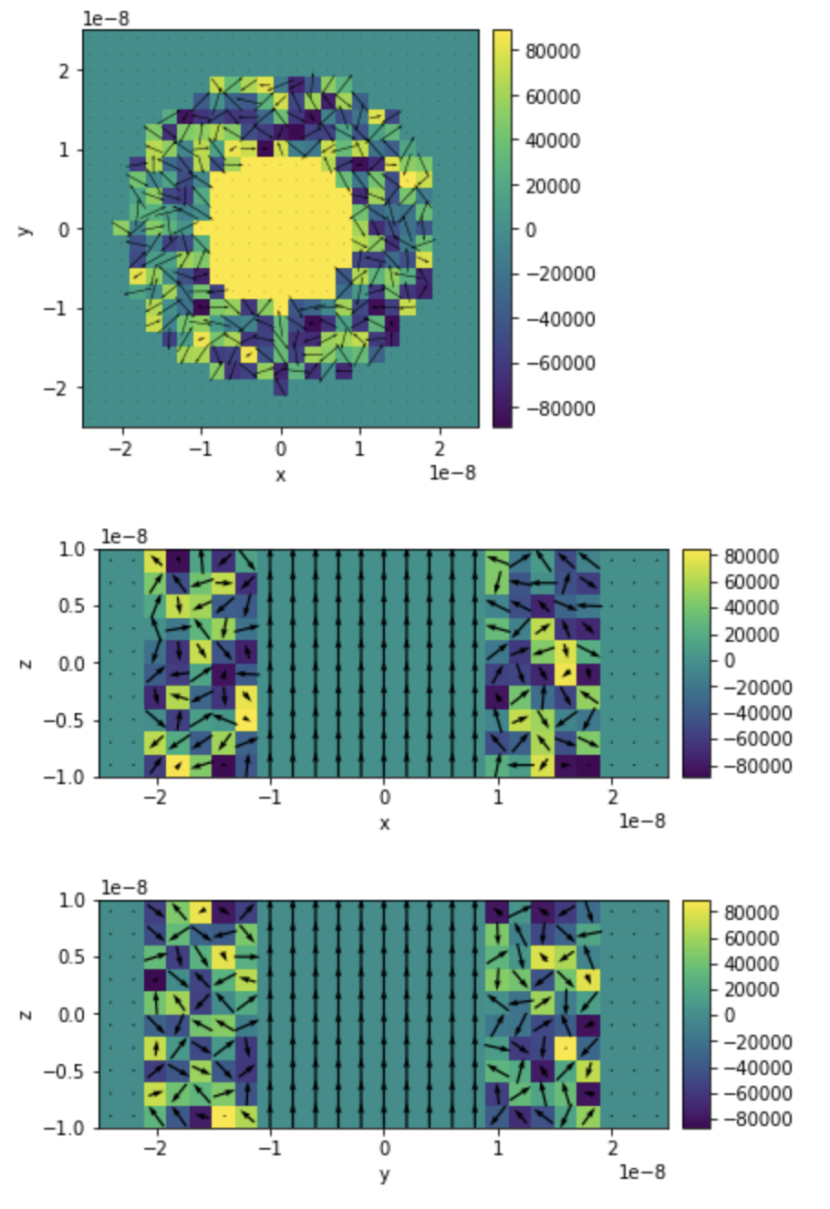
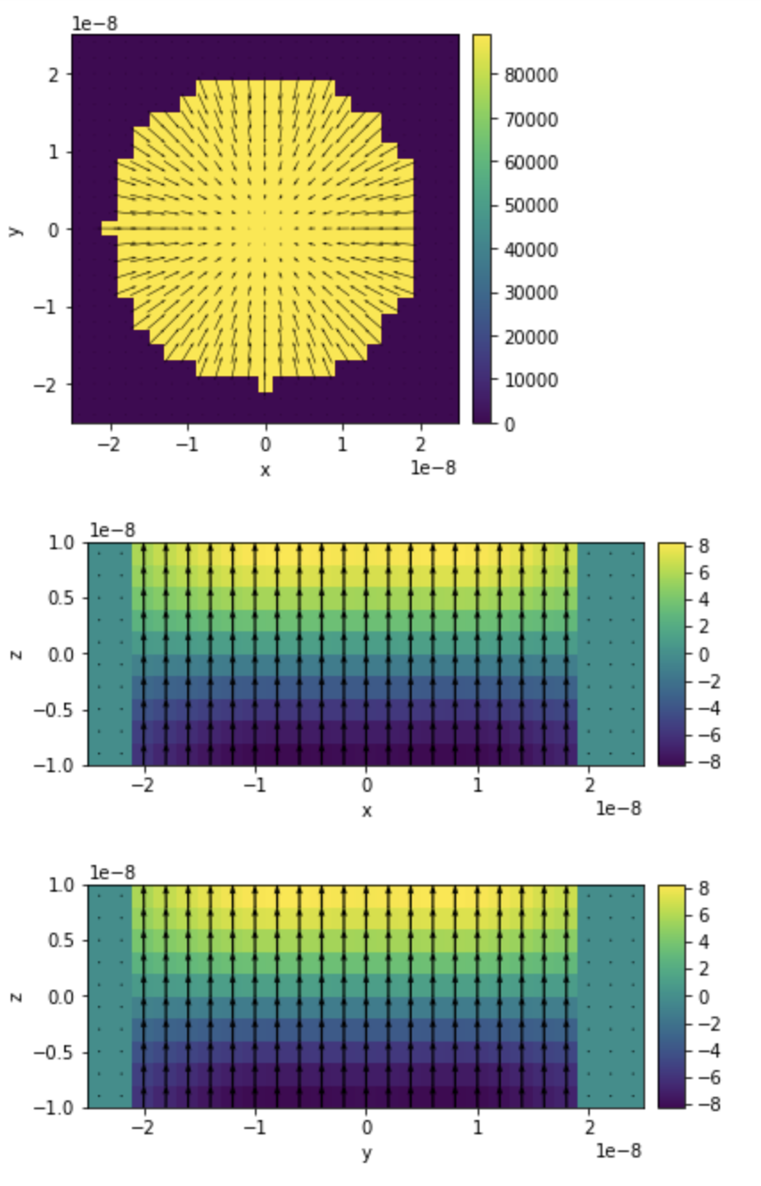
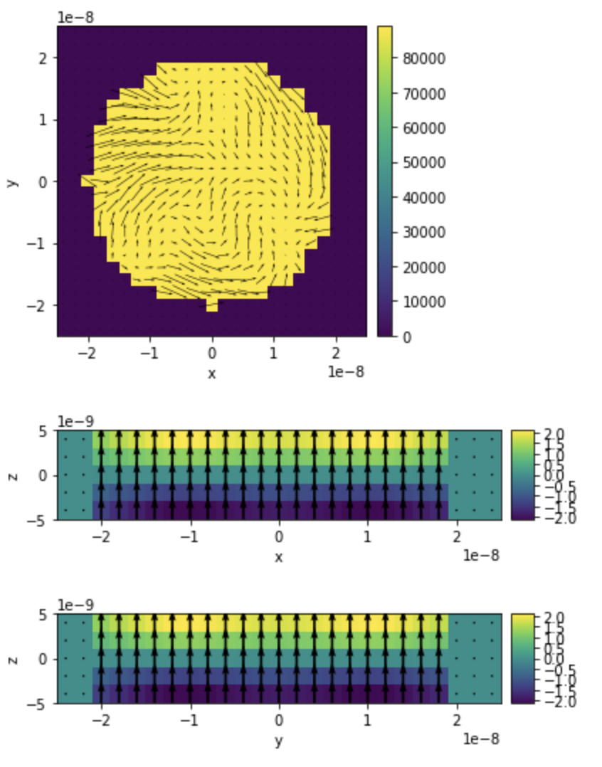
Initial configuration (GdCo), GdFeCo exactly same except only 10nm height
GdCo, minimized energy state
GdFeCo, minimized energy state

