Slide 1
Rutherford Scattering
Brandon Tran & Lab Partner: Lok Ching Lui

Slide 2
Objectives
Scattering of alpha-particles off gold foil
Verify the angular dependence of the Rutherford scattering formula
Calculate the atomic number of gold

Slide 3
Background- Plum Pudding Model
negative electrons occupied a region of space that itself was a uniform positive charge ("soup" of positive charge).
Spread out positive “pudding” would not be able to exert large couloumbic forces meaning alpha particles could not be deflected by more than a fraction of a degree (θ < 0.02 for gold) [Ref. Beiser, Perspectives of Modern Physics, Sec 5.3.]

Slide 4
Background- Rutherford Model
1 in 8000 alpha particles were deflected by very large angles (over 90°), while the rest passed through with little deflection
Conclusion: majority of the mass was concentrated in a minute, positively-charged region (the nucleus) surrounded by electrons. When an alpha particle approached sufficiently close to the nucleus, it was repelled strongly enough to rebound at high angles

Slide 5
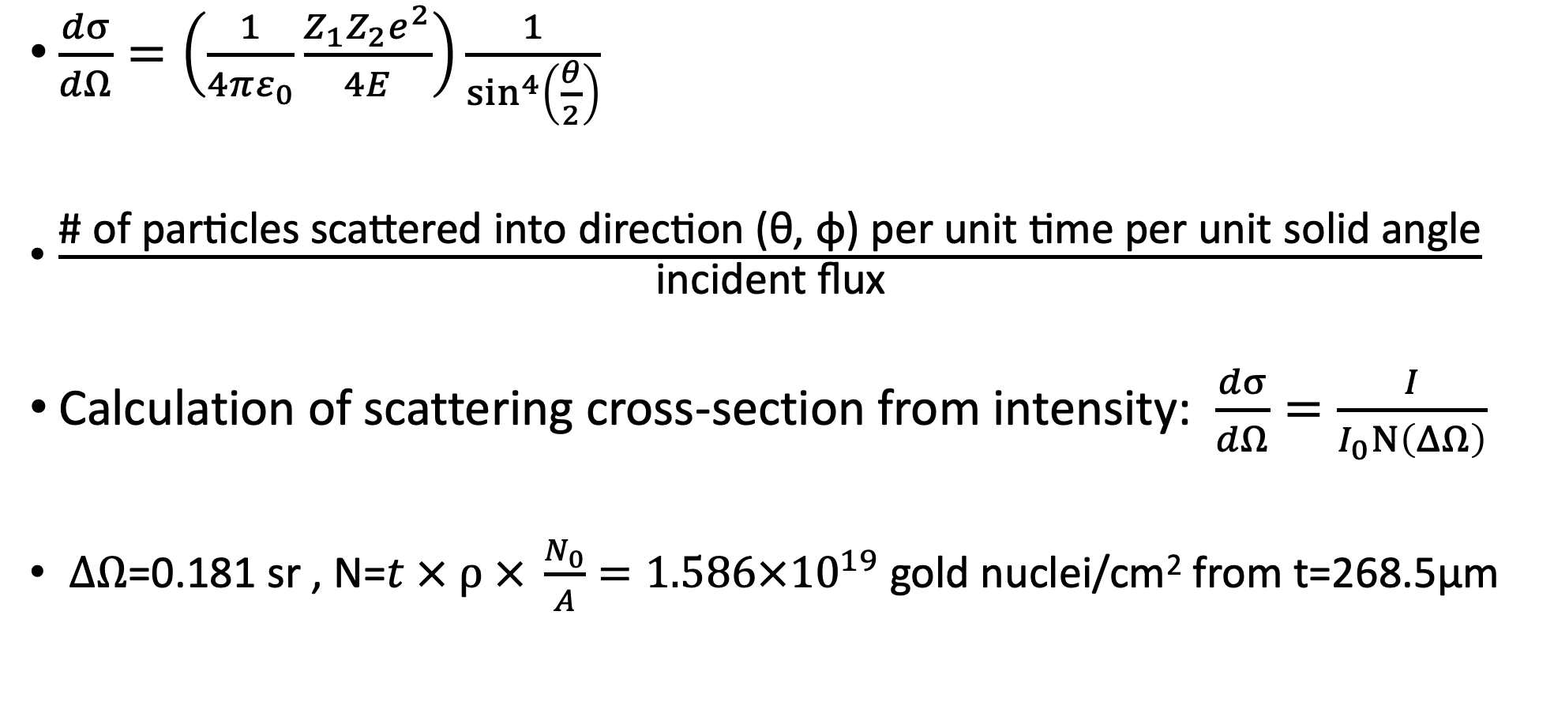
Rutherford Scattering Formula- The Differential Cross Section
$\frac{dσ}{dΩ}=\left(\frac{1}{4πε_{0}}\frac{Z_{1}Z_{2}e^{2}}{4E}\right)\frac{1}{\sin^{4}\left(\frac{θ}{2}\right)}$
$\frac{\text{\#} \text{of} \text{particles} \text{scattered} \text{into} \text{direction}\text{ (}\text{θ}\text{, }\text{φ}\text{) }\text{per} \text{unit} \text{time} \text{per} \text{unit} \text{solid} \text{angle}}{\text{incident} \text{flux}}$
Calculation of scattering cross-section from intensity: $\frac{dσ}{dΩ}=\frac{I}{I_{0}N\left(ΔΩ\right)}$
$ΔΩ$=0.181 sr , N=$t × ⍴ × \frac{N_{0}}{A}=1.586×{10}^{19}$ gold nuclei/cm² from t=268.5μm

Slide 6
Experimental Setup and Procedure
Bias Voltage
Pulse Height
Analyzer
Gold foil
Alpha-particle
Source Am²⁴¹
θ
Preamplifier
PN-junction
detector
Vacuum
Chamber
Amplifier

Slide 7
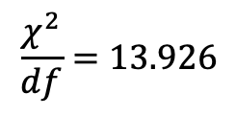
Beam Intensity Profile
Reasons for Obtaining a Beam Profile
It determines the background rate (0.086 counts/s) and gives the extent of the beam
provides the information on the incoming beam intensity (29.687 counts/s)
the beam profile gives information on the true 0º position of the detector (4.37º)
$$\frac{χ^{2}}{df}=13.926$$

Slide 8

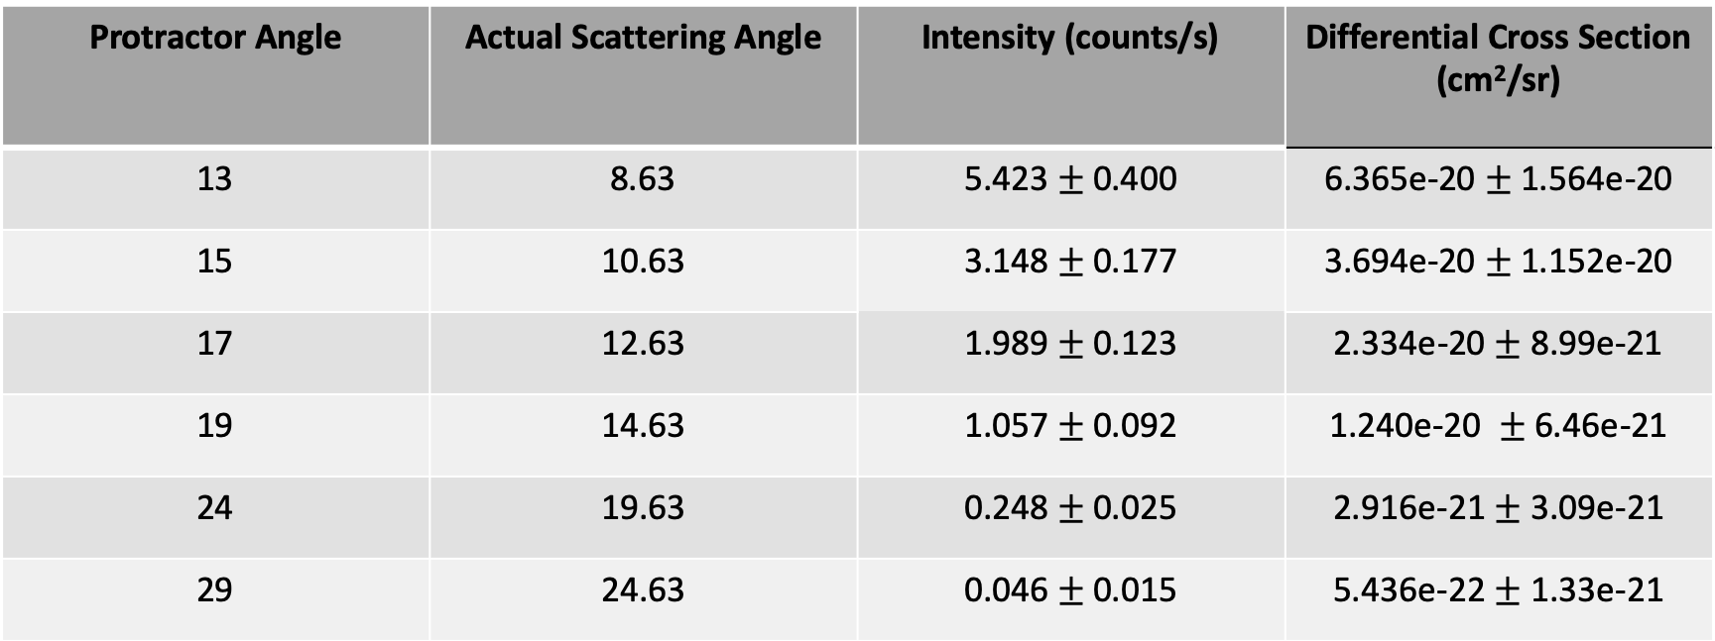
Scattering Data
$$\frac{dσ}{dΩ}=\frac{I}{I_{0}N\left(ΔΩ\right)}$$
Protractor Angle | Actual Scattering Angle | Intensity (counts/s) | Differential Cross Section (cm²/sr)
13 | 8.63 | 5.423$±$0.400 | 6.365e-20$±$ 1.564e-20
15 | 10.63 | 3.148$±$ 0.177 | 3.694e-20$±$ 1.152e-20
17 | 12.63 | 1.989 $±$0.123 | 2.334e-20$±$8.99e-21
19 | 14.63 | 1.057$±$ 0.092 | 1.240e-20 $±$ 6.46e-21
24 | 19.63 | 0.248 $±$0.025 | 2.916e-21$±$ 3.09e-21
29 | 24.63 | 0.046$±$ 0.015 | 5.436e-22$±$ 1.33e-21

Slide 9

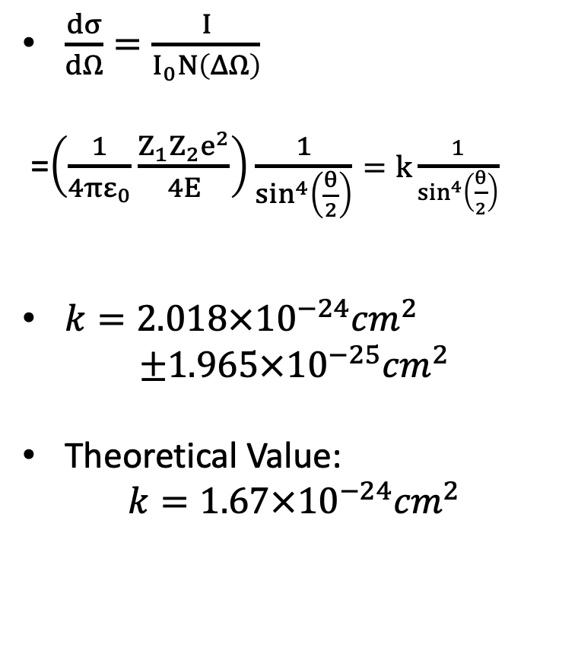
$\frac{dσ}{dΩ}=\frac{I}{I_{0}N\left(ΔΩ\right)}$
=$\left(\frac{1}{4πε_{0}}\frac{Z_{1}Z_{2}e^{2}}{4E}\right)\frac{1}{\sin^{4}\left(\frac{θ}{2}\right)}=k\frac{1}{\sin^{4}\left(\frac{θ}{2}\right)}$
$k=2.018×{10}^{−24}{cm}^{2}$
$$±1.965×{10}^{−25}{cm}^{2}$$
Theoretical Value:
$$k=1.67×{10}^{−24}{cm}^{2}$$
$\frac{χ^{2}}{df}$=0.496

Slide 10
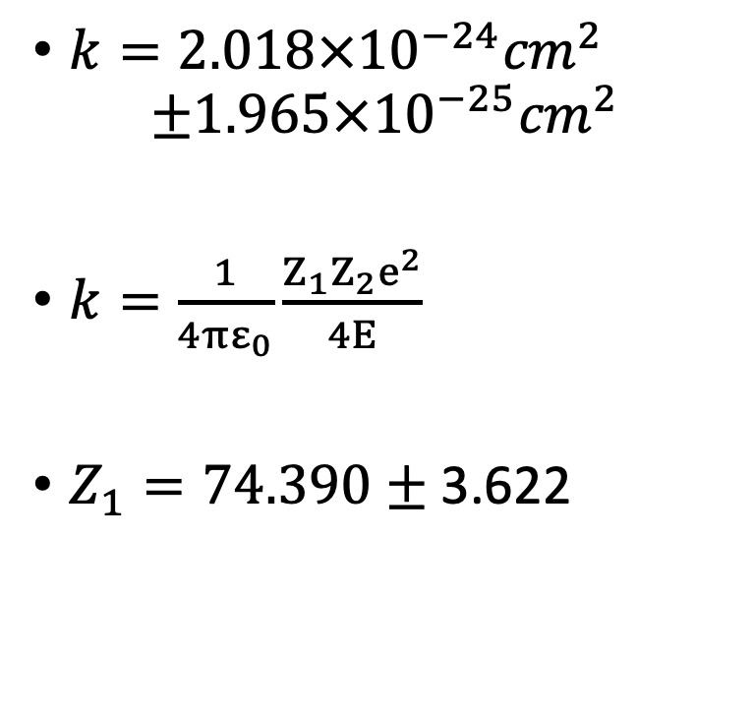
Atomic Number of Gold Calculation
$k=2.018×{10}^{−24}{cm}^{2}$
$$±1.965×{10}^{−25}{cm}^{2}$$
$k=\frac{1}{4πε_{0}}\frac{Z_{1}Z_{2}e^{2}}{4E}$
$Z_{1}=74.390±\text{3.622}$

Slide 11
Sources of Error
Main Sources of Error
Poisson error in counting
Uncertainty in incoming beam intensity
Uncertainty in foil thickness
Smaller Sources of Error
Multiple scattering in foil for data at smaller angles
Background Counts for data at larger angles
Finite size of detector

Slide 13
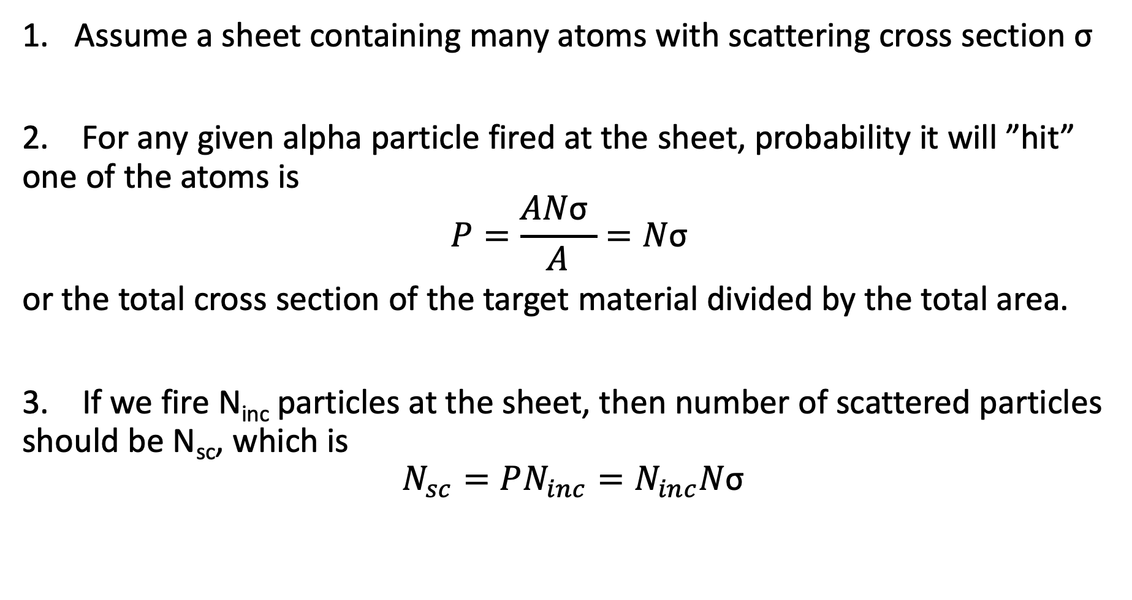
Derivation of Rutherford Formula
Assume a sheet containing many atoms with scattering cross section σ
2. For any given alpha particle fired at the sheet, probability it will ”hit” one of the atoms is
$$P=\frac{AN\text{σ} }{A}=N\text{σ}$$
or the total cross section of the target material divided by the total area.
3. If we fire N_{inc} particles at the sheet, then number of scattered particles should be N_{sc}, which is
$$N_{sc}=PN_{inc}=N_{inc}N\text{σ}$$

Slide 14
Multiple Scattering Calculation
Gold has nuclear radius of about 7 fermis (10⁻¹⁵) and atomic radius of 0.13nm leads to a geometric cross-section of about 154 fm²
So cross-sectional area of atom is 3.45 x 10⁸ times area of nucleus
So for a given scattered particle, to have a 1% probability of a second scattering, the remaining targets have to cover 1% of the area with nuclei assuming random distribution would need 3.45 x 10⁶ layers of atoms or 900um thickness
Note: in alpha particle scattering, cross section is much larger due to Coulomb force cross section is 100x bigger 9um thickness

