Slide 1

Meshing Practices and Tips
Matthew Brake
Computational Mechanics ME 404/504
School/College
Department of Mechanical Engineering

Slide 2
The Existential Pleasures of Meshing
Most analysts have a love/hate relationship with meshing
Very sophisticated software packages are out there…
But often there’s very little guidance
Consensus:
  Meshing is an art form, and takes a lot of practice/patience.
  Do convergence studies if at all possible!

Slide 3
Caveats Before We Begin
Every bit of meshing advice is problem dependent...you will always need convergence studies.
Most software has automeshing capabilities…don't rely on them! Learn how to mesh for yourself, then you'll understand what is happening

Slide 4
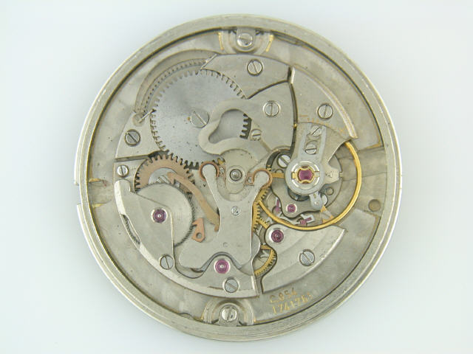
First: An Example
When given a complicated geometry, where do you start?

Slide 5
Where to Begin?
Determine what’s most important
This device needs to survive an impact event…
What do you think is worth focusing on?

Slide 6
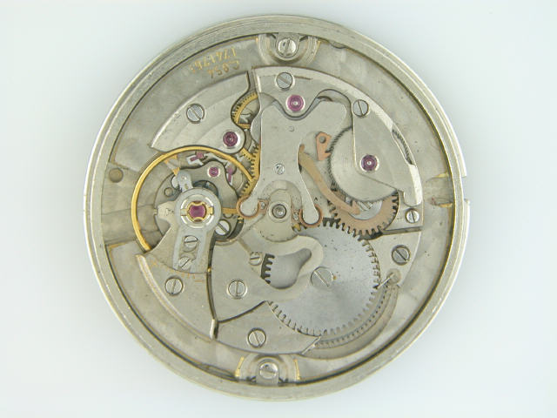
Parsing and Prioritizing
Impact event between pawl and gear important
Stresses in the large plate, not so much…

Slide 7
Divide and Conquer
Consider a submodel of just the important features…
A full model can be used to determine loads and BC’s…

Slide 8
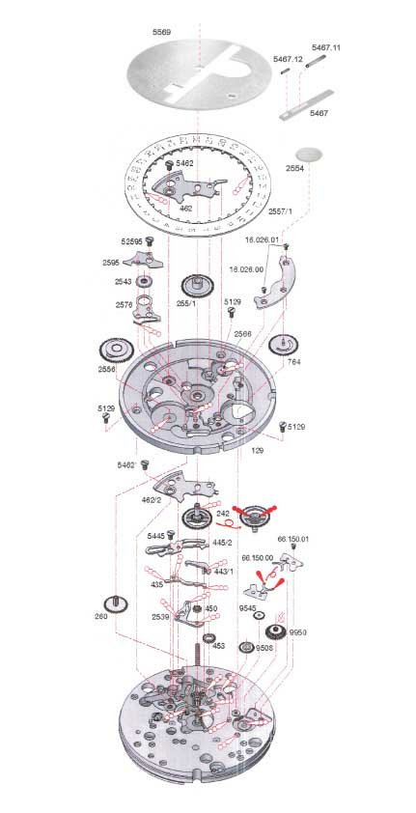
Build Up One Level at a Time
Most parts manufactured in a planar manner…
Build up a 3D model using 2D extrusions
Some 3D pieces will have to be assembled from 2D layers

Slide 9
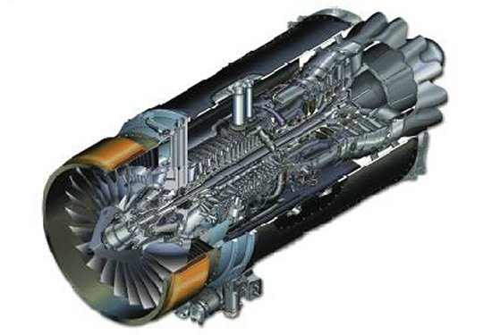
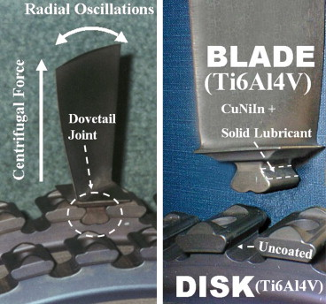
Reductione ad Potissimaque
Reduce to the most important aspects
If you’re just interested in whether the turbine blades will fail (e.g. fretting fatigue)

Slide 10
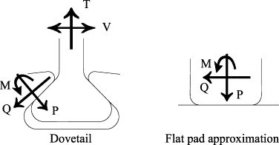
Reductione ad Potissimaque
You only need a high fidelity model of the joint…
Question: can you accurately simplify?

Slide 11
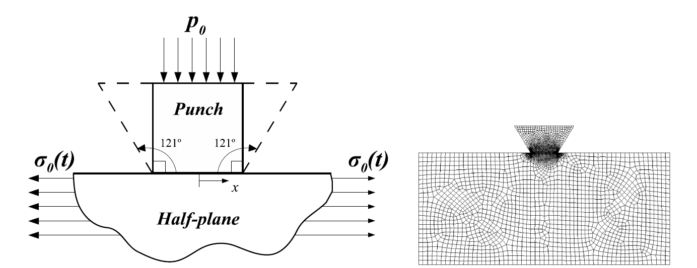
Reductione ad Potissimaque
Yes!
Thus to address a fundamental question, you may have a simple geometry…

Slide 12
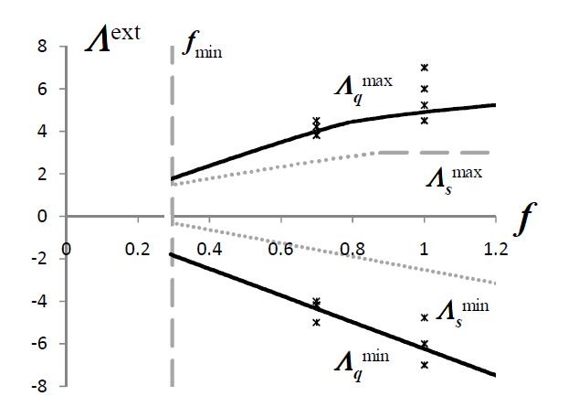
Reductione ad Potissimaque
This simple geometry is very useful for studying stresses in jet engines…

Slide 13
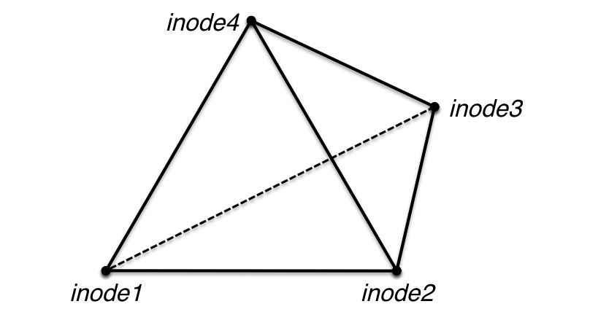
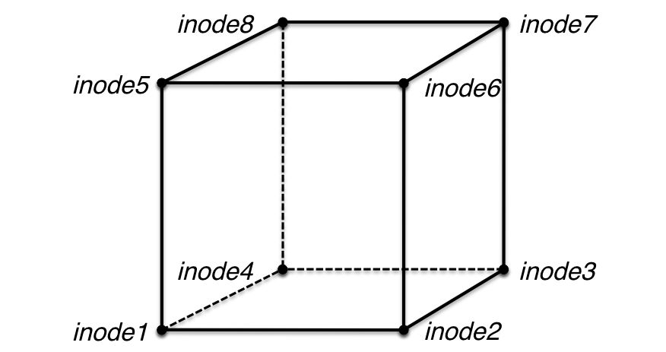
What Type of Elements Should You Use?
Highly problem dependent
Tet meshes are easier/quicker to generate than hex meshes but are more sensitive to the type of analysis
  Strutural dynamics – tetrahedrals will work
  Solid mechanics – hex work better

Slide 14
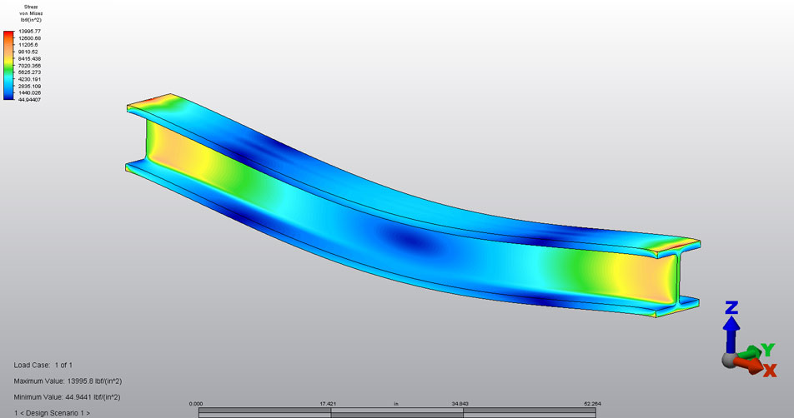
Mesh Selection Example: Bending
Generally, use hex elements.
Make sure you have enough through the thickness

Slide 15
Mesh Density
Much like for our 1D problems, the mesh density depends on the type of element used.
Higher order elements (such as hex) will require fewer elements for the same degree of convergence as a lower order element.
In 3D: a refinement factor of 2 increases CPU time by 16 (8 times as many elements, and the critical time step is cut in half)
Definition of critical time step based on wave propagation

Slide 16
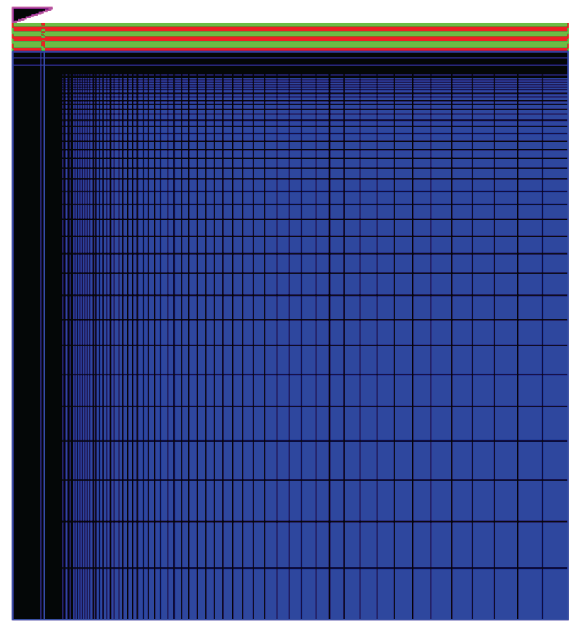
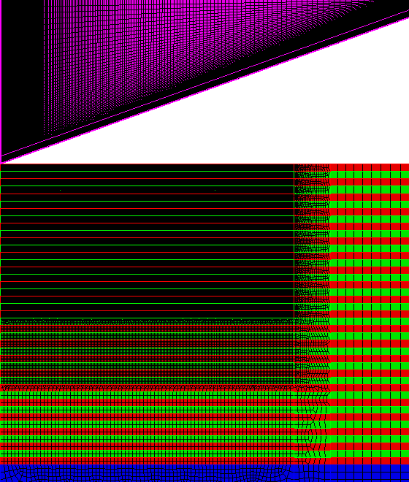
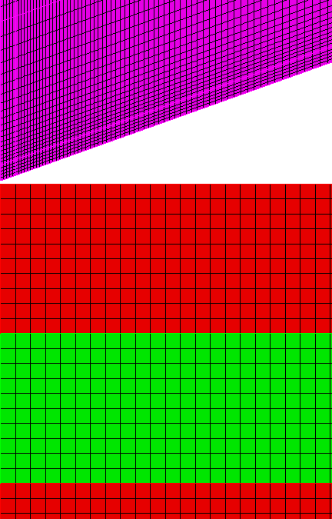
Biased Meshes
One method to reduce the number of elements is placing more in the area of interest and fewer in the far field:

Slide 17
Is This a Good Mesh?
Why/Why Not?

Slide 18
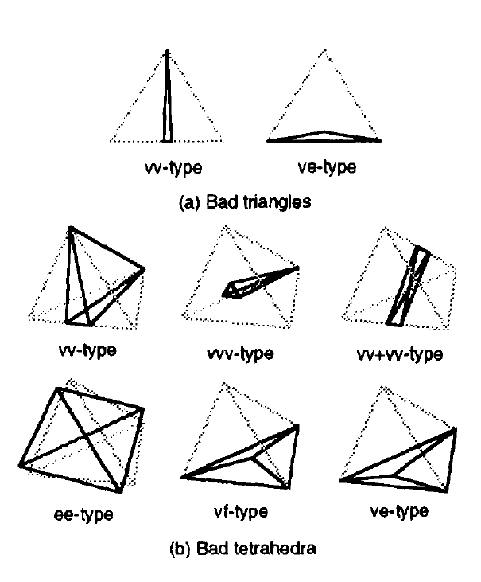
Mesh Quality
Many quality metrics:
  Aspect Ratio
  Shape
  Jacobian
Automatically calculated by meshing utility

Slide 19
Aspect Ratio
Rule of thumb: as close as 1:1 as possible.
In interesting areas, watch out when it’s 1:2 or 1:4
In the far field, with a uniaxial stress state, skewed elements (1:10) may not affect the solution…
Caution: beware of tiny elements when sweeping to mesh a volume!

Slide 20
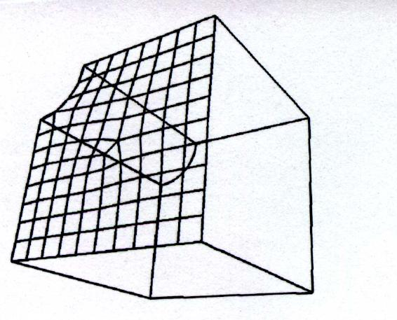
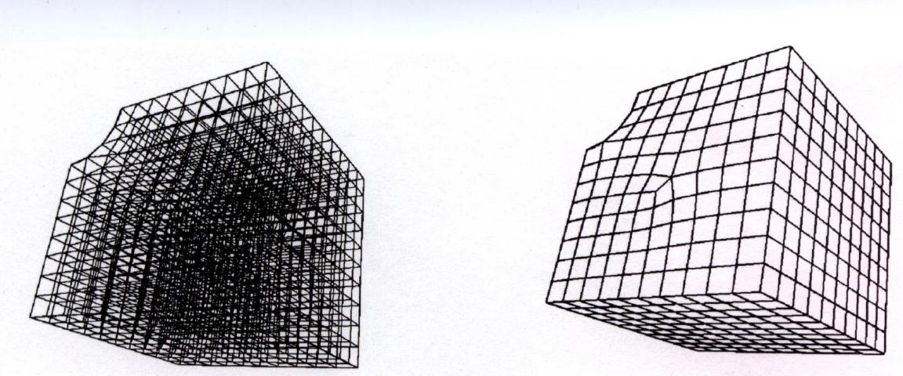
Mesh Sweeping
Mesh one surface, then keep that same pattern through the thickness

Slide 21
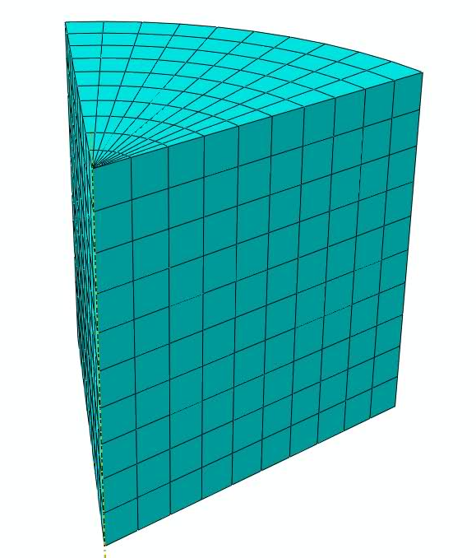
Symmetry
Great method to reduce number of elements
Use “Symmetry” boundary conditions

Slide 22
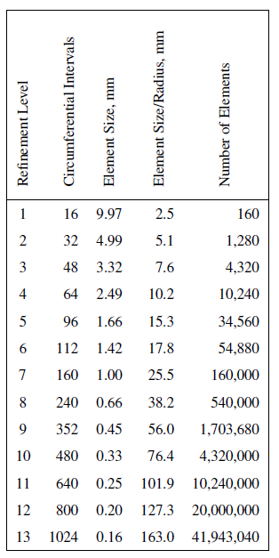
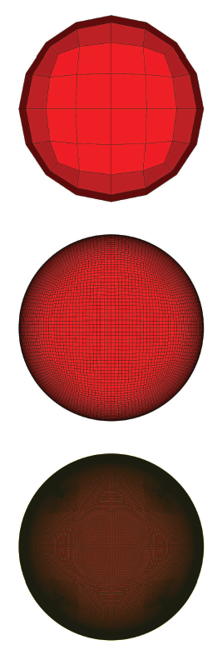
Cautionary Example About Symmetry
Consider the elastic impact of two spheres…
What opportunities for mesh savings exist?

Slide 23
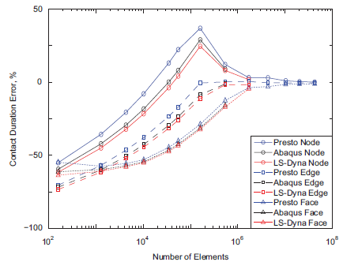
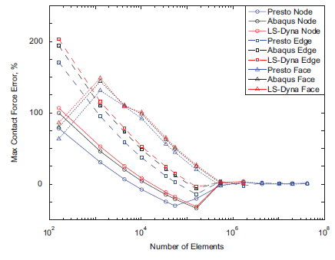
Cautionary Example About Symmetry
Numerical solutions compared to analytical (Hertzian) solution for elastic contact
Results differ based on node-node, edge-edge, or face-face contact…

Slide 24
Convergence Metrics
Rule of thumb: cut your element length in half and rerun the analysis…
Looking for clean gradients in your results
Just because one quantity (say stress) has converged, doesn’t mean that all other parameters have…

Slide 25
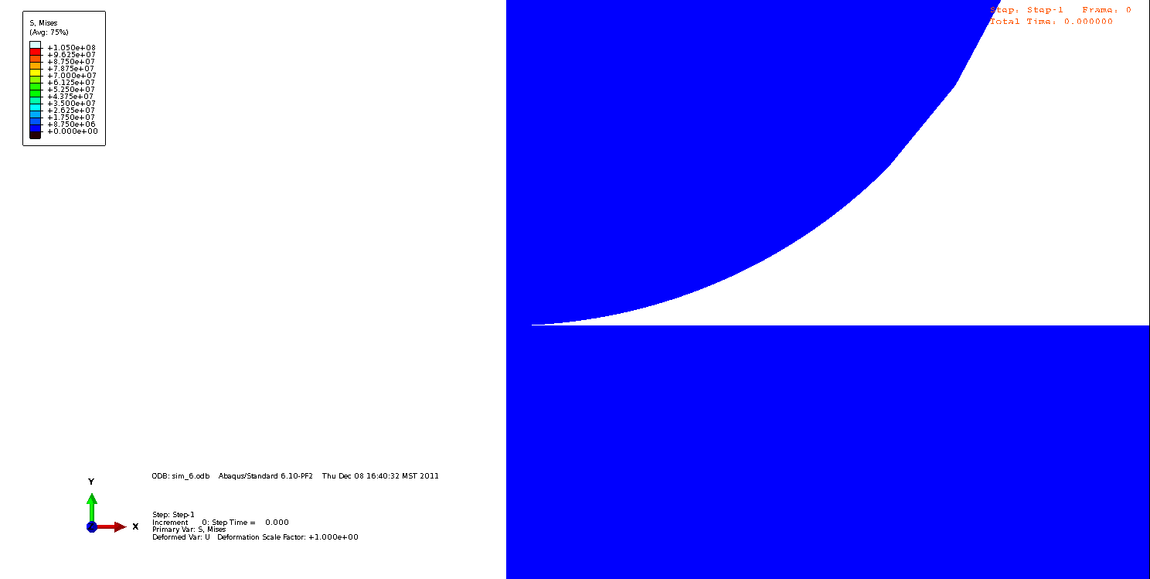
Convergence Example
Von Mises Stress for contact with coatings:

Slide 26
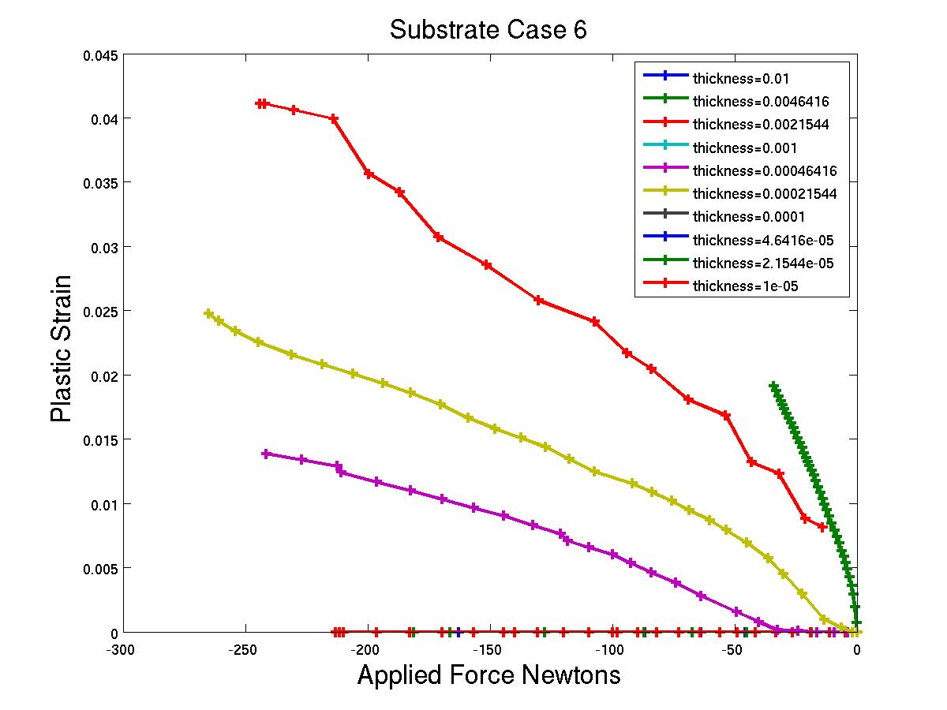
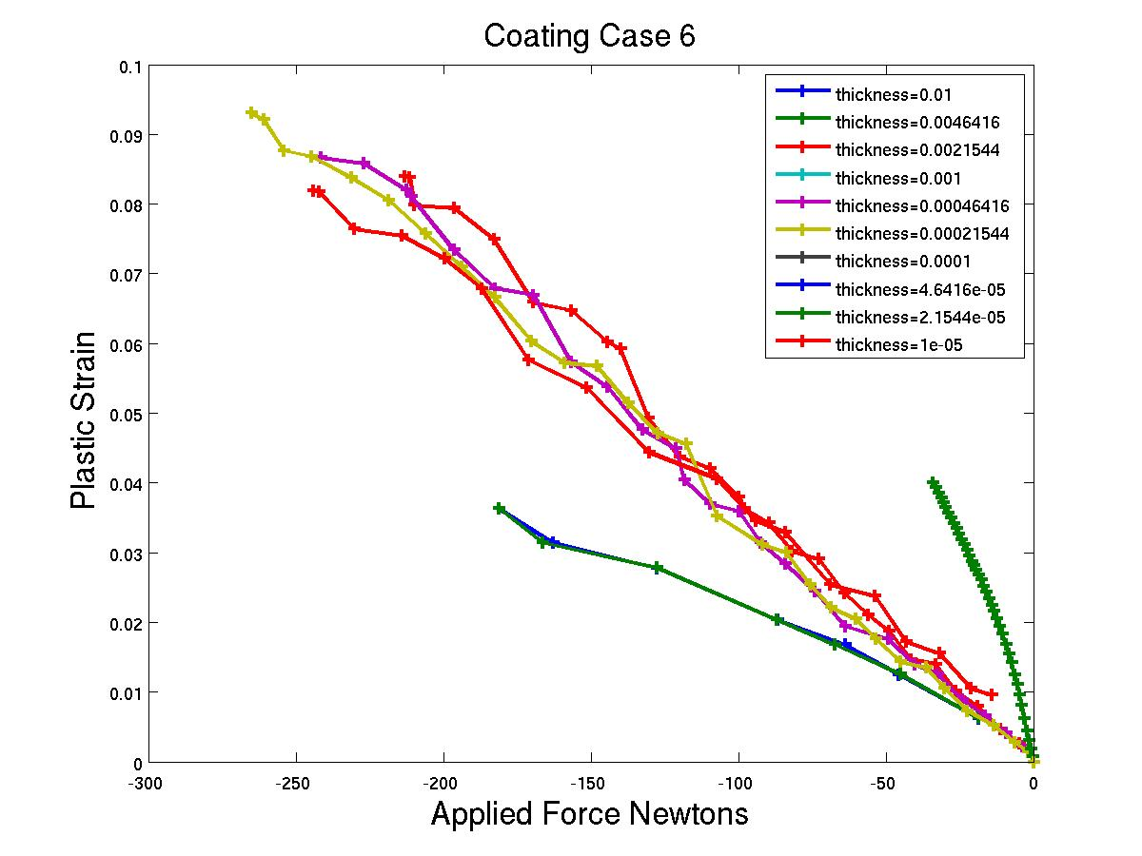
Convergence Example
The plastic strains tell a different story though:

Slide 27
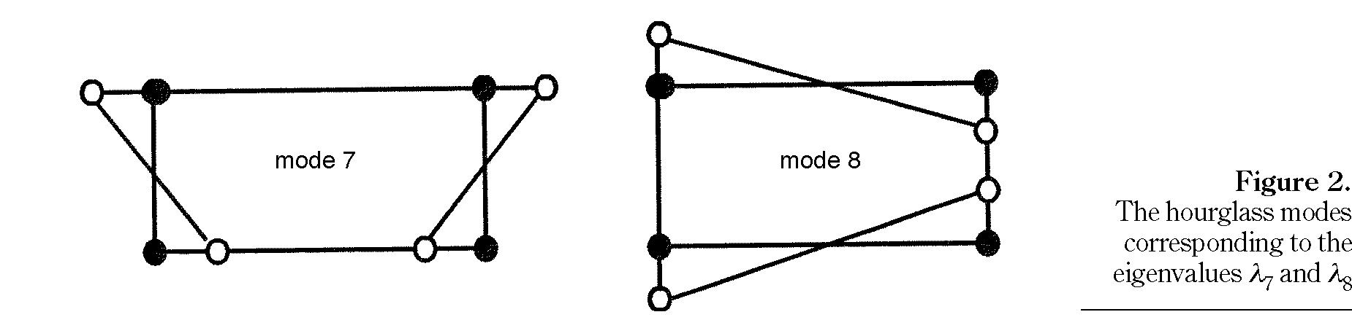
Something Evil This Way Comes…
Hourglassing: when elements become exceptionally deformed during an analysis…
  Time step too coarse
  Elements innapropriate
  Solutions involve building in additional stiffness (higher order elements that include more nodes, or analytical techniques)

Slide 28
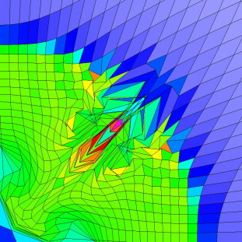
Hourglassing Example

Slide 29
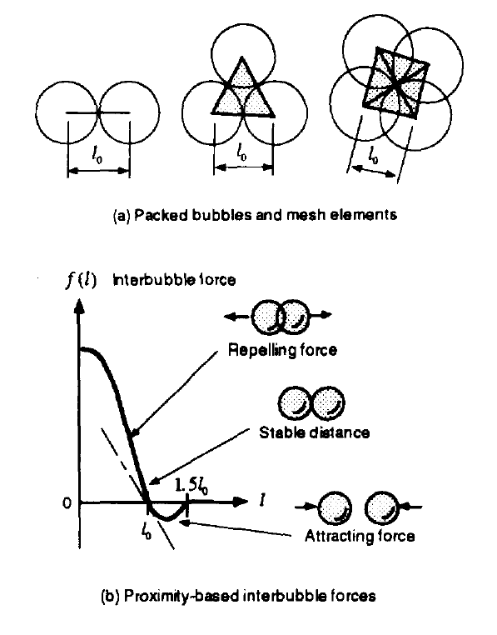
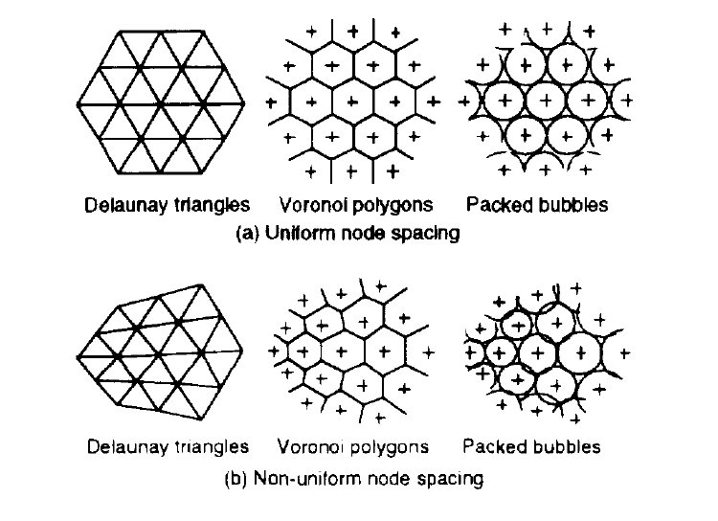
Meshing as Research
Given all of the inherent challenges with developing a good mesh, there’s a high research investment in it…
Ref: Kenji Shimada

Slide 30
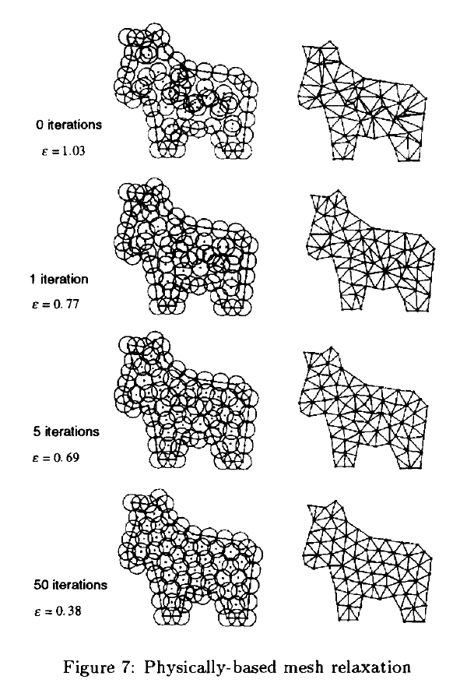
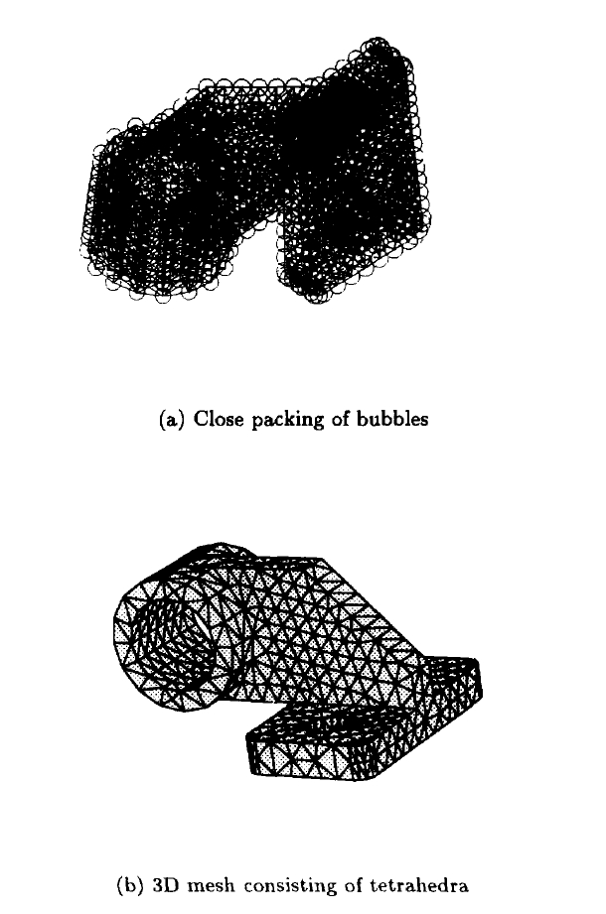
Example Applications of Bubble Mesh

Slide 31
Some Takeaways
Every geometry is a unique challenge
Focus elements where “interesting” behavior occurs
Take advantage of symmetry and mesh bias
Conduct convergence studies whenever possible
Reduce the problem to the simplest, representative geometry
Build 2D geometries into 3D assemblies
Be cognizant of the consequences of your choices!

