Slide 1
Lab & Tutorial 10
Dr. Zili Shao
cszlshao@comp.polyu.edu.hk

Slide 2
Hash Tables
A hash table is a data structure that offers very fast insertion and searching
No matter how many items there are, insertion and searching can take close to constant time: O(1)
  When you need to look up tens of thousands of items in less than one second, hash table should be a good choice
Faster than trees which operate in O(log(n)) and relatively easy to program
Disadvantages:
  Based on arrays and hard to be expanded
  Performance may degrade significantly when a table is too full
  Not convenient to visit items in a hash table in any order

Slide 3
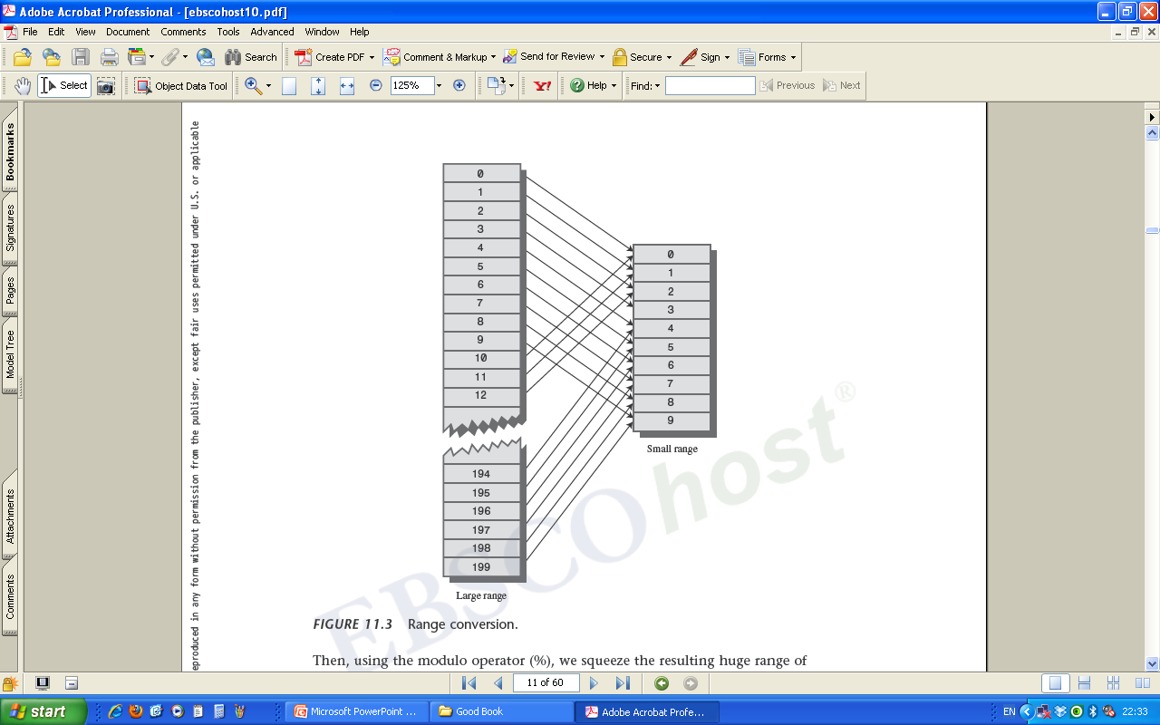
Hash Function: ArrayIndexSmall=
ArrayIndexLarge % ArraySize
Hash Table

Slide 4
Collisions
Two keys may hash to the same array index, which is called a collision.
Collisions can be solved by two ways
  Open addressing: when a collision occurs, search the array in some systematic way for an empty cell and insert the new item there, instead of at the index specified by the hash function
  Separate Chaining: Create an array that consists of linked lists of words instead of the words themselves
  when a collision occurs, the new item is simply inserted in the list at that index.

Slide 5
Open Addressing
Open addressing: when a collision occurs, search the array in some systematic way for an empty cell and insert the new item there, instead of at the index specified by the hash function
Three methods
  Linear probing: Search sequentially for vacant cells
  Quadratic probing
  Double hashing

Slide 6
Quadratic Probing
In quadratic probing, we probe more widely separated cells
  The distance from the initial probe is the square of the step number: x+1^2, x+2^2, x+3^2, x+4^2, x+5^2, and so on.
  That is, probes go to x+1, x+4, x+9, x+16, x+25, and so on (In linear probing, it is x+1, x+2, …).

Slide 7
Double Hashing
Double hashing can help eliminate secondary clustering as well as primary clustering.
Basic idea: generate probe sequences that depend on the key instead of being the same for every key.
The solution: hash the key a second time, using a different hash function, and use the result as the step size.
  For a given key the step size remains constant throughout a probe, but it’s different for different keys.
The following step works well:
  stepSize = constant – (key % constant)
  Here, constant is prime and less than the array size.

Slide 8
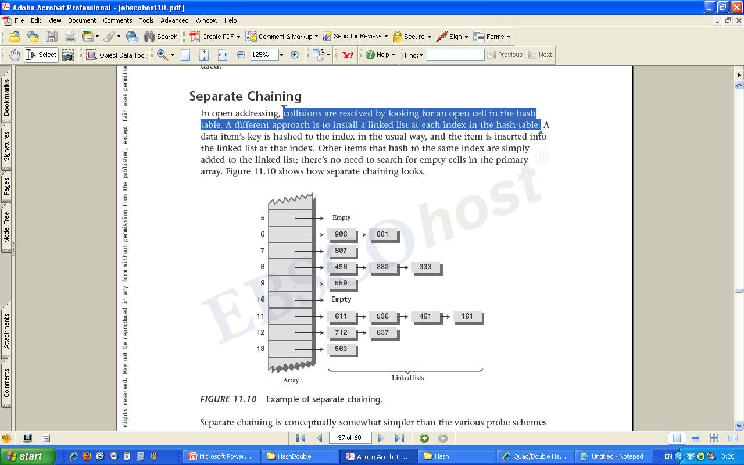
Separate Chaining
Collisions are resolved by with a linked list installed at each index in the hash table

Slide 9
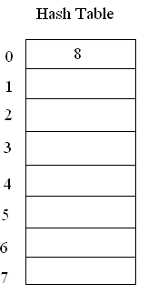
Question One - Example
Insert 8, 16, 24, 32 into a linear-probing hash table with array size 8
Insert 8
Insert …
Find 8: 1 (array cell 0)

Slide 10
Question Three
In Assignment Two, one question is related to removing duplicated links in a linked list.
  It is easy to give an algorithm with O(n ).
How about an algorithm with O(n)?
  Idea: Use a hash function to check if a link with a key has existed
  Set up a hash table using the maximum key value as the array size
  For each link, if its key is not in the hash table, insert the key; otherwise, remove the link
2

