Slide 1
Lab & Tutorial 7
Dr. Zili Shao
cszlshao@comp.polyu.edu.hk

Slide 2
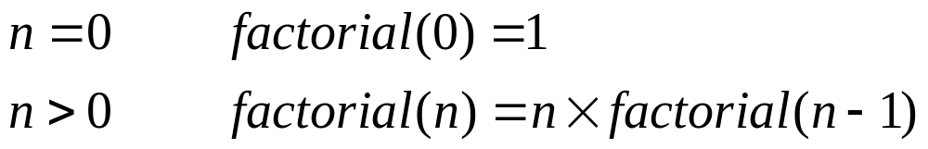
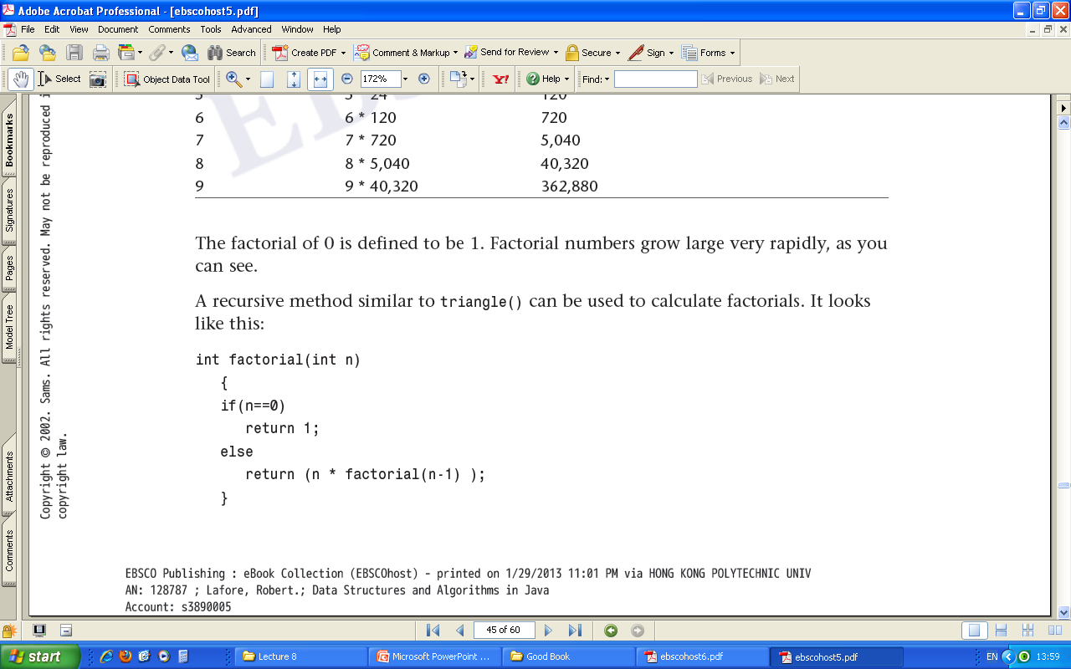
Recursion
Recursion – A method (function) calls itself.
For example:
Factorials

Slide 3
factorial(4)
4*6
4 * factorial(3)
3*2
3* factorial(2)
2*1
2*factorial(1)
1*1
1*factorial(0)
factorial(0)=1

Slide 4
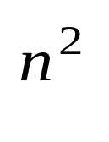
Mergesort
A much more efficient sorting algorithm than the simple sorting algorithms we have studied.
The complexity comparison
  O(N logN) for mergesort
  O( ) for inserting, selection, and bubble sort
4
16
64
256
1024
4096
16384

Slide 5
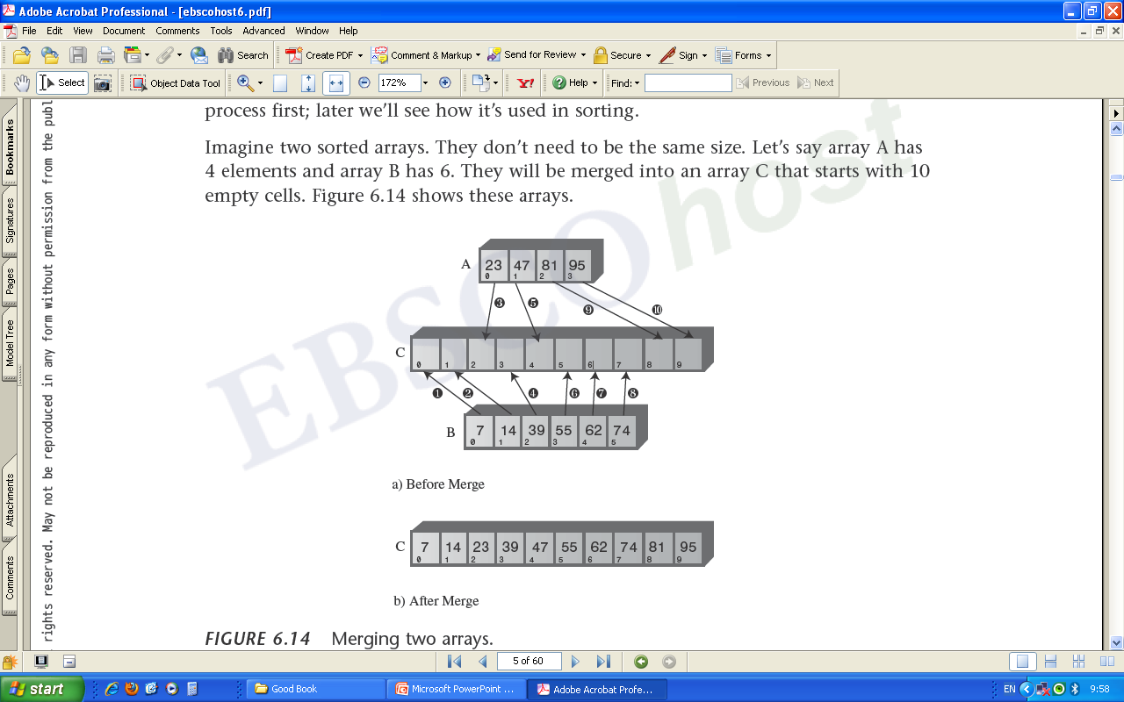
Basic Idea— Divide and Conquer
Idea: Divide an array in half, sort each half, and then merge the two halves into a single sorted array.
The heart of the algorithm is the merging of two already-sorted arrays.

Slide 6
The Sorted Sequence (Not Correct. Why?)

Slide 7
Download the lab exercise from the Blackboard.

