Slide 1
Lab & Tutorial 8
Dr. Zili Shao
cszlshao@comp.polyu.edu.hk

Slide 2
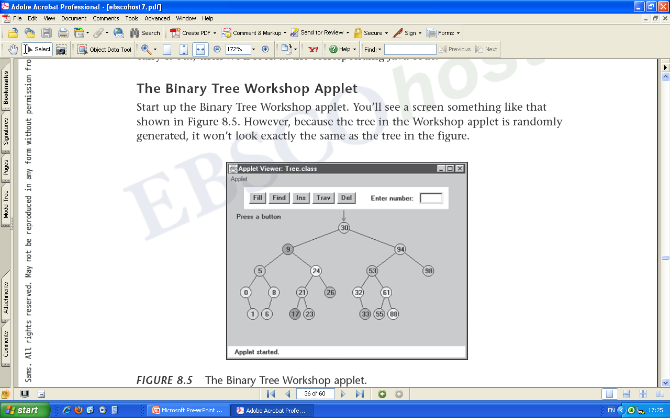
Binary Search Tree Applet Demo

Slide 3
Traversing A Tree
Traversing a tree means visiting each node in a specified order.
Three simple ways to traverse a tree: preorder, inorder, and postorder.
The order most commonly used for binary search trees is inorder.
An inorder traversal of a binary search tree will cause all the nodes to be visited in ascending order, based on their key values.

Slide 4
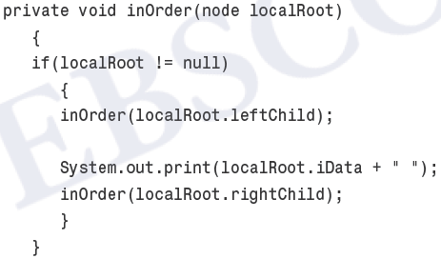
Inorder Traversal
1. Call itself to traverse the node’s left subtree.
2. Visit the node.
3. Call itself to traverse the node’s right subtree.

Slide 5
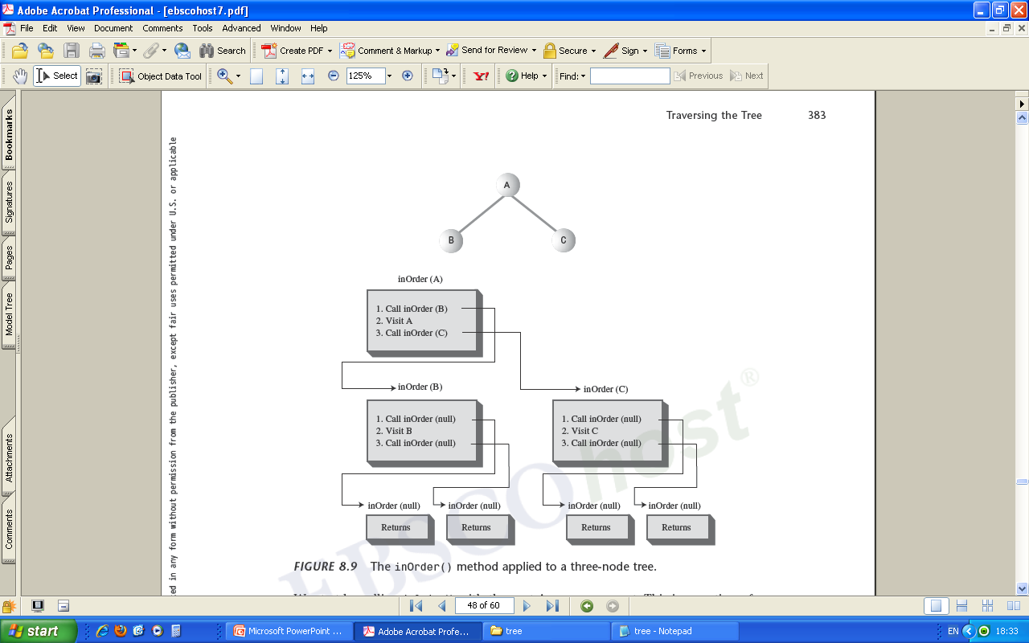

Slide 6
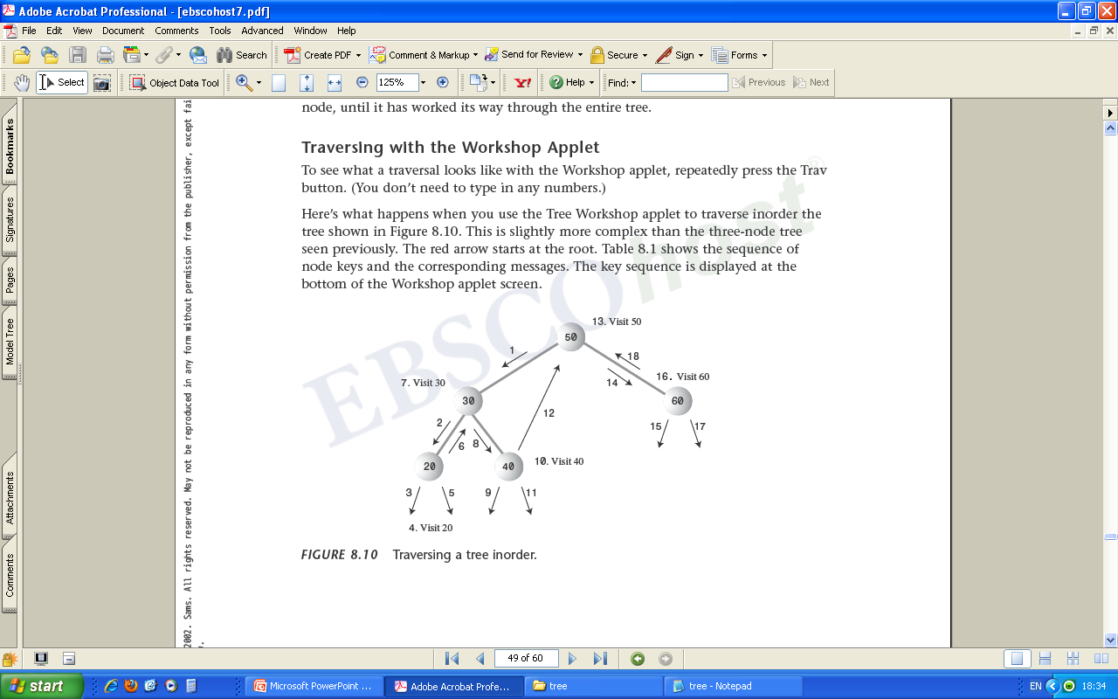

Slide 7
Question One
The procedure to build up a binary search tree (balanced and not balanced)

Slide 8
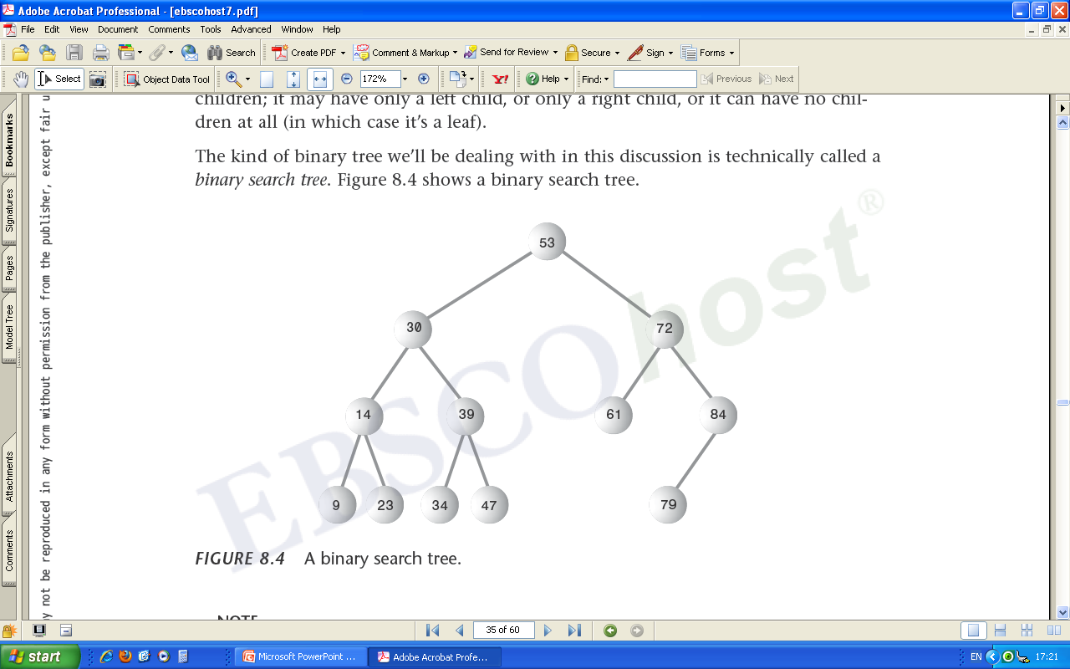
Question Two
Recursively calculate the summation of dData of each node in which all the nodes will be visited in descending order

