Slide 1
Lab & Tutorial 9
Dr. Zili Shao
cszlshao@comp.polyu.edu.hk

Slide 2
Partitioning
Partitioning is the underlying mechanism of quicksort, and it’s also a useful operation applied in many algorithms.
To partition data is to divide it into two groups, so
  all the items with a key value higher than a specified amount are in one group, and
  all the items with a lower key value are in another.

Slide 3
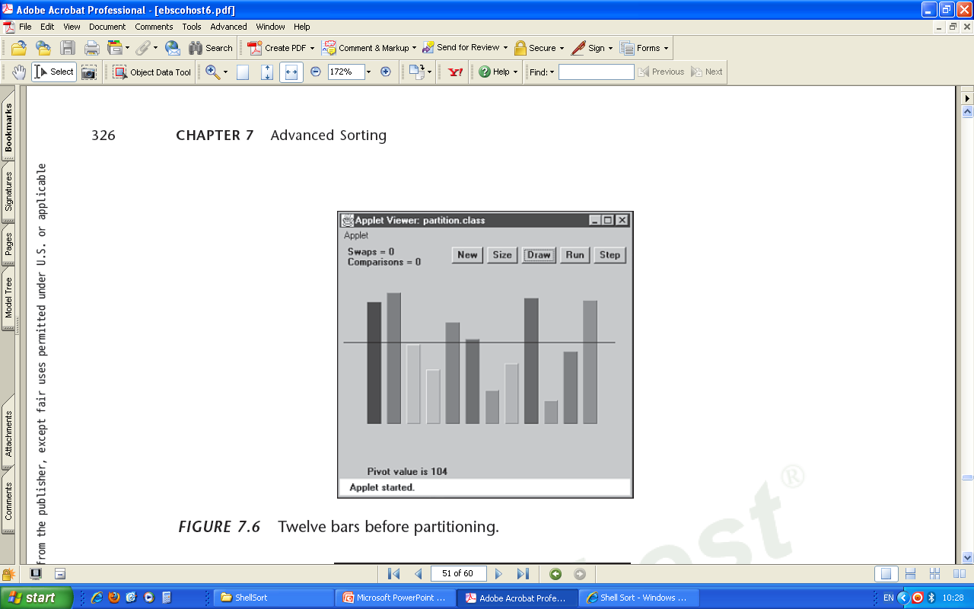
Applet Demo

Slide 4
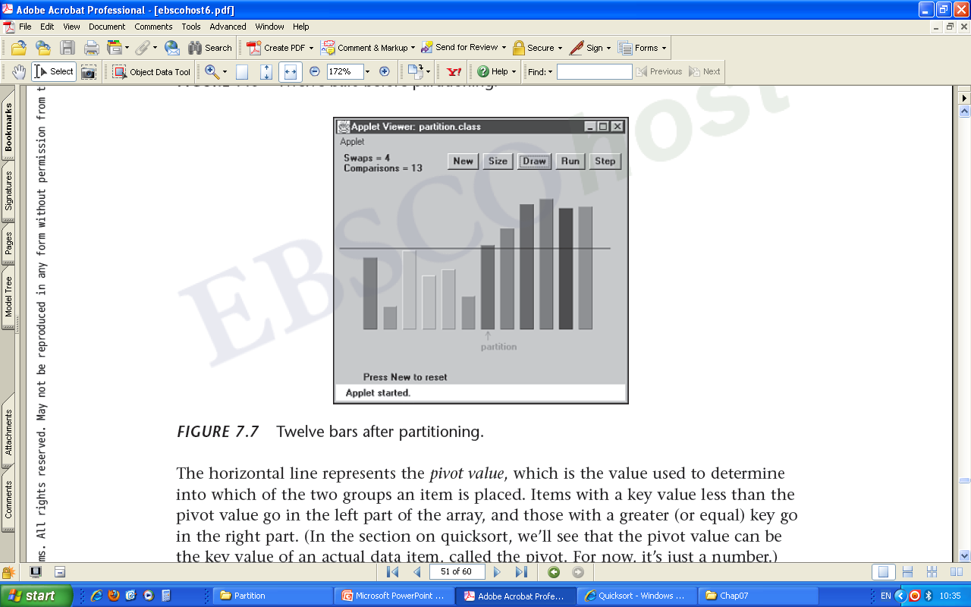
Pivot and Partition
The horizontal line represents the pivot value.
After being partitioned, data will be divided into two groups.
The arrow labeled partition points to the leftmost item in the right (higher) subarray.

Slide 5
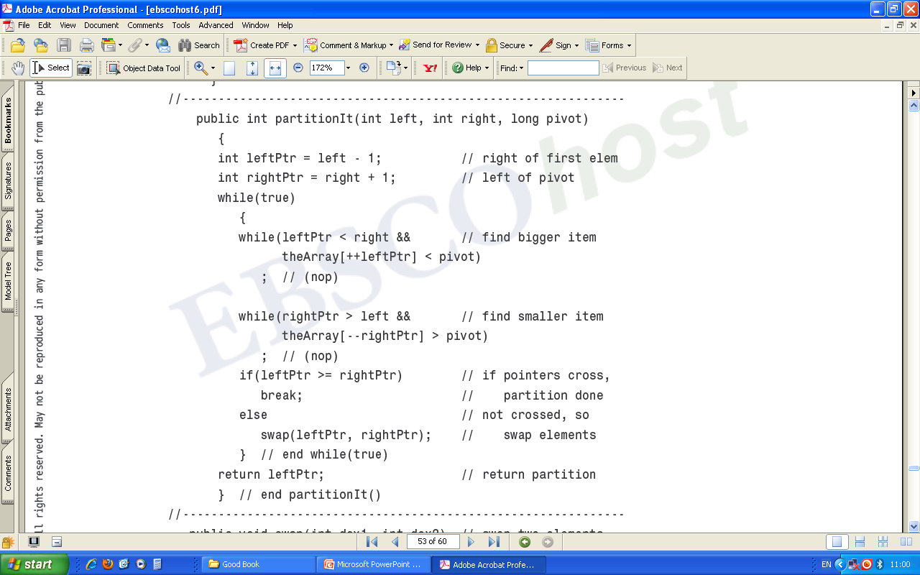

Slide 6
The Partition Alg.
Two pointers, one at each end of the array, move toward each other
  The pointer on the left moves toward the right, and
  the one on the right moves toward the left.
Stop and swapping
  the left pointer keeps moving until it encounters a data item larger than the pivot value;
  Similarly, the right pointer keeps moving until it encounters a data item smaller than the pivot value;
  Swap the data items pointed by the left and right pointers.
Continue the above until finish all data items.

Slide 7
Quicksort
Quicksort is undoubtedly the most popular sorting algorithm, and was discovered by C.A.R. Hoare in 1962.
In the majority of situations, it’s the fastest, operating in O(N*logN) time.
Basic idea: partition an array into two subarrays and then call itself recursively to quicksort each of these subarrays.
Issues: how to select the pivot and sort small partitions.

Slide 8
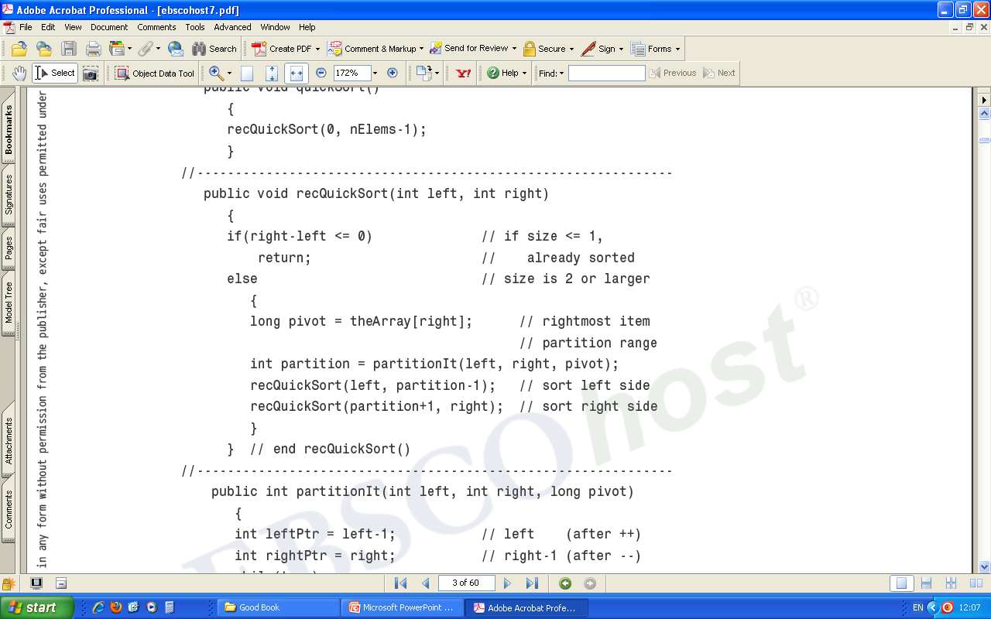

Slide 9
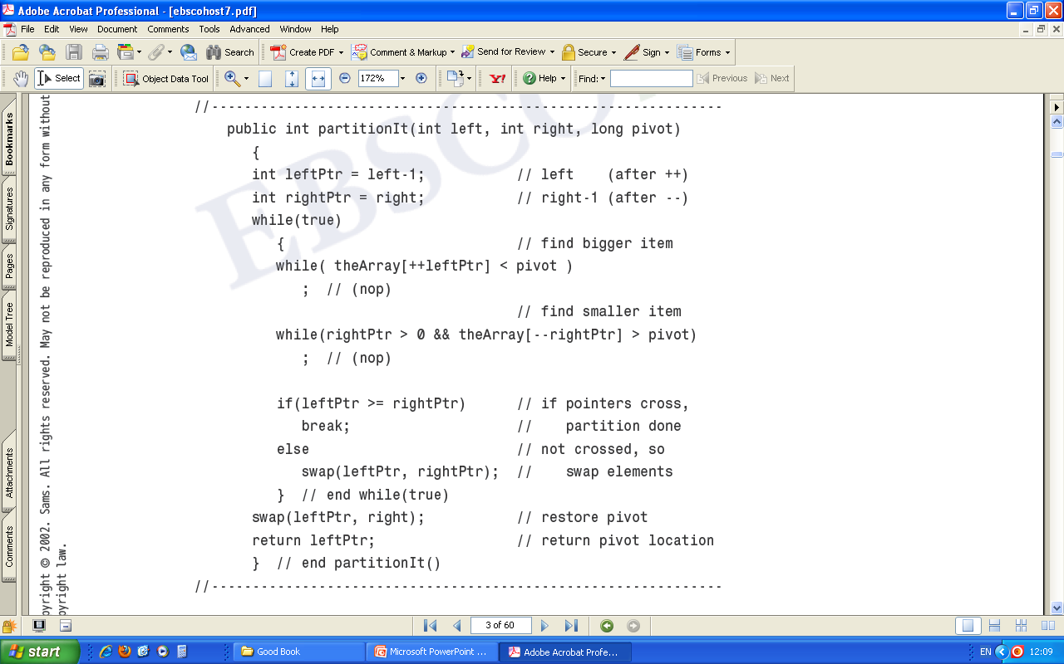

Slide 10
Exercises
Q1. How does the partition method work?
Q2. Revise the quicksort program so
  the leftmost array element is selected as the pivot value in each partition;
  when partitioning an input array, an array element that is equal to the pivot value can only be put into the left partition;
  print the pivot and display the array after each partition.

