Slide 1
Student Performance
High School
By: Orianne Adams, Hanna Akhtar, Taylor Livingston, Brandon Mendoza, Davin Nguyen, Rachel Olivas, & Ashley Valdivia

Slide 2
01
Background

Slide 3
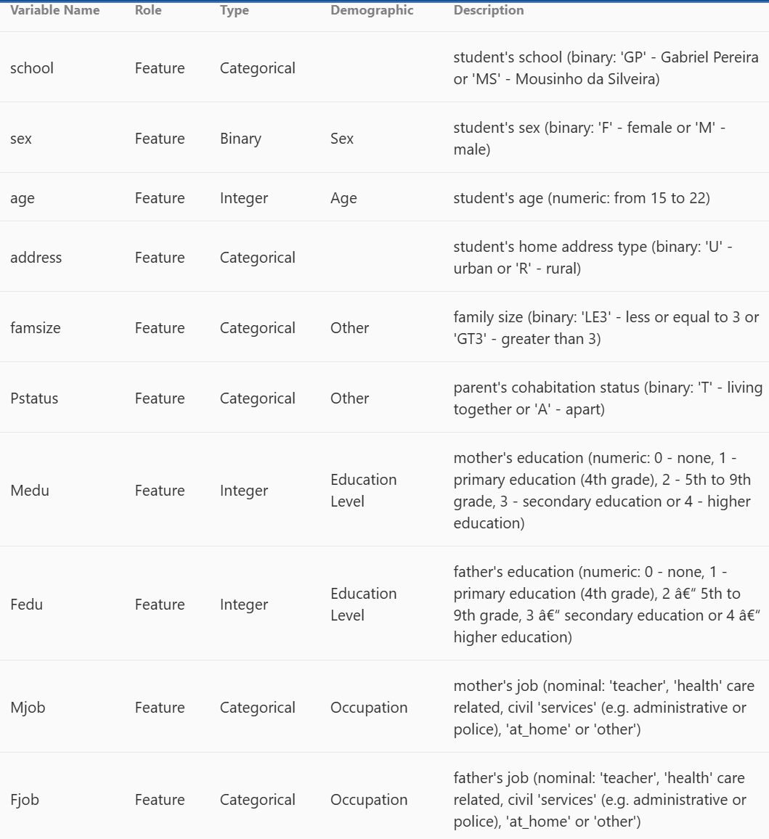
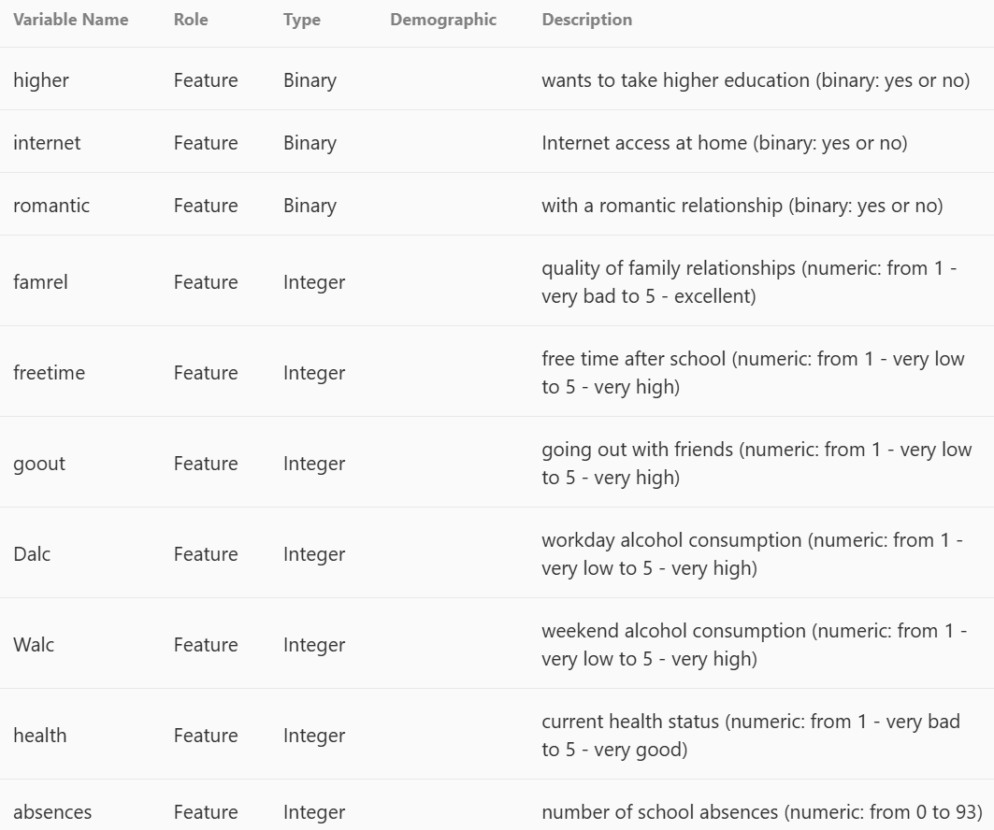
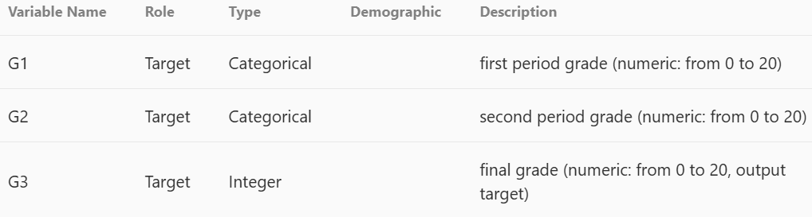
Background
DATA CONTENT & STRUCTURE
Student achievement of two Portuguese schools
Attributes:
  Students grades
  Demographic
  Social and school related features
Collected by school reports and questionnaires
2 subjects: Mathematics & Language
  For this project: we utilized the Language data set
No missing values
Notes:
Period = semesters
We chose to do language as our dataset

Slide 4
Background
LITERATURE REVIEW:
Source: Cortez, P., & Silva, A.M. (2008). Using data mining to predict secondary school student performance.
  Study uses data mining (DM) to predict academic success in Portuguese secondary schools
  Data from 2 schools: grades, demographics, social & behavioral factors
  Models used: Decision Trees
  Predictive tasks: pass/fail, 5-level grades, and numeric regression
  Early grades (G1 & G2) are the strongest predictors
  Social factors (e.g., alcohol use, parental education) still provided insights
Notes:
LITERATURE REVIEW LINK: http://repositorium.sdum.uminho.pt/bitstream/1822/8024/1/student.pdf
ASHLEY

Slide 5
Background
LITERATURE REVIEW:
Source: Marcondes, D., Simonis, A., & Barrera, J. (2017). Feature Selection based on the Local Lift Dependence Scale. Entropy, 20.
  Goal: Identify which entrance exam subjects best predict a student’s first-year university performance.
  Method: Used classical and multiple feature selection algorithms based on the Local Lift Dependence Scale (LLDS)..
  Process:
    Adjusted exam scores by course & year.
    Grouped performance levels (low, medium, high).
  Findings:
    Multi-resolution methods provided deeper insights than classical approaches.
    Helps improve admission strategies and student support planning.
Notes:
LITERATURE REVIEW LINK: https://www.semanticscholar.org/reader/b2af31331cd9199832a503b8901878ad1871343f
ASHLEY

Slide 6
Background
LITERATURE REVIEW:
Source: Nahar, K., Shova, B.I., Ria, T. et al. Mining educational data to predict students performance. Educ Inf Technol 26, 6051–6067 (2021).
  Study focuses on mining data to predict students’ performance
    Utilized academic and behavioral data → 2 datasets
      (1) AIPerformance & (2) AllTheoryPerformance
    Collected data through surveys and mark sheets
  Models used: Decision Trees and Naive Bayes → classification & performance evaluations
  Process:
    transformed numerical scores into categorical data, removed outliers & cleaned data, model evaluation based on accuracy, precision, and more
  Findings:
    Early performance → strongly correlated with final results
    Learning behavior influences performance
Notes:
LITERATURE REVIEW LINK: https://link.springer.com/article/10.1007/s10639-021-10575-3
Data revolved around: (a few examples)
Academic scores → based on Computer Science Lab scores
Behavioral/Survey Variables → interest, learning strategy, career aspiration
Demographics → gender

Slide 7
02
Data Preprocessing
Notes:
ORIANNE

Slide 8
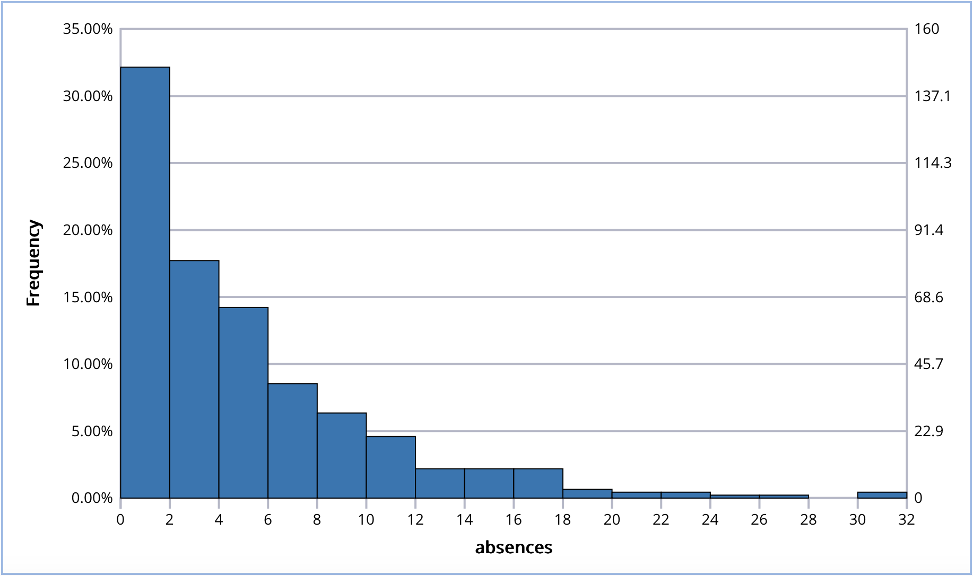
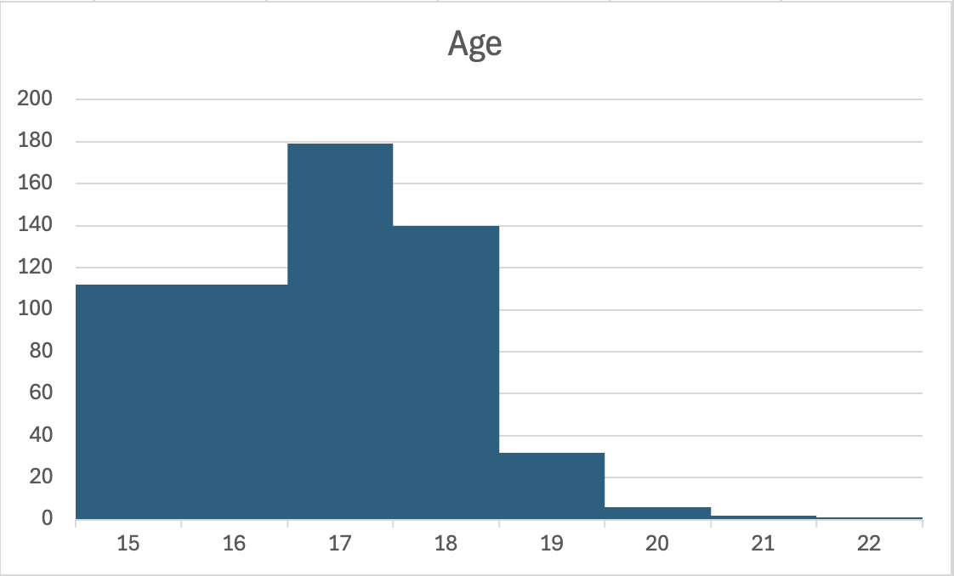
Step 1 → Heatmap displayed no missing values
Step 2 → Distribution check for continuous variables
Absences:
Right-skewed
2 outliers removed
Values : 30, 32
Age:
Ages 20, 21, and 22 removed
Not common ages for high school students
Notes:
ORIANNE

Slide 9
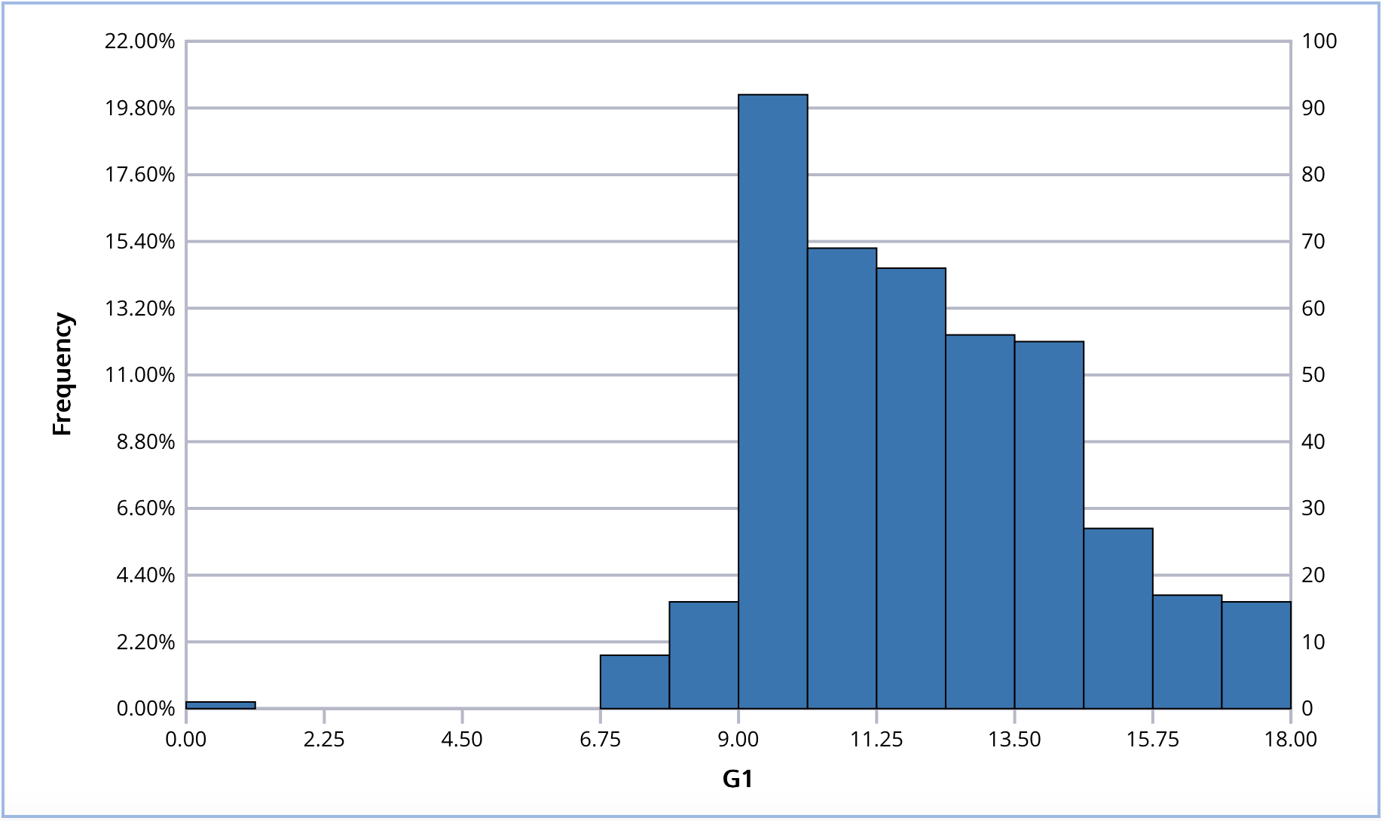
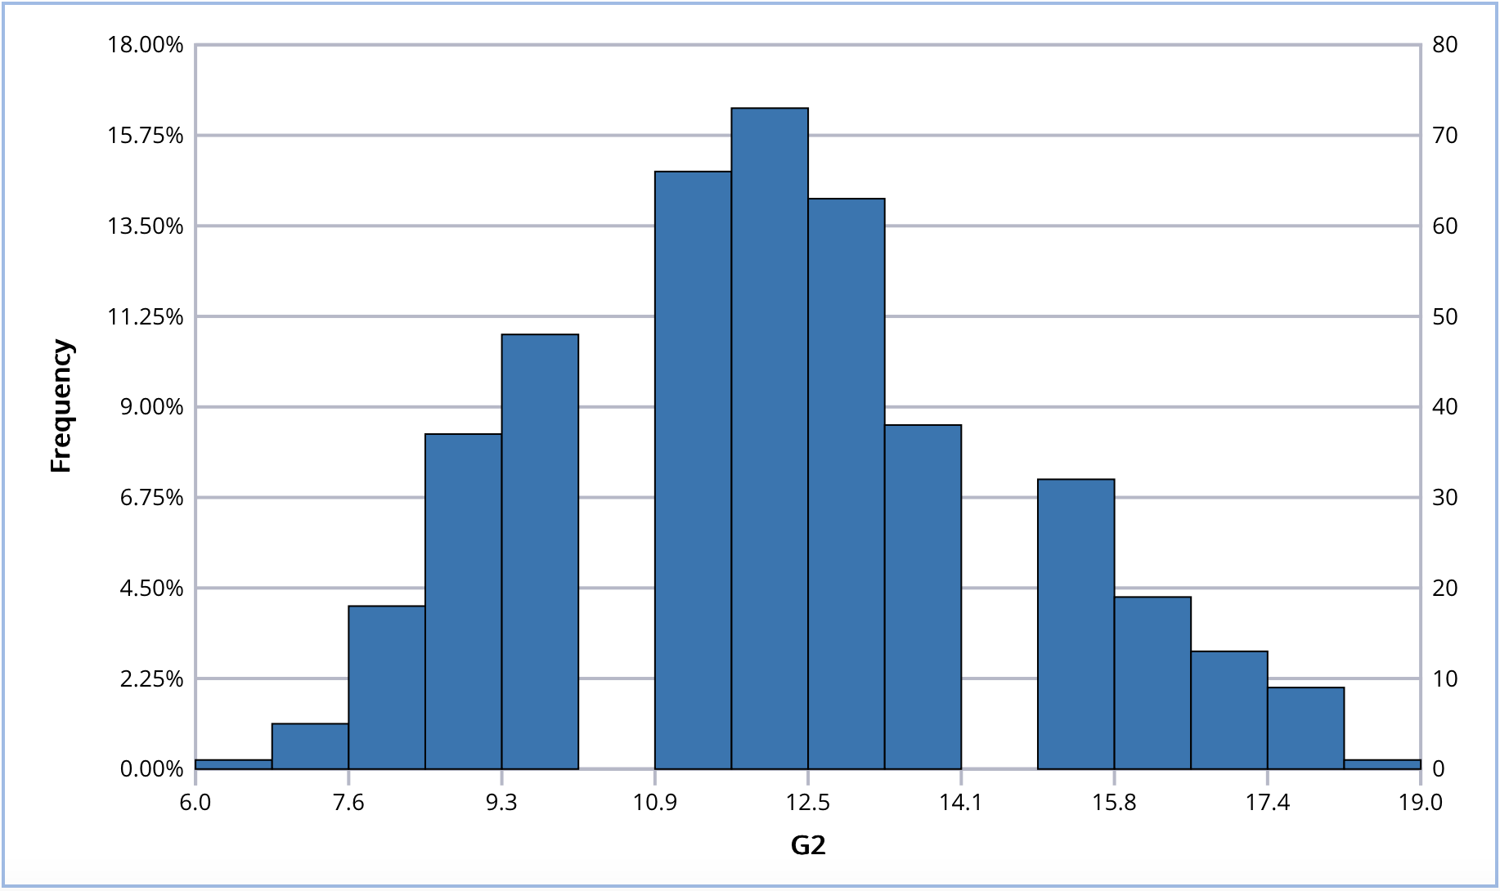
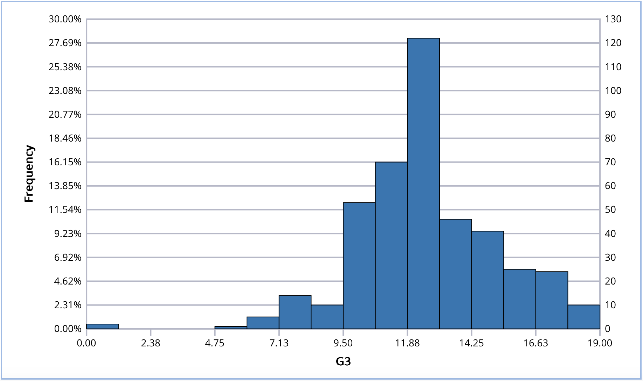
G1, G2, & G3:
No outliers removed
G1, G2, & G3 are non-cumulative grades → 0s are possible
Notes:
ORIANNE

Slide 10
Step 3 → Frequency Tables checked for categorical tables
Somewhat even distribution within all categories
No combining done
Step 4 → Dummy variables were made for categorical variables.
Binary variables were reduced to one dummy variable.
Step 5 → Correlation check
High correlation between guardian_father and guardian_mother (-0.87)
Guardian_father was removed
Notes:
ORIANNE

Slide 11
03
Multiple Linear Regression (MLR)

Slide 12
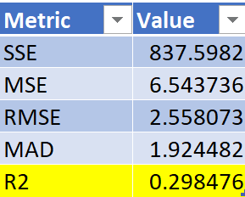
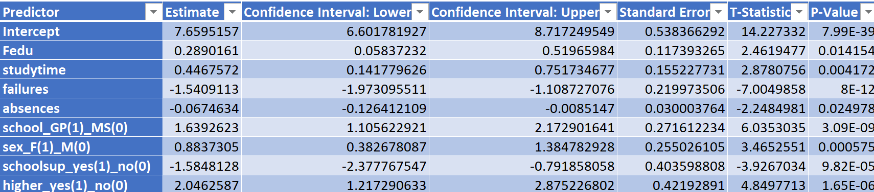
MLR: Forward Selection
01
02
03
04
Beta Values:
Y= 7.66 + 0.289x₁+ 0.447x₂ - 1.541x₃ - 0.067x₄ + 1.639x₅ + 0.884x₆- 1.585x₇ + 2.046x₈
29.85% of the variation in the target variable is explained by the model.
R²:
P-Values:
Predictive Performance
The model provides some predictive value, is statistically valid, and gives directional insights. Could include more contributing variables.
However, it is not highly accurate for precise prediction.
Notes:
Including G1 and 2 led to an extremely high R^2 and the goal was to be able to predict G3 without any knowledge of prior performance. Our GOAL: Predict the final grade of a student based on a student’s lifestyle, habits, and environment
Beta Values: after selecting the best subset, which is selected through observing R2 and Mallow’s cp, were including beta values of fathers education, study time, failures, absences, school support, the sex, and if the student plans to pursue a higher education and an intercept of 7.66 (variables 6 through 8 in the equation use dummy variables 1 and 0)
The R2 had a result of 0.2985, indicating that 29.85% of the variation in the target variable is explained by the model
P-Values: The p-values displayed are predictors that are statistically significant, as we used forward selection to select best subset of variables
Predictive Performance: The model provides some predictive value, is statistically valid, and gives directional insights. Could include more contributing variables.
However, it is not highly accurate for precise prediction.
ASHLEY

Slide 13
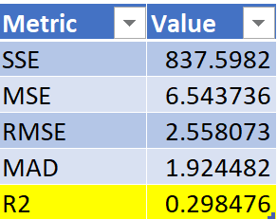
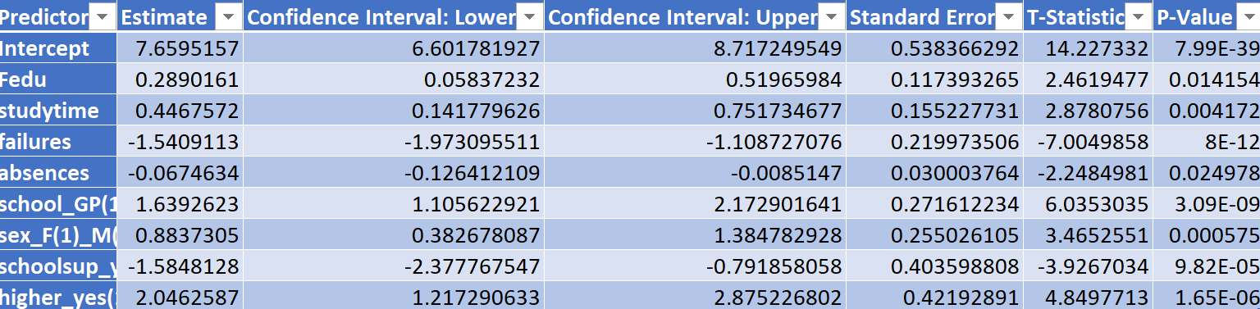
MLR: Stepwise Selection
01
02
03
04
Beta Values:
Y= 7.66 + 0.289x₁+ 0.447x₂ - 1.541x₃- 0.067x₄ + 1.639x₅ + 0.884x₆- 1.585x₇ + 2.046x₈
R²:
29.85% of the variation in the target variable is explained by the model.
P-Values
Prediction Performance
The model has moderate predictive power. The significant predictors are logically consistent with academic performance drivers like study time, academic failures, and educational aspirations.
Notes:
Stepwise selection had similar results to forward selection. Here are some key differences:
When looking at the BETA VALUES we have the same variables selected as compared to the forward selection. The linear regression equation includes the beta values for the variables selected after clicking best subset. The noticeable difference would be the intercept of 7.659
R2: The r2 is 0.2985 suggesting, 29.85% of the variance in the outcome is explained by the model.
P-values:The p-values displayed are predictors that are statistically significant, as we used forward selection to select best subset of variables and present how these variables have an effect towards the outcome
Prediction Performance: The model has moderate predictive power. The significant predictors are logically consistent with academic performance drivers like study time, academic failures, and educational aspirations.
ASHLEY and HANNA

Slide 14
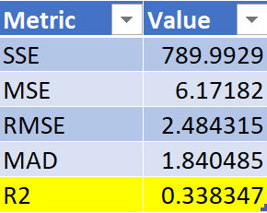
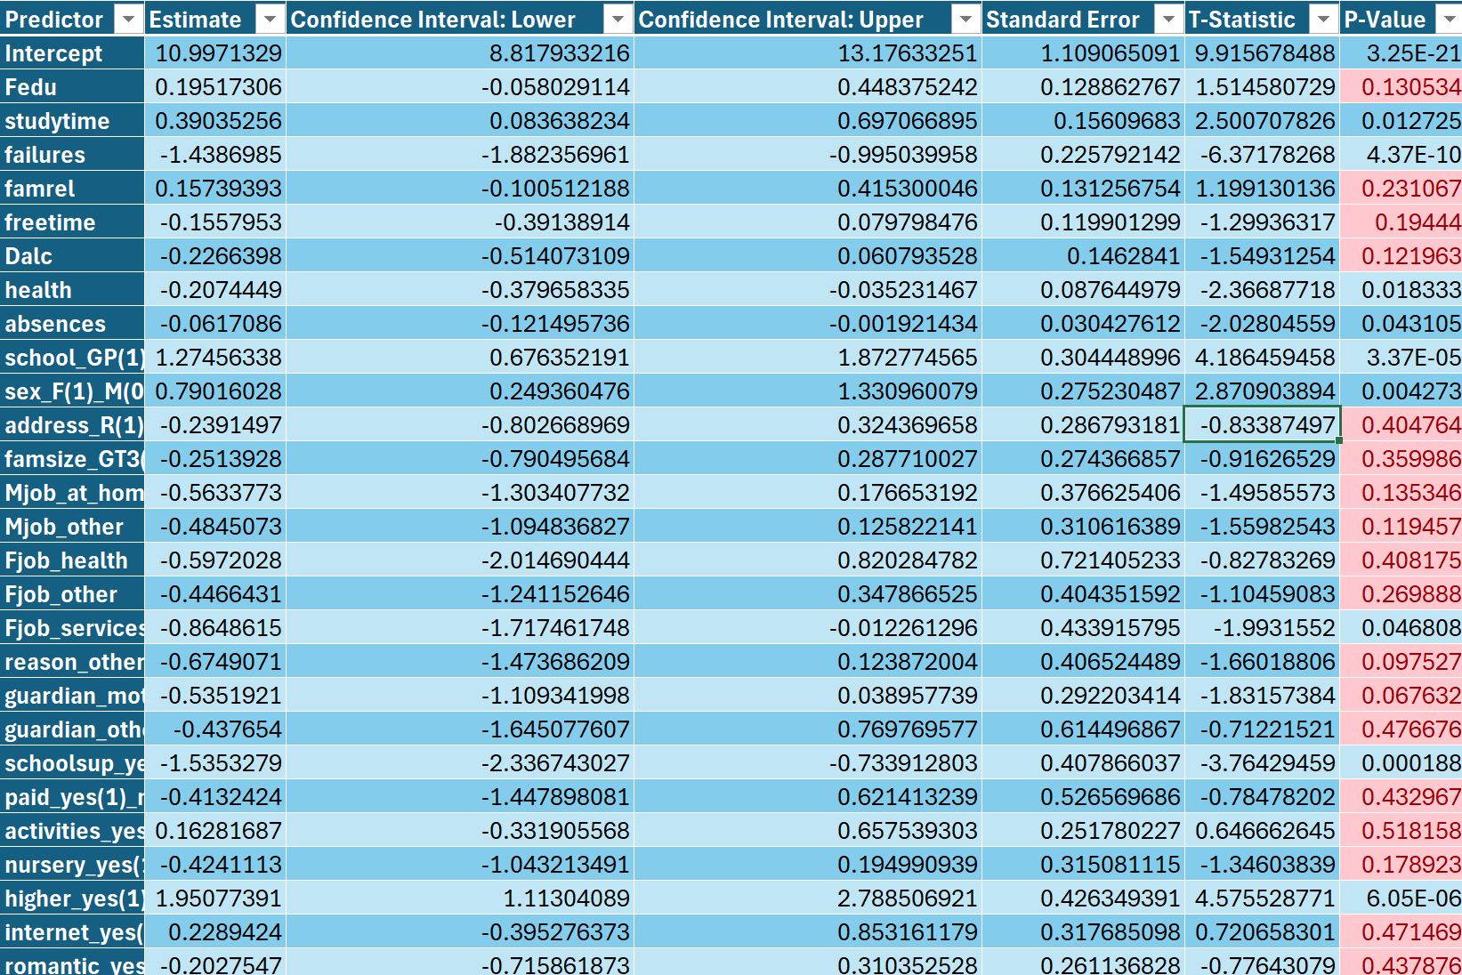
MLR: Backward Selection
01
02
03
04
Beta Values
Y= 10.997 + 0.195x₁+ 0.390x₂ - 1.439x₃+ 1.157x₄ -0.155x₅ …- 0.203x₂₇
R²
33.83% of the variation in the target variable is explained by the model.
P-Values
Prediction Performance
Key academic and demographic features like study time, academic failures, school, gender, and future education goals—are significant predictors. With a moderate R². This selection method has the lowest RMSE.
Notes:
Beta Values: after selecting the best subset there was noticeable difference in coefficients and there is an intercept of 10.99 , and 27 variables that contribute to the linear regression equation. But it was consistent with the previous variables such as fathers education, failures, study time, etc.
P-Values: The p-values displayed the ones highlighted in red indicate they are not statistically significant and are higher than 0.05, some added variables in this model with a statistically significant p-values include geological address/ location, relationship status, and health status.
R2
Predictive Performance: Key academic and demographic features like study time, academic failures, school, gender, and future education goals—are significant predictors. With a moderate R². However, this selection method has the lowest RMSE. This would be the best selection method as it also has a higher R2 given more selected variables.
ASHLEY

Slide 15
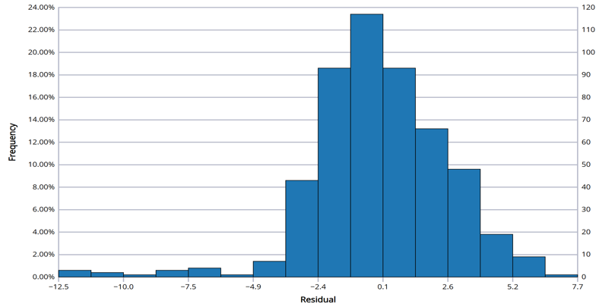
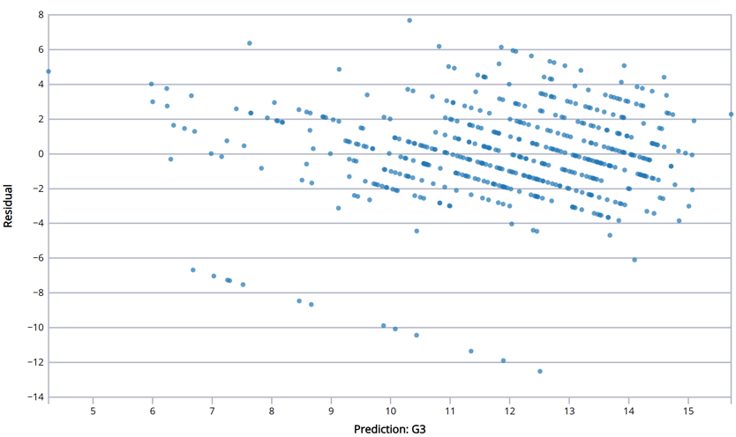
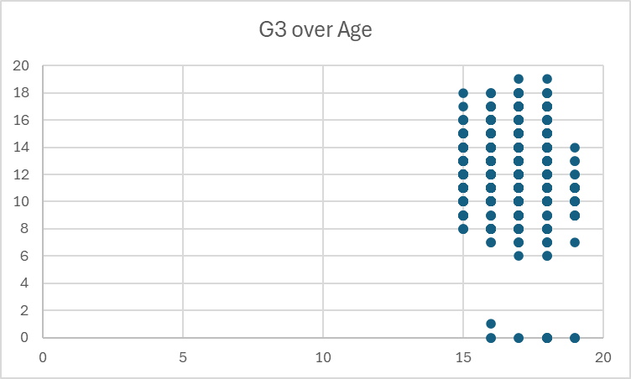
MLR: Backward Selection
check assumptions:
NORMALITY:
Normally distributed
LINEARITY:
The amount and degree of truly continuous data was limited. Considering this, the data barely qualifies as linear
INDEPENDENCE/HOMOSCEDASTICITY:
Assumption of its independence is satisfied. Homoscedasticity appears to be slightly violated due to some residuals being dispersed.
Notes:
Now that we selected backwards selection due to analyzing the summary of data and having lowest RMSE. The histogram of residuals suggests that they are normally distributed. We continued to check assumptions. The scatter plot is of the residuals over fitted grade, it suggests that the independence assumption is met, as residuals are randomly scattered. However, homoscedasticity is violated, with residual variance decreasing as predicted values increase, indicating potential issues with unequal error spread.
ASHLEY

Slide 16
04
k-Nearest Neighbors
Notes:
DAVIN

Slide 17
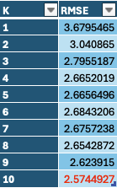
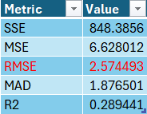
kNN: All Variables
01
The machine shows that Root Mean Squared Error is lowest at 10 nearest neighbors.
Because this is a prediction model, we can go ahead and use even K values.
02
R²:
28.94% of the variation in the target variable is explained by the model.
03
The model provides some predictive value, is statistically valid, and gives directional insights. However, it is not highly accurate for precise prediction.
Validation: Prediction Summary
Notes:
DAVIN

Slide 18
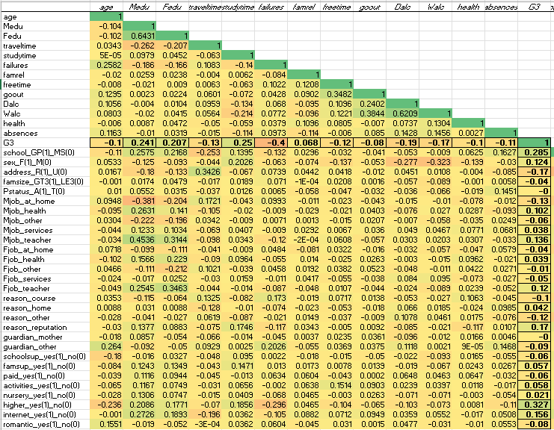
kNN: Screened Variables
.05
3 Different Correlation Cutoff Methods
.10
.15
Notes:
DAVIN

Slide 19
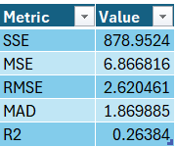
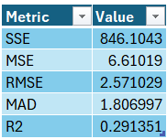
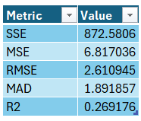
7 Variables Removed
R^2: .2638
Removing variables that had a less than 5% correlation to the final grade actually resulted in decreased predictive power of the overall model
Correl
< 0.05 or < -.05
19 Variables Removed
R^2 : .2913
Removing variables that had less than 10% correlation to the final grade slightly increased the prediction power of the model
Correl
< .1 or < -.1
.15 Cutoff
31 Variables Removed
R^2 : .2692
Setting the cutoff at 15% correlation resulted in a loss of key variables and led to a significant drop in predictive power
Correl < 0.15 or < -0.15
Notes:
DAVIN

Slide 20


kNN: Variables from MLR
Stepwise
Forward
Backward
Higher RMSE
Lower R²
Higher RMSE
Lower R²
Lowest RMSE
Highest R²
Notes:
Brandon
Stepwise: RMSE: 2.5581 → R2: .2985; Removal of least relevant predictors (keeping 8) for this model, but produced results with low prediction power.
Forward : RMSE: 2.5581 → R2: .2985 XLMiner uses the same variables as the stepwise model, thus producing identical results.
Backward: RMSE: RMSE: 2.4843 → R2: .3383 Outperformed both stepwise and forward models in fit and prediction accuracy. Most effective model overall. CHOSEN FOR KNN

Slide 21
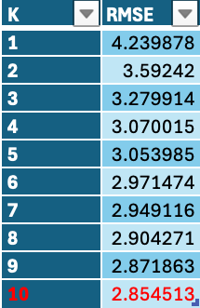
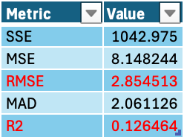
kNN: MLR Variables (Backward)
01
The machine shows that Root Mean Squared Error is lowest at 10 nearest neighbors.
Because this is a prediction model, we can go ahead and use even K values.
02
R²:
12.65% of the variation in the target variable is explained by the model.
The model provides some predictive value, is statistically valid, and gives directional insights. Could include more contributing variables. However, it is not highly accurate for precise prediction.
03
Validation: Prediction Summary
Notes:
Brandon

Slide 22
05
Regression Trees
Notes:
DAVIN

Slide 23
Best Pruned Tree
Parameters
Limits
Variables
Standard XLMiner parameters used (Maximum number of levels = 7).
No additional limits were placed because sample size is small.
Failures, Higher (if a student is planning on pursuing higher education), Absences, and School GPA.
Notes:
ORIANNE

Slide 24
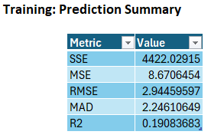
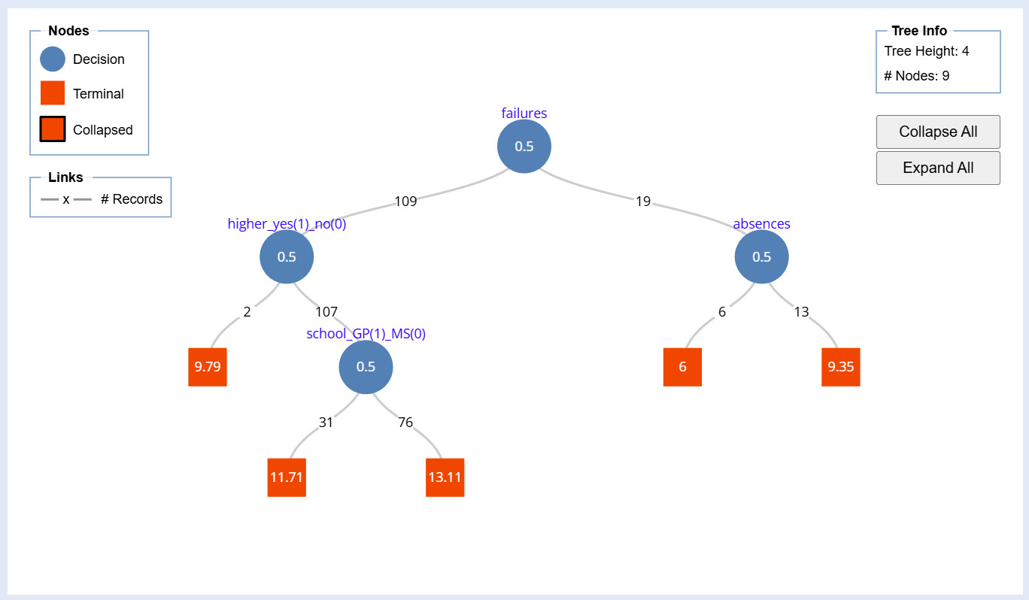
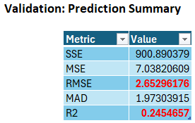
Notes:
ORIANNE
Abnormality: R^2 is higher on validation than on training. RMSE is lower on validation than on training.
Interpretation:
Left branch of failures (no failures)
Left branch of higher (no higher education, 0) → G3 = 9.79
Right branch of higher (yes higher education)
Left branch of school (school MS - Mousinho da Silveira, 0) → G3 = 11.71
Right branch of school (school GP - Gabriel Pereira, 1) → G3 = 13.11
Right branch of failures (more than 1 failure)
Left branch of absences (no absences, 0) → G3 = 6
Right branch of absences (one or more absence, 1) → G3 = 9.35

Slide 25
Minimum Error Tree
Parameters
Limits
Variables
Standard XLMiner parameters used (Maximum number of levels = 7).
No additional limits were placed because sample size is small.
Failures.
Notes:
ORIANNE

Slide 26
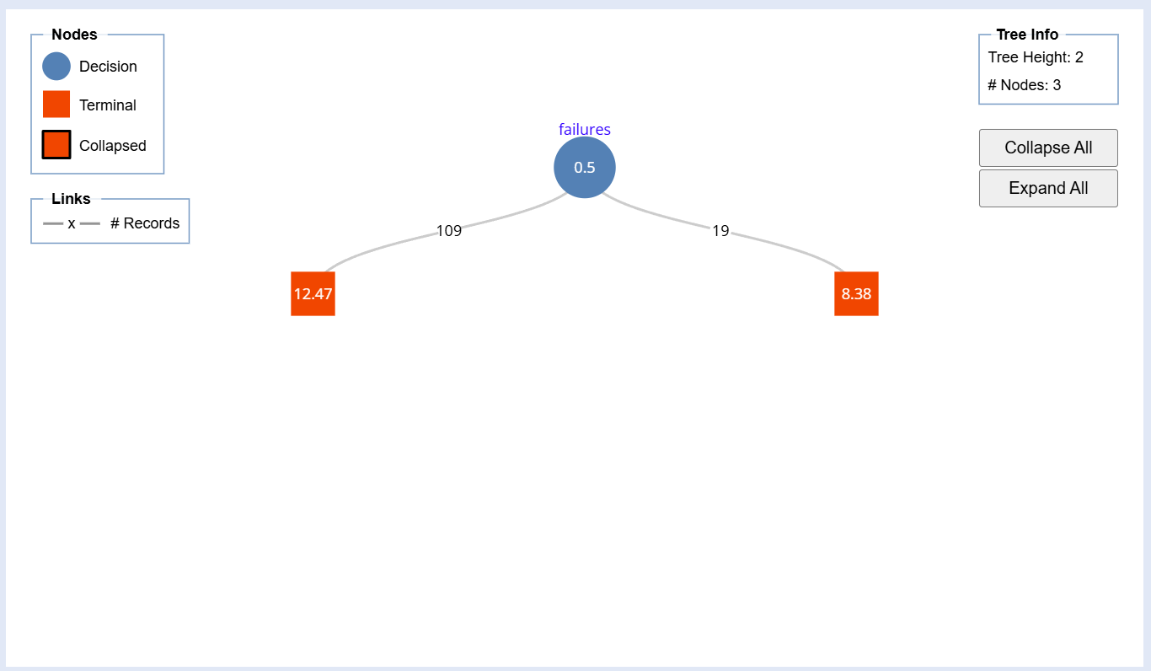
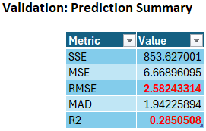
Notes:
ORIANNE
RMSE is 2.6 and R^2 is 29%.
Interpretation:
Left branch of failures (0 failures) → 12.47
Right branch of failures (1+ failures) → 8.38
Conclusion: Lower R^2 in comparison to other models, not the best model for prediction

Slide 27
06
Discussion
Notes:
DAVIN

Slide 28
Key Insights & Findings
Resource Access & Ambition
Students with access to internet & the desire for higher education —> perform better
Impact of Parental Background & Social Behavior
Parental education → student performance
Performance can be impacted negatively from social outings
Machine Learning Effectiveness
MLR, Regression Trees, and kNN → used
Backward MLR or kNN with screened variables (-.1/.1) → best models
Notes:
TAYLOR

Slide 29
Comparison - MLR
Source: Student Academic Performance Prediction using Classification and Regression.
R
Variables: ALL variables (even those with high p-values)
R^2 = 84.43%
RMSE = 1.624
Discrepancies: Due to methodology. All variables were included, including G1 and G2. Variables with the lowest p-values in this model are failures, paid (extra paid class within course subject), famsup (family support), health, absences, G1 and G2.
Similarities: Variables included in our model (significant variables), included failures and absences.
Notes:
https://rpubs.com/Shuhxian123/1137519
ORIANNE

Slide 30
Comparison - kNN
Source: Hulela, B. (2025). Using K-Nearest Neighbors for Student Performance Regression.
Python
Nearest neighbors chosen → 5
Variables: Socioeconomic score (indicated the socioeconomic status of the student; how this was calculated was not specified), study hours, sleep hours, attendance (%), grades (G3 as a %)
Split → 80% training, 20% validation
R^2 = 92.6%
Discrepancies: Due to methodology. Socioeconomic score, taken from the other variables, were combined into one variable. Data standardization was done differently.
Notes:
https://medium.com/@brianhulela/using-k-nearest-neighbors-for-student-performance-regression-fd5c58155c06
ORIANNE and HANNA

Slide 31
Comparison - Decision Trees
Source: Neelamegam, A.S & Soundain, K.. (n.d.). Student Performance Prediction using Machine Learning Models
R
Response variable “Passed” was added. Scores above 9.99 were determined to be passing.
Variables used: age, Medu, Fedu, traveltime, studytime, failures, famrel (quality of family relationships), freetime, goout (going out with friends), Dalc, Walc, health, absences, and passed.
Split → 75% training, 25% validation
R^2 = 89.57%
Discrepancies: Due to methodology. Specific variables were used that appealed to their common sense; meanwhile we used all variables in our models. “Passed” was also added with the intention of improving prediction.
Similarities: G1 and G2 were removed because of their high correlation with G3.
Notes:
https://rpubs.com/krithiha/709739
ORIANNE

Slide 32
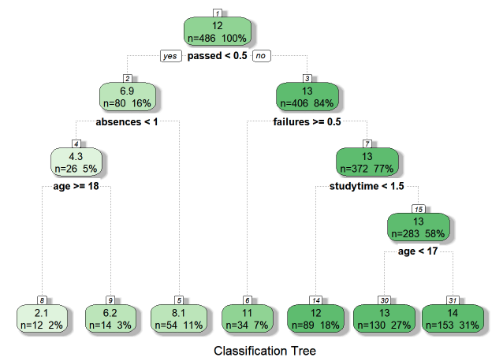
Comparison - Decision Trees
Notes:
ORIANNE and HANNA

Slide 33
Implications
Theory
Results align with similar studies
Refer to Comparisons
Practice
School Wi-Fi initiatives
Academic Advising
Policy
Social Outing Policies
Notes:
DAVIN and HANNA
Theoretical Implications: Our findings are consistent with the 2008 study by P. Cortez and A.M. Silva, which highlighted how social factors—such as parental education and alcohol use—can significantly influence student performance in secondary schools. Similarly, in our analysis of students from the Portuguese school, we observed that social influences played a role in shaping academic outcomes. Additionally, when comparing our results to the data mining study on student performance by Nahar, Shova, and Ria, we recognized that the variables used in our project may not be the most effective predictors of student grades, suggesting room for further refinement in future research.
Practical Implications: Based on insights from the best-performing model, the school could initiate a study to ensure that all students have reliable access to Wi-Fi. Additionally, they could conduct checks across different campus areas to confirm consistent internet availability throughout the entire school. The school could also post the wifi connection process on the school website to make it easy for students to join the network.
Policy Implications:
The findings suggest that frequent social outings are negatively associated with student grades. As a result, the school may consider revisiting its policies on social events or reevaluating funding for clubs centered on socialization. While such measures could potentially improve academic performance, it’s important to strike a balance—overly restrictive policies may lead students to feel unsupported or overly controlled.

Slide 34
Limitations
Very few continuous predictors, categorical predictors were not highly correlated to output variable
Overall Content
Lack of background information about dataset
G1, G2, G3 were not explicitly defined. Cumulative, general association
Guardian vs PTstatus
Overlapping predictors
Notes:
HANNA

Slide 35
Future Works
External Datasets
Include Additional Predictors
Avenues for future research to build upon your findings or address unresolved questions
Compare to other datasets
  See if the model works on students from other schools or places
  Helps check if the results are true for more than one group
  Use real-world education data
More relevant and nuanced predictors
  Psychological and Behavioral
  Sleep Patterns and Screen Time
  Socioeconomic Details
Notes:
Brandon
Although our model performed moderately well within this dataset, it’s essential to test whether it works in other settings. This is where external validation comes in. By applying the model to new data whether from another school, region, or even year, we check if its predictive power holds up (performs well and appropriately).
This helps us determine if the factors we’ve identified are genuinely impactful or just specific to this sample.
To address unresolved questions: Include → additional predictors
These relevant predictors could look like psychological and behavioral factors such as providing stress levels.
Sleep patterns and average screen time per day can be insightful to a student’s performance
Socioeconomic details, although we were provided variables regarding family and parents occupations it could be insightful to be provided with household income amount

Slide 36
Thank You!

