Slide 1
Introduction to Git and GitHub
General Assembly – Data Science

Slide 2
Agenda
Introduction
Exploring GitHub
Using Git with GitHub
Updating a Local Repo from GitHub
Assorted Tips

Slide 3
I. Introduction

Slide 4
Why learn version control?
Useful to have a formal system for tracking different versions of your work
Especially useful when you write code
Enables teams to easily collaborate on the same codebase
Enables you to contribute to open source projects
Attractive skill for employment

Slide 5
What is Git?
Version control system that allows you to track files and file changes in a repository ("repo")
Primarily used by software developers
Most widely used version control system
Alternatives: Mercurial, Subversion, CVS
Runs from the command line (usually)
Can be used alone or in a team

Slide 6
What is GitHub?
A website, not a version control system
Allows you to put your Git repos online
Largest code host in the world
Alternative: Bitbucket
Benefits of GitHub:
Backup of files
Visual interface for navigating repos
Makes repo collaboration easy
"GitHub is just Dropbox for Git"
Note: Git does not require GitHub

Slide 7
Git can be challenging to learn
Designed (by programmers) for power and flexibility over simplicity
Hard to know if what you did was right
Hard to explore since most actions are "permanent" (in a sense) and can have serious consequences
We'll focus on the most important 10% of Git

Slide 8
II. Exploring GitHub

Slide 9
Navigating a GitHub repo (1 of 2)
Example repo: https://git.generalassemb.ly/DATDC31/course-info
Account name, repo name, description
Folder structure
Viewing files:
Rendered view (with syntax highlighting)
Raw view
README.md:
Describes a repo
Automatically displayed
Written in Markdown

Slide 10
Navigating a GitHub repo (2 of 2)
Commits:
One or more changes to one or more files
Revision highlighting
Commit comments are required
Most recent commit comment shown by filename
Profile page

Slide 11
Creating a repo on GitHub
Click "Create New" (plus sign):
Define name, description, public or private
Initialize with README (if you're going to clone)
Notes:
Nothing has happened to your local computer
This was done on GitHub, but GitHub used Git to add the README.md file

Slide 12
Basic Markdown
Easy-to-read, easy-to-write markup language
Usually (always?) rendered as HTML
Many implementations (aka "flavors")
Let's edit README.md using GitHub!
Common syntax:
## Header size 2
*italics* and **bold**
[link to GitHub](https://github.com)
* bullet
`inline code` and ```code blocks```
Valid HTML can also be used within Markdown

Slide 13
III. Using Git with GitHub

Slide 14
Preview of what you're about to do
Copy your new GitHub repo to your computer
Make some file changes locally
Save those changes locally ("commit" them)
Update your GitHub repo with those changes

Slide 15
Cloning your new GitHub repo
Cloning = copying to your local computer
Like copying your Dropbox files to a new machine
First, change your working directory to where you want the repo to be stored locally: cd
Then, clone the repo: git clone <URL>
Get URL from GitHub (ends in .git)
Clones to a subdirectory of the working directory
No visual feedback when you type your password
Navigate to the repo (cd), then list the files (ls)

Slide 16
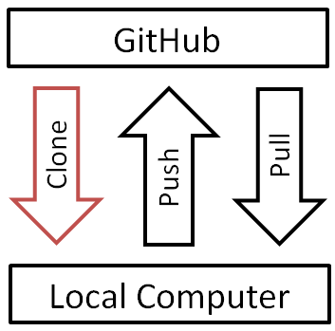
GitHub workflow diagram

Slide 17
Checking your remotes
A "remote alias" is a reference to a repo not on your local computer
Like a connection to your Dropbox account
View remotes: git remote -v
"origin" remote was set up by "git clone"
Note: Remotes are repo-specific

Slide 18
Making changes, checking your status
Making changes:
Modify README.md in any text editor
Create a new file: touch <filename>
Check your status:
git status
File statuses (possibly color-coded):
Untracked (red)
Tracked and modified (red)
Staged for committing (green)
Committed

Slide 19
Staging and committing changes
Stage changes for committing:
Add a single file: git add <filename>
Add all "red" files: git add -A
Check your status:
Red files have turned green
Commit changes:
git commit -m "message about commit"
Check your status again!
Check the log: git log

Slide 20
Pushing changes to GitHub
Everything you've done to your cloned repo (so far) has been local
You've been working in the "master" branch
Push committed changes to GitHub:
Like syncing local file changes to Dropbox
git push <remote> <branch>
Often: git push origin master
Refresh your GitHub repo to check!

Slide 21
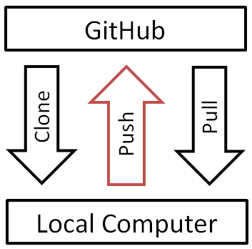
GitHub workflow diagram

Slide 22
Quick recap of what you've done
Created a repo on GitHub
Cloned repo to your local computer (git clone)
Automatically sets up your "origin" remote
Made two file changes
Staged changes for committing (git add)
Committed changes (git commit)
Pushed changes to GitHub (git push)
Inspected along the way (git remote, git status, git log)

Slide 23
Let's do it again!
Modify or add a file, then git status
git add <filename>, then git status
git commit -m "message"
git push origin master
Refresh your GitHub repo

Slide 24
IV. Updating a Local Repo from GitHub

Slide 25
Changes being made remotely
So far, repo changes have been made on your local machine and then pushed to GitHub
What if you clone someone else's GitHub repo, and then they make changes to it?
Git does not automatically update your local repository with remote changes

Slide 26
Pulling changes from GitHub
Git allows you to manually "pull" changes from remote locations
Like syncing your local files from Dropbox
git pull <remote> <branch>
Often: git pull origin master

Slide 27
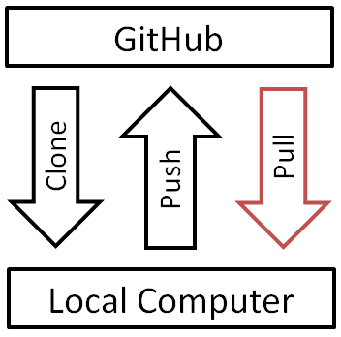
GitHub workflow diagram

Slide 28
Practice pulling from DAT31
Clone the DAT31 course-info repo:
git clone https://git.generalassemb.ly/DATDC31/course-info
Store it where you can find it easily
Don't store it inside another Git repo
Navigate to the repo (cd), then list the files (ls)
git pull origin master
I'll push a new change to course-info
Again: git pull origin master

Slide 29
When is pulling necessary?
Pulling is only necessary when changes have been made remotely but not locally
Most common scenario: repo is owned by someone else
Also common: you make changes to the same repo from multiple computers
Good habit to pull before you start working
No harm is done by pulling from a repo that hasn't changed

Slide 30
Merge conflicts
The most common problem when pulling is a "merge conflict": there is a conflict between the changes being merged and changes you have made locally
How to avoid merge conflicts:
If you want to edit DAT31 files, make copies and edit the copies instead
How to resolve a merge conflict:
Discard your changes: git checkout -- <filename>
Then try pulling again

Slide 31
V. Assorted Tips

Slide 32
Deleting or moving a repo
Deleting a GitHub repo:
Settings, then Delete
Deleting a local repo:
Just delete the folder!
Moving a local repo:
Just move the folder!

Slide 33
Gists: lightweight repos
You have access to Gist: gist.github.com
Can include one or more files
Useful for snippets, homework submissions
Can be public or secret (not private)
Let's create one right now!
Sharing the correct URL for a Gist
Supports online editing, cloning, committing, commenting, embedding, etc.

Slide 34
Excluding files from a repo
Create a ".gitignore" file in your repo: touch .gitignore
Specify exclusions, one per line:
Single files: pip-log.txt
All files with a matching extension: *.pyc
Directories: env/
Templates: github.com/github/gitignore

Slide 35
Two ways to initialize Git
Initialize on GitHub:
Create a repo on GitHub (with a README)
Clone to your local machine
This is what we did today (and what I recommend)
Initialize locally:
Initialize Git in an existing local directory: git init
Create a repo on GitHub (without a README)
Add remote: git remote add origin <URL>

Slide 36
Exiting Vim
Always include a message with your commit: git commit -m "message"
You will be taken to a text editor if you try to commit without a message: git commit
Default text editor is often Vim
How to exit Vim:
Hit Esc key (to enter command mode)
Type :q! (to quit without saving)
Hit Enter key

