Slide 1
Dissertation Proposal
Brandon Neth

Slide 2
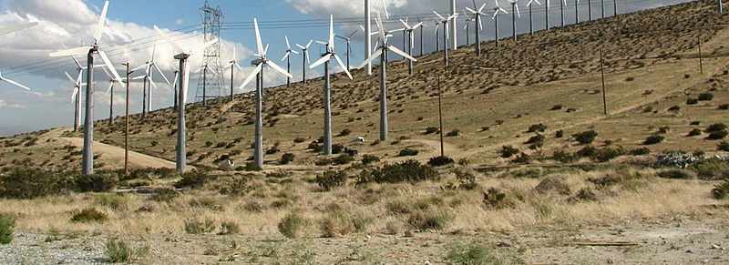
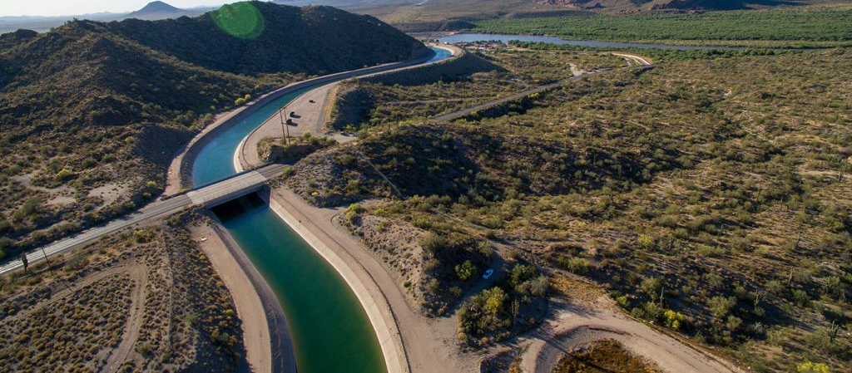
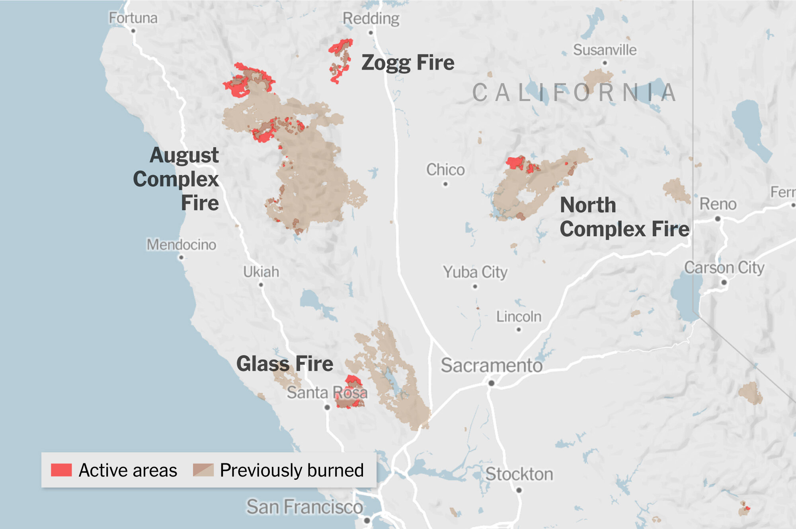
Computer Simulation and the Climate Crisis
Wind Farms
Watersheds
Extreme Weather / Natural Disaster
Intro
Context
GRQ
Example 1
Example 2
Notes:
Example 1: Wind farms
1.75 billion for 1000 MW
https://www.ans.org/news/article-638/the-economics-of-wind-power/
Example 2: Watersheds
Colorado River provides ~50% of Tucson’s water supply
Example 3: Wildfires / Extreme Weather
2020 wildfires destroyed 10,500 structures and 31 lives
wind: KTAR News
fire map: NYT
td font size

Slide 3

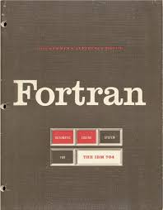




Developing Simulation Codes
Developer Productivity
How long does it take to write?
Execution-Time Performance
How long does it take to run?
Cross-system Portability
How much does performance change when run on a new system?
Intro
Context
GRQ
Example 1
Example 2
Notes:
C and Fortran are the least productive languages according to IFPUG
Runtime performance needs to be clear that its not about accuracy, its about execution time, TIME

Slide 4
Common Patterns: Data and Code
By-Hand
Schedule optimizations [1]
Problem: High developer cost
Compilers
Data layout for HPF and D [2]
CPU + GPU systems [3,4]
Problem: Lacks user control
Domain-Specific Languages
Image processing pipelines [5,6]
Sparse computations [7,8]
Problem: Complex build environments; codegen, compilation, linking at runtime
Libraries!
for(i=0; i < N; i++)
a[i] = b[i] + alpha * c[i];
for(i=0; i < N; i++)
e[i] = a[i] + alpha * d[i];
for(i=0; i < N; i++)
g[i] = e[i] + alpha * f[i];
Intro
Context
GRQ
Example 1
Example 2
Notes:
By-Hand
Schedule optimizations (Olschanowsky et al 2014)
Problem: High developer cost
Compilers
Data layout for HPF and D (Kennedy and Kremer 1998)
CPU + GPU systems (Jaeger and Barthou 2012, Majeti et al 2013)
Problem: Lacks user control
Domain-Specific Languages
Image processing pipelines (Ragen-Kelley et al 2013; Mullapudi, Vasista, and Bondhugula 2015)
Sparse computations (Kjolstad et al 2017; Hu et al 2019)
Problem: Complex build environment and runtime requirements

Slide 5
Proposed Dissertation
Research Question: How do we enable program analyses and transformations across loops within the constraints of a performance-portable parallel library rather than a compiler?
Intro
Context
GRQ
Example 1
Example 2

Slide 6

Example: Scheduling Across Loops
for(i=0; i < N; i++)
a[i] = b[i] + alpha * c[i];
for(i=0; i < N; i++)
e[i] = a[i] + alpha * d[i];
for(i=0; i < N; i++)
g[i] = e[i] + alpha * f[i];
for(i=0; i < N; i++)
a[i] = b[i] + alpha * c[i];
e[i] = a[i] + alpha * d[i];
g[i] = e[i] + alpha * f[i];
program analysis and transformation
Intro
Context
GRQ
Example 1
Example 2
Notes:
Put a cue in the margin that this is background and it needs to be understood before moving on
(slide 6) - I would make sure the arrows between the dots and the code are the same color
(slide 6) - I forget what colors are bad for colorblind people but I'd make sure the ones you chose work

Slide 7
Example: Data Layouts
Row-major, Memory
0,0 | 0,1 | 0,2 | 0,3 | 1,0 | 1,1 | 1,2 | 1,3 | 2,0 | 2,1 | 2,2 | 2,3 | 3,0 | 3,1 | 3,2 | 3,3
2D Data, Logical
0,0 | 0,1 | 0,2 | 0,3
1,0 | 1,1 | 1,2 | 1,3
2,0 | 2,1 | 2,2 | 2,3
3,0 | 3,1 | 3,2 | 3,3
Column-major, Memory
0,0 | 1,0 | 2,0 | 3,0 | 0,1 | 1,1 | 2,1 | 3,1 | 0,2 | 1,2 | 2,2 | 3,2 | 0,3 | 1,3 | 2,3 | 3,3
Intro
Context
GRQ
Example 1
Example 2

Slide 8
Example: Data Layouts
0,0 | 0,1 | 0,2 | 0,3 | 1,0 | 1,1 | 1,2 | 1,3 | 2,0 | 2,1 | 2,2 | 2,3 | 3,0 | 3,1 | 3,2 | 3,3
Row-major, Memory
0,0 | 0,1 | 0,2 | 0,3 | 1,0 | 1,1 | 1,2 | 1,3 | 2,0 | 2,1 | 2,2 | 2,3 | 3,0 | 3,1 | 3,2 | 3,3
2D Data, Logical
j
0,0 | 0,1 | 0,2 | 0,3
1,0 | 1,1 | 1,2 | 1,3
2,0 | 2,1 | 2,2 | 2,3
3,0 | 3,1 | 3,2 | 3,3
0,0 | 0,1 | 0,2 | 0,3
1,0 | 1,1 | 1,2 | 1,3
2,0 | 2,1 | 2,2 | 2,3
3,0 | 3,1 | 3,2 | 3,3
i
for i:
for j:
A(i,j)...
0,0 | 1,0 | 2,0 | 3,0 | 0,1 | 1,1 | 2,1 | 3,1 | 0,2 | 1,2 | 2,2 | 3,2 | 0,3 | 1,3 | 2,3 | 3,3
Column-major, Memory
0,0 | 1,0 | 2,0 | 3,0 | 0,1 | 1,1 | 2,1 | 3,1 | 0,2 | 1,2 | 2,2 | 3,2 | 0,3 | 1,3 | 2,3 | 3,3
Intro
Context
GRQ
Example 1
Example 2
Notes:
CPUs don’t want to communicate, GPUs want to coalesce accesses

Slide 9
Example: Data Layouts
0,0 | 0,1 | 0,2 | 0,3 | 1,0 | 1,1 | 1,2 | 1,3 | 2,0 | 2,1 | 2,2 | 2,3 | 3,0 | 3,1 | 3,2 | 3,3
Row-major, Memory
0,0 | 0,1 | 0,2 | 0,3 | 1,0 | 1,1 | 1,2 | 1,3 | 2,0 | 2,1 | 2,2 | 2,3 | 3,0 | 3,1 | 3,2 | 3,3
2D Data, Logical
k
0,0 | 0,1 | 0,2 | 0,3
1,0 | 1,1 | 1,2 | 1,3
2,0 | 2,1 | 2,2 | 2,3
3,0 | 3,1 | 3,2 | 3,3
0,0 | 0,1 | 0,2 | 0,3
1,0 | 1,1 | 1,2 | 1,3
2,0 | 2,1 | 2,2 | 2,3
3,0 | 3,1 | 3,2 | 3,3
l
for k:
for l:
... A(l,k) ...
0,0 | 1,0 | 2,0 | 3,0 | 0,1 | 1,1 | 2,1 | 3,1 | 0,2 | 1,2 | 2,2 | 3,2 | 0,3 | 1,3 | 2,3 | 3,3
Column-major, Memory
0,0 | 1,0 | 2,0 | 3,0 | 0,1 | 1,1 | 2,1 | 3,1 | 0,2 | 1,2 | 2,2 | 3,2 | 0,3 | 1,3 | 2,3 | 3,3
Intro
Context
GRQ
Example 1
Example 2
Notes:
Later in the program, A may be accessed in a different order
No matter which layout we choose, one of the loops will lose performance

Slide 10
Data Layout for Matrix Multiplication, CPU
Lower is better
N = M = L = 2048
for(i=0; i < N; i++)
for(j=0; j < M; j++)
for(k=0; k < L; k++)
C(i,j) += A(i,k) * B(k,j);
Intro
Context
GRQ
Example 1
Example 2
Notes:
CPUs good for giving each thread its own chunk of data
GPU will perform better when they get data thats together
the transformation is worth it because of how much we traverse the data. Would’nt be necessarily a good transform if its not doing that third loop
IBM Power9 Architecture, 44 cores/node
2 IBM POWER9 processors (dual socket), 22 cores each
likely 4 hardware threads per core, so 88 threads per node
L1 32kb per core 8-way private
L2 512kb per core, 8-way private
L3 120mb, 20-way, shared as 12 10MB banks

Slide 11
Proposed Dissertation
Research Question: How do we enable program analyses and transformations across loops within the constraints of a performance-portable parallel library rather than a compiler?
Runtime overhead
Host language
Library idioms
Part 1: Optimizing Schedules Across Loops
Part 2: Optimizing Data Layouts Across Loops
Part 3: Optimizing Sparse Data Layouts Across Loops
Completed
In Progress
Proposed

Slide 12
Part 1: Optimizing Schedules Across Loops
Context: Considering loops independently leaves performance on the table
Problem: Parallel libraries cannot express transformations across multiple loops (fusion, overlapped tiling)
Research Questions:
Q1.1: How do we provide an interface for expressing inter-loop transformations?
Q1.2: How do we analyze the loops to ensure that a transformation is safe to apply?
Q1.3: How do we reduce runtime overhead from analysis and transformation?
Answers:
A1.1: Transformation API available to user
A1.2: Symbolic program analysis through library data abstractions
A1.3: Run analysis once, reuse results
Q1.1: Interface
Q1.2: Safety
Q1.3: Overhead

Slide 13
Computation Objects and Transformation API
for(i=0; i < N; i++)
a[i] = b[i] + alpha * c[i];
for(i=0; i < N; i++)
e[i] = a[i] + alpha * d[i];
for(i=0; i < N; i++)
g[i] = e[i] + alpha * f[i];
body1 = [=](auto i) {
a[i] = b[i] + alpha * c[i];
};
body2 = [=](auto i) {
e[i] = a[i] + alpha * d[i];
};
body3 = [=](auto i) {
g[i] = e[i] + alpha * f[i];
};
knl1 = make_kernel(body1, 0, N);
knl2 = make_kernel(body2, 0, N);
knl3 = make_kernel(body3, 0, N);
transformed = fuse(knl1, knl2, knl3);
transformed();
Q1.1: Interface
Q1.2: Safety
Q1.3: Overhead
Notes:
Let's start with an example of how a programmer might specify the loop fusion transformation from our earlier example. Next, we'll take a look at how we make sure that transformation is safe to apply

Slide 14
Staying Safe with Runtime Symbolic Evaluation
Regular iterator values
a
0 | 3 | 0 | 3 | 4 | 1
0 | 0 | 0 | 0 | 0 | 0
body(1);
b
0 | 1 | 0 | 0 | 0 | 0
body = [=](auto i) {
b(i) = (a(i-1) + a(i) + a(i+1)) / 3;
};
-
Read(a, )
Read(a, )
Read(a, )
Write(b, )
Symbolic iterator values
i
1
i
-
+
b( ) = (a( ) + a( ) + a( )) / 3;
i
i
+
i
1
i
1
i
1
body(new SymIter(“i”));
i
Q1.1: Interface
Q1.2: Safety
Q1.3: Overhead
Notes:
With our transformation written, let's see how we can make sure the transformation is safe to apply.
Our technique relies on a common language feature called overloading. Overloading means defining the same functions and operators, like plus and assignment, for different types.
Here, we can see how this works for a lambda in C++. Notice that type for the lambda's argument is 'auto’. This means that the lambda can accept arguments of different types.

Slide 15
b( ) = a( -1) + a( ) + a( +1);
b( ) = b( ) / 3.0;
b(i) = a(i-1) + a(i) + a(i+1);
b(i) = b(i) / 3.0;
i
i
i
i
i
i
-
+
b( ) = a( ) + a( ) + a( );
b( ) = b( ) / 3.0;
i
i
1
i
i
1
i
i
-
+
Access{b, } = Access{a, } + Access{a, } + Access{a, };
b( ) = b( ) / 3.0;
i
1
i
i
i
1
i
i
-
+
Access{b, } = AccessList[Access{a, }, Access{a, }, Access{a, }];
b( ) = b( ) / 3.0;
i
i
i
1
i
1
i
i
Access Collector
-
+
Write{b, } = AccessList[Read{a, }, Read{a, }, Read{a, }];
b( ) = b( ) / 3.0;
Access{a,i-1}
i
i
Read{a,i-1}
i
1
i
1
i
i
Access{a,i}
Read{a,i}
Read{a,i+1}
b( ) = b( ) / 3.0;
Access{a,i+1}
i
i
Access{b, } = Access{b, } / 3.0;
Access{b,i}
Write{b,i}
i
i
Access{b,i}
Access{b, } = AccessList[Access{b, }];
Read{b,i}
i
i
Write{b, } = AccessList[Read{b, }];
Access{b,i}
i
i
Write{b,i}

Slide 16
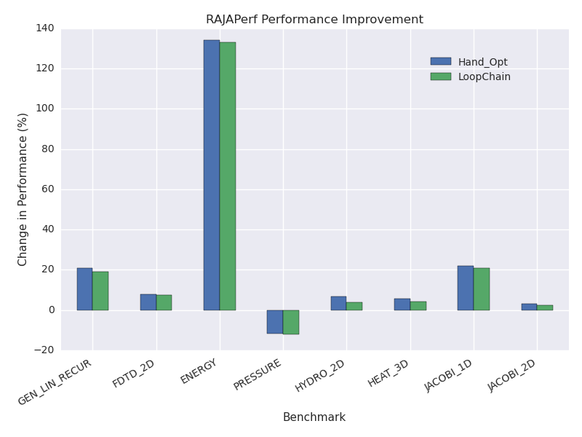
Evaluation: RAJAPerf
Higher is better
Transformed by Hand
Transformed via API
Benchmark | Manual Implementation |  | RAJALC Implementation
 | Changed | Added | Changed | Added
Fusion
ENERGY | 6 | 6 | 6 | 2
PRESSURE | 2 | 3 | 2 | 2
GEN_LIN_RECUR | 1 | 1 | 2 | 2
FDTD_2D | 8 | 4 | 9 | 4
Average | 4.25 | 3.5 | 4.75 | 2.5
Overlapped Tiling
HYDRO_2D | 4 | 41 | 3 | 2
JACOBI_1D | 3 | 17 | 3 | 3
JACOBI_2D | 10 | 33 | 10 | 3
HEAT_3D | 12 | 38 | 12 | 3
Average | 7.25 | 32.25 | 7 | 2.75
Q1.1: Interface
Q1.2: Safety
Q1.3: Overhead
Notes:
SLOW DOWN
Way bigger charts
Draw right onto the charts
"Library implemenatation"
IBM Power9 Architecture, 44 cores/node
2 IBM POWER9 processors (dual socket), 22 cores each
likely 4 hardware threads per core, so 88 threads per node
L1 32kb per core 8-way private
L2 512kb per core, 8-way private
L3 120mb, 20-way, shared as 12 10MB banks

Slide 17
Proposed Dissertation
Research Question: How do we enable program analyses and transformations across loops within the constraints of a performance-portable parallel library rather than a compiler?
Part 1 Published at ICS 2021
Part 1: Optimizing Schedules Across Loops
Part 2: Optimizing Data Layouts Across Loops
Part 3: Optimizing Sparse Data Layouts Across Loops
ICS 2021
Completed
In Progress
Proposed

Slide 18
Part 2: Data Layout Optimizations
Context: Different parts of a computation access the same data in different orders
Problem: Changing data layout mid-computation is laborious to implement and may not improve performance
Research Questions:
Q2.1: How do we expose layout transformation specification to the user?
Q2.2: How do we reduce runtime overhead due to problem setup and solve?
Proposed Answers:
A2.1: Declarative API for registering layouts and model for “filling in” choices
A2.2: Reuse profiling data, pre-prune model, restrict the modelled space
Q2.1: Interface
Q2.2 ILP Overhead

Slide 19
Data Layout Example, 3MM
F, row, knl1
F, col, knl1
auto knl1 = /* E = A*B */
auto knl2 = /* F = C*D */
auto knl3 = /* G = E*F */
auto chain = format_decisions(tie(B,D,F), knl1, knl2, knl3);
chain.set_format_before(B, col_major, knl1);
chain.set_format_before(D, col_major, knl2);
chain.set_format_before(F, row_major, knl2);
chain.set_format_before(F, col_major, knl3);
auto comp = chain.finalize();
comp();
F, row, knl2
F, col, knl2
F, row, knl3
F, col, knl3
F, row, out
F, col, out
[2]
Q2.1: Interface
Q2.2 ILP Overhead

Slide 20
Preliminary Results
Version | Objects | Layout Changes | Chosen By | Written With
Baseline | No | No | - | -
 | Yes | No | - | -
 | Yes | Yes | User | No API
 | Yes | Yes | User | API
 | Yes | Yes | Model | API
Lower is better
Q2.1: Interface
Q2.2 ILP Overhead
Notes:
go slow go slow go slow
Plots separated by whether there's data reuse to justify any transformation
GEMVER and MVT are evidence of the need to do some preliminary checks before launching the model

Slide 21
Proposed Dissertation
Research Question: How do we enable program analyses and transformations across loops within the constraints of a performance-portable parallel library rather than a compiler?
Part 1 Published at ICS 2021
Part 2 Rejected at ICS 2022, Resubmit Fall 2022
Part 1: Optimizing Schedules Across Loops
Part 2: Optimizing Data Layouts Across Loops
Part 3: Optimizing Sparse Data Layouts Across Loops
ICS 2021
Completed
In Progress
Proposed

Slide 22
Part 3: Sparse Data Formats
Context: Good format choice for sparse apps impacts algorithmic complexity and memory performance
Problem: RAJA couples data format, computation, schedule, and iteration space definitions too tightly for sparse apps
Research Questions:
Q3.1: How do we extend the decoupling of data, operation, schedule, and iteration space to sparse codes while maintaining idiomatically RAJA-like code?
Q3.2: How do we support efficient iteration through sparse data without the ability to rewrite the operation?
Q3.3: How do we formulate format selection as an ILP problem?
Proposed Answers:
A3.1: Symbolic iteration space API and format-agnostic computation description
A3.2: Dynamically selected indexing logic
A3.3: Sparsity metrics and asymptotic complexity

Slide 23
Sparse Format Example, COO(rdinate)
3.2 | 0 | 1.3 | 6.9 | 0 | 0
0.2 | 0 | 0 | 0 | 0 | 0
0 | 12 | 4.4 | 0 | 0 | 9.0
0 | 5.5 | 0 | 0 | 0 | 0
7.4 | 0 | 0 | 2.8 | 0 | 0
0 | 0 | 0 | 0 | 8.3 | 0
3.2 | 0 | 1.3 | 6.9 | 0 | 0
0.2 | 0 | 0 | 0 | 0 | 0
0 | 12 | 4.4 | 0 | 0 | 9.0
0 | 5.5 | 0 | 0 | 0 | 0
7.4 | 0 | 0 | 2.8 | 0 | 0
0 | 0 | 0 | 0 | 8.3 | 0
row
0 | 0 | 0 | 1 | 2 | 2 | 2 | 3 | 4 | 4 | 5
column
0 | 0 | 0 | 1 | 1 | 2 | 2 | 3 | 3 | 4 | 5
column
0 | 2 | 3 | 0 | 1 | 2 | 5 | 1 | 0 | 3 | 4
row
0 | 1 | 4 | 2 | 3 | 0 | 2 | 0 | 4 | 5 | 2
values
3.2 | 1.3 | 6.9 | 0.2 | 12 | 4.4 | 9.0 | 5.5 | 7.4 | 2.8 | 8.3
values
3.2 | 0.2 | 7.4 | 12 | 5.5 | 1.3 | 4.4 | 6.9 | 2.8 | 8.3 | 9.0

Slide 24
Row, Then Column
3.2 | 0 | 1.3 | 6.9 | 0 | 0
0.2 | 0 | 0 | 0 | 0 | 0
0 | 12 | 4.4 | 0 | 0 | 9.0
0 | 5.5 | 0 | 0 | 0 | 0
7.4 | 0 | 0 | 2.8 | 0 | 0
0 | 0 | 0 | 0 | 8.3 | 0
3.2 | 0 | 1.3 | 6.9 | 0 | 0
0.2 | 0 | 0 | 0 | 0 | 0
0 | 12 | 4.4 | 0 | 0 | 9.0
0 | 5.5 | 0 | 0 | 0 | 0
7.4 | 0 | 0 | 2.8 | 0 | 0
0 | 0 | 0 | 0 | 8.3 | 0
row
0 | 0 | 0 | 1 | 2 | 2 | 2 | 3 | 4 | 4 | 5
column
0 | 0 | 0 | 1 | 1 | 2 | 2 | 3 | 3 | 4 | 5
column
0 | 2 | 3 | 0 | 1 | 2 | 5 | 1 | 0 | 3 | 4
row
0 | 1 | 4 | 2 | 3 | 0 | 2 | 0 | 4 | 5 | 2
values
3.2 | 1.3 | 6.9 | 0.2 | 12 | 4.4 | 9.0 | 5.5 | 7.4 | 2.8 | 8.3
values
3.2 | 0.2 | 7.4 | 12 | 5.5 | 1.3 | 4.4 | 6.9 | 2.8 | 8.3 | 9.0

Slide 25
Column, Then Row
3.2 | 0 | 1.3 | 6.9 | 0 | 0
0.2 | 0 | 0 | 0 | 0 | 0
0 | 12 | 4.4 | 0 | 0 | 9.0
0 | 5.5 | 0 | 0 | 0 | 0
7.4 | 0 | 0 | 2.8 | 0 | 0
0 | 0 | 0 | 0 | 8.3 | 0
3.2 | 0 | 1.3 | 6.9 | 0 | 0
0.2 | 0 | 0 | 0 | 0 | 0
0 | 12 | 4.4 | 0 | 0 | 9.0
0 | 5.5 | 0 | 0 | 0 | 0
7.4 | 0 | 0 | 2.8 | 0 | 0
0 | 0 | 0 | 0 | 8.3 | 0
row
0 | 0 | 0 | 1 | 2 | 2 | 2 | 3 | 4 | 4 | 5
column
0 | 0 | 0 | 1 | 1 | 2 | 2 | 3 | 3 | 4 | 5
column
0 | 2 | 3 | 0 | 1 | 2 | 5 | 1 | 0 | 3 | 4
row
0 | 1 | 4 | 2 | 3 | 0 | 2 | 0 | 4 | 5 | 2
values
3.2 | 1.3 | 6.9 | 0.2 | 12 | 4.4 | 9.0 | 5.5 | 7.4 | 2.8 | 8.3
values
3.2 | 0.2 | 7.4 | 12 | 5.5 | 1.3 | 4.4 | 6.9 | 2.8 | 8.3 | 9.0

Slide 26
Sparse Format Example, CSC
3.2 | 0 | 1.3 | 6.9 | 0 | 0
0.2 | 0 | 0 | 0 | 0 | 0
0 | 12 | 4.4 | 0 | 0 | 9.0
0 | 5.5 | 0 | 0 | 0 | 0
7.4 | 0 | 0 | 2.8 | 0 | 0
0 | 0 | 0 | 0 | 8.3 | 0
column
0 | 0 | 0 | 1 | 1 | 2 | 2 | 3 | 3 | 4 | 5
row
0 | 1 | 4 | 2 | 3 | 0 | 2 | 0 | 4 | 5 | 2
values
3.2 | 0.2 | 7.4 | 12 | 5.5 | 1.3 | 4.4 | 6.9 | 2.8 | 8.3 | 9.0
column indices
0 | 3 | 5 | 7 | 9 | 10
row
0 | 1 | 4 | 2 | 3 | 0 | 2 | 0 | 4 | 5 | 2
values
3.2 | 0.2 | 7.4 | 12 | 5.5 | 1.3 | 4.4 | 6.9 | 2.8 | 8.3 | 9.0

Slide 27
Sparse Format Example, CSR
3.2 | 0 | 1.3 | 6.9 | 0 | 0
0.2 | 0 | 0 | 0 | 0 | 0
0 | 12 | 4.4 | 0 | 0 | 9.0
0 | 5.5 | 0 | 0 | 0 | 0
7.4 | 0 | 0 | 2.8 | 0 | 0
0 | 0 | 0 | 0 | 8.3 | 0
row
0 | 0 | 0 | 1 | 2 | 2 | 2 | 3 | 4 | 4 | 5
column
0 | 2 | 3 | 0 | 1 | 2 | 5 | 1 | 0 | 3 | 4
values
3.2 | 1.3 | 6.9 | 0.2 | 12 | 4.4 | 9.0 | 5.5 | 7.4 | 2.8 | 8.3
row indices
0 | 3 | 4 | 7 | 8 | 10
column
0 | 2 | 3 | 0 | 1 | 2 | 5 | 1 | 0 | 3 | 4
values
3.2 | 1.3 | 6.9 | 0.2 | 12 | 4.4 | 9.0 | 5.5 | 7.4 | 2.8 | 8.3

Slide 28
Part 3: Sparse Data Formats
Context: Good format choice for sparse apps impacts algorithmic complexity and memory performance
Problem: Parallel libraries couple data format, computation, schedule, and iteration space definitions too tightly for sparse apps
Research Questions:
Q3.1: How do we extend the decoupling of data, operation, schedule, and iteration space to sparse codes while maintaining the idioms of the library?
Q3.2: How do we support efficient iteration through sparse data without the ability to rewrite the operation?
Q3.3: How do we formulate format selection as an ILP problem?
Proposed Answers:
A3.1: Symbolic iteration space API and format-agnostic computation description
A3.2: Dynamically selected indexing logic
A3.3: Sparsity metrics and asymptotic complexity
Q3.1: Decoupling
Q3.2: Iteration
Q3.3: ILP Formulation

Slide 29
Sparse Iteration Spaces and Computation Description
auto loop_body = [=](auto i, auto j) {
x(i) = x(i) – A(i,j) * x(j);
};
auto i_dim = RangeSegment(0,N);
auto j_lt_i = RangeSegment(0,i_dim);
auto nonzero_A = A.nonzeros(1);
auto j_dim = j_lt_i && nonzero_A;
auto dims = tuple(i_dim, j_dim);
auto knl = make_kernel<POL>(loop_body, dims);
knl.set_format(A, Format::Dense);
knl.set_format(A, Format::CSR);
knl();
for(i = 0; i < N; i++) {
for(j = 0; j < i; j++) {
x(i) = x(i) – A(i,j) * x(j);
}
}
Dense
How much does the format of A
affect the structure of the code?
for(i = 0; i < N; i++) {
for(k = A.rowptr(i);
k < A.rowptr(i+1) && A.col(k) < i;
k++) {
x(i) = x(i) – A.val(k) * x(A.col(k));
}
}
CSR
Q3.1: Decoupling
Q3.2: Iteration
Q3.3: ILP Formulation
Notes:
Let's start with the interface for writing sparse computations. We'll do this by looking at two versions of the same code, implemented for different formats

Slide 30
Efficient Iteration Backend
Many other approaches perform a rewriting / code generation step, while this approach is built directly into the parallel library
Cannot “reach into” lambdas or change their operation, so efficient data traversal must be built into the call operator.
A(i,j)
Access Pattern
Indexing Behavior 1
Indexing Behavior 2
Logic Selector
...
Loop Schedule
Indexing Behavior N
Q3.1: Decoupling
Q3.2: Iteration
Q3.3: ILP Formulation

Slide 31
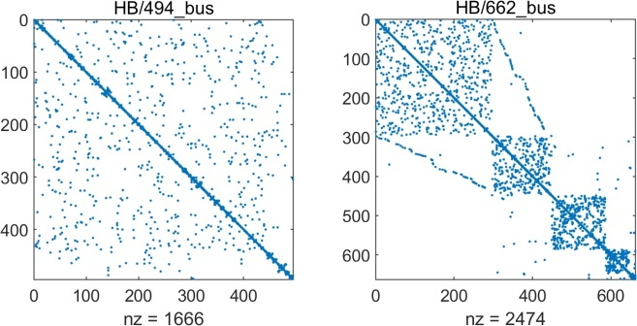
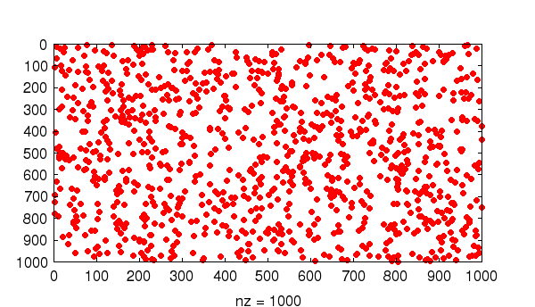
Sparse Format Selection Model
Based on dense model
Coefficients based on sparsity, complexity of indexing behavior
Image created by Nick Higham
Image created by FreeMat
Q3.1: Decoupling
Q3.2: Iteration
Q3.3: ILP Formulation

Slide 32
Proposed Dissertation
Research Question: How do we enable program analyses and transformations across loops within the constraints of a performance-portable parallel library rather than a compiler?
Part 1 Published at ICS 2021
Part 2 Rejected at ICS 2022, Resubmit Fall 22
Part 3 Planned for Fall 2022, Spring 2023
Part 1: Optimizing Schedules Across Loops
Part 2: Optimizing Data Layouts Across Loops
Part 3: Optimizing Sparse Data Layouts Across Loops
ICS 2021
Completed
In Progress
Proposed

Slide 33
Proposed Schedule
Part 1: Optimizing Schedules Across Loops
Part 2: Optimizing Data Layouts Across Loops
Part 3: Optimizing Sparse Data Layouts Across Loops
Completed
Research Question: How do we enable program analyses and transformations across loops within the constraints of a performance-portable parallel library rather than a compiler?
In Progress
Proposed
Curate Evaluation Kernels
IWOMP Publications Chair
Revised and Resubmit Part 2
Chapel Internship
Sparse Formats and Computation Description
Sparse ILP Model
Write and Submit
May 22
Aug 22
Nov 22
Feb 23
May 23
Notes:
'

Slide 34
Contributions
Part 1: Optimizing Schedules Across Loops
Part 2: Optimizing Data Layouts Across Loops
Part 3: Optimizing Sparse Data Layouts Across Loops
Completed
API for transforming schedules across loops
Runtime symbolic evaluation and analysis
Correctness formulation for overlapped tiling
Research Question: How do we enable program analyses and transformations across loops within the constraints of a performance-portable parallel library rather than a compiler?
ICS 2021
In Progress
API for transforming data layout between loops
Approach to reducing layout selection time
Proposed
API for transforming sparse data layout between loops
Technique for dynamically selecting access logic
Interface for specifying sparse computations in a library

Slide 35
References
[1] C. Olschanowsky, M. M. Strout, S. Guzik, J. Loffeld, and J. Hittinger. A study on balancing parallelism, data locality, and recomputation in existing pde solvers. In SC’14: Proceedings of the International Conference for High Performance Computing, Networking, Storage and Analysis, pages 793–804. IEEE, 2014.
[2] K. Kennedy and U. Kremer. Automatic data layout for distributed-memory machines. ACM Transactions on Programming Languages and Systems (TOPLAS), 20(4):869–916, 1998.
[3] J. Jaeger and D. Barthou. Automatic efficient data layout for multithreaded stencil codes on CPUs and GPUs. In 2012 19th International Conference on High Performance Computing, pages 1–10. IEEE, 2012.
[4] D. Majeti, R. Barik, J. Zhao, M. Grossman, and V. Sarkar. Compiler-driven data layout transformation for heterogeneous platforms. In European Conference on Parallel Processing, pages 188–197. Springer, 2013.
[5] J. Ragan-Kelley, C. Barnes, A. Adams, S. Paris, F. Durand, and S. Amarasinghe. Halide: a language and compiler for optimizing parallelism, locality, and recomputation in image processing pipelines. In Proceedings of the 34th ACM SIGPLAN conference on Programming Language Design and Implementation, PLDI ’13, pages 989 519–530, New York, NY, USA, 2013. ACM.
[6] R. T. Mullapudi, V. Vasista, and U. Bondhugula. Polymage: Automatic optimization for image processing pipelines. In Proceedings of the Twentieth International Conference on Architectural Support for Programming Languages and Operating Systems, ASPLOS ’15, pages 429–443, New York, NY, USA, 2015. ACM.
[7] F. Kjolstad, S. Kamil, S. Chou, D. Lugato, and S. Amarasinghe. The tensor algebra compiler. Proceedings of the ACM on Programming Languages, 1(OOPSLA):1–29, 2017.
[8] Y. Hu, T.-M. Li, L. Anderson, J. Ragan-Kelley, and F. Durand. Taichi: a language for high-performance computation on spatially sparse data structures. ACM Transactions on Graphics (TOG), 38(6):1–16, 2019.

