Slide 1
Learner Lane Web Application
Name: Brandon O’Connor
Matriculation Number: 9214115
Phase 2: Development Phase / Reflection Phase
GitHub Repository: https://github.com/brandonoconnor10/LearnerLane
Site Link: https://learnerlane.netlify.app/

Slide 2
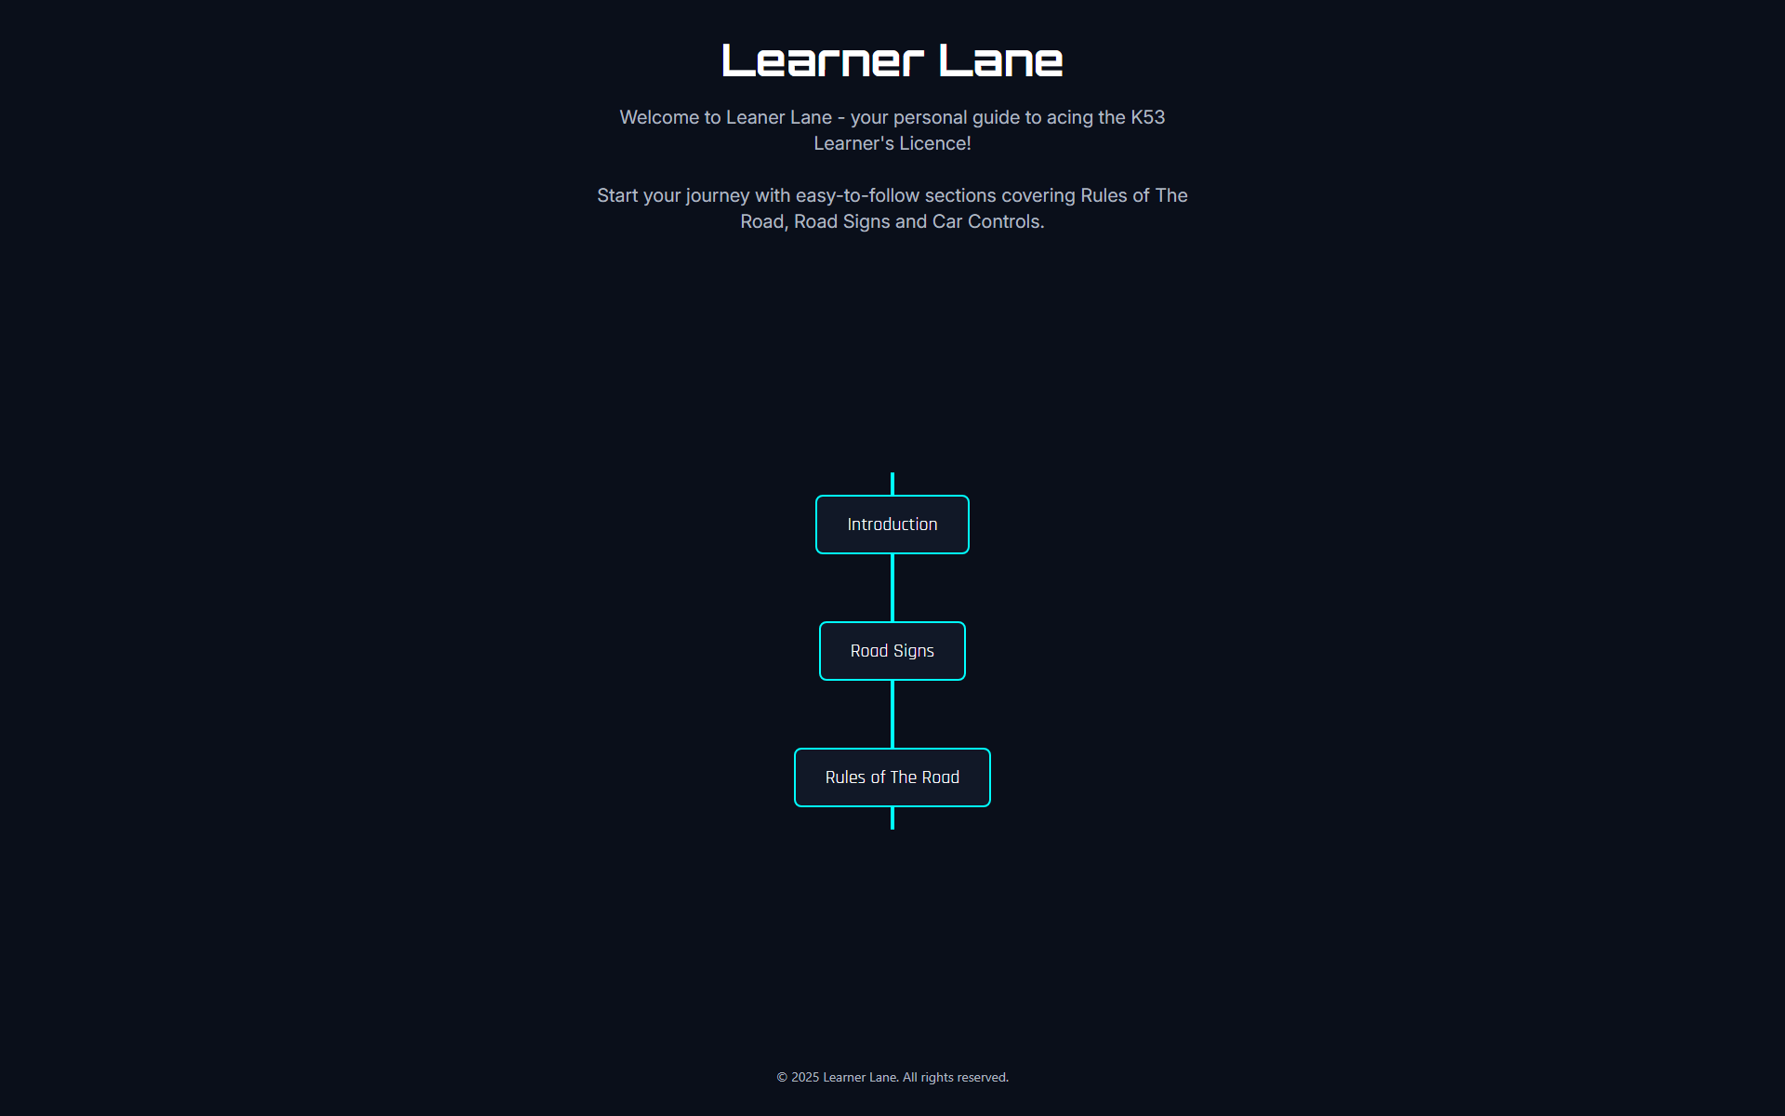
Purpose of Learner Lane
LearnerLane was created to simplify and modernize the way young South African drivers prepare for the K53 learner’s license. Many learners struggle with outdated, text-heavy study materials that are hard to follow and lack interactivity. The purpose of this web app is to provide a clean, visual, and structured learning experience through clearly divided sections: Road Signs, Rules of the Road, and Quizzes - making the process less overwhelming and more effective. By focusing on ease of use, accessibility, and confidence-building, LearnerLane empowers learners to study at their own pace and feel better prepared for the test.

Slide 3
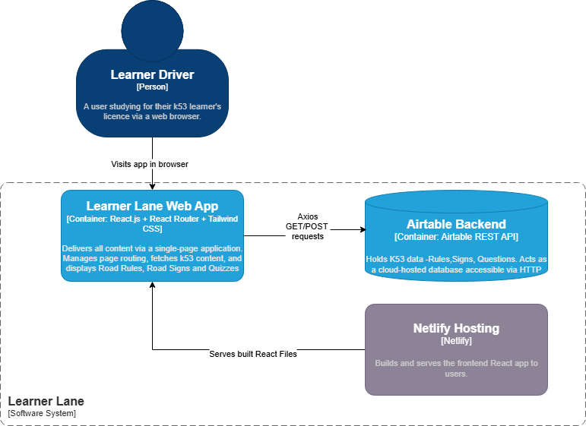
Architecture Diagram of Learner Lane
React.js SPA handles routing and UI
Airtable stores K53 content (Signs, Rules, Questions)
Axios fetches data via REST API
Netlify deploys and serves the app
React Router enables dynamic navigation

Slide 4



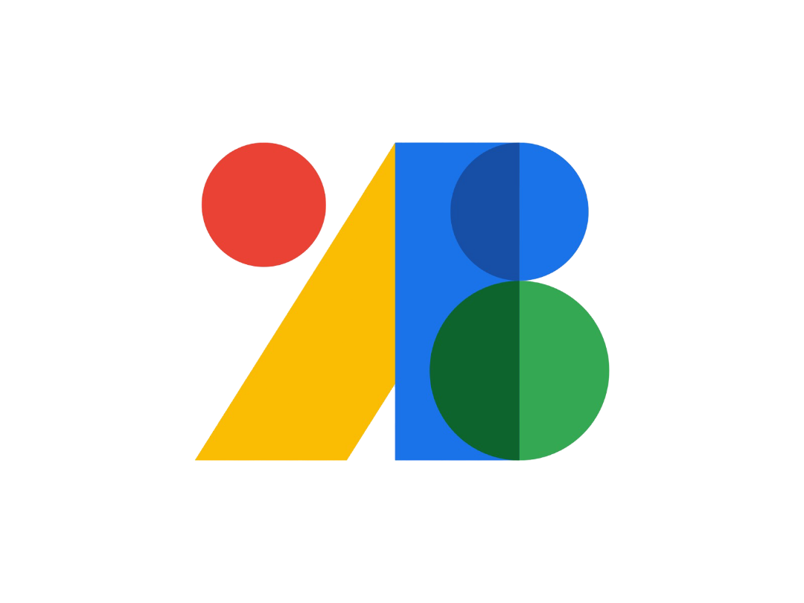




Overview of Technology Choices:
React.js: Used to build a fast, modular single-page application (SPA)
React Router: Handles client-side routing between pages
Tailwind CSS: Utility-first CSS framework for responsive and modern UI design
Google Fonts: Enhances visual appeal with clean typography
Airtable: Acts as a cloud-based backend/database for storing all K53 content (rules, signs, questions)
Axios: Used to fetch data from Airtable via HTTP requests
REST API: Airtable exposes the data via REST, which is accessed by the frontend
Netlify: Handles build and deployment of the React app (serves the frontend)

Slide 5
Screenshots of Learner Lane
Heading text that serves as a Home Button
Hero Text For Home Page
Section Navigation
Footer

Slide 6
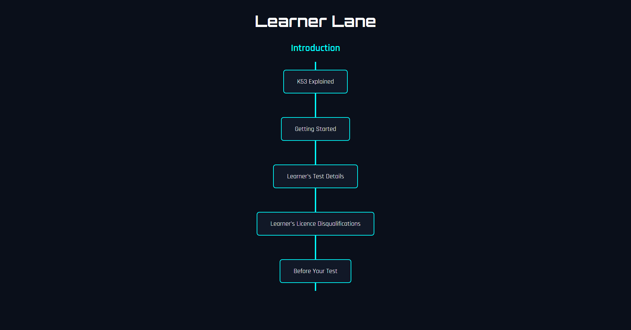
When the Introduction Button was clicked , it would take you to this page with even more sections to choose from

Slide 7
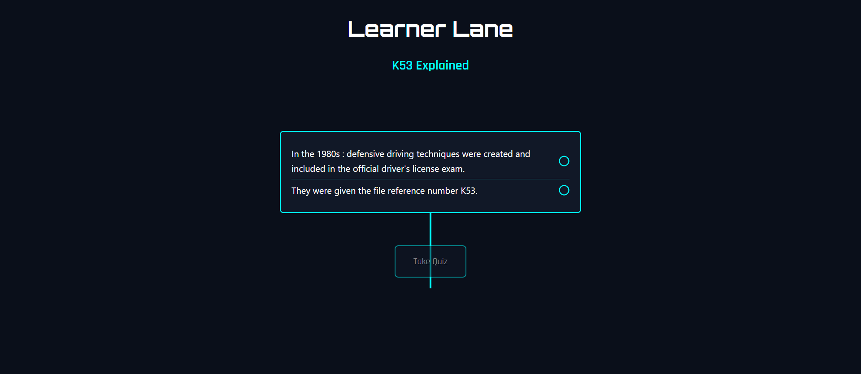
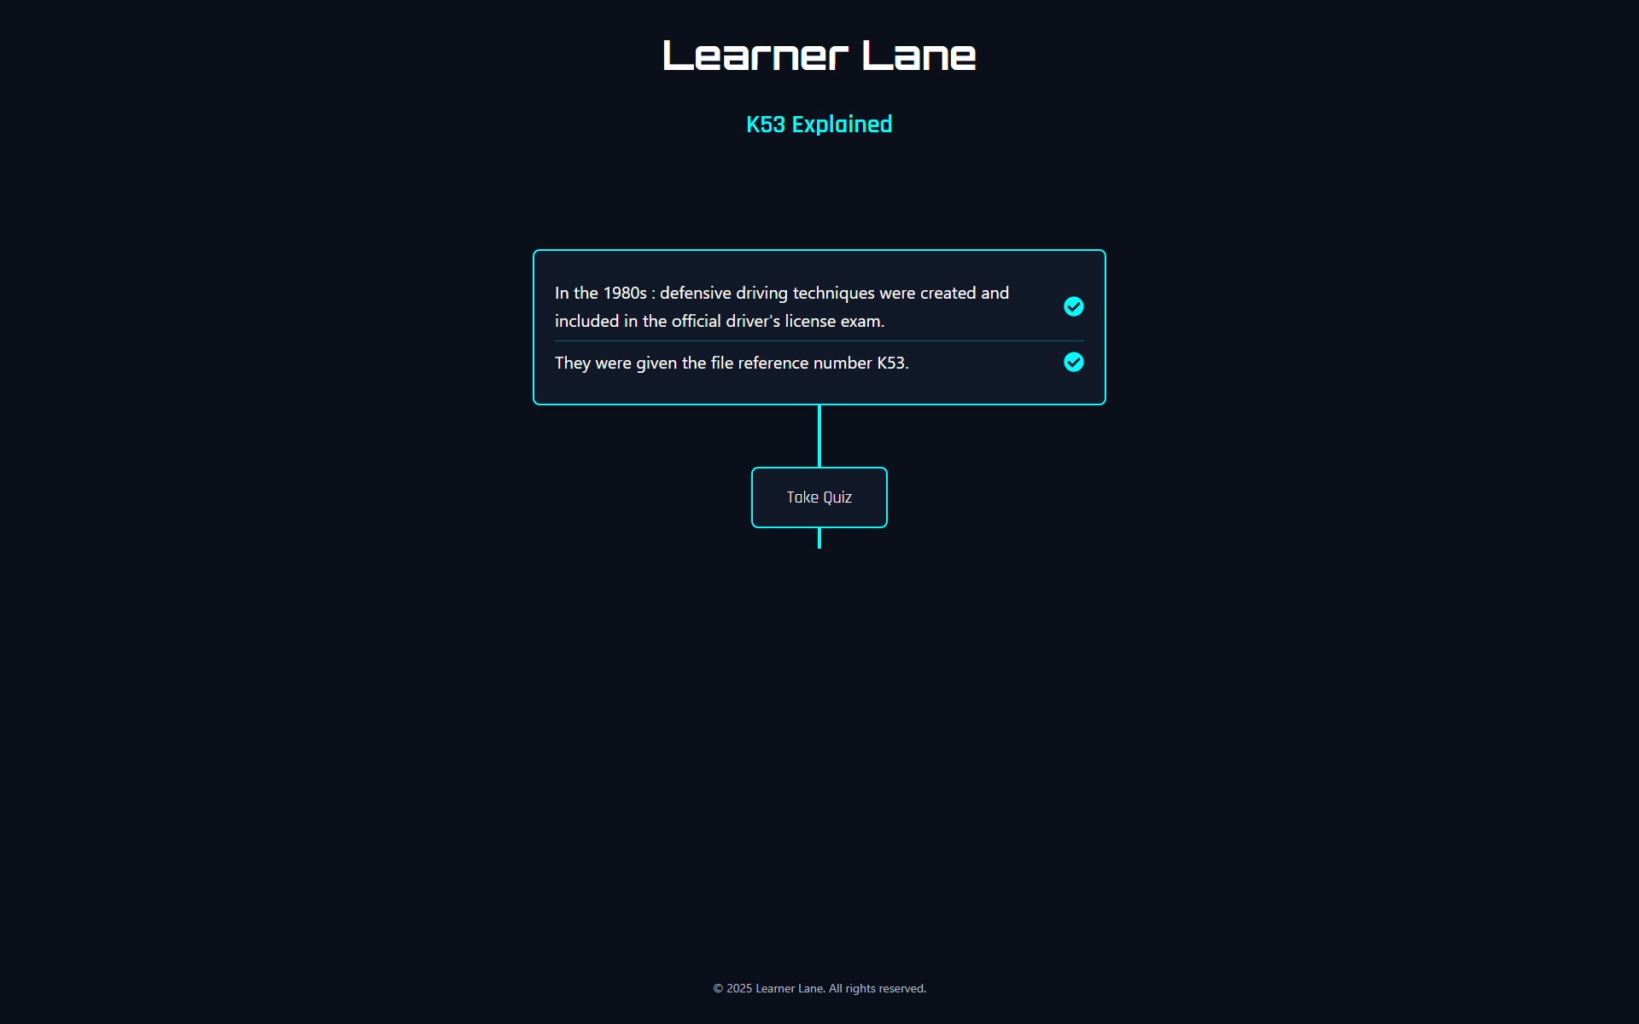
Each section ends with a take quiz button that leads to the quiz page for that section
The Quiz button is only clickable once all check marks are clicked , making sure you only take the quiz once you understand each sentence.

Slide 8
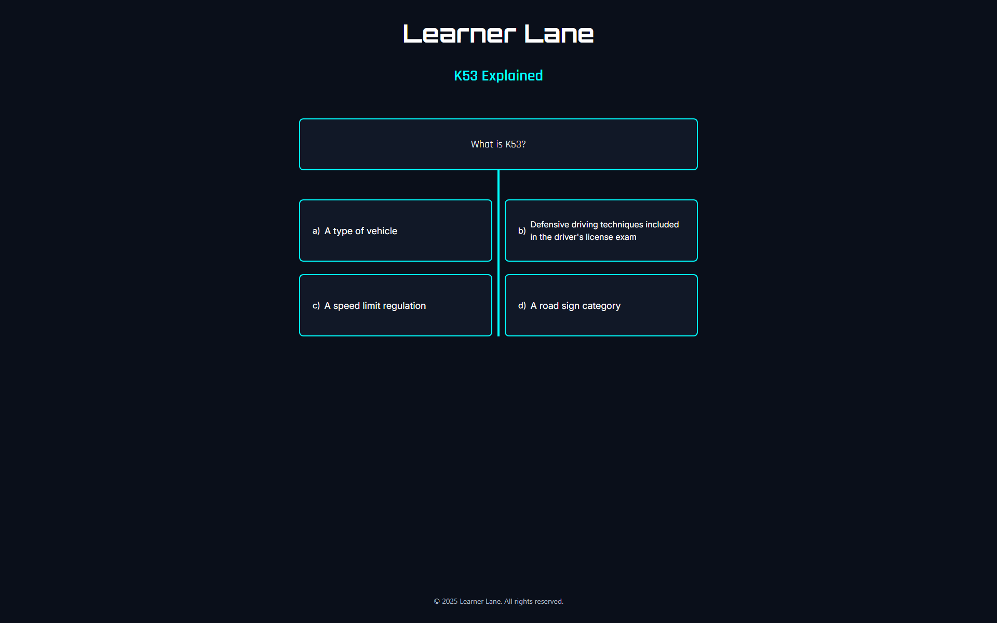
The Quiz after each section looks like this , where 4 possible answers are available.
The Questions are displayed above the answers.
There might be moments where a section has more than one question.

Slide 9
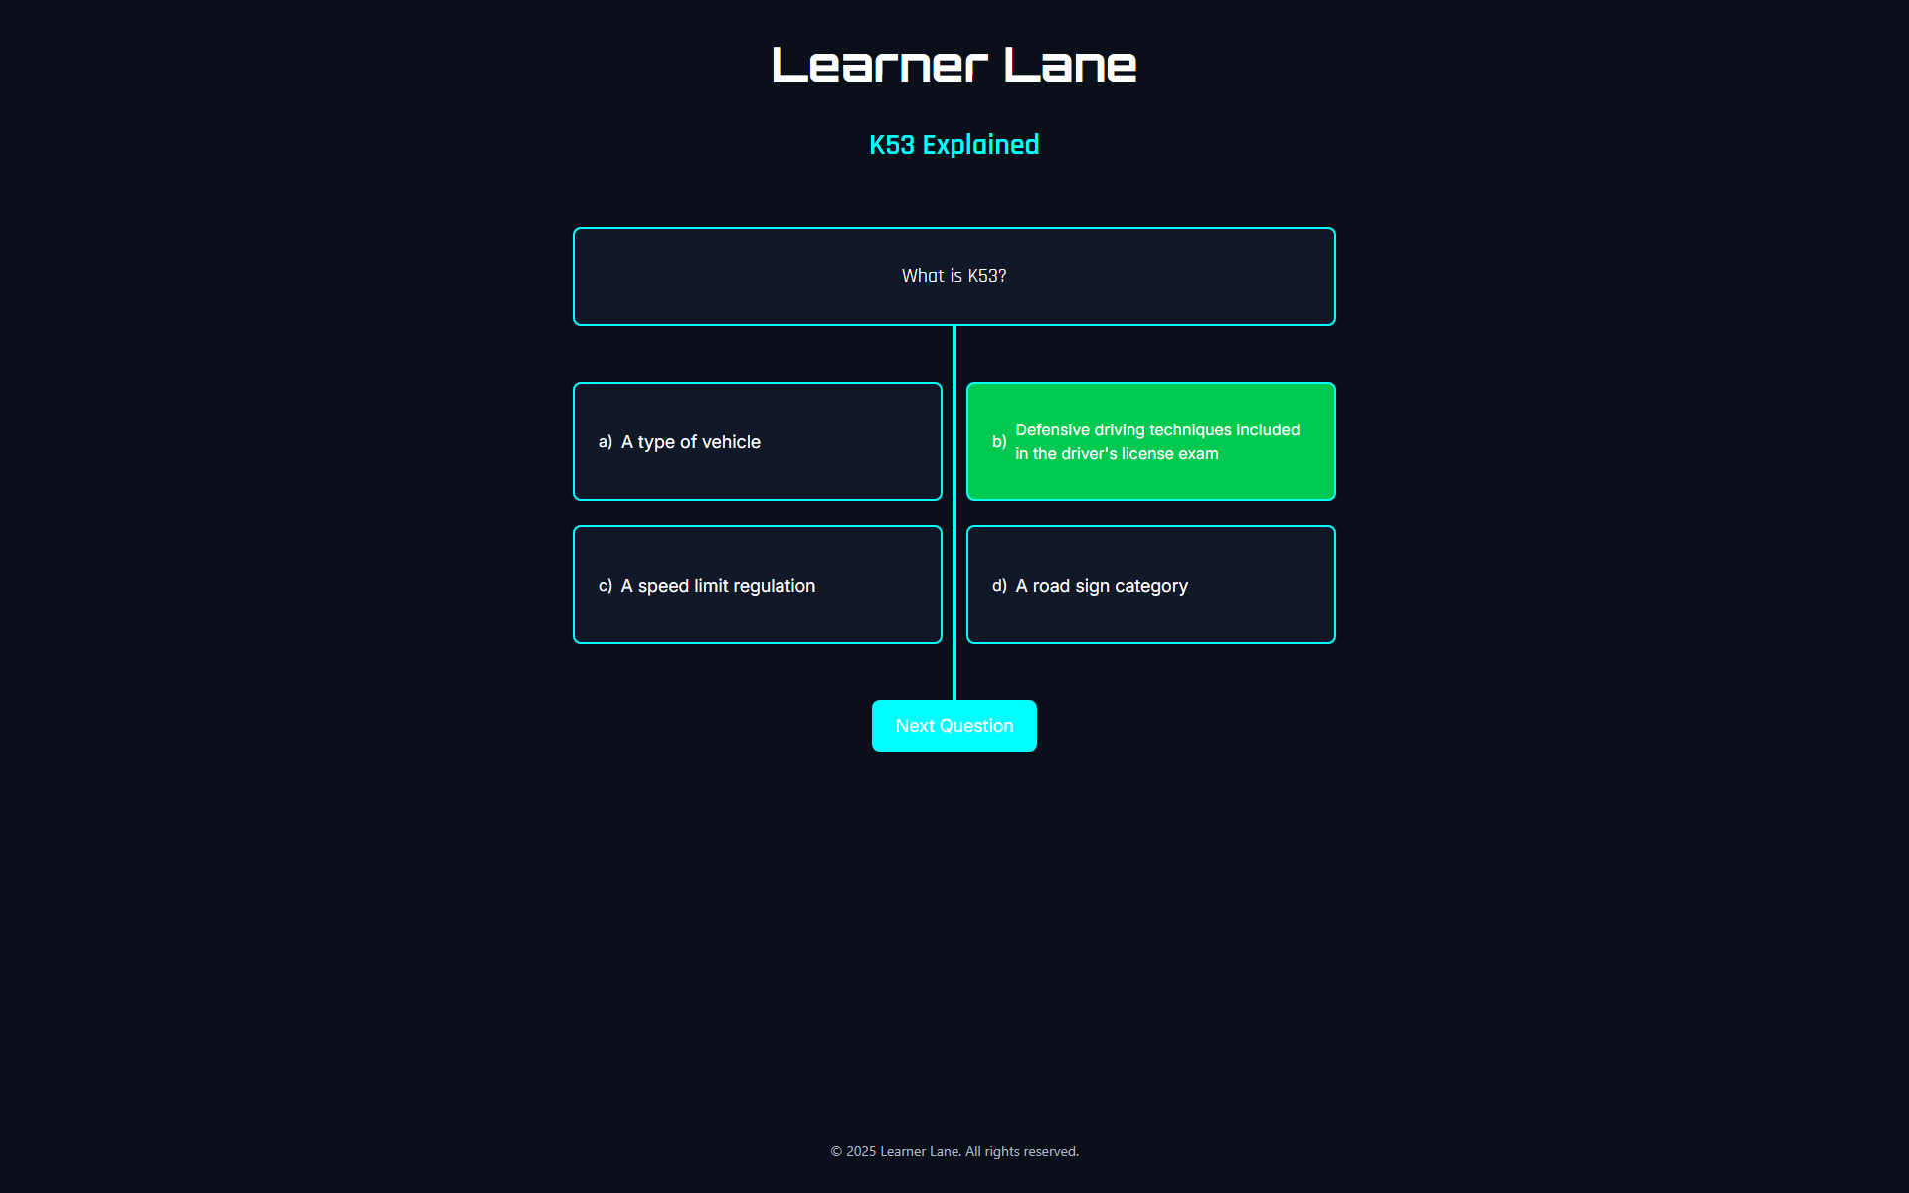
A next Question Button will be displayed only once the right answer is selected.
The correct answer will be shown as green and red when incorrect.

Slide 10
Feature / Design | Original Plan | Final Implementation | Reason For Change
Section Locking / Sequential Flow | Users had to complete topics in a fixed order | Users can now access any topic in any order | Gave users more freedom and reduced frustration
Font Styling | Default Fonts | Switched to custom Google Fonts | Improved readability and made the design feel more modern
Section Page Layouts | Basic Static Design | Enhanced layout with better spacing, alignment and styling | Improved visual flow and engagement on rules and signs pages
Progress Tracking | No visual Feedback for Completed Content | Added icons to show completion of lines before the quiz | Helps users track learning progress and feel a sense of accomplishment
Data Fetching | Used Native fetch() for HTTP requests | Replaced with Axios | Cleaner syntax, better error handling, and easier to use with Airtable

Slide 11
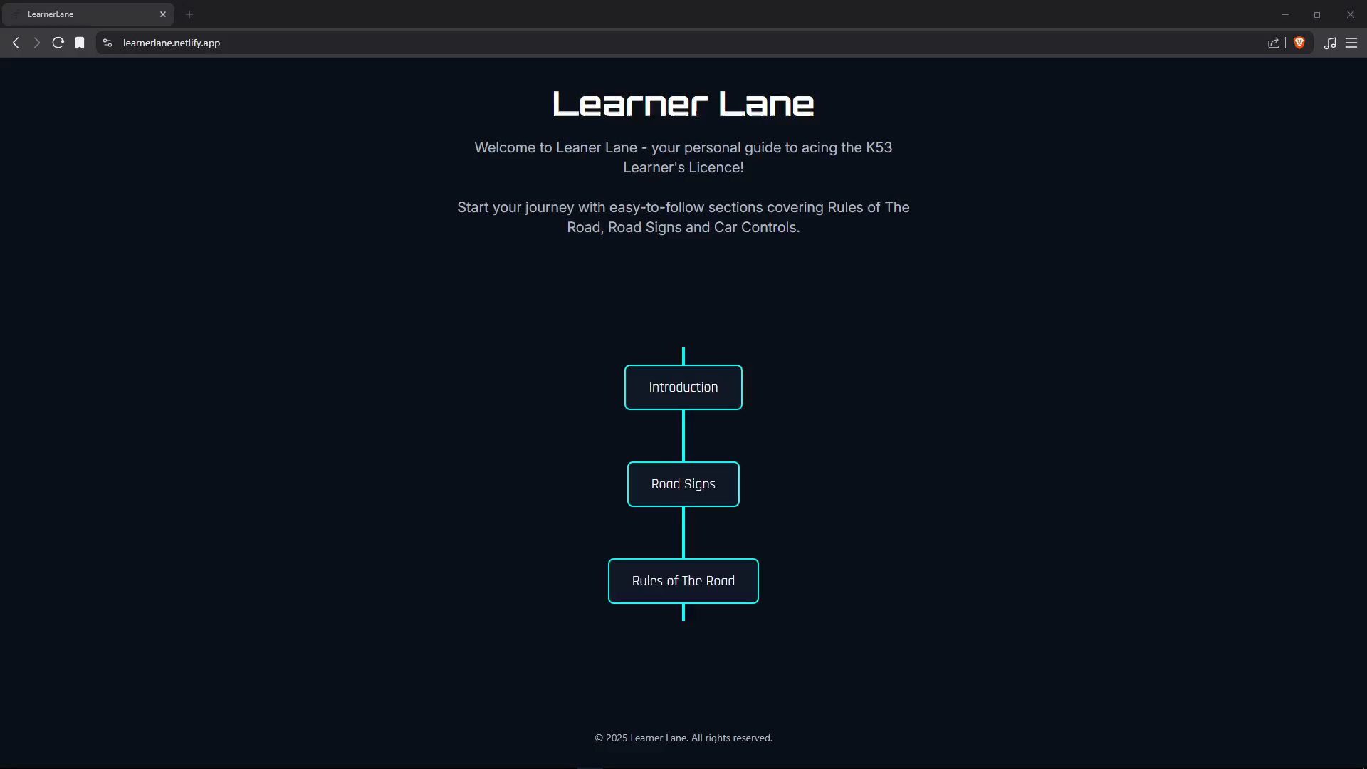
Learner Lane Web App

