Slide 1


Binary Search Trees
Dictionary Operations:
  get(key)
  put(key, element)
  remove(key)
Additional operations:
  ascend()
  get(index) (indexed binary search tree)
  remove(index) (indexed binary search tree)

Slide 2
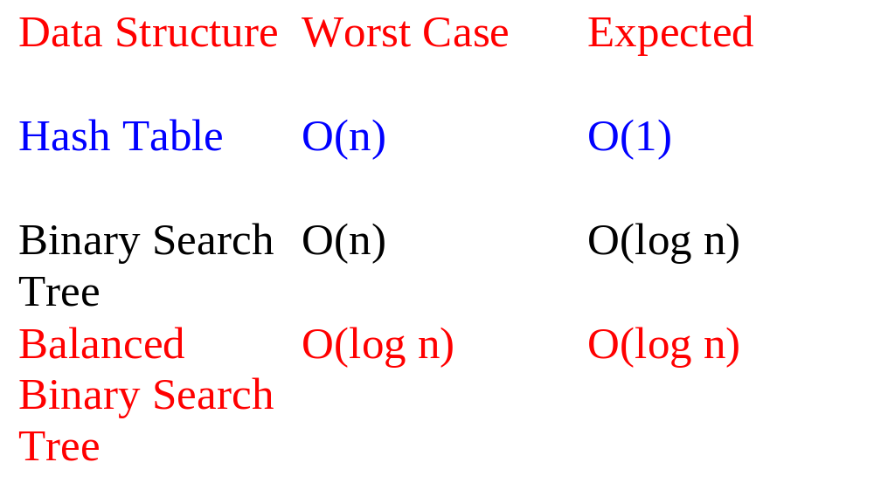
Complexity Of Dictionary Operations get(), put() and remove()
n is number of elements in dictionary

Slide 3
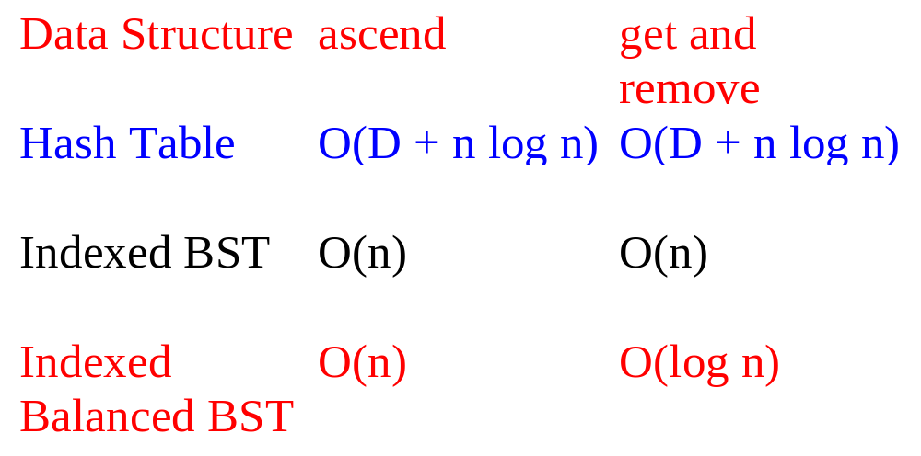
Complexity Of Other Operations ascend(), get(index), remove(index)
D is number of buckets

Slide 4
Definition Of Binary Search Tree
A binary tree.
Each node has a (key, value) pair.
For every node x, all keys in the left subtree of x are smaller than that in x.
For every node x, all keys in the right subtree of x are greater than that in x.

Slide 5
Example Binary Search Tree
20
10
40
6
15
30
2
8
25
Only keys are shown.

Slide 6
The Operation ascend()
20
10
40
6
15
30
2
8
25
Do an inorder traversal. O(n) time.

Slide 7
The Operation get()
20
10
40
6
15
30
2
8
25
Complexity is O(height) = O(n), where n is number of nodes/elements.

Slide 8
The Operation put()
20
10
40
6
15
30
2
8
25
35
Put a pair whose key is 35.

Slide 9
The Operation put()
20
10
40
6
15
30
2
8
25
35
7
Put a pair whose key is 7.

Slide 10
The Operation put()
20
10
40
6
15
30
18
25
35
2
8
7
Put a pair whose key is 18.

Slide 11
The Operation put()
20
10
40
6
15
30
18
25
35
2
8
7
Complexity of put() is O(height).

Slide 12
The Operation remove()
Three cases:
  Element is in a leaf.
  Element is in a degree 1 node.
  Element is in a degree 2 node.

Slide 13
Remove From A Leaf
20
10
40
6
15
30
18
25
35
2
8
7
Remove a leaf element. key = 7

Slide 14
Remove From A Leaf (contd.)
20
10
40
6
15
30
18
25
35
2
8
7
Remove a leaf element. key = 35

Slide 15
Remove From A Degree 1 Node
20
10
40
6
15
30
18
25
35
2
8
7
Remove from a degree 1 node. key = 40

Slide 16
Remove From A Degree 1 Node (contd.)
20
10
40
6
15
30
18
25
35
2
8
7
Remove from a degree 1 node. key = 15

Slide 17
Remove From A Degree 2 Node
20
10
40
6
15
30
18
25
35
2
8
7
Remove from a degree 2 node. key = 10

Slide 18
Remove From A Degree 2 Node
20
10
40
6
15
30
18
25
35
2
8
7
Replace with largest key in left subtree (or smallest in right subtree).

Slide 19
Remove From A Degree 2 Node
20
10
40
6
15
30
18
25
35
2
8
7
Replace with largest key in left subtree (or smallest in right subtree).

Slide 20
Remove From A Degree 2 Node
20
8
40
6
15
30
18
25
35
2
8
7
Replace with largest key in left subtree (or smallest in right subtree).

Slide 21
Remove From A Degree 2 Node
20
8
40
6
15
30
18
25
35
2
8
7
Largest key must be in a leaf or degree 1 node.

Slide 22
Another Remove From A Degree 2 Node
20
10
40
6
15
30
18
25
35
2
8
7
Remove from a degree 2 node. key = 20

Slide 23
Remove From A Degree 2 Node
20
10
40
6
15
30
18
25
35
2
8
7
Replace with largest in left subtree.

Slide 24
Remove From A Degree 2 Node
20
10
40
6
15
30
18
25
35
2
8
7
Replace with largest in left subtree.

Slide 25
Remove From A Degree 2 Node
18
10
40
6
15
30
18
25
35
2
8
7
Replace with largest in left subtree.

Slide 26
Remove From A Degree 2 Node
18
10
40
6
15
30
2
8
25
35
7
Complexity is O(height).

Slide 27
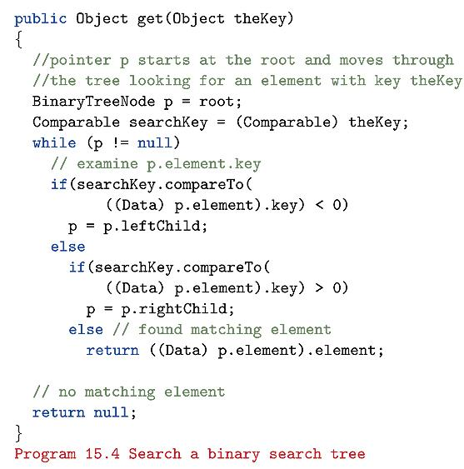

Slide 28
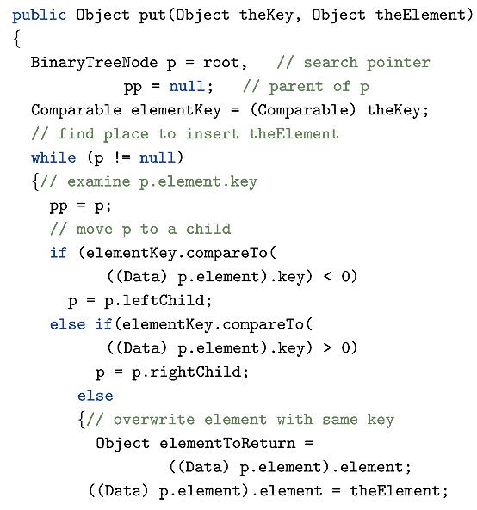

Slide 29
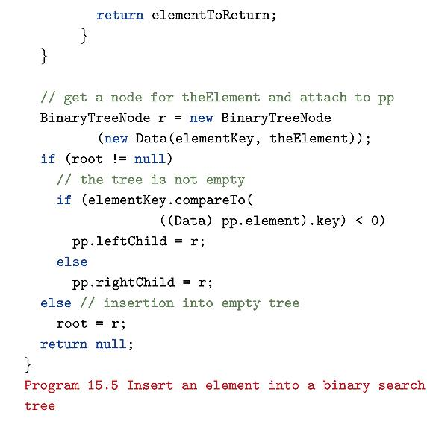

Slide 30
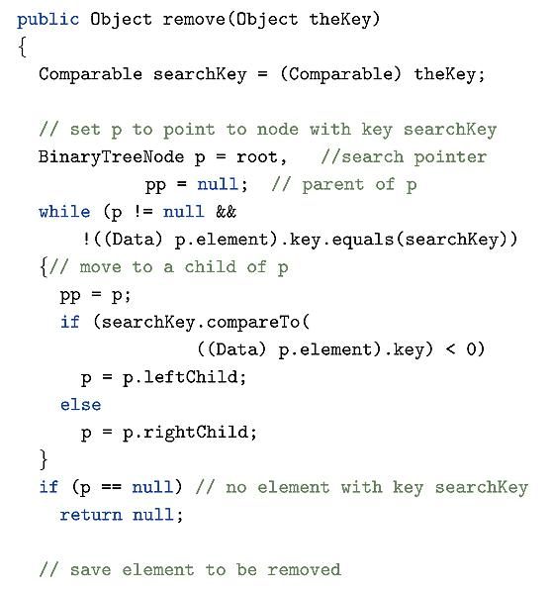

Slide 31
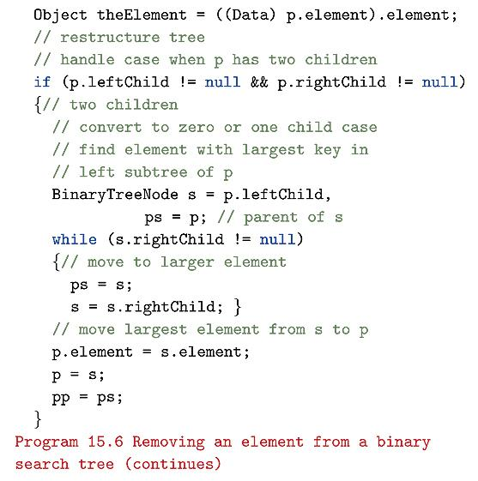

Slide 32
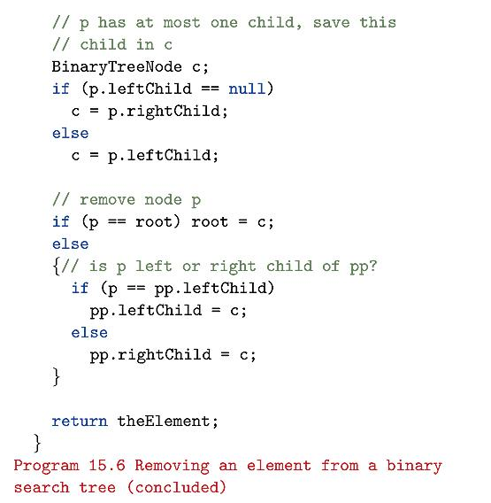

Slide 33
Indexed Binary Search Tree
Binary search tree.
Each node has an additional field.
  leftSize = number of nodes in its left subtree

Slide 34
Example Indexed Binary Search Tree
7
20
4
3
10
40
1
0
1
6
15
30
0
0
0
1
0
18
25
35
2
8
0
7
leftSize values are in red

Slide 35
leftSize And Rank
Rank of an element is its position in inorder (inorder = ascending key order). In a binary search tree, this is sorted order.
[2,6,7,8,10,15,18,20,25,30,35,40]
rank(2) = 0
rank(15) = 5
rank(20) = 7
Notes:
If you do an inorder traversal of the tree, you get the array given above. This is NOT the same as storing a
Binary tree in an array.

Slide 36
leftSize And Rank
leftSize(x) = rank(x) with respect to elements in subtree rooted at x
This is because all of the elements in the left subtree of x precede x.
If we look at the rank array, an element is preceded by all of elements smaller than it.
Since all elements in the left subtree of a node are smaller than it, the rank(x) must be the same as the leftSize(x)

Slide 37
leftSize And Rank
7
20
4
3
10
40
1
0
1
6
15
30
0
0
0
1
0
18
25
35
2
8
0
7
sorted list = [2,6,7,8,10,15,18,20,25,30,35,40]

Slide 38
get(index) And remove(index)
if index = x.leftSize desired element is x.element
  this is because the array is in value order so the index^{th} element in the array is preceded by all smaller elements,
  this is just x.leftsize, since there are leftsize smaller elements than x
if index < x.leftSize desired element is index’th element in left subtree of x
  the array is in value order, so the index looking for is still the index’th value in the array.
  since index < x.leftSize and we know that there are leftsize values less than x, so index must be in left subtree.

Slide 39
get(index) And remove(index)
7
20
4
3
10
40
1
0
1
6
15
30
0
0
0
1
0
18
25
35
2
8
0
7
sorted list = [2,6,7,8,10,15,18,20,25,30,35,40]

Slide 40
get(index) And remove(index)
if index > x.leftSize desired element is (index - x.leftSize-1)’th element in right subtree of x
  this is because there are x.leftSize nodes in the left subtree of x
  all of these occur before index in the array.
  but the leftSize values in the right subtree do not include the values in x’s left subtree.
  so must subtract x.leftsize +1 (must include x since x is less than index also) from the index
Must update leftsize fields in all nodes on the path from the root to the physically deleted node when do a remove.

Slide 41
get(index) And remove(index)
Example: get(4) from the example tree given earlier.
The sorted list is:
[2,6,7,8,10,15,18,20,25,30,35,40]
So want to get the item 10.
See next slide

Slide 42
get(4)
7
20
4
3
10
40
1
0
1
6
15
30
0
0
0
1
0
18
25
35
2
8
0
7
sorted list = [2,6,7,8,10,15,18,20,25,30,35,40]
4 < 7, so search for index 4 in left subtree of node 20

Slide 43
get(4)
7
20
4
3
10
40
1
0
1
6
15
30
0
0
0
1
0
18
25
35
2
8
0
7
sorted list = [2,6,7,8,10,15,18,20,25,30,35,40]
4 = 4, so return element 10. Correct!

Slide 44
get(2) = 7
7
20
4
3
10
40
1
0
1
6
15
30
0
0
0
1
0
18
25
35
2
8
0
7
sorted list = [2,6,7,8,10,15,18,20,25,30,35,40]
2 < 7, so search for 2 in left subtree of node 20

Slide 45
get(2) = 7
7
20
4
3
10
40
1
0
1
6
15
30
0
0
0
1
0
18
25
35
2
8
0
7
sorted list = [2,6,7,8,10,15,18,20,25,30,35,40]
2 < 4, so search for 2 in left subtree of node 10

Slide 46
get(2) = 7
7
20
4
3
10
40
1
0
1
6
15
30
0
0
0
1
0
18
25
35
2
8
0
7
sorted list = [2,6,7,8,10,15,18,20,25,30,35,40]
2 >1, so search for 2-1-1 in right subtree of node 6

Slide 47
get(2) = 7
7
20
4
3
10
40
1
0
1
6
15
30
0
0
0
1
0
18
25
35
2
8
0
7
sorted list = [2,6,7,8,10,15,18,20,25,30,35,40]
0 < 1, so search for 0 in left subtree of node 8

Slide 48
get(2) = 7
7
20
4
3
10
40
1
0
1
6
15
30
0
0
0
1
0
18
25
35
2
8
0
7
sorted list = [2,6,7,8,10,15,18,20,25,30,35,40]
0 = 0, so return 7 from node 7. Correct!

Slide 49
get(index) And remove(index)
Must update leftsize fields in all nodes on the path from the root to the physically deleted node.
Time to search, insert, and remove: O(h) where h is the height of the indexed tree.

Slide 50
Applications
Best-fit bin packing in O(n log n) time.
Can’t use hash tables .

Slide 51
Bin Packing
  n items to be packed into bins
  each item has a size
  each bin has a capacity of c tons
  minimize number of bins

Slide 52
Bin Packing
Bin packing to minimize number of bins is NP-hard.
Several fast heuristics have been proposed.

Slide 53
Bin Packing Heuristics
First Fit.
  Bins are arranged in left to right order.
  Items are packed one at a time in given order.
  Current item is packed into leftmost bin into which it fits.
  If there is no bin into which current item fits, start a new bin.

Slide 54
First Fit
n = 4
weights = [4, 7, 3, 6]
capacity = 10
Pack red item into first bin.

Slide 55
First Fit
n = 4
weights = [4, 7, 3, 6]
capacity = 10
Pack blue item next.
Doesn’t fit, so start a new bin.

Slide 56
First Fit
n = 4
weights = [4, 7, 3, 6]
capacity = 10

Slide 57
First Fit
n = 4
weights = [4, 7, 3, 6]
capacity = 10
Pack yellow item into first bin.

Slide 58
First Fit
n = 4
weights = [4, 7, 3, 6]
capacity = 10
Pack green item.
Need a new bin.

Slide 59
First Fit
n = 4
weights = [4, 7, 3, 6]
capacity = 10
Not optimal.
2 bins suffice.

Slide 60
Bin Packing Heuristics
First Fit Decreasing.
  Items are sorted into decreasing order.
  Then first fit is applied.

Slide 61
Bin Packing Heuristics
Best Fit.
  Items are packed one at a time in given order.
  To determine the bin for an item, first determine set S of bins into which the item fits.
  If S is empty, then start a new bin and put item into this new bin.
  Otherwise, pack into bin of S that has least available capacity.

Slide 62
Bin Packing Heuristics
Best Fit Decreasing.
  Items are sorted into decreasing order.
  Then best fit is applied.

Slide 63

Performance
For first fit and best fit:
  Heuristic Bins <= (17/10)(Minimum Bins) + 2
For first fit decreasing and best fit decreasing:
  Heuristic Bins <= (11/9)(Minimum Bins) + 4

Slide 64
Best Fit with BST
Use a BST with duplicates.
Change while loop in put routine to code on next slide.
Change second occurrence of the line:
If (elementKey.compareTo(((Data) pp.element).key < 0)
To
If (elementKey.compareTo(((Data) pp.element).key <= 0)

Slide 65
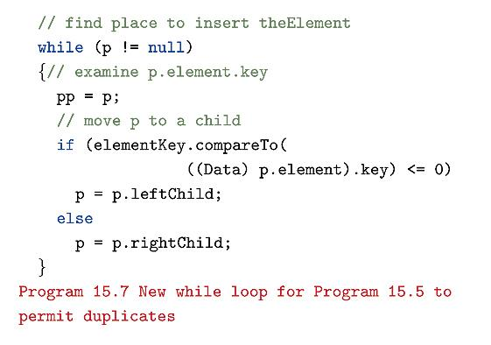

Slide 66
Best Fit with BST
Expected time is O(nlogn).
If use balanced tree, worst case time is θ(nlogn)
BST will contain one element for each bin that is currently in use and has nonzero unused capacity.
Example
object i
  9 bins, a through I
  Bins are stored in BST with duplicates
  See next slide

Slide 67
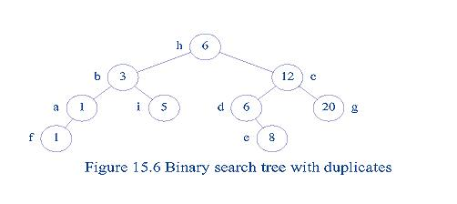

Slide 68
Best Fit with BST algorithm
look at node.
If element is smaller than node’s bin capacity, this bin is a candidate
  can ignore right subtree since every bin in that subtree will have more space than our node.
  so go to left subtree.
  If there is no left subtree, stop, have found best bin.
If element is larger than node’s bin capacity, this bin is not a candidate
  can ignore left subtree since every bin in that subtree will have less space than our node.
  So go to right subtree.
  If no right subtree, stop. Current candidate is best bin.

Slide 69
Best Fit with BST algorithm continued
If element is equal to node’s bin capacity, this bin is the solution.
When find the best node, delete it.
If no node available, create a new node.

Slide 70
Best Fit with BST
Example: if objectSize[I] = 4 traverse tree to node i
Example: if objectSize[I] = 7 traverse to node e

Slide 71
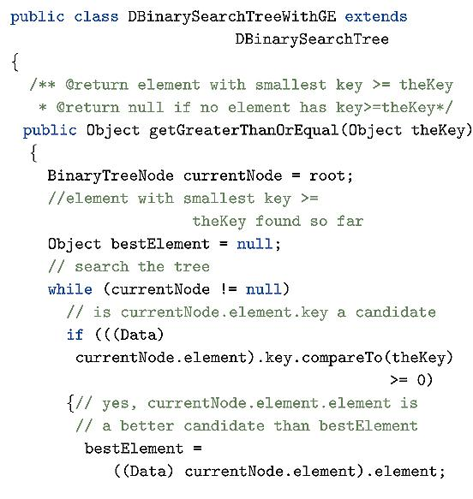

Slide 72
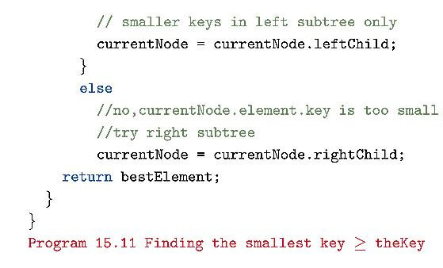

Slide 73
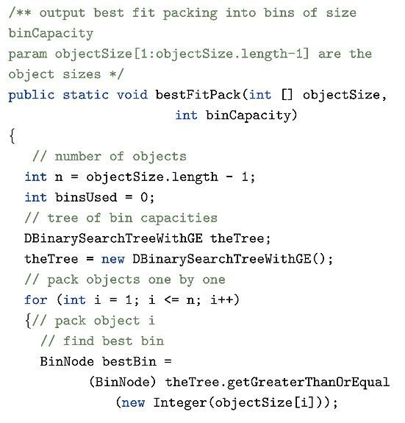

Slide 74
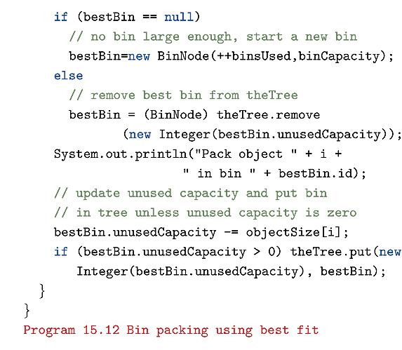

Slide 75
Applications
(Complexities Are For Balanced Trees)
Representing a linear list so that get(index), add(index, element), and remove(index) run in O(log(list size)) time (uses an indexed binary tree, not indexed binary search tree).
Can’t use hash tables for this application.

Slide 76
Linear List As Indexed Binary Tree
7
h
4
3
e
l
1
0
1
b
f
j
0
0
0
1
0
g
i
k
a
d
0
c
list = [a,b,c,d,e,f,g,h,i,j,k,l]
Notes:
List elements are placed in a binary tree so that an inorder traversal of the binary tree visits the elements in list order from left to right.
get() and remove() work as they do in an indexed binary search tree.

Slide 77
add(5,’m’)
7
h
4
3
e
l
1
0
1
b
f
j
0
0
0
1
0
g
i
k
a
d
0
c
list = [a,b,c,d,e,f,g,h,i,j,k,l]

Slide 78
add(5,’m’)
7
h
4
3
e
l
1
0
1
b
f
j
0
0
0
1
0
g
i
k
a
d
0
c
list = [a,b,c,d,e, m,f,g,h,i,j,k,l]
find node with element 4 (e)

Slide 79
add(5,’m’)
7
h
4
3
e
l
1
0
1
b
f
j
0
0
0
1
0
g
i
k
a
d
0
c
list = [a,b,c,d,e, m,f,g,h,i,j,k,l]
find node with element 4 (e)

Slide 80
add(5,’m’)
7
h
4
3
e
l
1
m
0
1
b
f
j
0
0
0
1
0
g
i
k
a
d
0
c
Choice 1: add m as right child of e; former right subtree of e becomes right subtree of m

Slide 81
add(5,’m’)
7
h
4
3
e
l
1
0
1
b
f
j
0
0
0
1
0
m
g
i
k
a
d
0
c
Choice 2: add m as leftmost node in right subtree of e

Slide 82
add(5,’m’)
Other possibilities exist.
Must update some leftSize values on path from root to new node.
Complexity is O(height).
Note that a linked list will take O(n) to insert in a specific index.
Array implementation of a linked list will take O(n) to insert at a specific index.

Slide 83
Applications
Crossing Distribution
Problem: start with a routing channel with n pins on both the top and bottom of the channel.
See next slide. n = 10.
Routing region in slide is the shaded area.
Also have a permutation C of the numbers [1,2,3,…,n].
Must connect pin i on top to pin C_{i} on bottom
The n wires needed are numbered left to right, 1 through n.
Wire i connects top pin i to bottom pin C_{i}. Wire i is to the left of wire j iff i < j.

Slide 84
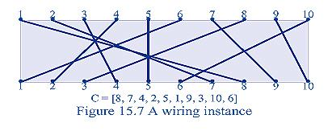

Slide 85
Applications
Crossing Distribution
Crossings of wires are undesirable. Require insulators.
Crossings given by pair (i,j) where i and j are the two wires that cross.
To avoid duplicates, require that i < j. Note that (9,10) is same as (10,9).
Wires i and j cross iff C_{i} > C_{j}.

Slide 86
Applications
Crossing Distribution
Let k_{i} be the number of pairs (i, j), i < j such that wires i and j cross.
Recall that wire i is the wire that connects top pin i to bottom pin C_{i}.
In the example, k₉ = 1, k₁₀ = 0, and k₆ = 0 (since no wires with top pin greater than 6 that crosses with wire with top pin 6).
See next figure.

Slide 87
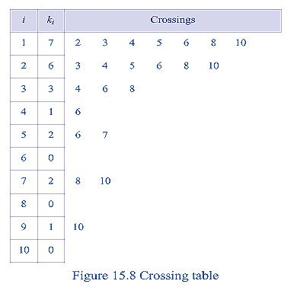

Slide 88
Applications
Crossing Distribution
Total crossings K found by adding all of the individual crossings k_{i}.
This example: K = 22.
Since k_{i} counts the crossings of wire i only with wires to its right, k_{i} gives the number of right-side crossings of wire i.
The crossing problem: want to balance the routing complexity in the top and lower halves of the channel.
Require that each half have approximately the same number of crossings, ie, top must have floor of K/2 crossings, bottom must have ceiling K/2.

Slide 89
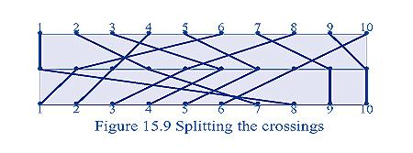

Slide 90
Applications
Crossing Distribution
Connections in top half given by permutation:
A = [1,4,6,3,7,2,9,5,10,8]
Top pin i connects to center pin A_{i}.
Connections in bottom half given by:
B = [8,1,2,7,3,4,5,6,9,10]
Center pin i is connected to bottom pin B_{i}.

Slide 91
Applications
Crossing Distribution
Note that C_{i} = B_{ai}
This equality is necessary to accomplish the connections given by C_{i} .
Now need algorithms to compute the permutations A and B so that the top half of the channel has floor K/2 crossings where K is the total number of crossings.

Slide 92
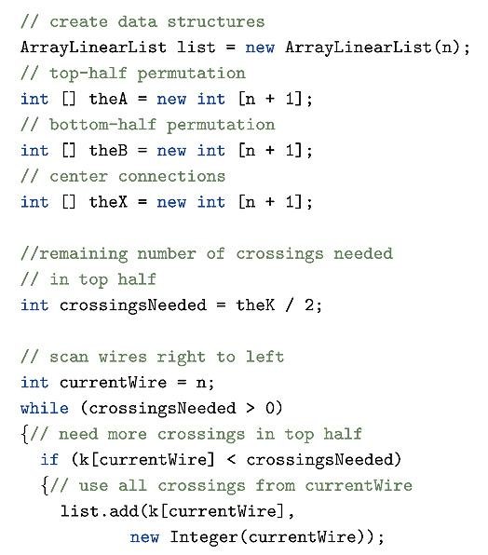

Slide 93
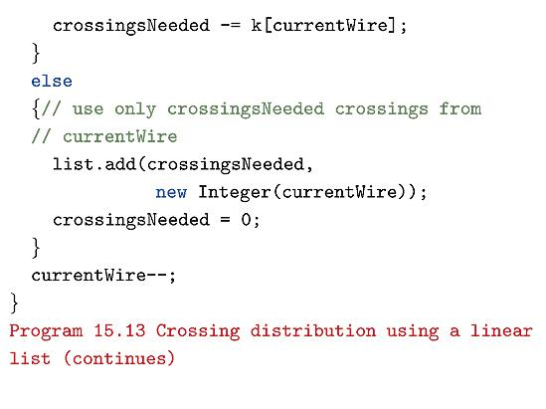

Slide 94
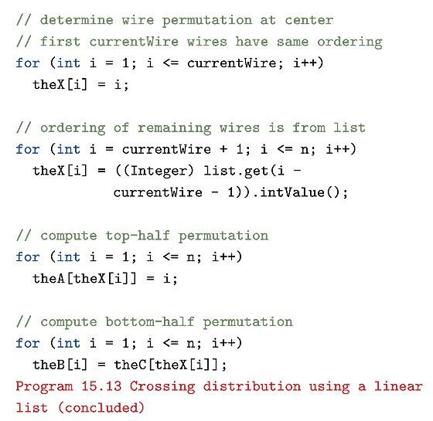

Slide 95
