Slide 1


Binary Search Trees
Dictionary Operations:
  find(key)
  insert(key, value)
  erase(key)
Additional operations:
  ascend()
  get(index) (indexed binary search tree)
  delete(index) (indexed binary search tree)

Slide 2
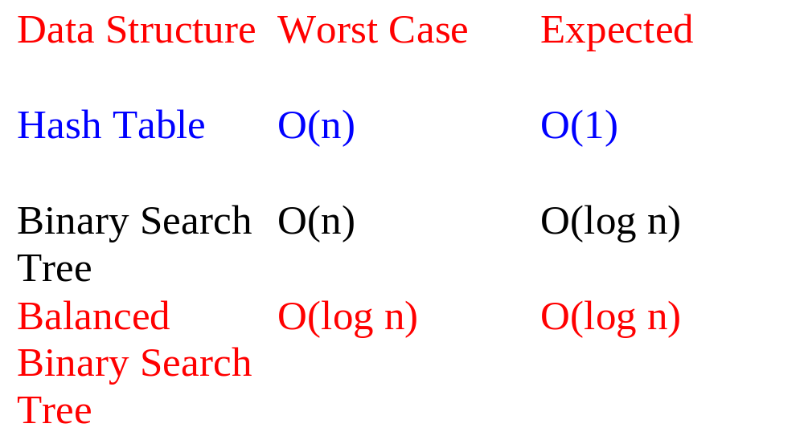
Complexity Of Dictionary Operations find(), insert() and erase()
n is number of elements in dictionary

Slide 3
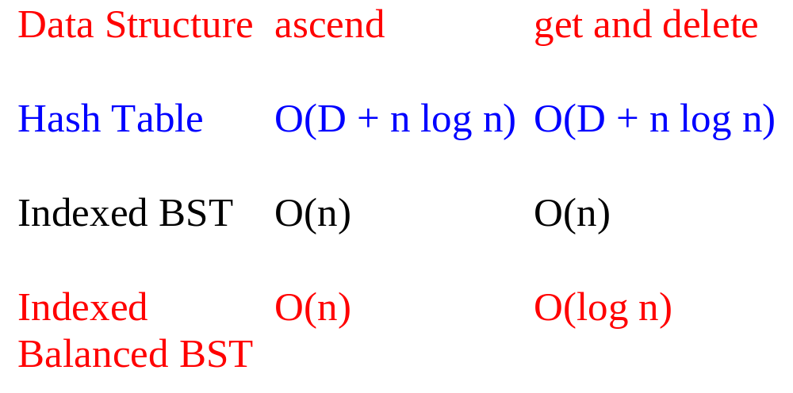
Complexity Of Other Operations ascend(), get(index), delete(index)
D is number of buckets

Slide 4
Definition Of Binary Search Tree
A binary tree.
Each node has a (key, value) pair.
For every node x, all keys in the left subtree of x are smaller than that in x.
For every node x, all keys in the right subtree of x are greater than that in x.

Slide 5
Example Binary Search Tree
20
10
40
6
15
30
2
8
25
Only keys are shown.

Slide 6
The Operation ascend()
20
10
40
6
15
30
2
8
25
Do an inorder traversal. O(n) time.

Slide 7
The Operation find()
20
10
40
6
15
30
2
8
25
Complexity is O(height) = O(n), where n is number of nodes/elements.

Slide 8
The Operation insert()
20
10
40
6
15
30
2
8
25
35
Insert a pair whose key is 35.

Slide 9
The Operation insert()
20
10
40
6
15
30
2
8
25
35
7
Insert a pair whose key is 7.

Slide 10
The Operation insert()
20
10
40
6
15
30
18
25
35
2
8
7
Insert a pair whose key is 18.

Slide 11
The Operation insert()
20
10
40
6
15
30
18
25
35
2
8
7
Complexity of insert() is O(height).

Slide 12
The Operation erase()
Three cases:
  Element is in a leaf.
  Element is in a degree 1 node.
  Element is in a degree 2 node.

Slide 13
Erase From A Leaf
20
10
40
6
15
30
18
25
35
2
8
7
Erase a leaf element. key = 7

Slide 14
Erase From A Leaf (contd.)
20
10
40
6
15
30
18
25
35
2
8
7
Erase a leaf element. key = 35

Slide 15
Erase From A Degree 1 Node
20
10
40
6
15
30
18
25
35
2
8
7
Erase from a degree 1 node. key = 40

Slide 16
Erase From A Degree 1 Node (contd.)
20
10
40
6
15
30
18
25
35
2
8
7
Erase from a degree 1 node. key = 15

Slide 17
Erase From A Degree 2 Node
20
10
40
6
15
30
18
25
35
2
8
7
Erase from a degree 2 node. key = 10

Slide 18
Erase From A Degree 2 Node
20
10
40
6
15
30
18
25
35
2
8
7
Replace with largest key in left subtree (or smallest in right subtree).

Slide 19
Erase From A Degree 2 Node
20
10
40
6
15
30
18
25
35
2
8
7
Replace with largest key in left subtree (or smallest in right subtree).

Slide 20
Erase From A Degree 2 Node
20
8
40
6
15
30
18
25
35
2
8
7
Replace with largest key in left subtree (or smallest in right subtree).

Slide 21
Erase From A Degree 2 Node
20
8
40
6
15
30
18
25
35
2
8
7
Largest key must be in a leaf or degree 1 node.

Slide 22
Another Erase From A Degree 2 Node
20
10
40
6
15
30
18
25
35
2
8
7
Erase from a degree 2 node. key = 20

Slide 23
Erase From A Degree 2 Node
20
10
40
6
15
30
18
25
35
2
8
7
Replace with largest in left subtree.

Slide 24
Erase From A Degree 2 Node
20
10
40
6
15
30
18
25
35
2
8
7
Replace with largest in left subtree.

Slide 25
Erase From A Degree 2 Node
18
10
40
6
15
30
18
25
35
2
8
7
Replace with largest in left subtree.

Slide 26
Erase From A Degree 2 Node
18
10
40
6
15
30
2
8
25
35
7
Complexity is O(height).

Slide 27
Indexed Binary Search Tree
Binary search tree.
Each node has an additional field.
  leftSize = number of nodes in its left subtree

Slide 28
Example Indexed Binary Search Tree
7
20
4
3
10
40
1
0
1
6
15
30
0
0
0
1
0
18
25
35
2
8
0
7
leftSize values are in red

Slide 29
leftSize And Rank
Rank of an element is its position in inorder (inorder = ascending key order).
[2,6,7,8,10,15,18,20,25,30,35,40]
rank(2) = 0
rank(15) = 5
rank(20) = 7
leftSize(x) = rank(x) with respect to elements in subtree rooted at x

Slide 30
leftSize And Rank
7
20
4
3
10
40
1
0
1
6
15
30
0
0
0
1
0
18
25
35
2
8
0
7
sorted list = [2,6,7,8,10,15,18,20,25,30,35,40]

Slide 31
get(index) And delete(index)
7
20
4
3
10
40
1
0
1
6
15
30
0
0
0
1
0
18
25
35
2
8
0
7
sorted list = [2,6,7,8,10,15,18,20,25,30,35,40]

Slide 32
get(index) And delete(index)
if index = x.leftSize desired element is x.element
if index < x.leftSize desired element is index’th element in left subtree of x
if index > x.leftSize desired element is (index - x.leftSize-1)’th element in right subtree of x

Slide 33
Applications
(Complexities Are For Balanced Trees)
Best-fit bin packing in O(n log n) time.
Representing a linear list so that get(index), insert(index, element), and erase(index) run in O(log(list size)) time (uses an indexed binary tree, not indexed binary search tree).
Can’t use hash tables for either of these applications.

Slide 34
Linear List As Indexed Binary Tree
7
h
4
3
e
l
1
0
1
b
f
j
0
0
0
1
0
g
i
k
a
d
0
c
list = [a,b,c,d,e,f,g,h,i,j,k,l]
Notes:
List elements are placed in a binary tree so that an inorder traversal of the binary tree visits the elements in list order from left to right.
get() and erase() work as they do in an indexed binary search tree.

Slide 35
insert(5,’m’)
7
h
4
3
e
l
1
0
1
b
f
j
0
0
0
1
0
g
i
k
a
d
0
c
list = [a,b,c,d,e,f,g,h,i,j,k,l]

Slide 36
insert(5,’m’)
7
h
4
3
e
l
1
0
1
b
f
j
0
0
0
1
0
g
i
k
a
d
0
c
list = [a,b,c,d,e, m,f,g,h,i,j,k,l]
find node with element 4 (e)

Slide 37
insert(5,’m’)
7
h
4
3
e
l
1
0
1
b
f
j
0
0
0
1
0
g
i
k
a
d
0
c
list = [a,b,c,d,e, m,f,g,h,i,j,k,l]
find node with element 4 (e)

Slide 38
insert(5,’m’)
7
h
4
3
e
l
1
m
0
1
b
f
j
0
0
0
1
0
g
i
k
a
d
0
c
add m as right child of e; former right subtree of e becomes right subtree of m

Slide 39
insert(5,’m’)
7
h
4
3
e
l
1
0
1
b
f
j
0
0
0
1
0
m
g
i
k
a
d
0
c
add m as leftmost node in right subtree of e

Slide 40
insert(5,’m’)
Other possibilities exist.
Must update some leftSize values on path from root to new node.
Complexity is O(height).

