Slide 1
Hypothesis Testing and Simple Statistics
Brandon Wood
Weston 2017

Slide 2
Overview
The statistics we will cover are neither particularly rigorous nor complete. They are, however, very powerful tools for understand data, and will be integral to understanding both more advanced statistics and experimental data alike.
This presentation is mad dense, but hopefully you’ll walk away with a solid understanding of the most fundamental statistical methods that we’ll use.

Slide 3
Overview
What is a hypothesis?
What is statistical significance?
Normal distribution and Z-Score
Hypothesis testing (Showing hypothesis are significant)
Models
Line of best fit
Linear regression
R²
Other error types and models

Slide 4
What is a Hypothesis?
In statistics we will deal with hypothesis that are slightly more rigorous than you may have worked with before.
We’ll define a hypothesis regarding some population to be a claim about the parameters of the population (ie; the mean, mode, or standard deviation).

Slide 5
Example Hypothesis
Say we hypothesize that a fertilizer, f1, will allow a plant population to grow taller that grown in another fertilized, f2.
Statistically, we are hypothesizing that the average height of the population in f1 is greater than that of f2.
This is a fine hypothesis. We could go plant some plants in f1 and f2 and measure each, take the average and see which is greater.
But what if the averages are close, say, 1’5” vs 1’6”. Is a 1” difference enough to accept our hypothesis?

Slide 6
Statistical Significance
Well, it may be. But, that’s dependent on the average variation of the plant heights (standard deviation).
Say, for instance, the average variation between the plants in f2 is normally 1/1000th of an inch. That would mean the almost all the plants are almost precisely 1’5” tall, so we would all probably agree that increasing it an inch is a pretty clear improvement.
Of course, the more likely case is that the standard deviation is something like 2”-3”, in which case would probably agree it didn’t have an affect.
But what’s the middle ground? Say we have a standard deviation of .5” or .25”. Is that enough to accept our hypothesis? That is the question that statistical significance tests try to answer.

Slide 7
Normal Distribution
Before we talk about accepting or rejecting a hypothesis, we need to understand how to incorporate randomness into our model, because when we show that a hypothesis is significant, we are essentially saying that it has a very small probability of occurring randomly.

Slide 8
Normal Distribution
Math is fun has a great explanation of the normal distribution, its properties, and z-scores. So, rather than copying everything here, I’ll just provide the link, which I’ll assume you’ve read for the rest of the slides.
https://www.mathsisfun.com/data/standard-normal-distribution.html

Slide 9
Hypothesis Testing
When we test a hypothesis for significance, we are saying that it is more than a certain number of standard deviations away from the mean. If it is, then we are fairly confident that we can accept our hypothesis.
So what’s far enough from the mean to be significant? Well, the area under the curve outside our n-standard deviations is the likeness that our hypothesis occurs randomly. Generally, 2 standard deviations is good enough, as only 2.5% is outside (per side). That means we have an uncertainty of 5%, which is pretty good.
If you’re interested, here’s an example of being over precise: https://en.wikipedia.org/wiki/Texas_sharpshooter_fallacy
And not precise-enough:
https://en.wikipedia.org/wiki/Statistical_significance#See_also

Slide 10
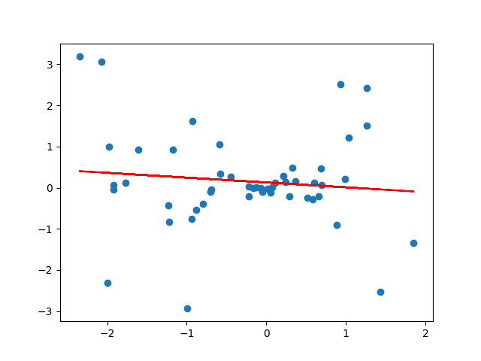
Mathematical Models
Another important statistical technique is ‘fitting’ mathematical models to our data, and measuring how incorrect that model is.
For example, say we had the following plot and wanted to determine how close to linear the relationship is (made in python):

Slide 11
Line of Best Fit
The red line you see below is the line of best fit for this data. That is, it is the best approximation of a linear relationship that we can find for this data set. Even though this data set is clearly non-liner (its actually random), we can fit a linear model to it and measure how inaccurate it is. This is key for understanding and testing for relationships.

Slide 12
Linear Regression
Linear regression is the primary method of identifying the line of best fit. Since most calculators, Excel, and Python have built-in methods for this method, I won’t go over it here, but you can find more information on it here: https://onlinecourses.science.psu.edu/stat501/node/250

Slide 13
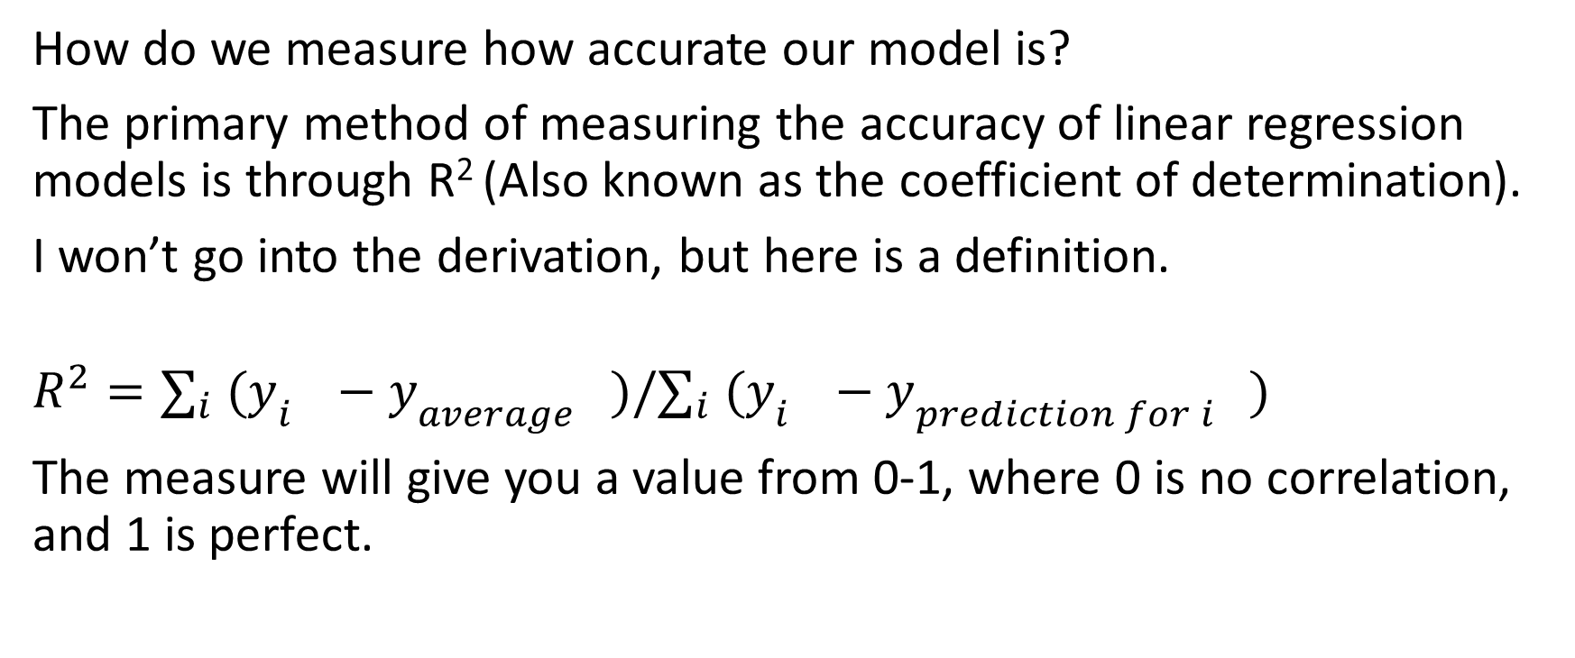
R²
How do we measure how accurate our model is?
The primary method of measuring the accuracy of linear regression models is through R² (Also known as the coefficient of determination).
I won’t go into the derivation, but here is a definition.
$$R^{2}=∑_{i} (y_{i^{}}−y_{{average}^{}})/∑_{i} (y_{i^{}}−y_{{prediction for i}^{}})$$
The measure will give you a value from 0-1, where 0 is no correlation, and 1 is perfect.

Slide 14
Other Error Measures
There are other methods for creating functions and measuring their error for, say , quadratic or exponential functions, but we won’t cover those. A very useful technique is to “linearize” your relationships, is essence manipulating them algebraically in order to achieve a linear relationship, over which to use these simpler methods on.
For those interested, here are a few other error functions:
https://en.wikipedia.org/wiki/Mean_squared_error
https://en.wikipedia.org/wiki/Chi-squared_test
https://en.wikipedia.org/wiki/Norm_(mathematics)

