Slide 1
A Framework for Data Standard Readiness
Brandon Sapp - Boeing

Slide 2
Bio?
Brandon Sapp, MIS, BSIT
18 years @ Boeing Commercial Airplanes
3 years @ PLM Consultant
US TAG Designated Expert to ISO TC184/SC4 and SC5
A&D PAG MBD Leader
PDES MBx User Group Co-Leader
ASME MBE

Slide 3
Presentation Overview
Problem Statement
Causes/Effects
Solution – Framework for Assessing Readiness

Slide 4
Problem Statement
Many organizations fail to realize the full and complete benefits of using industry data standards because they have not or inappropriately implemented them.

Slide 5
Causes/Effects
Cause 1: Knowledge of data standard’s intended use
Cause 2: Poorly implemented in business processes
Cause 2: Inadequate tools to create/consume the data in a standard
Cause 3: Supply chain ability to consume
Effect: Wasted Resources [Rework, Common tools, etc.]

Slide 6
Industry Framework
ISO TC 184 : Automation Systems and Integration
SC 5 : Interoperability, integration, and architectures for enterprise systems and automation applications
ISO/DIS 22549-1 : Assessment on convergence of informatization and industrialization for industrial enterprises
Part 1: Framework and reference model
ISO/CD 22549-2.2 : Assessment on convergence of informatization and industrialization for industrial enterprises
Part 2: Maturity model and evaluation methodology
Notes:
These standards serve as a framework and normalization guide for enterprises to promote the convergence of information technology into the processes of production and operations management.
The purposes of this document include, but not limited to, providing industrial enterprises guidance for:
assessing the current situation of CII
finding weakness within the CII
identifying ways to improve CII

Slide 7
Overview of Assessment Framework
Enterprise Assessment Objective
Assessment Expert Team
Industrial Enterprise Assessment Framework
Infrastructure
Domain Application
Enterprise Assessing
Comprehensive Integration
Collaborative Integration
Assessment Reference Model
Infrastructure
CII Level
Domain Application
CII Level
Comprehensive CII Level
Collaborative Integration
CII Level
Evaluation Questionnaires
Maturity Model
Aggregating
Extend of CII
Reference: ISO/DIS 22549-1:2019
CII: Convergence of Information and Industrialization

Slide 8
Breakdown of the Assessment Reference Model
Infrastructure
Domain
Comprehensive Integration
Collaborative Integration
Capital Investment
Process Design
Product Design
Equipment & Facilities
Materials Management
Production Management
Product Design & Manufacturing Integration
Information Security
Financial Management
Sales Management
Production Management & Control Integration
Organization & Planning
Project Management
Security Management
Production, Supply & Marketing Integration
Information Resources
Human Resource Management
Maintenance Management
Operation Decision Support
Quality Management
Document Management
Energy Management
Environment, Health, and Safety (EHS) Management

Slide 9
Maturity Model Definitions
Maturity Level Indicator | Descriptive Name | Characteristics
Level 0 | Unidentified | Little or no systematic documentation available
Level 1 | Identified | Tracking and traceability of materials, data and etc. Registration and management of data using information collection devices and systems.
Level 2 | Measured | Real time data acquisition of materials, machinery, process and human roles, and data integration. Measurement, aggregation, classification and management of data using information collection devices and systems. Synchronous history of data for the same time, same lot and same product.
Level 3 | Analyzed | Data analysis and optimized decision making using aggregated data.
Level 4 | Optimized | Automation of processes according to optimized decision making throughout the intra-enterprise and/or the inter-enterprises.
Level 5 | Customized | Self-diagnosis and self-healing through cyber-physical system [CPS], Internet of Things [IoT], artificial intelligence [AI], etc. Flexible production of customized products through autonomous control.

Slide 10
Assessment Method
Activity | Question | Maturity Level Indicator
Activity Name | Questions for maturity level 1 | 1
 | Questions for maturity level 2 | 2
 | Questions for maturity level 3 | 3
 | Questions for maturity level 4 | 4
 | Questions for maturity level 5 | 5
Evaluate Level 1 Questions
All YES
Evaluate Level 2 Questions
Maturity Level 0
All YES
Evaluate Level 3 Questions
Maturity Level 1
All YES
Evaluate Level 4 Questions
Maturity Level 2
All YES
Evaluate Level 5 Questions
Maturity Level 3
All YES
Maturity Level 4
Maturity Level 4

Slide 11
Breakdown of Activities and Sample Questions
Activity | Description
Environment Analysis | Use of IT systems and applications for environment analysis
Commodity Planning | Use of IT systems and applications supporting commodity planning
Design Automation | Use of designing software systems and smart connected technology for design
BOM/Parts Management | Use of BOM/Part management system
Engineering Change Management | Use of engineering change management systems
Prototyping | Use of IT systems and applications for prototyping and its validation
Advance Quality Management | Use of IT systems and applications for advance quality management
Activity | Description | Level
Design Automation | Do you design with 2D CAD? | 1
 | Do you design with 3D CAD? | 2
 | Do you analyze and validate with CAE? | 3
 | Do you design automatically with optimization solutions as one of the following? Model-Based Parametric Design Engineering-based Parametric design Integrated parametrical design | 4
 | Do you design a product by using smart connected technology such as IoT, AR/VR | 5
Activity | Description | Level
BOM/Parts Management | Do you upload the engineering BOM [E-BOM] to the system | 1
 | Do you integrate the E-BOM with 3D CAD? Do you generate the E-BOM automatically | 2
 | Do you generate the manufacturing BOM [M-BOM] automatically in PLM? Do you manage the software configuration in PLM? | 3
 | Do you configure the BOM according to the purpose of use such as procurement, process cost, production, and customer service for warranty, etc? | 4
 | Do you improve business through preliminary simulation using the BOM data according to the purpose of use? | 5

Slide 12
Modified Assessment Model
ISO
Assessment Reference Model
Modified Assessment Reference Model
Domain Application
Data Standard
Infrastructure
Tool Chain
Collaborative Integration
Internal Processes
Comprehensive Integration
Industry/Supply Chain

Slide 13
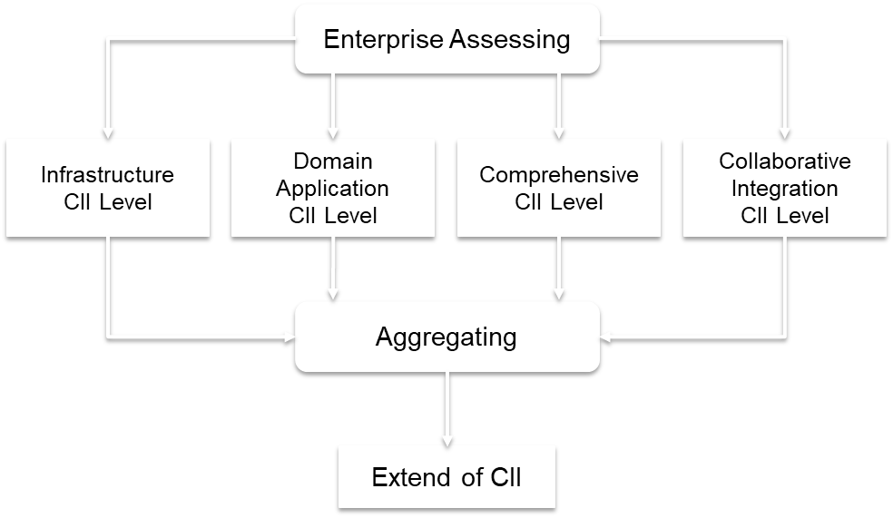
Modified Assessment System
ISO Assessment System
Modified Assessment System
1. Identify Business Processes
2. Identify Information Requirements
3. Identify Tool Chain Requirement
4. Identify Industry/Supplier Requirements
Aggregating

Slide 14
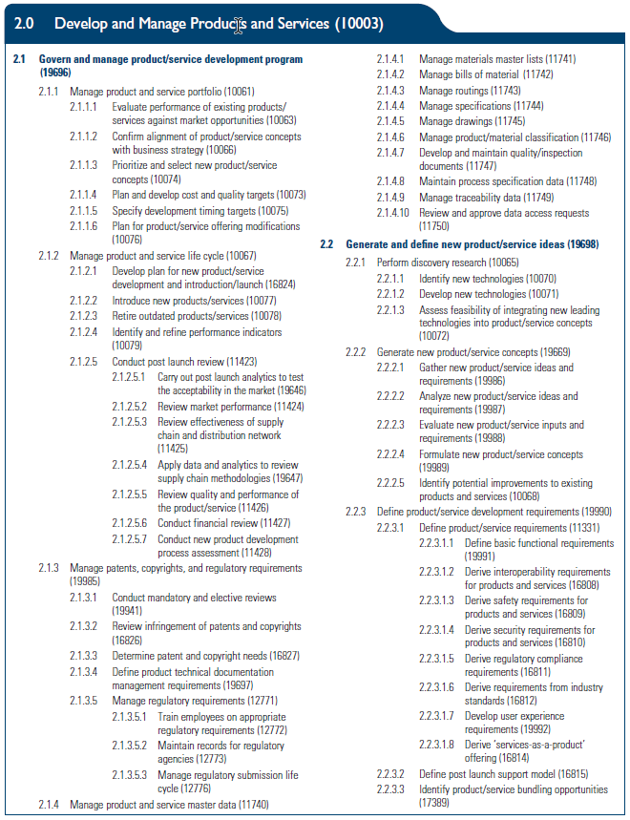
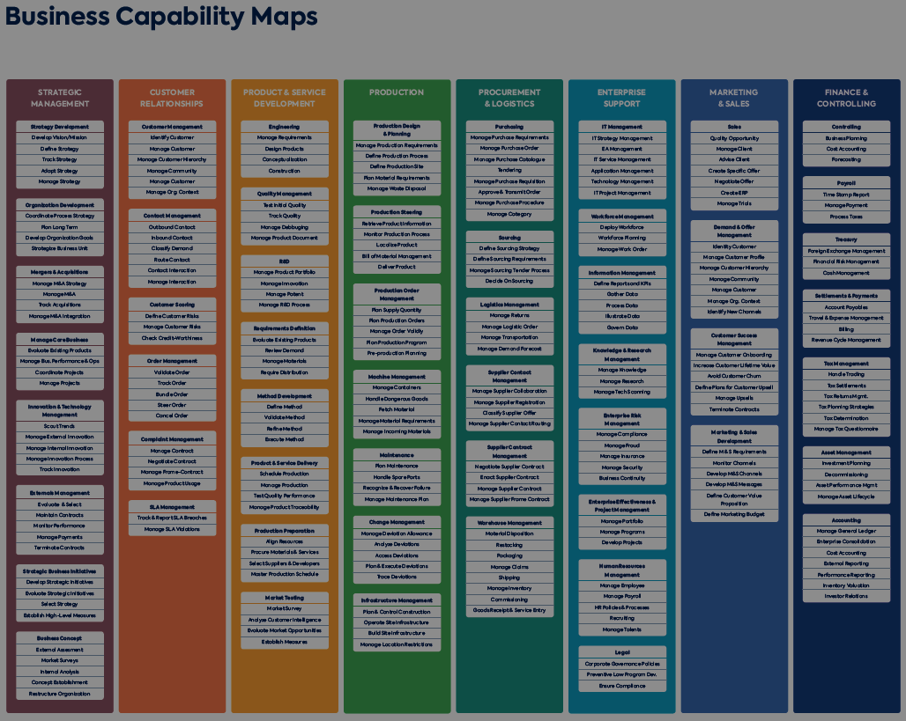
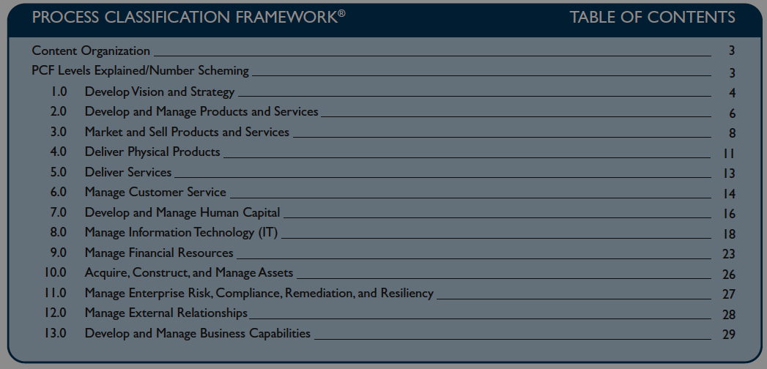
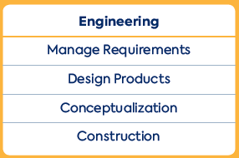
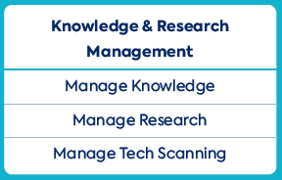
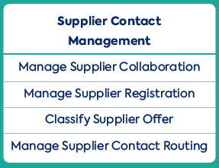
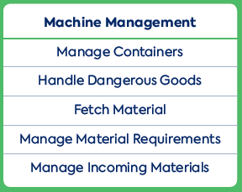
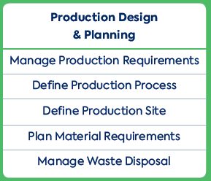
Identify Business Processes
Start with Business Capabilities
Breakdown to the Business Processes
Reference:
http://www.leanix.com
https://www.apqc.org

Slide 15
Identify Information Requirements
PEOPLE: Training, Certification, Skills, etc.
EX: 2 Classes, 1 Certification = 3
PROCESS: Business Instruction, User Guides, Modeling Requirements, etc.
EX: 2 BI, 5 UG, 2 MR = 9
DATA: [Used in STEP 2]
Modeling Requirements that define the format of the information artifacts in the applications that comply with the industry standard
TOOLS: [Used in STEP 3]
Software Applications used to create, manage or consume the information in the form of the data standard format

Slide 16
Identify the Tool Chain Requirements

Slide 17
Identify Industry/Supplier Requirements

Slide 18
Summary

Slide 19
References
ISO/DIS 22549-1:2019, Automation Systems and Integration – Assessment on Convergence of Information and Industrialization for Industrial Enterprises Part 1: Framework and Reference Model
ISO/CD 22549-2:2019, Automation Systems and Integration – Assessment on Convergence of Information and Industrialization for Industrial Enterprises Part 2: Maturity Model and Evaluation Methodology
ISO 15704, Industrial Automation Systems – Requirements for Enterprise-Reference Architectures and Methodologies

