Slide 1
Source code management with Jira and GIT
ISO/TC 184/SC 4: Industrial Data Living Lab
Brandon Sapp - Boeing
Melissa Harvey - Boeing
Kevin Le Tutour - Boost

Slide 2
TC 184/SC 4: Industrial Data
Source code management with Jira and GIT
Project Description:
ISO/TC 184/SC 4/WG 12 currently manages an extensive architecture and tool chain for a computer generated version of ISO 10303 that fully integrates all the parts of the standard coupled with integrated quality checks and publication to ISO. This tool chain is managed outside the ISO environment and is frequently challenged with support and technology obsolescence. This project deploys a GIT source code control server and associated defect management system within the ISO IT infrastructure enabling the concurrent development of ISO 10303 and its parts, including models, data schemas, validation and modeling tools. This is viewed as a prototype for other TC’s to follow for standards that utilize code management more than document management in the development of their standards.

Slide 3
Source code management with Jira and GIT
Project Leaders: B.Sapp; K.Le Tutour & Stephan Chatelet
Project Sponsor: Kenny Swope – ISO TC184/SC Chair
Project Summary:
Migrate & demonstrate issues management from Bugzilla to ISO Living Lab JIRA.
Migrate & demonstrate source code management from CVS/GIT to ISO Living Lab
Implement new Project Management capability using JIRA.
Integrate Issue/Project Management with new Source Code management environment.
Expected Benefits:
Mitigate risk of source code loss and configuration control lapses
Speed development of standards
Significantly enhance quality of standards
Stakeholders:
ISO TC184/SC4 Leaders, Industry Consumers, Developers
High level Plan:
Part 1 – Issue Management [Bugzilla Bugs]
Part 2 – Project Management [Tasks, SCRUMS, Projects, Dashboard, etc.]
Part 3 – Source Code Management [Data/Process Architecture Integration with JIRA, etc.]
  Part 3a – CVS2GIT [stepmod tool chain]
  Part 3b – GIT2GIT [steplib library]
Part 4 – Continuous Integration
Part 5 – Multi-user collaboration
Project Target:
Parts 1, 2, 3 for ISO 10303-242e3 NWI
Development branch
Testing & Validation branch
Capability Roadmap
(based on industry best practices)
Production

Slide 4
Project Parts Explained
Part1 – Issues Management
  Migrate Bugzilla information included attributes, comment history and attachments to the “Issue” object in JIRA
  Modify current workflows to utilize JIRA Issues workflows and lifecycle states – mapping of data required
Part2 – Project Management
  Implement and utilize the new JIRA object types: Projects, Tasks, Sub-Tasks, etc.
  Validate the workflow and change process when a Change Request is authorized. Demonstrate GIT branching to manage the Statement of Work.
Part 3 – Source Code Management
  Implement three GIT Repositories [STEPMod, STEPLib, STEPDev]
  Convert data from existing CVS repository and populate the GIT repositories
  Validate data conversion mapping
  Demonstrate branching from the Development Branch for release
Part 4 – Continuous Integration [Pipelines]
  Capture requirements to validate the integration, perform quality checks and build the required ISO documentation upon Branch Merger.
Part 5 – Multi-user collaboration
  Demonstrate advanced collaboration capabilities that refine business processes, data models and proposals

Slide 5

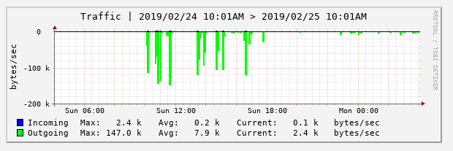
Existing Bugzilla Re-hosted
LKSoft requested that WG12 re-host the existing Bugzilla instance
PDES Purchased Bugzilla Hosting from RoseHosting.com
  http://www.step-bugzilla.com << new
  Some anomalies have been found, e.g. Missing Bugs ~169 out of 7488.
    Early analysis suggest they are missing from previous instance as well.
  Data transfer limits
  Bugzilla individual file size 1mb > 20mb

Slide 6
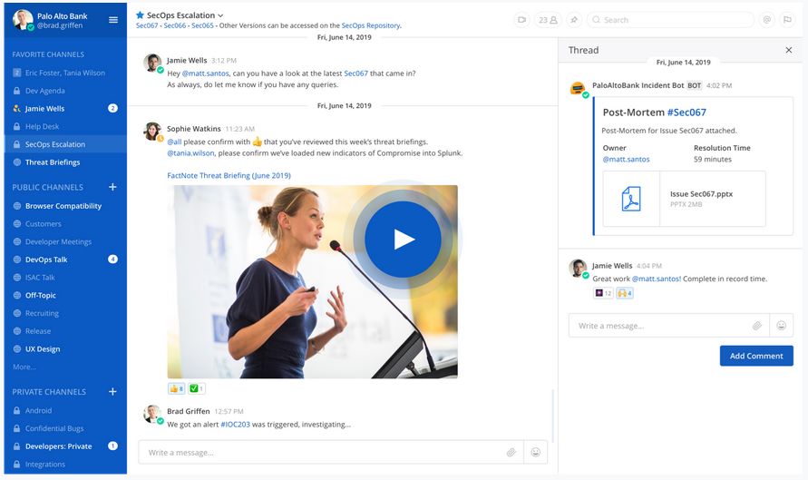


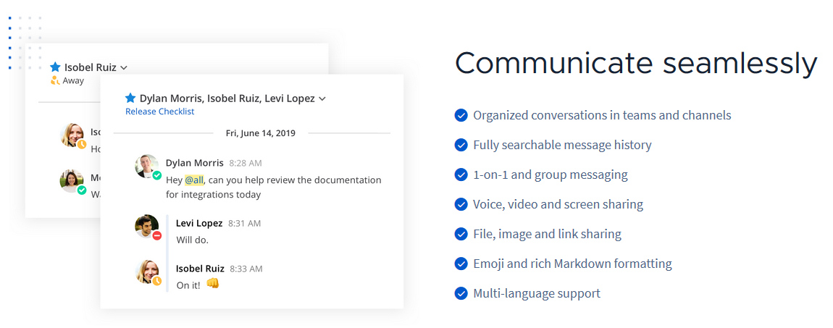
Other Advantages to Managed Hosting

Slide 7
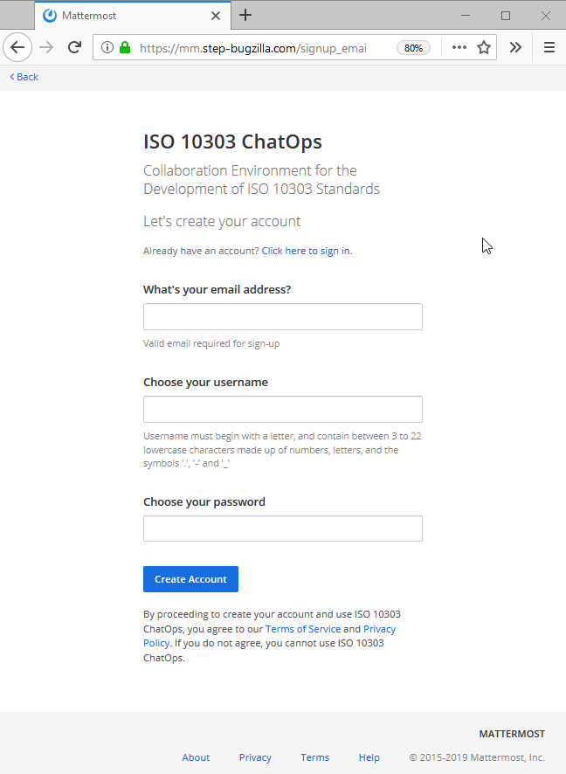
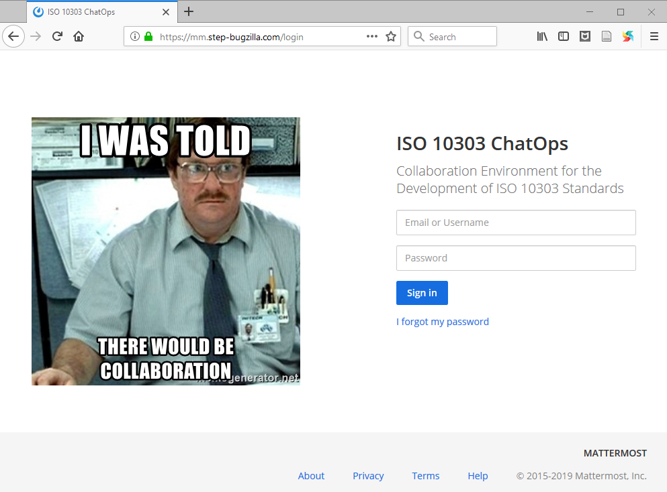
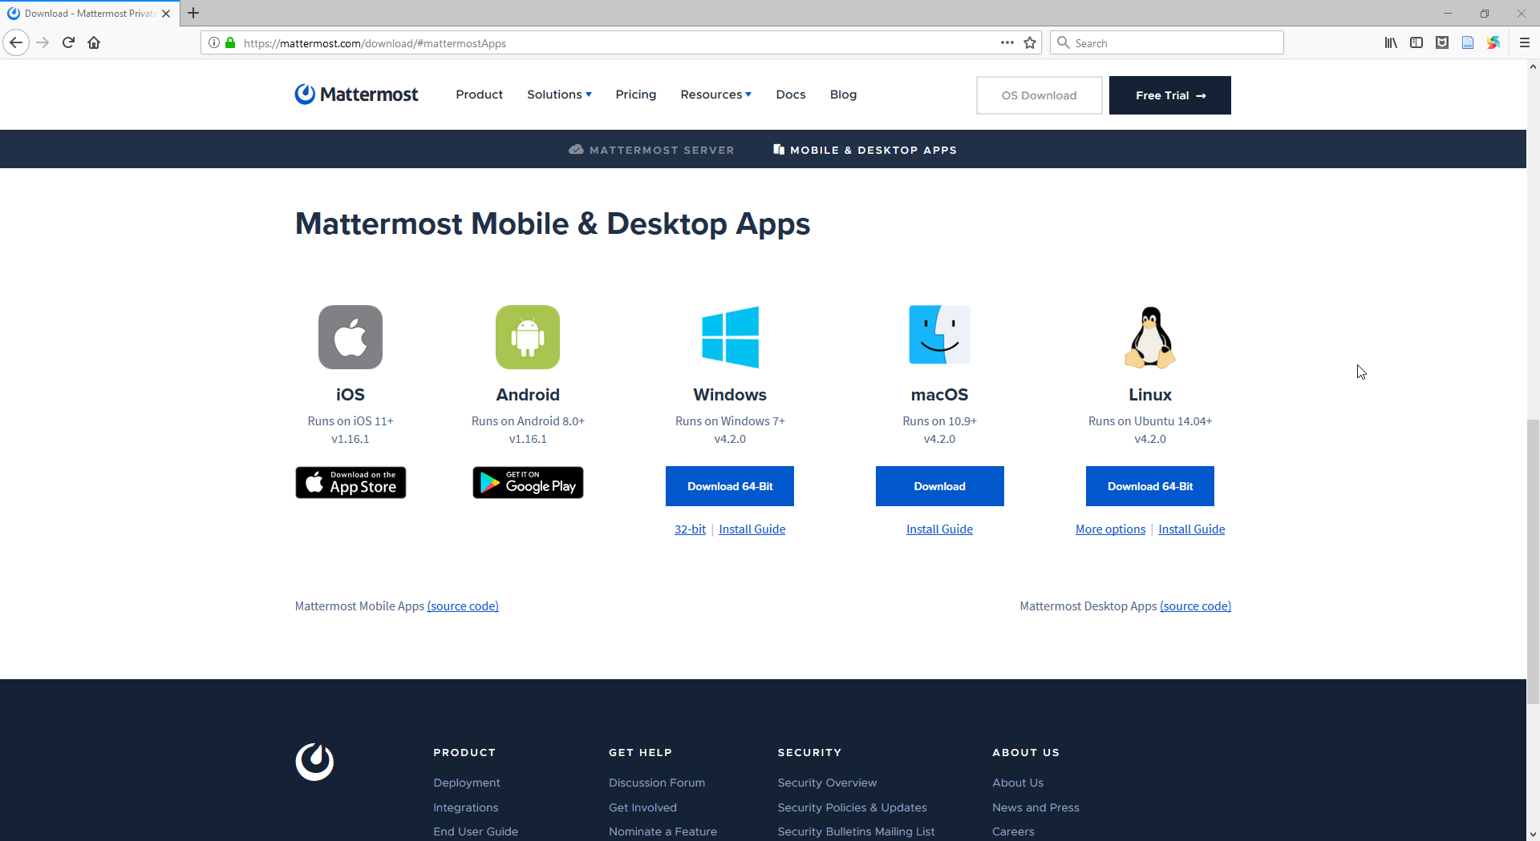
Other Advantages to Managed Hosting
Sign up Link: https://mm.step-bugzilla.com/signup_user_complete/?id=f4z9xyyec3nd8ppc386t7jgo9c
Login Link: http://mm.step-bugzilla.com/
Client Download: https://mattermost.com/download/#mattermostApps

Slide 8
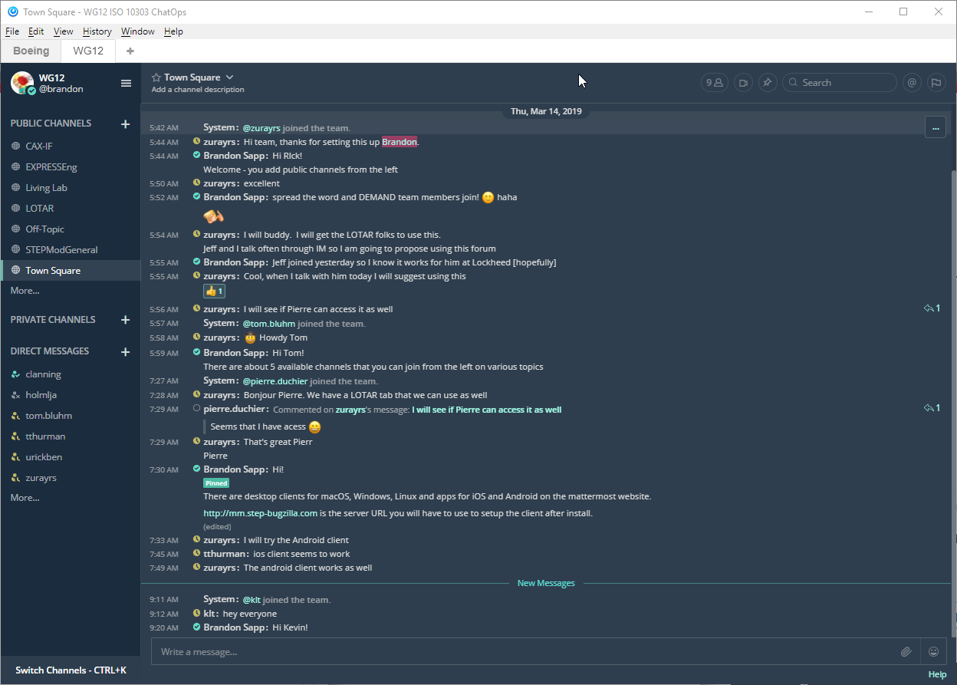
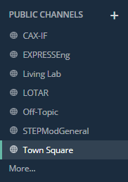
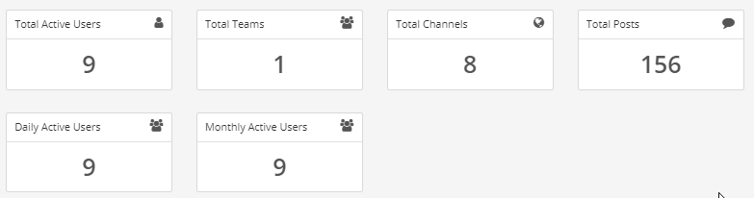
Benefits
Social benefits
  Increased collaboration
  Increased sharing of domain knowledge
  Increased visibility and awareness
  Enhanced learning
  Improved empathy
Process and technical benefits
  Increased automation [integration with JIRA, GIT, etc.]
  Increased speed of actions and executed commands
  Improved security and safety
  Automatic logging of conversations and actions
  Synchronous communication
  Reduction in email
3 days of usage

Slide 9
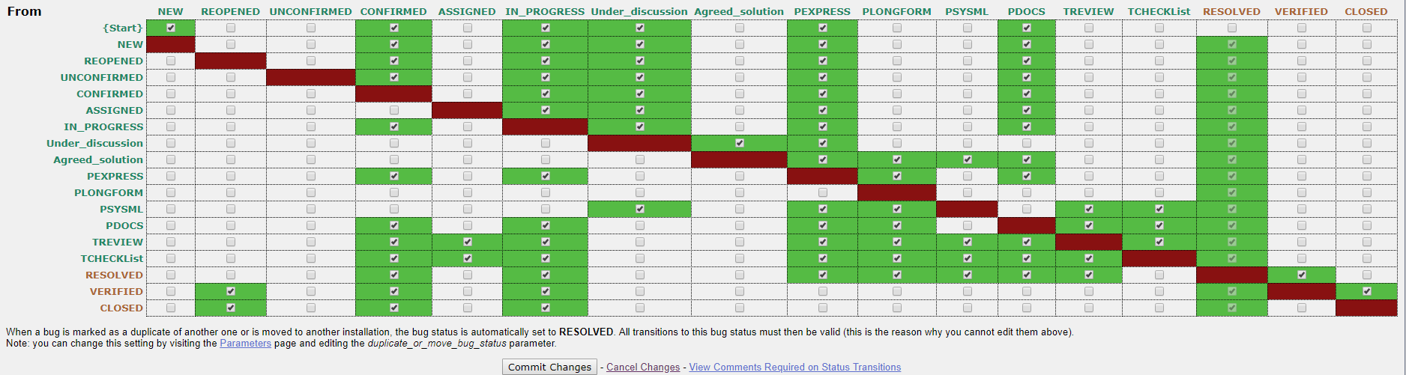
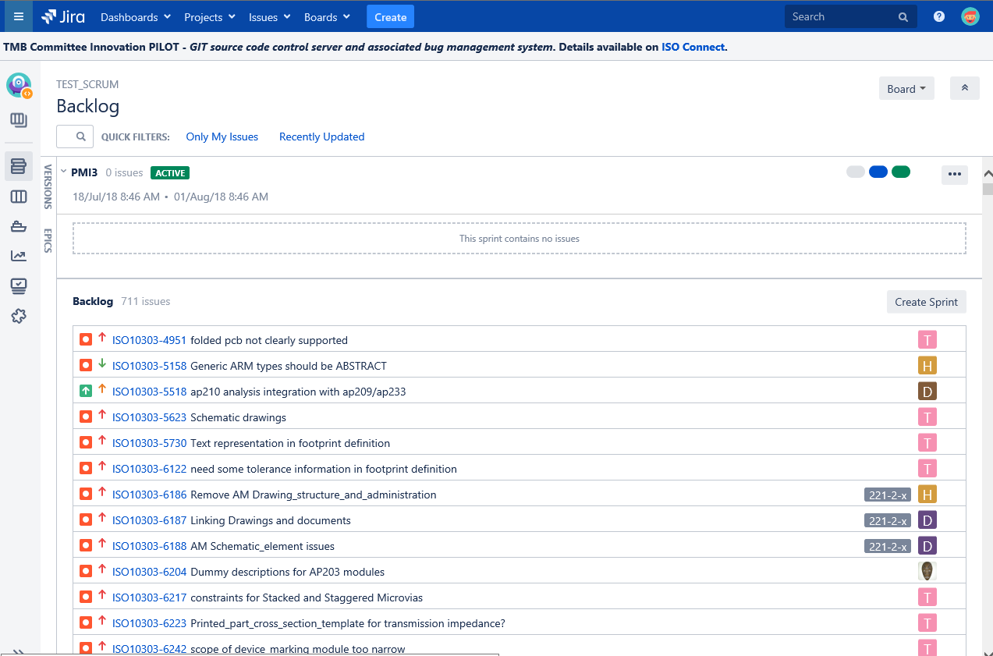
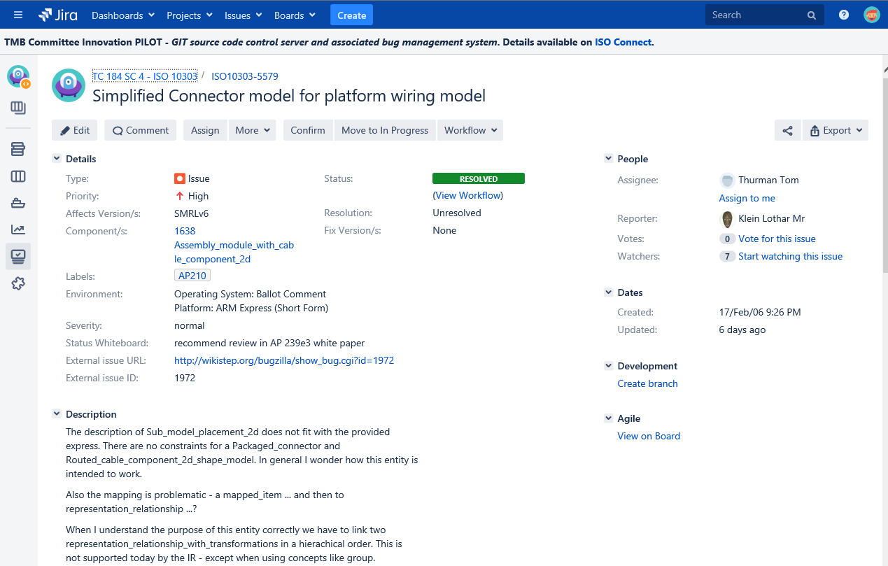
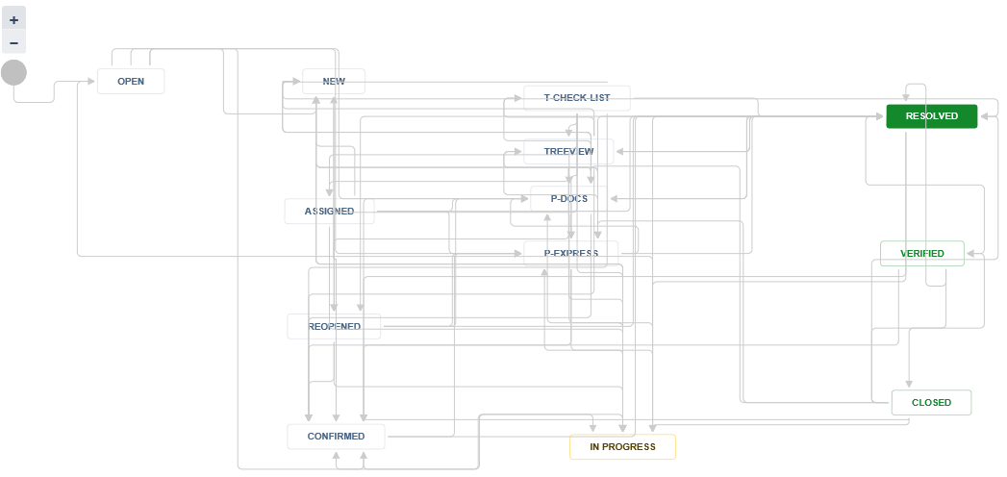
Part 1 & 2: Issues/Project Management
Bugzilla Workflow migrated
Backlog management
Detailed Issue example
Workflow demonstrated
Basic structures of JIRA Issues and Project Management demonstrated.
Data conversion process from Bugzilla to JIRA demonstrated.
Out of the box capabilities using industry best practices for issue management were used.

Slide 10
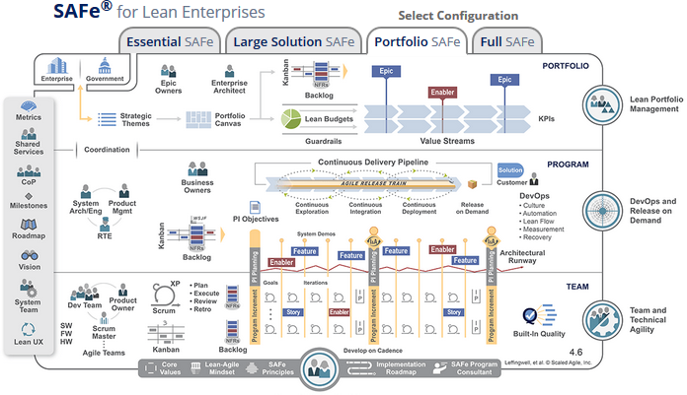
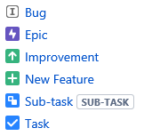
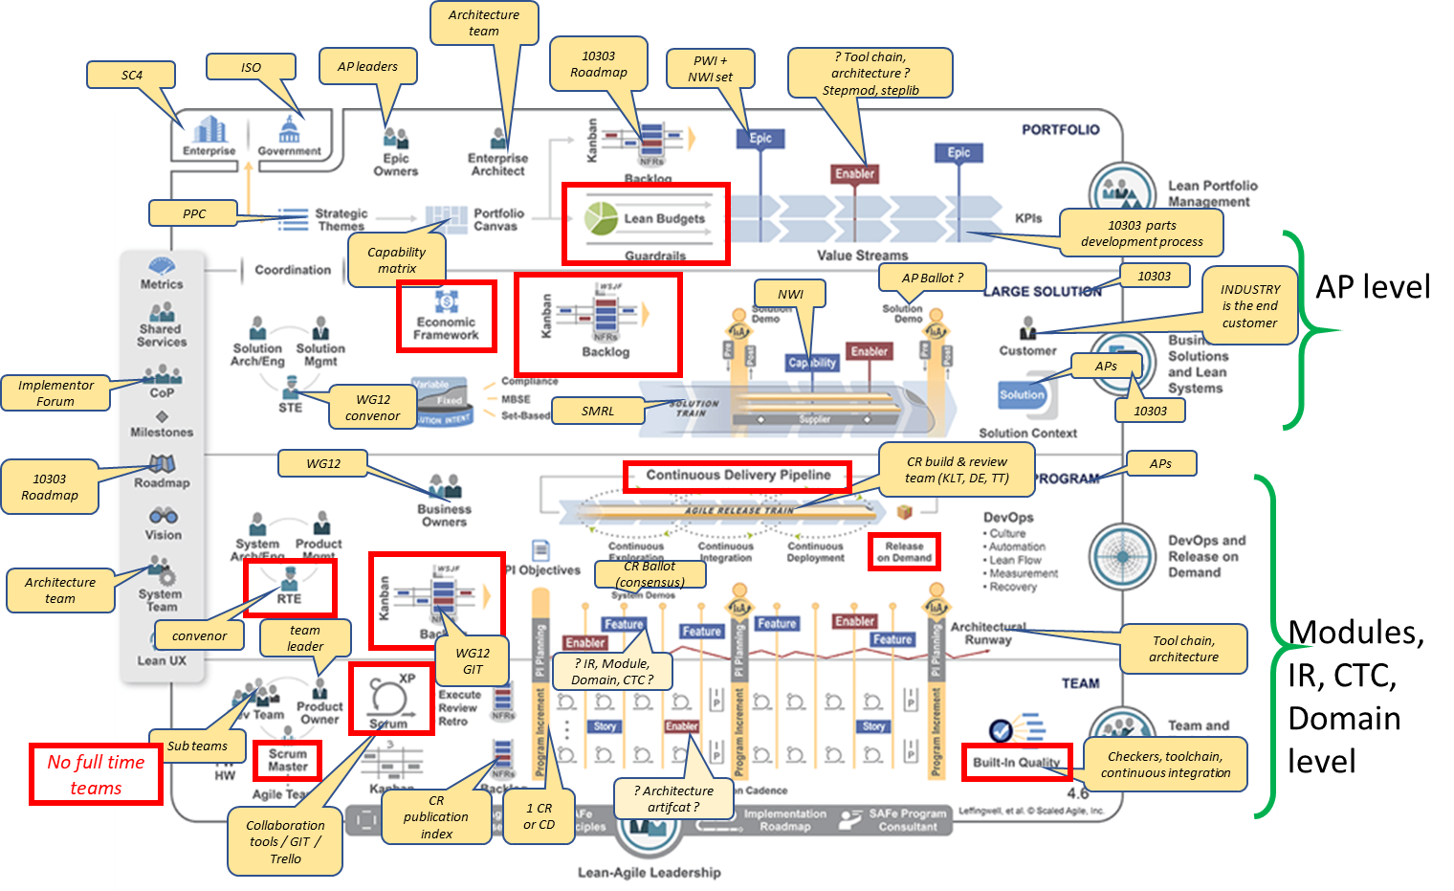
Adopt Agile Workflow
Project goal to use agile development methods to accelerate development and publication of standards
SAFe Agile Framework
Existing ISO Development Terms and Team Structure
JIRA Objects for Agile

Slide 11
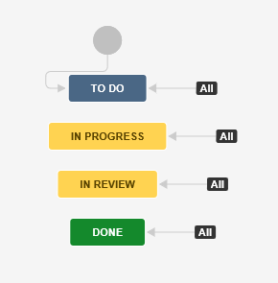
Adopt Agile Workflow
Overall Backlog
All ISO Work items will be an EPIC
Bugs from Bugzilla
Standard Workflow
New Bugs/Features

Slide 12
Clean Up Bugzilla
Bugzilla Projects
10303 Recommended Practices : 114 Bugs : Recommend ARCHIVAL
P210 IS1 : 1105 Bugs : Recommend ARCHIVAL
Express Engine : 66 Bugs : Recommend MIGRATION to ISO Living Lab TC 184 SC 4 Utilities Project
ISO 10303 : 5208 Bugs : Recommend MIGRATION to ISO Living Lab Bugzilla Backlog
ISO 14306 : 14 Bugs : Recommend ARCHIVAL
ISO 29002 : 0 Bugs : Recommend DELETION
SC4 Standing documents : 27 Bugs : Recommend MIGRATION to ISO Living Lab TC 184 SC 4 Standing Documents Development and Management Project
stepmod environment and Utilities : 490 Bugs : Recommend MIGRATION to ISO Living Lab TC 184 SC 4 Utilities Project
test : 1 Bugs : Recommend DELETION
WG12 Policy : 2 Bugs : Recommend MIGRATION to ISO Living Lab TC 184 SC 4 Standing Documents Development and Management Project

Slide 13
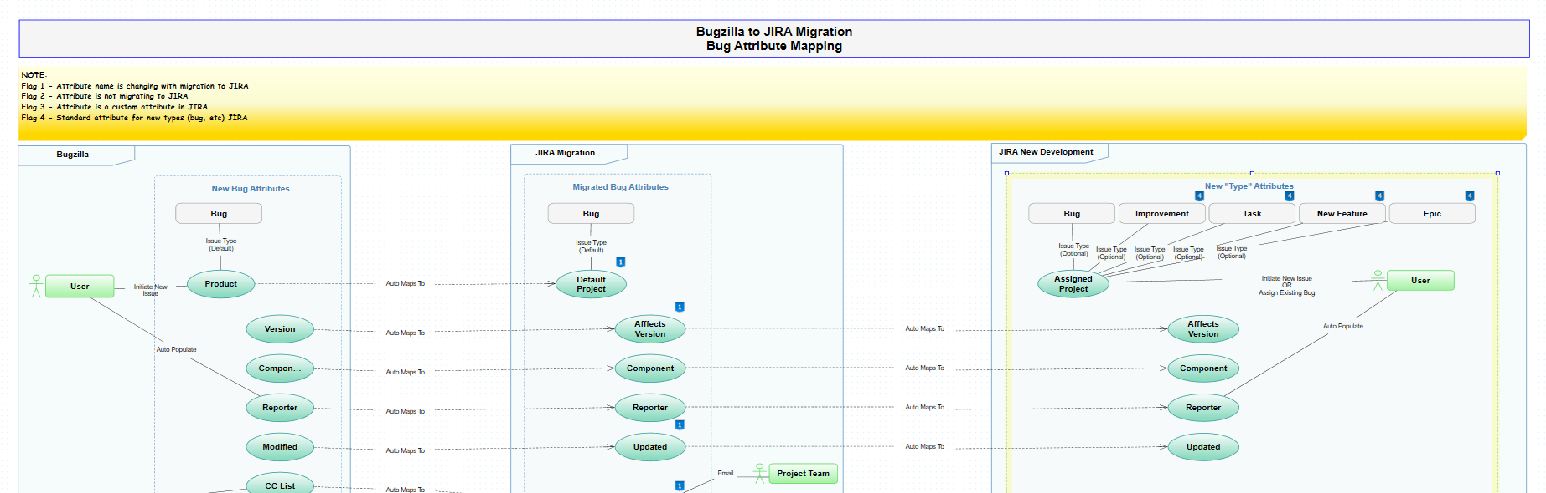
Attribute Analysis and Mapping
10 Custom attributes that need to be reviewed
Bugzilla > JIRA Bugzilla Backlog Project > JIRA Agile Project

Slide 14
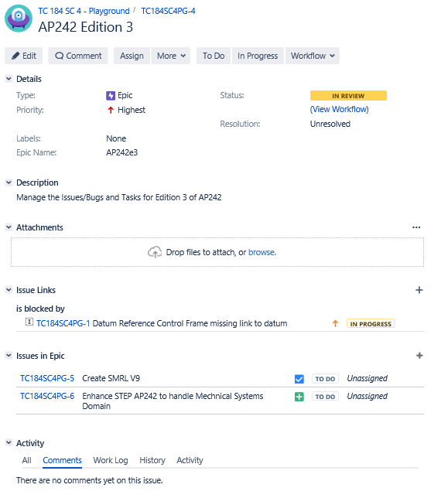
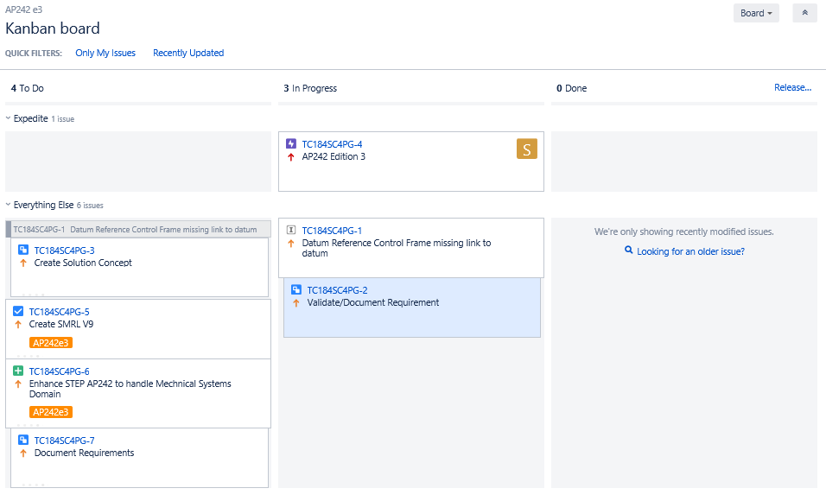
Adopt Agile Workflow
AP242e3 EPIC
KANBAN Board for AP242e3 EPIC

Slide 15
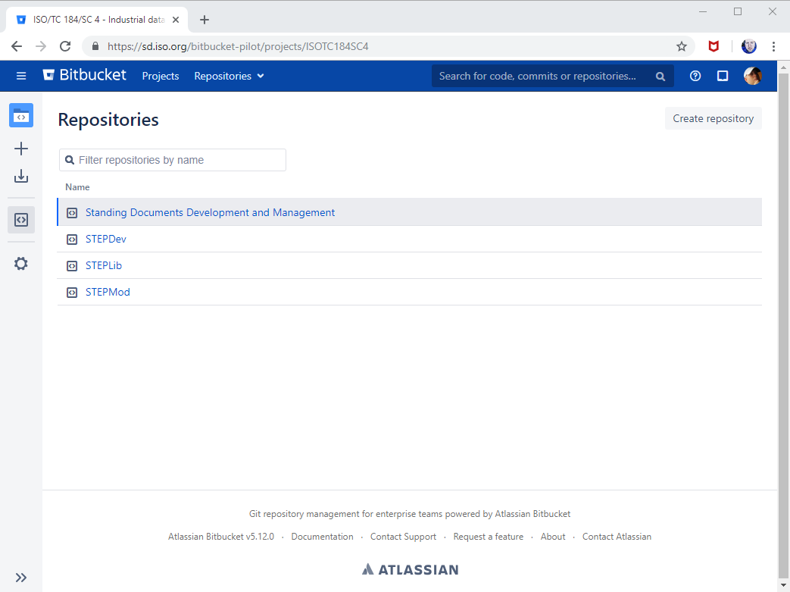
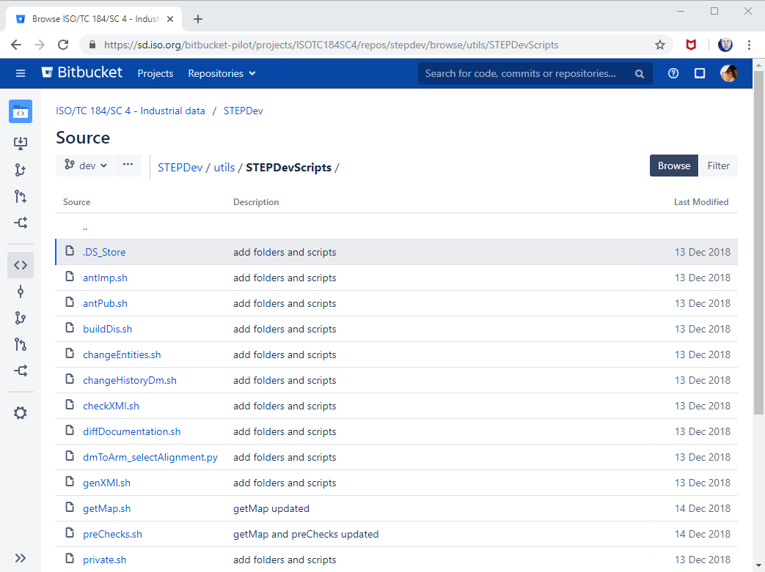
Part 3: Source Code Management of ISO 10303 models
Model Repositories
Code files in one Repository with traceability
Populated STEPDev repository with scripts and utilities that perform the automated quality checks of ISO 10303.
Used GIT as a source code repository and demonstrated configuration control.
Data conversion (CVS to GIT) required to convert from CVS STEPMOD to GIT STEPMOD, required task for production.

Slide 16


Recommendations
ISO/TC 184/SC 4 will take the action to propose a Living Lab project to the LL TF demonstrating Atlassian Bamboo as a continuous integration solution with ISO 10303
Capability Roadmap
Development branch
Testing & Validation branch
Production
ISO/TC 184/SC 4 recommends the following actions from this work
  Move ISO JIRA and ISO GIT from pilot status to production
  Support ISO/TC 184/SC 4 with a production data conversion of JIRA and GIT supporting ISO 10303-242 ed3 (end of 2019 forecast)

Slide 17
STEP Short to Long Form Transition
Requirements:
  Generate a LF per ISO 10303-11 Annex G
  Open Source
    Community can assist in the development of enhancements/improvements/bug fixes
  Multi-Platform [x86, Amd64, Arm64, Windows, Linux. Etc.]
  Continuous Integration Ready
    Speeds integration analysis
    Reduces Patches
Express Engine is already part of the process pipeline for checking, graphing for visualization, comparing, etc.
Express Engine is part way through the development process that creates a basic Long Form.

Slide 18
Developer Analysis of Progress
Ready for Test:
Create new Longform schema
Add contents of Shortform schema
Add USE resources
Add REFERENCE resources
Add Implicit resources
Conversion of Extensible ENUMERATION
Conversion of Extensible SELECT
Pretty Print resulting Longform Schema
In-Development:
Conversion of Attributes RENAMED in a Re-declaration
To Do:
Prune Unused items
Conversion of SUBTYPE_CONSTRAINT
Conversion of Abstract Entity and Generalized Types

Slide 19
Summary
Proved migration of Bugzilla bugs to JIRA Issues [along with workflow]
Proved use of STEPDev GIT repository for STEP development tools
ISO IT piloting Living Lab until end of 2019
To do in 2019:
Establish Agile Workflow with new JIRA objects
Finish 10303-11 Annex G Implementation of Long Form generation in Express Engine
CVS to GIT Migration:
  Investigate the cvs2git migration tools to complete migration of STEPMOD source code.
  Design changes to development/publication workflow [e.g., branching]
Move STEPLib [AP243, AP242/239 Domain/Core Model]

Slide 20
ISO/TC 184/SC 4 - Industrial Data
Brandon Sapp | The Boeing Company
Address: 9902 24th Place W., Everett, WA 98204-1404
Mobile: 425.471.9712 | Desk: 425-865-3111
Email: brandon.sapp@boeing.com
Melissa Harvey Sapp | The Boeing Company
Address: 9902 24th Place W., Everett, WA 98204-1404
Phone: 425-234-5422
Email: Melissa.K.Harvey@boeing.com
Kevin Le Tutour | Boost Conseil
Address: 30 rue de Miromesnil 75008 Paris
tel: +33 144 568 750 | gsm: +33 663 591 281
kevin.letutour@boost-conseil.com | www.boost-conseil.com
Stéphane Châtelet | ISO director information technology services | iso central secretariat | phone: +41 22 749 02 39 | mobile: +41 78 881 24 43
International Organization for Standardization
ISO Central Secretariat Chemin de Blandonnet 8 Case Postale 401
CH – 1214 Vernier, Geneva
Switzerland
iso.org
© ISO, 2015
All rights reserved ISBN 978-92-67-10648-9

Slide 21
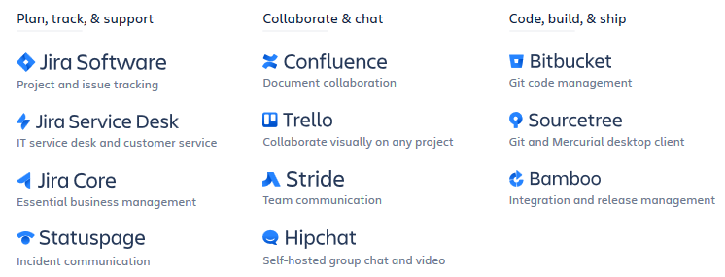
Atlassian Products
Part 1 & 2
Part 3a & 3b
For the configuration of the demonstration, ISO installed Jira and Bitbucket and integrated to the ISO Single Sign on Federation. Basic structures and configuration were provided by ISO CS IT.

Slide 22
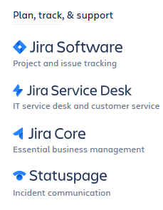
Part 1 & 2: Issues/Project Management
Current State:
  Mozilla’s Bugzilla operating LKSOFT company servers
  Access Control not managed by ISO Global Directory
  Used for both Issue Management and Project Management with multiple process workarounds
  Dated technology from 1998 [20 years old]
    No dashboards
    No real time tracking
    No integration with source code repository
Future State:
  Atlassian JIRA on ISO Server
  Access control by ISO Global Directory
  Dedicated object types and flows for issues, requirements, tasks, sub-tasks, epics, scrums, etc.
  Linked to source code repository
  High support for AGILE development processes:
    Dashboards
    Kanbans
    EPICs, SCRUMS
https://dzone.com/articles/which-one-to-choose-jira-or-bugzilla-training

Slide 23

Part 3: Source Code Management of ISO 10303 models*
Current State [2nd Generation Technology]:
  Sourceforge CVS for “stepmod” source code
  Access Control not managed by ISO Global Directory
  Older Technology first developed in 1990 [28 years old]. Last updated in 2011 [7 years]
    Merge before commit
    No collaboration or development areas
    No integration with Issues/Project management tools
Future State [3rd Generation Technology]:
  Atlassian BitBucket [GIT] on ISO Server
  Access control by ISO Global Directory
  Version Control System of choice for today’s developers
    Integrated with JIRA
    Decentralized and distributed architecture
    Commit before merge capabilities
    Integrated quality controls
*EXPRESS (ISO 10303-11) is a data modeling language used to develop ISO 10303 documentation.
ISO 10303 is created by modeling data structures and “compiling” documentation from the models.
Stepmod is the internally developed code base that integrates the ISO 10303 parts for publication.

Slide 24
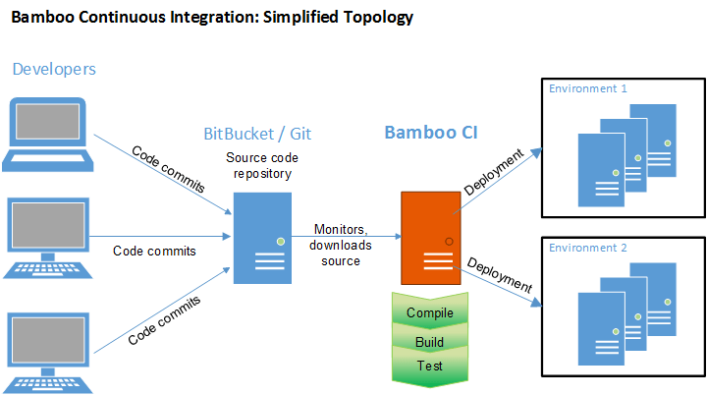
Part 4: Continuous Integration/Pipelines
Continuous Integration enables publication and deployment beyond source code control.
This functionality was not evaluated for this pilot and a necessary component to reduce publication time.

Slide 25
Atlassian Products
To accomplish all 5 parts of the capability roadmap, the highlighted products are required.

