Slide 1
Source code management with Jira and GIT
ISO/TC 184/SC 4: Industrial Data Living Lab
Brandon Sapp - Boeing
Melissa Harvey - Boeing
Kevin Le Tutour - Boost

Slide 2
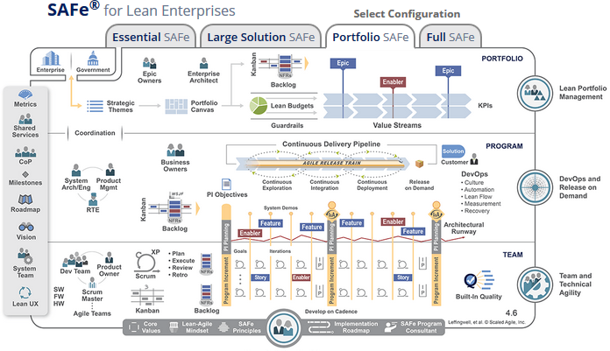
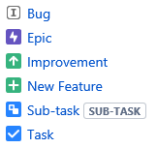
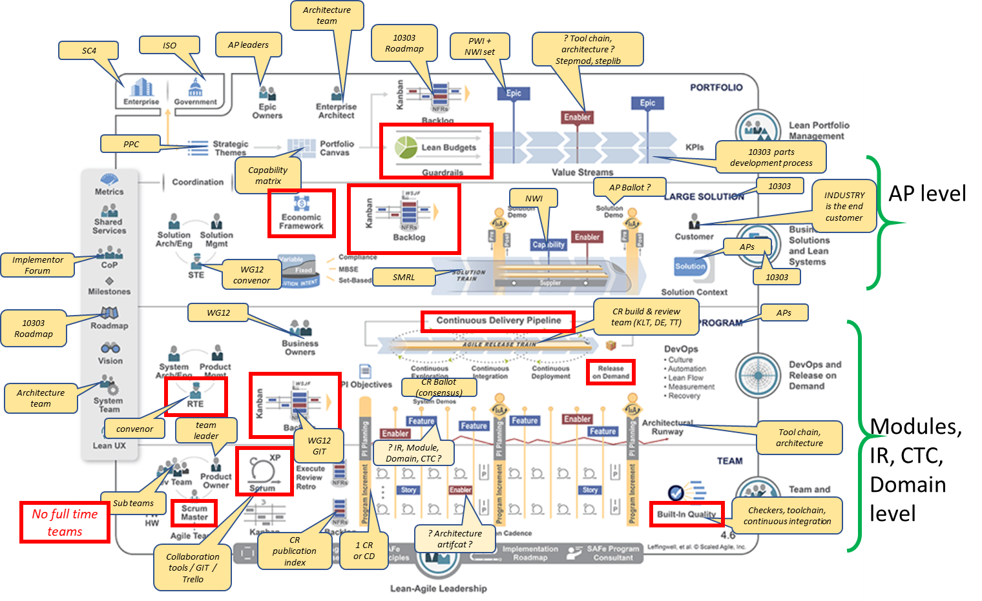
Adopt Agile Workflow
Project goal to use agile development methods to accelerate development and publication of standards
SAFe Agile Framework
Existing ISO Development Terms and Team Structure
JIRA Objects for Agile

Slide 3
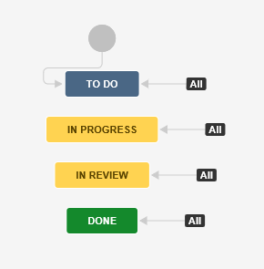
Adopt Agile Workflow
Overall Backlog
All ISO Work items will be an EPIC
Bugs from Bugzilla
Standard Workflow
New Bugs/Features

Slide 4
Clean Up Bugzilla
Bugzilla Projects
10303 Recommended Practices : 114 Bugs : Recommend DELETION [Confirmed by Jochen]
P210 IS1 : 1105 Bugs : Recommend ARCHIVAL [zip on SC4 Dropbox]
Express Engine : 66 Bugs : Recommend MIGRATION to ISO Living Lab TC 184 SC 4 Utilities Project
ISO 10303 : 5208 Bugs : Recommend MIGRATION to ISO Living Lab TC 184 SC 4 WG12
ISO 14306 : 14 Bugs : Recommend ARCHIVAL [zip on SC4 Dropbox]
ISO 29002 : 0 Bugs : Recommend DELETION
SC4 Standing documents : 27 Bugs : Recommend MIGRATION to ISO Living Lab TC 184 SC 4 Standing Documents Development and Management Project
stepmod environment and Utilities : 490 Bugs : Recommend MIGRATION to ISO Living Lab TC 184 SC 4 Utilities Project
test : 1 Bugs : Recommend DELETION
WG12 Policy : 2 Bugs : Recommend MIGRATION to ISO Living Lab TC 184 SC 4 Standing Documents Development and Management Project

Slide 5
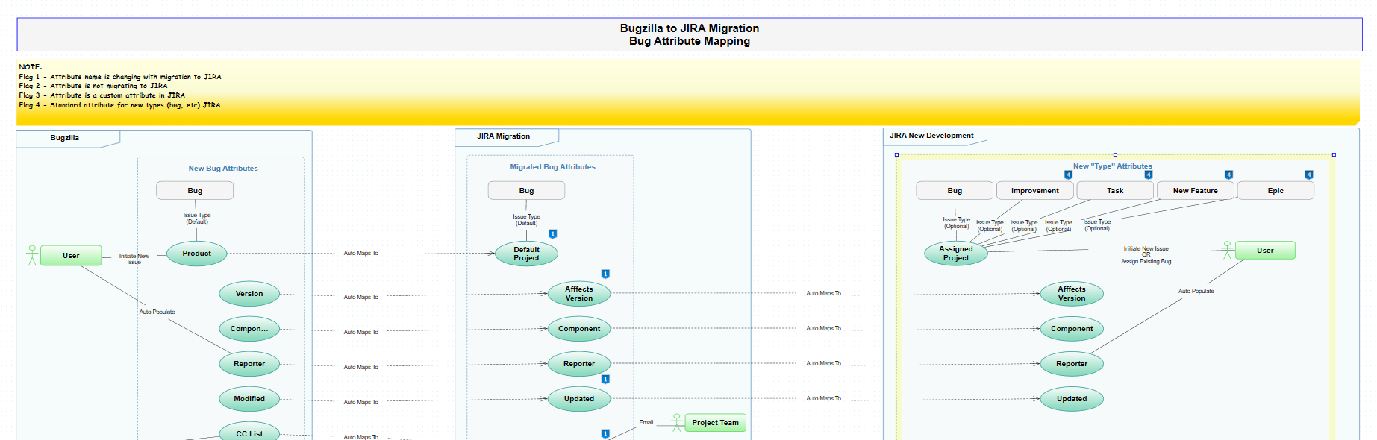
Attribute Analysis and Mapping
10 Custom attributes that need to be reviewed
Bugzilla > JIRA Bugzilla Backlog Project > JIRA Agile Project

Slide 6
Next STEPS
Confirm with WG leaders their impacts:
  Using JIRA and Scaled Agile [SAFe Requirements model, Project Management]
  Agreement on Recommendation for Bugzilla historical data
  Cutover date
By request of SC4 Chair – Plan for implementation/cutover, by WG, to be approved at the November ISO TC 184/SC4 meeting in November.

Slide 7
ISO/TC 184/SC 4 - Industrial Data
Brandon Sapp | The Boeing Company
Address: 9902 24th Place W., Everett, WA 98204-1404
Mobile: 425.471.9712 | Desk: 425-865-3111
Email: brandon.sapp@boeing.com
Melissa Harvey Sapp | The Boeing Company
Address: 9902 24th Place W., Everett, WA 98204-1404
Phone: 425-234-5422
Email: Melissa.K.Harvey@boeing.com
Kevin Le Tutour | Boost Conseil
Address: 30 rue de Miromesnil 75008 Paris
tel: +33 144 568 750 | gsm: +33 663 591 281
kevin.letutour@boost-conseil.com | www.boost-conseil.com
Stéphane Châtelet | ISO director information technology services | iso central secretariat | phone: +41 22 749 02 39 | mobile: +41 78 881 24 43
International Organization for Standardization
ISO Central Secretariat Chemin de Blandonnet 8 Case Postale 401
CH – 1214 Vernier, Geneva
Switzerland
iso.org
© ISO, 2015
All rights reserved ISBN 978-92-67-10648-9

