Slide 1

AB Test
Flex Lux vs 50% off Intro Offer (Classics 12, Classics 6, Pops 7)

Slide 2
The Experiment/Summary
This was meant to determine the efficacy of offering a 50% off intro package to either Classics 12, 6, or Pops 7 (excluding any CYO) vs offering a Flex Lux package.
Treatment A: Received the 50% off offer
Treatment B: Received the Flex Lux offer
Treatment A:
Sample Size: 27,730
Conversions: 22
Avg Price Paid: $595.23
Treatment B:
Sample Size: 28,864
Conversions 28
Avg Price Paid: $613.36

Slide 3
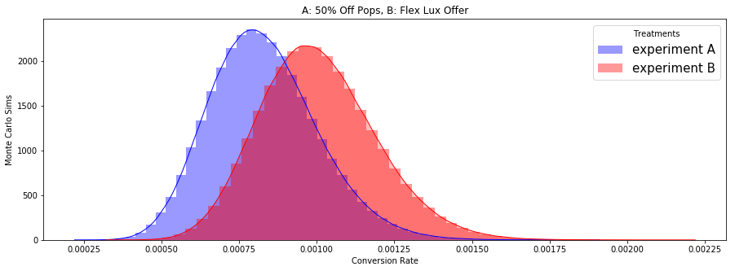
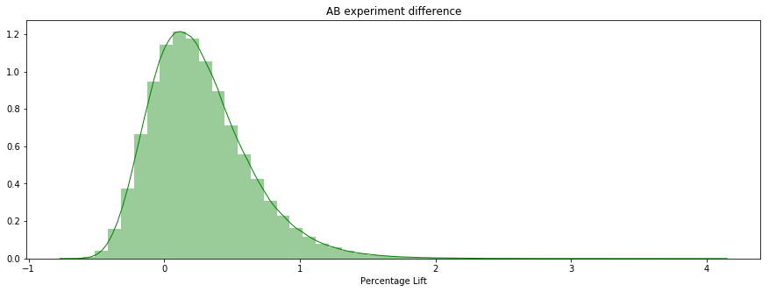
Observed Monte Carlo
Although the summary results appear to show that treatment B is superior to A, we cannot say with 100% certainty as there is overlap between the distributions. The relative difference shows the possible lift observed from B over treatment A. The lower part of the distribution goes below zero indicating a potential for negative lift (A outperforms B). If we seek 100% accuracy (which we shouldn’t) we need further testing.

Slide 4
Results/ROI
That said, we are 75% confident that treatment B – Flex Lux – converts at a higher rate than treatment A. We expect that conversion lift to be 21.5%.
Given that expected lift holds true, had we only offered treatment B to all customers within our experiment population, we would have increased our revenue by $2,942.68.
We should focus our efforts on selling Flex Lux and not fixed packages. We sell them at a higher conversion rate and at a higher average price for those within the population of our experiment.

