Slide 1

Donor Retention Analysis
Description:
This is to determine retention, upgrade, downgrade, new, and attrition for donors at Pacific Symphony. The time period is over a ten-year span starting in fiscal year 10 and ending in fiscal year 19. Tiers are based on provided donor levels as broken out by the development team.
Definitions:
Retained – Donor made contribution in current year within the same tier in the prior year.
Upgrade – Donor made contribution in current year in a higher tier than in the prior year.
Downgrade – Donor made contribution in current year in a lower tier than in the prior year.
New – Donor made contribution in current year but did not make contribution in prior year.
Lapsed (attrition) – Donor did not make contribution in current year but made contribution in prior year.
Donor Tiers:
$1 - $99.99
$100 - $299.99
$300 - $499.99
$500 - $999.99
$1,000 - $2,499.99
$2,500 - $4,999 .99
$5,000 - $9,999.99
$10,000 - $19,999.99
$20,000 - $29,999.99
$30,000 - $49,999.99
$50,000 - $99,999.99
$100,000+

Slide 2
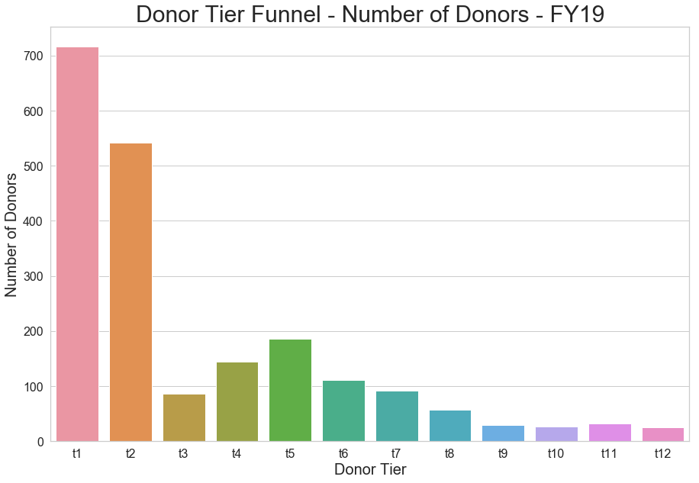
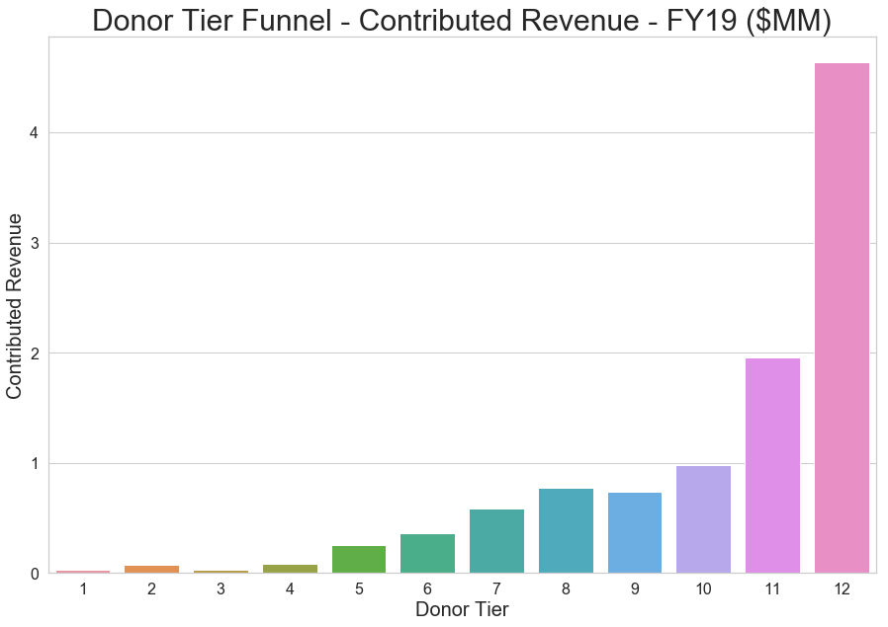
Donor Retention Analysis
Let’s start with an overview of the donor funnel from a total donor standpoint and from a revenue standpoint.

Slide 3
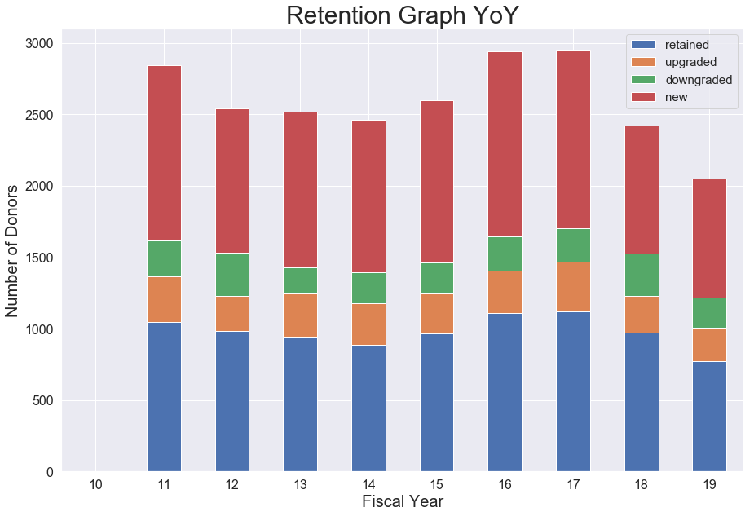
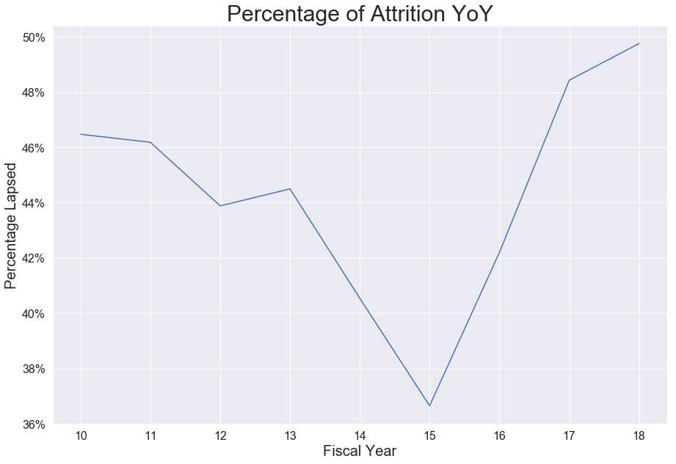
Donor Retention Analysis
Initially, we can look at the retention across all of donor contributions in its entirety before breaking it out by tier.

Slide 4
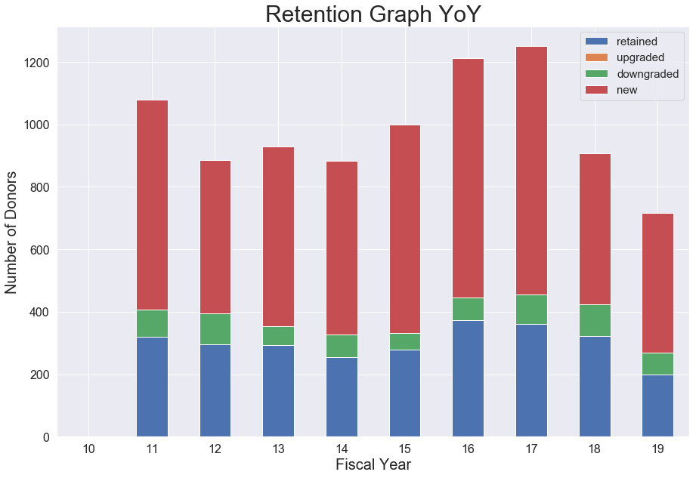
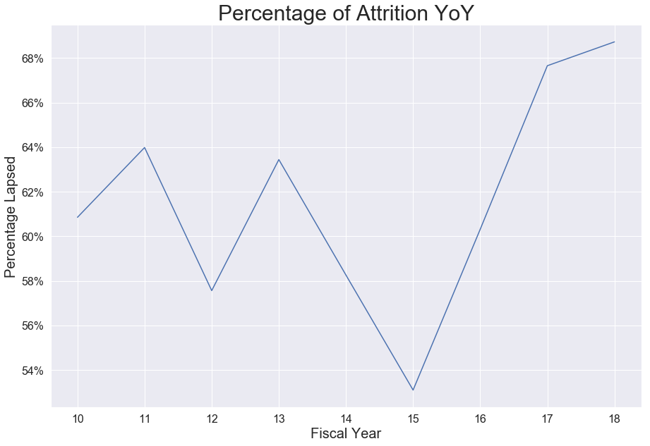
Donor Retention Analysis
Tier 1 : $1 - $99.99

Slide 5
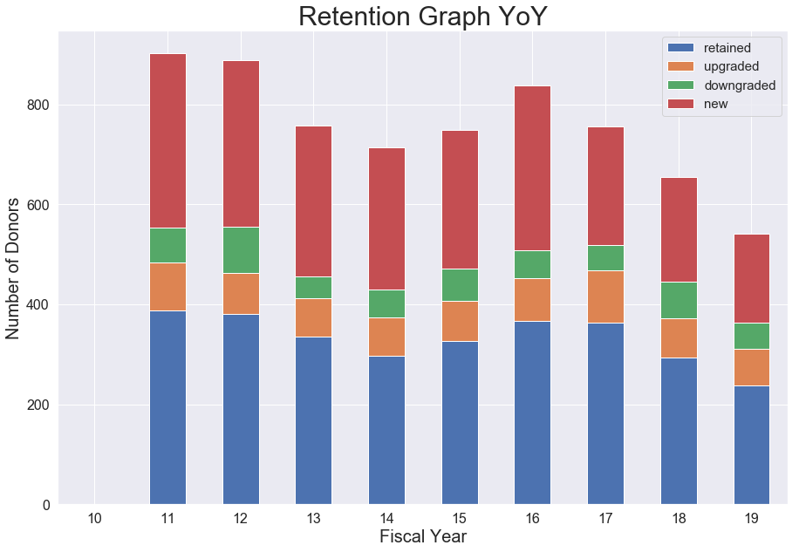
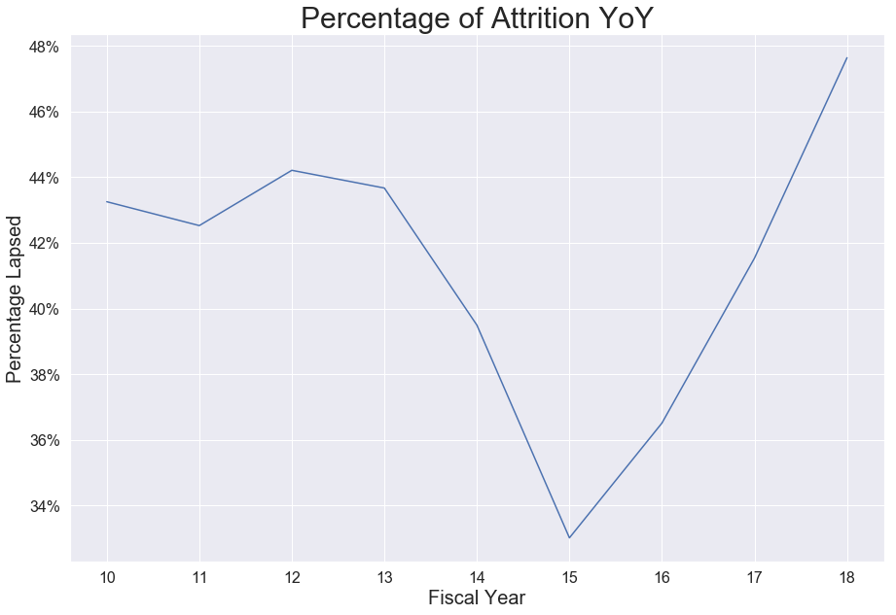
Donor Retention Analysis
Tier 2 : $100 - $299.99

Slide 6
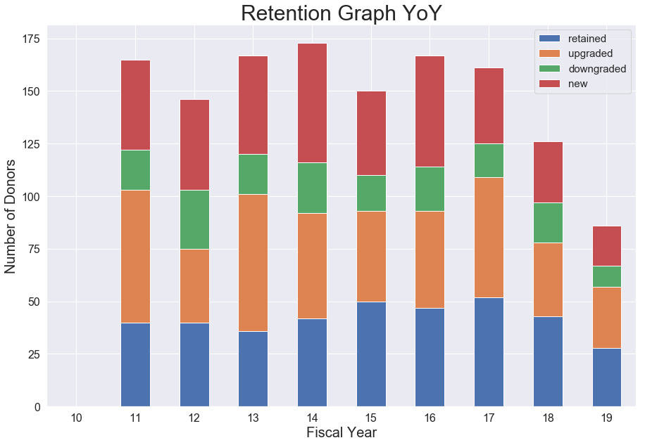
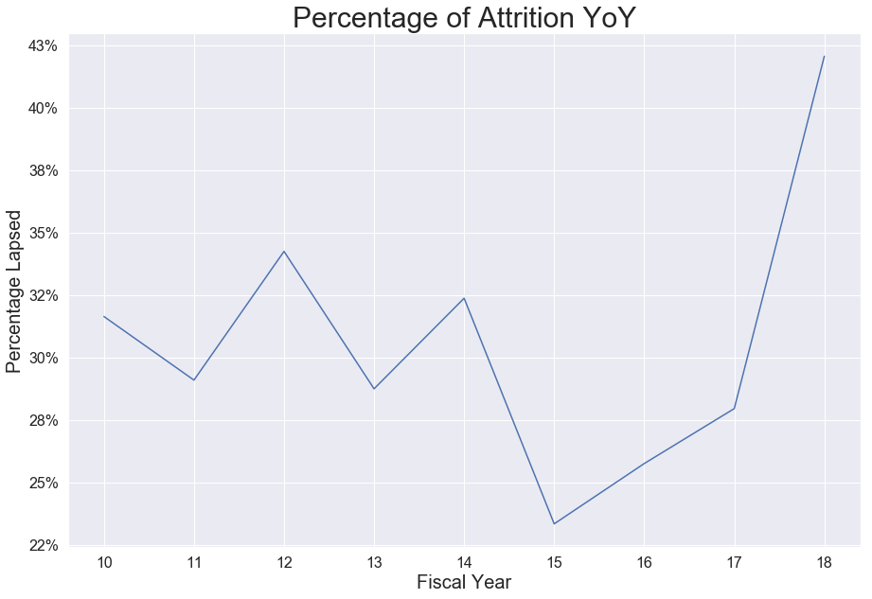
Donor Retention Analysis
Tier 3 : $300 - $499.99

Slide 7
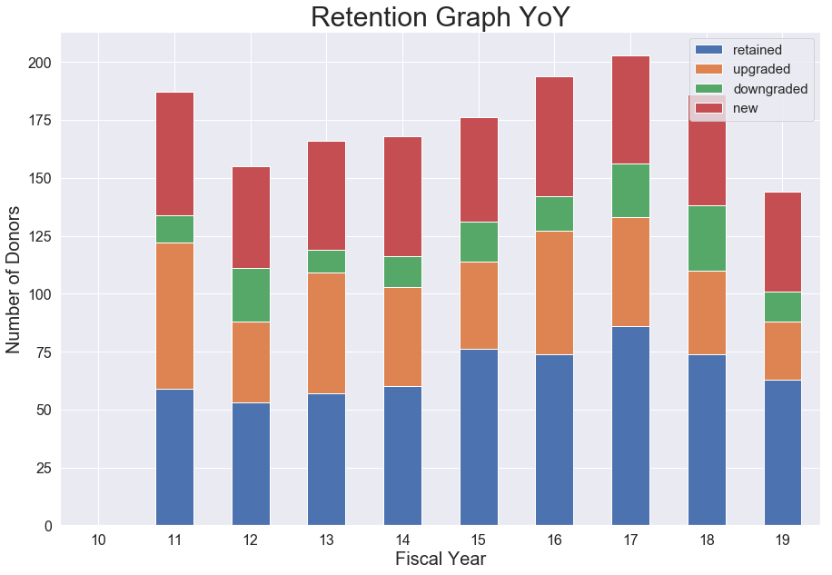
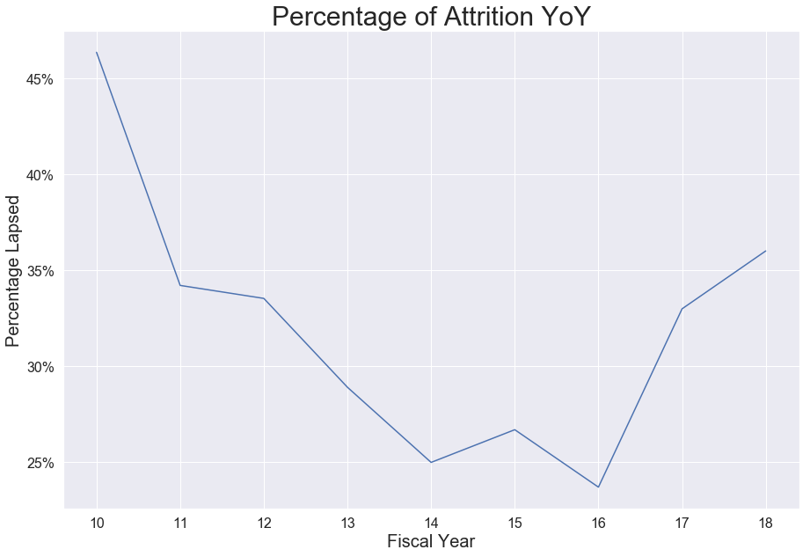
Donor Retention Analysis
Tier 4 : $500 - $999.99

Slide 8
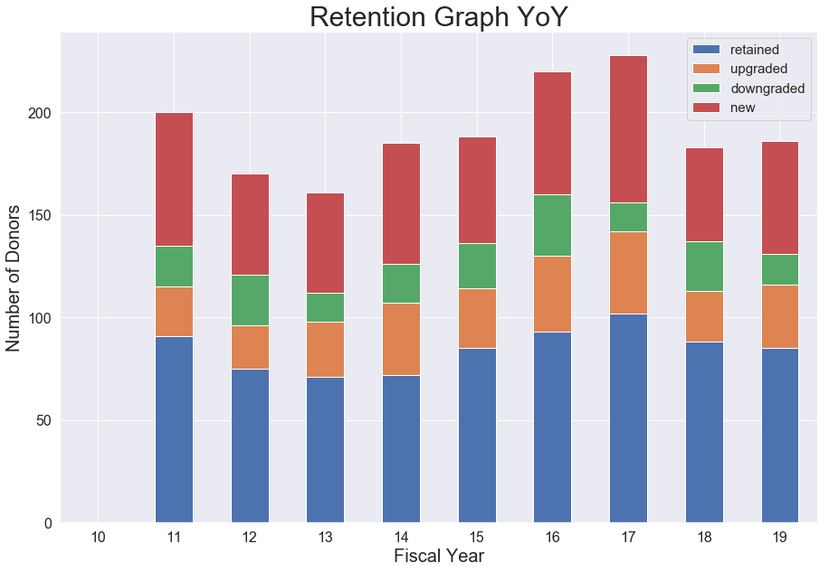
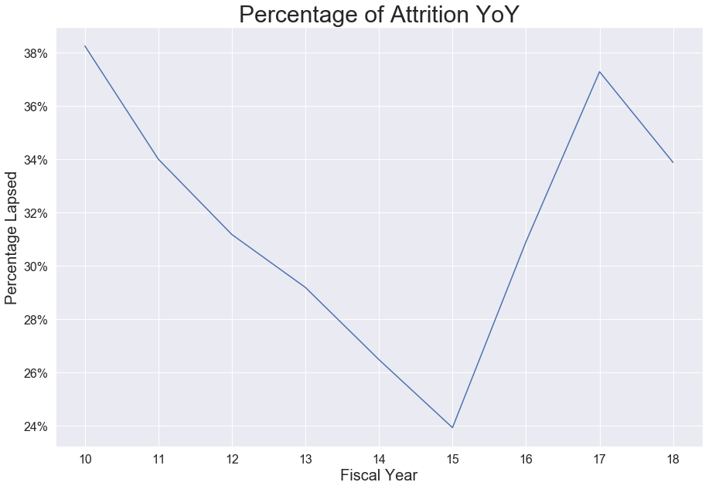
Donor Retention Analysis
Tier 5 : $1000 - $2499.99

Slide 9
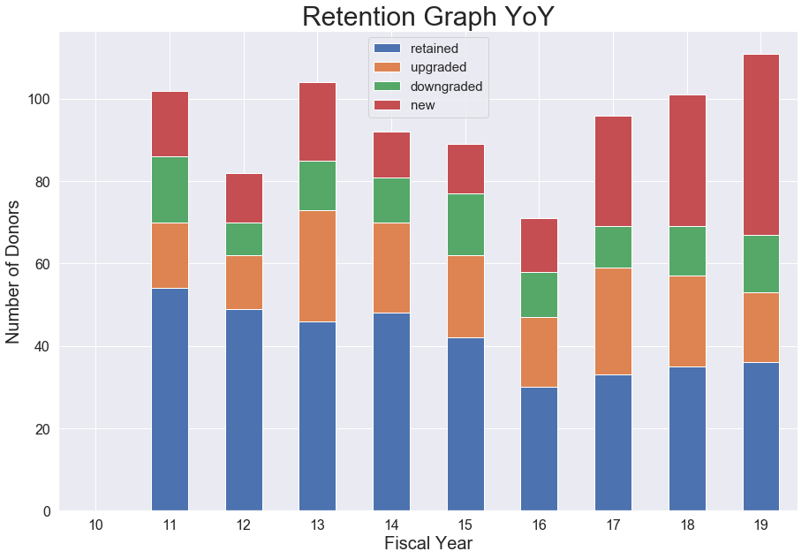
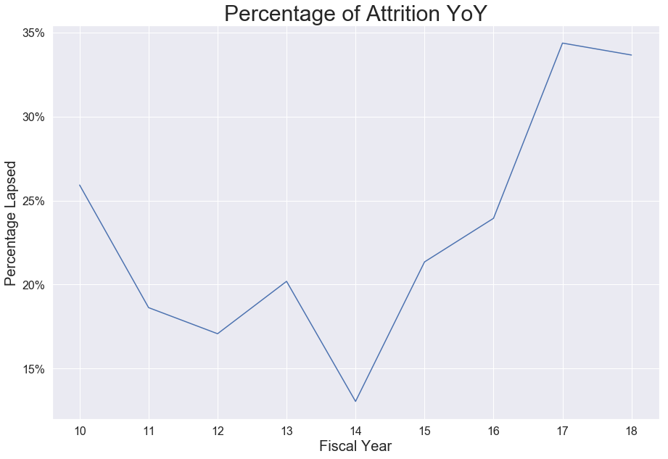
Donor Retention Analysis
Tier 6 : $2500 - $4999.99

Slide 10
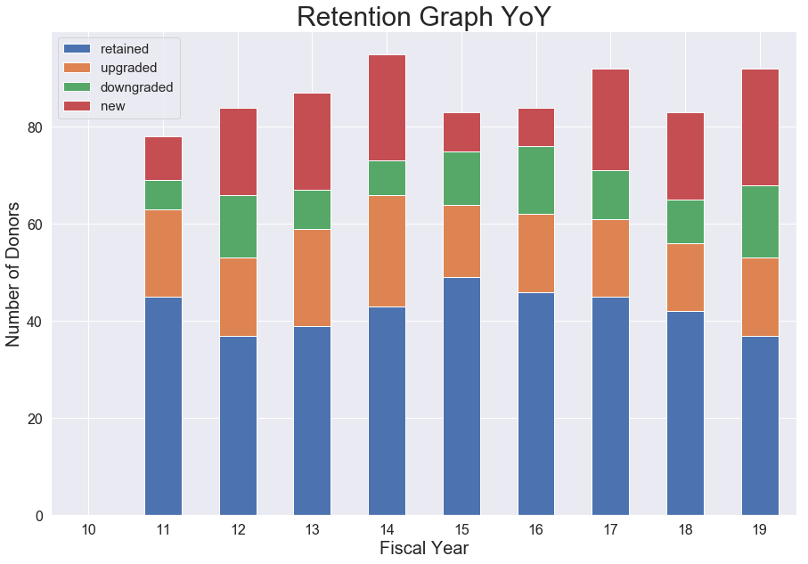
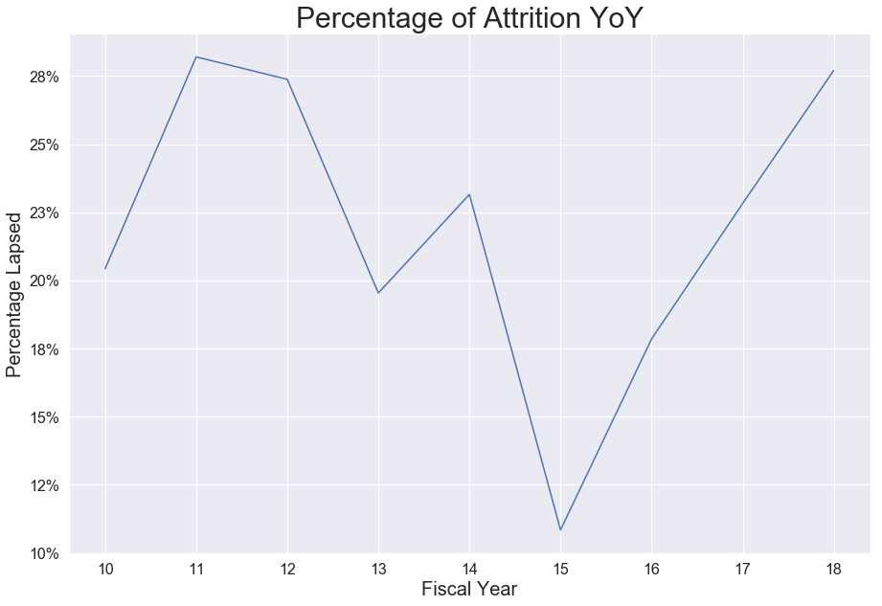
Donor Retention Analysis
Tier 7 : $5000 - $9999.99

Slide 11
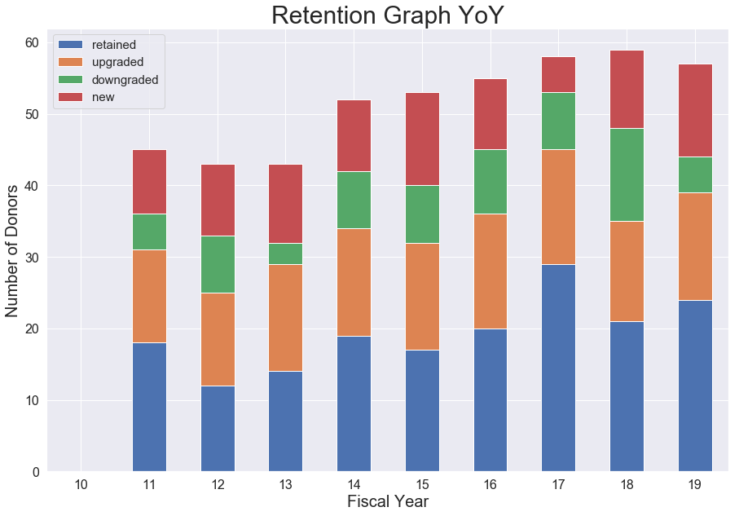
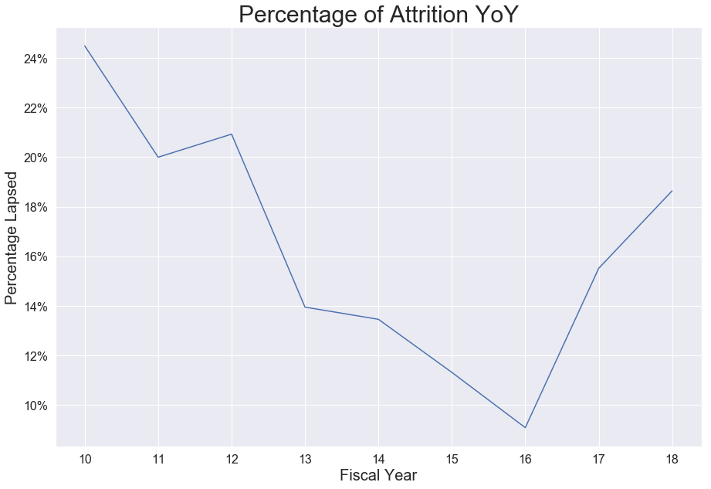
Donor Retention Analysis
Tier 8 : $10000 - $19999.99

Slide 12
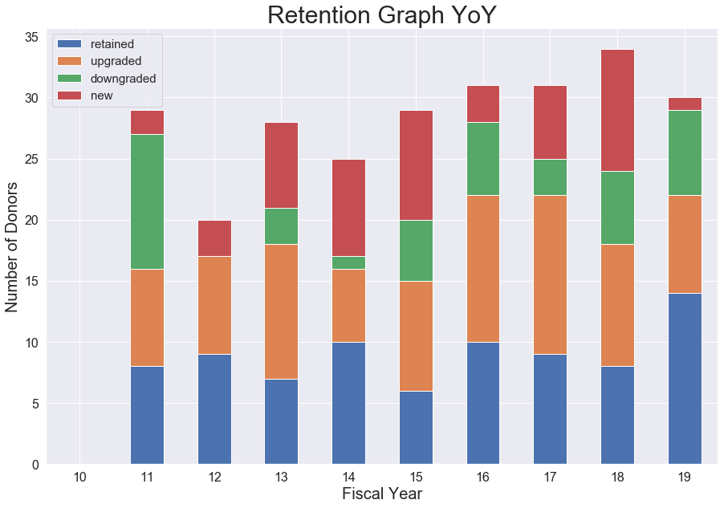
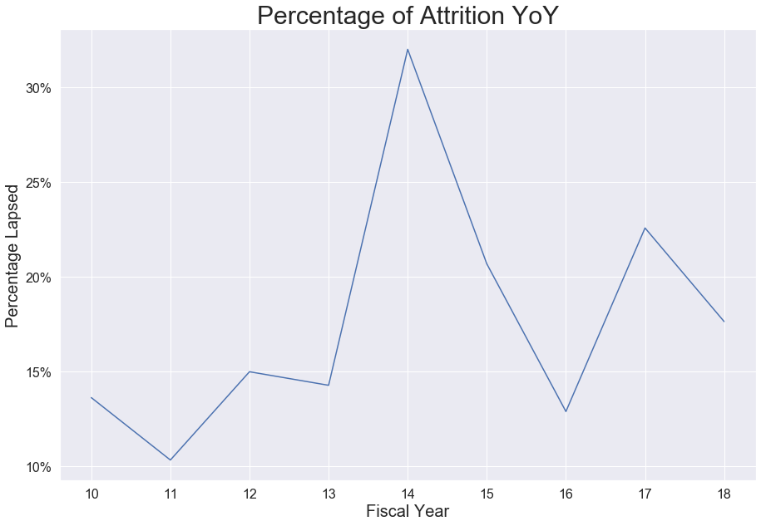
Donor Retention Analysis
Tier 9 : $20000 - $29999.99

Slide 13
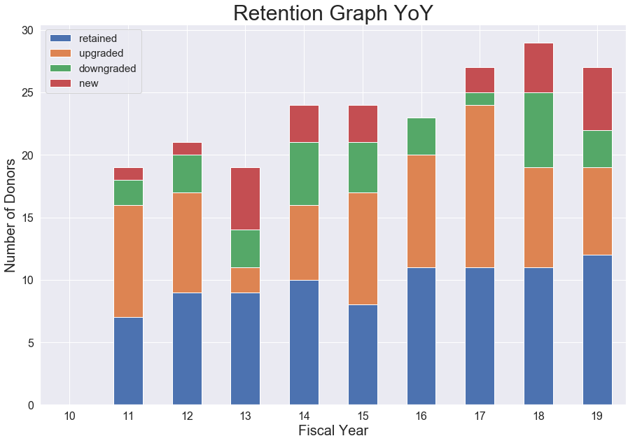
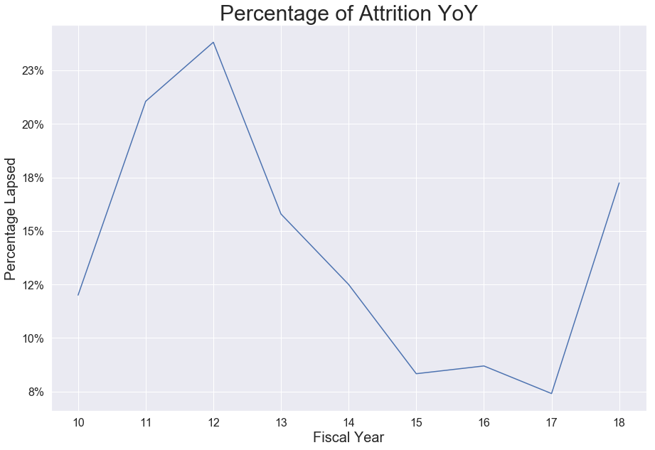
Donor Retention Analysis
Tier 10 : $30000 - $49999.99

Slide 14
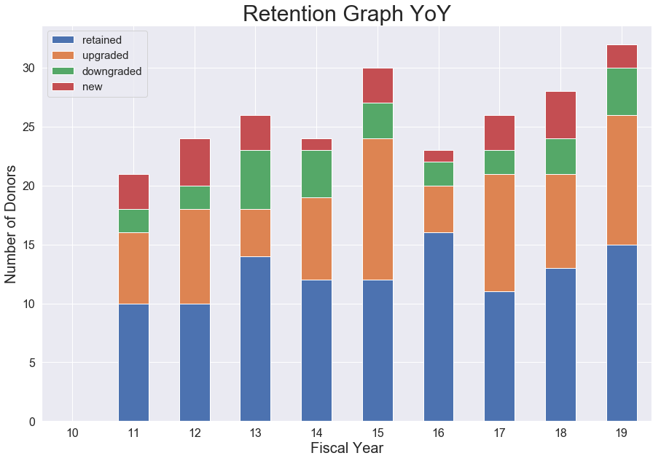
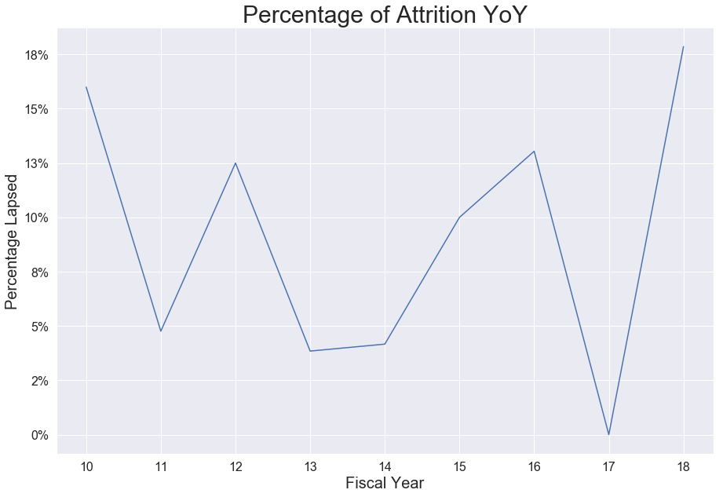
Donor Retention Analysis
Tier 11 : $50000 - $99999.99

Slide 15
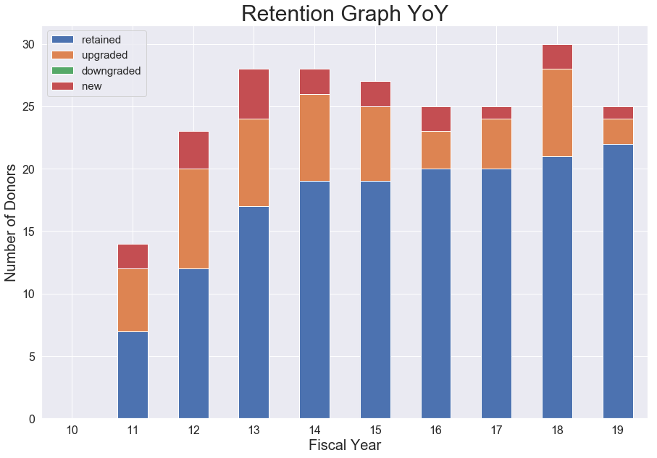
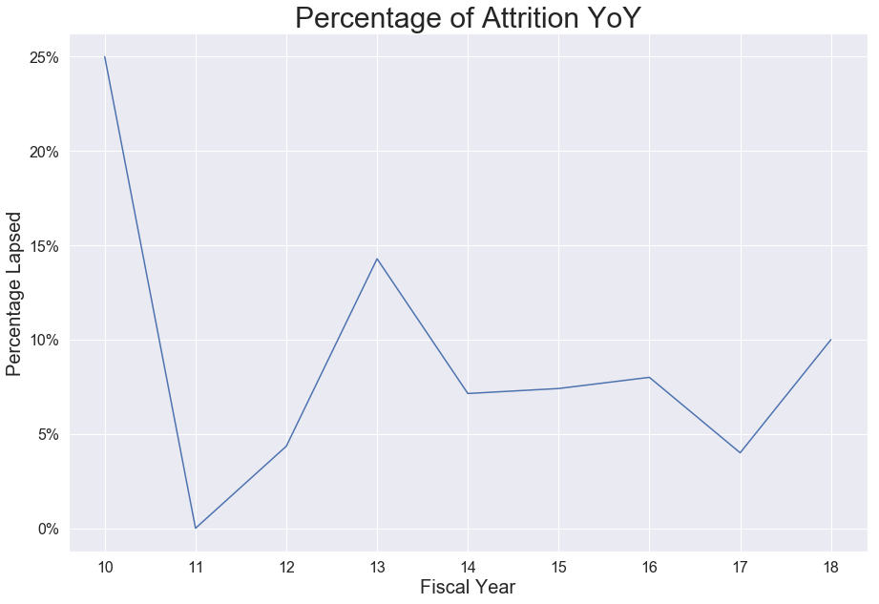
Donor Retention Analysis
Tier 12 : $100000+

