Slide 1

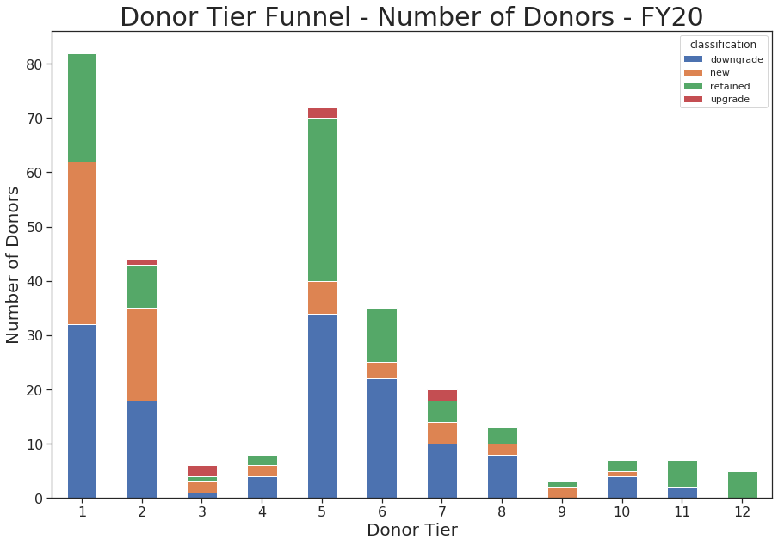
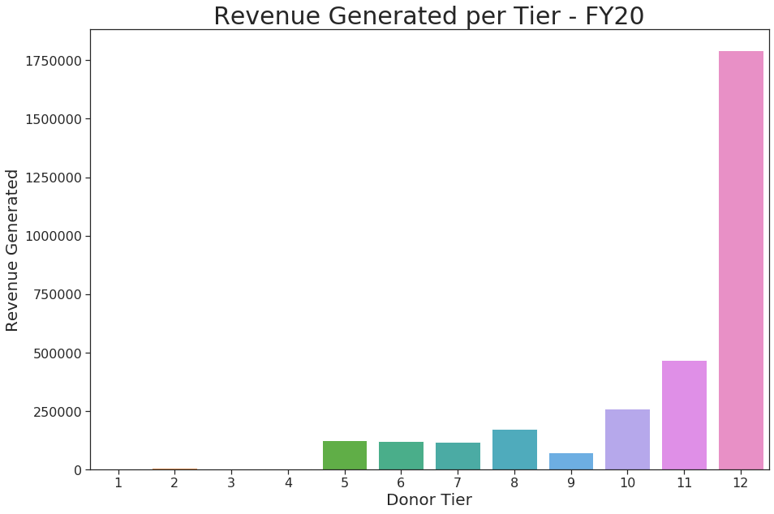

Development Dashboard – Prototype
KPIS
INSIGHTS
High Cap Prospects
326
Note: High Capacity Prospects are indicated by top 3 capacity rating groups ($50K+ per year) and have not donated to Pacific Symphony in the last 2 fiscal years (FY19-20). Activities are defined by the number of concerts attended by those prospects in FY20 to date.
Here is where we can drop some insights based on what we’re seeing month over month – maybe a couple bullet points for example:
Although we see % Retained to Date increasing, it is at a slower pace than expected. We must improve our retention of donors if we are to meet our quarterly goal blah bla.
There is a major issue in moving people from tiers 1 and 2 into tiers 3 and 4 blah blah.
+10% MoM
Activities by Prosp.
1.3
+10% MoM
% Retained to Date
6.39%
+10% MoM
% Upgrade to Date
6.4%
+10% MoM
% Downgrd to Date
2.85%
+10% MoM

