Slide 1






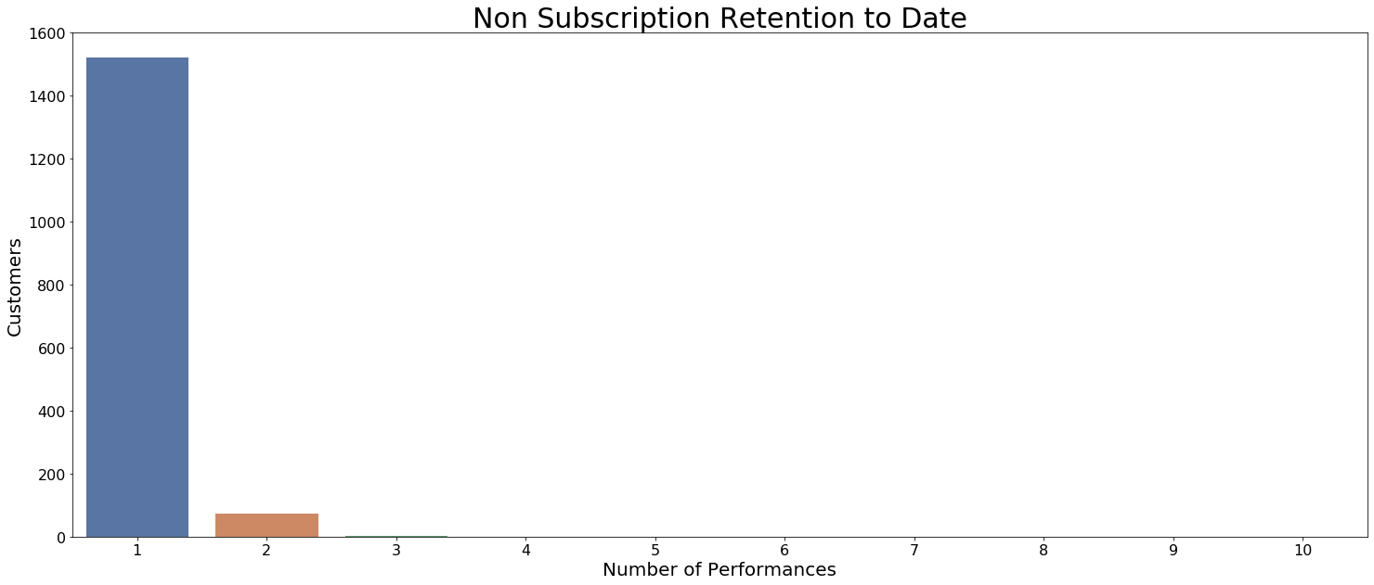
Marketing Dashboard – Prototype
Key Performance Indicators
Notes/Definitions
47.9%
Capacity Sold
+X% YoY
501
Prospects
-X% YoY
8,110
Total Subs
-X% Monthly
Marketing Goal: $6,004,664
Capacity Sold: Average of sold seats / capacity per concert (capacity = 1750).
Prospects: Non-subscribers that have purchased at least 3 single tickets over the current and previous fiscal years.
Total Subs: Total Subscription packages sold
Total HHs: Total households making a transaction
Non-Sub Retention Rate: Measures flow throughout the year of our single ticket buyers (Classics, Pops, Summer).
63.4%
% of Goal
+X% monthly
6,160
Total HHs
-X% Monthly
58,476
Tickets Sold
-X% Monthly
Insights/Recommendation
This is a note

