Slide 1





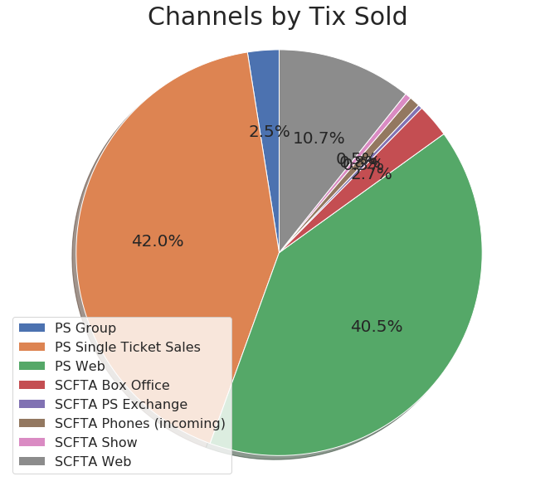
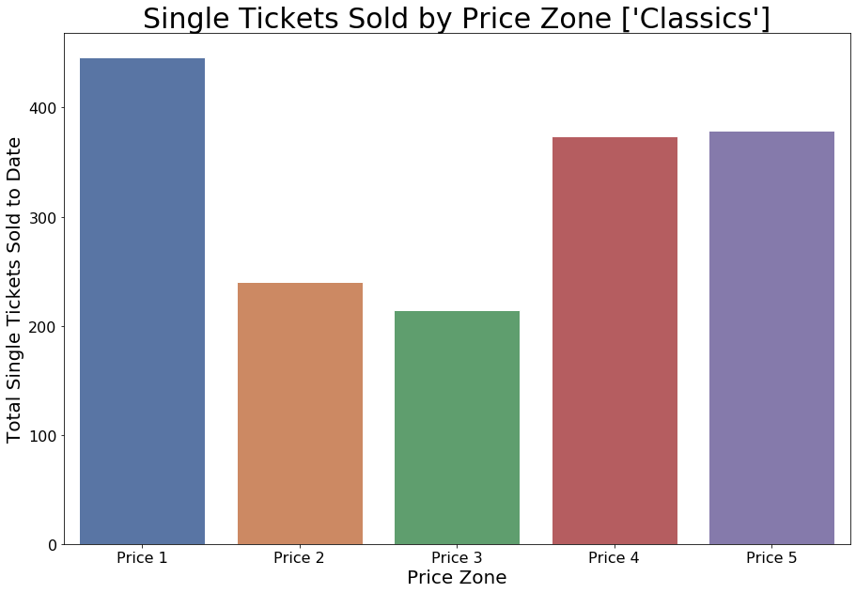
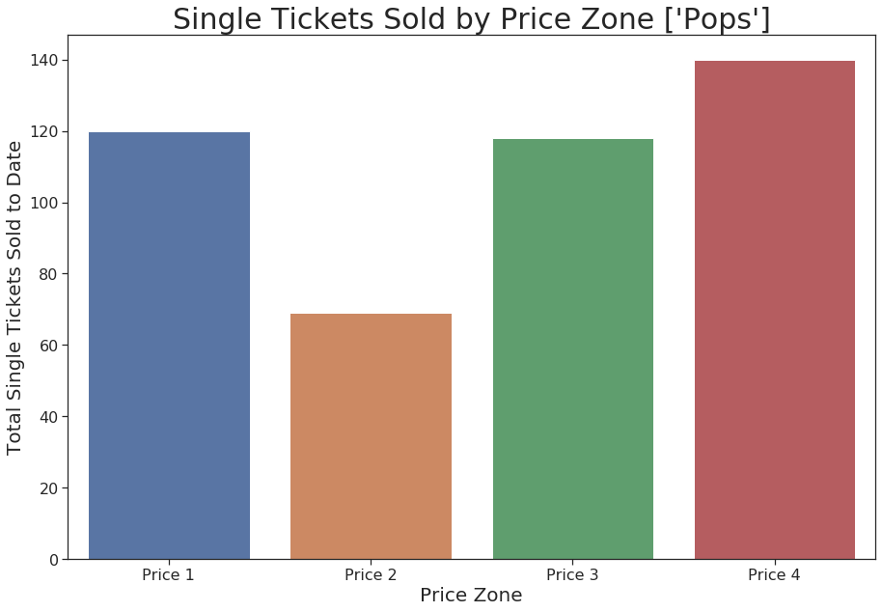
Single Tickets Dashboard – Prototype
KPIS
NOTES/INSIGHTS
Tickets Sold
20,215
Fulfilled Funnel
536
Definitions
Fulfilled Funnel – Represents the number of HHs that have purchased single tickets to at least three concerts over this and the prior fiscal year. This is fulfilled because at that point, they are ready to move on to subscriptions based on our current model.
NtF Retained – Of the new to files this year, this is how many purchased a second ticket.
Notes
We are extremely high in our new to file retention rate.
+x% MoM
+x% MoM
New to File
2,232
NtF Retained
481 20%
+x% MoM
+x% MoM

