Slide 1
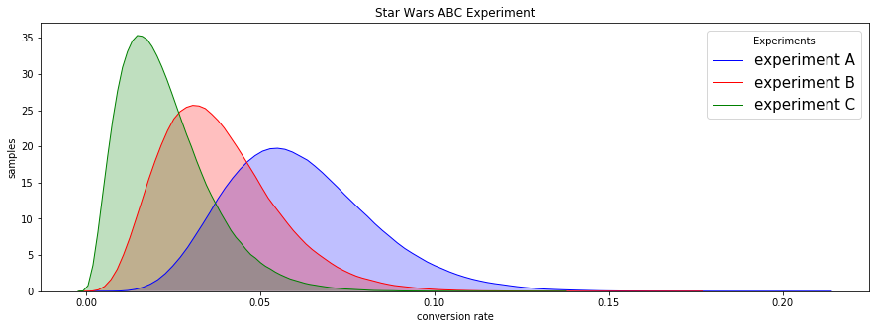









Subscription Dashboard – Prototype
Key Performance Indicators
Current Experiment
8,110
Total Subs
+X% monthly
5.8
Avg. pkg size
-X% YoY
61.21%
YoY Retention
-X% monthly
730
New Subs
-X% monthly
6,326
Prospects
+X% monthly
0
Hot Prospects
-X% monthly
Insights/Recommendation
This is where we will point out some issues/patterns in the data as well as potential action steps to take
Notes on Reading this Document
Prospects: Non-subscribers that have purchased at least 3 tickets over the last four years.
Hot Prospects: Non-subscribers that have purchased at least 3 tickets in the current fiscal year.
Current Experiment: Ongoing AB Tests and results

