Slide 1






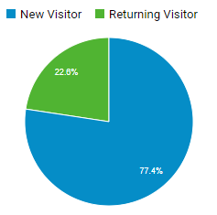
Web Performance Dashboard – Prototype
Key Performance Indicators
Notes/Insights
37,676
Sessions
-14% monthly
27,056
Users
-9% monthly
55.9%
Bounce Rate
-1.3% monthly
Google Grants -> $3.9K Revenue with 353 clicks.
Other notes
3.8%
User Conv. Rate
Transactions / Users
+12% monthly
$154
Avg Order Size
+2% monthly
$14.09
PPC Rev/Cost
Revenue per $1 of cost
+250% monthly
Top 5 Products | $
Carmina Burana | 14.4k
O Fortuna | 2k
Nutcracker for Kids | 1.5k
Marie Osmond | 1.5k
19-20 Family 11:30 | 1.1k

Slide 2
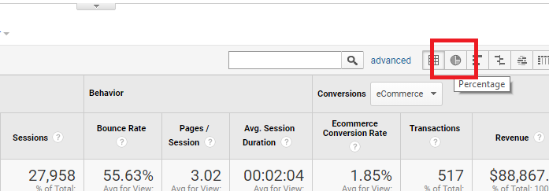
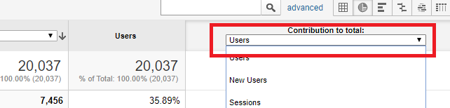
Google Analytics Reports used:
Metrics
Sessions ---- Audience -> Overview
Users ---- Audience -> Overview
Bounce Rate ---- Audience -> Overview
User Conversion Rate ---- Acquisition -> All Traffic -> Channels === Transactions / Users
Average Order Size ---- Acquisition -> All Traffic -> Channels === Revenue / Transactions
PPC Rev/Cost ---- Acquisition -> Campaigns -> Paid Keywords && Cost Analysis === Revenue / Cost
Charts
Channel Usage/Transaction Contribution ---- Acquisition -> All Traffic > Channels -> Click Percentage -> Switch the contribution to total dropdown between Users and Transactions
New/Returning ---- Audience -> Overview
Top 5 Products ---- Home -> scroll down to bottom
Social Overview ---- Acquisition -> All Traffic -> Source/Medium -> Search: (facebook, Instagram, youtube, linkedin, and pacificsymphony.blog)
Additional: Google Grants ---- Acquisition -> Google Ads -> Accounts

