Slide 1

Pre/Post Spa Club Enrollment Analysis
Upon spa club enrollment, expect customers to spend an additional $X with the enterprise over the next 6-months with 90% coming from increased grooming spend – spa club leads to major improvement in grooming activity with no downside to enterprise
29% Lift in Grooming Revenue
$[ABC]M Grooming Revenue
$[XYZ]M Grooming Revenue
Customer Signs Up for Pet Spa
6-Months Pre-Signup
6-Months Post-Signup
$[ABC]M Enterprise Revenue
8% Lift in Enterprise Revenue
$[XYZ]M Enterprise Revenue
NOTE REVENUE REMOVED DUE TO ALTERATIONS MADE REMOVING ANY PRIVATE INFO
Methodology: Customers included in analysis are spa club enrolled with at least one transaction with Petco that is 6 months or before enrollment and had enrolled 6 months or before date of analysis – 3/8/21 – allowing for isolation of customers with a 6-month pre and 6-month post enrollment purchasing behavior

Slide 2
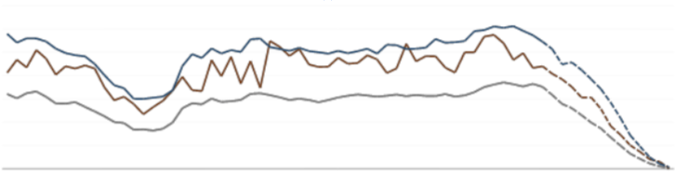

Retention Trends: Spa Club vs Grooming Overall
Spa club outpaces the grooming retention rate baseline by approximately 2500 basis points with spa club being the key lever driving improvements in overall retention
NOTE CHARTS ARE BLURRY AND LACK DETAILS DUE TO ALTERATIONS MADE REMOVING ANY PRIVATE INFO
Methodology: Cohort retention is based on 13wk retention upon acquisition. NTG-Spa Club is the cohort in which the customer’s first grooming transaction with Petco is spa club. ExistingGrm-Spa Club is the cohort in which the customer had grooming transactions before enrolling in spa club.

Slide 3
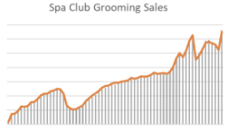
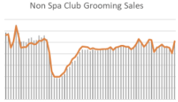
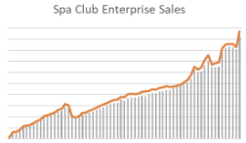
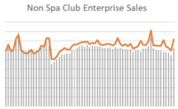
Spa Club/Non-Spa Club Revenue Comparison
Non-Spa Club grooming sales have remained stagnant over the last year while spa club revenue and customers have grown indicating incremental gains over the base; Spa Club under-stated and non-Spa Club overstated due to ~80% match of IDs to sales table
NOTE CHARTS ARE BLURRY AND LACK DETAILS DUE TO ALTERATIONS MADE REMOVING ANY PRIVATE INFO

