Slide 1
Non-Standard Interactions and Neutrino Oscillations in Core-Collapse Supernovae
Brandon Shapiro

Slide 2
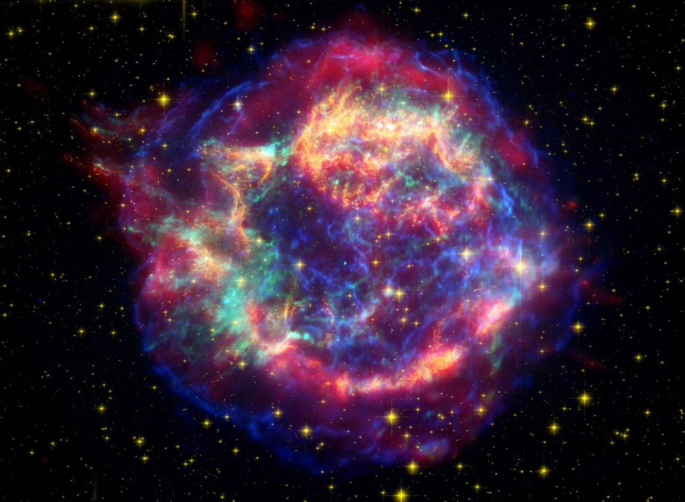
Background: Core-Collapse Supernovae

Slide 3
Background: Core-Collapse Supernovae
In the core or stars, hydrogen atoms are fused into helium
When all of the hydrogen has been used up, the remaining helium contracts and begins fusing into heavier elements
In stars of 8 to about 40 solar masses, this process eventually builds up a core of iron and nickel
When this core exceeds the Chandrasekhar limit of 1.4 solar masses, gravity causes it to collapse inward
When the core reaches the maximum nucleon density, it rebounds outward as a shock wave, forming the explosion
As the core collapses, it emits large quantities of neutrinos

Slide 4
Background: Neutrinos
Neutrinos (ν) are electrically neutral fundamental particles, first imagined in 1930 to conserve energy and momentum in beta decay
They interact with other particles only via the short ranged weak nuclear force, so neutrinos can pass right through most normal matter
Therefore, they are very difficult to detect; neutrino detectors today are the size of large buildings
There are (at least) 3 neutrino flavors, ν_{e}, ν_{μ}, & ν_{τ}, each interacting slightly differently with its corresponding lepton (electron, muon, tau)

Slide 5
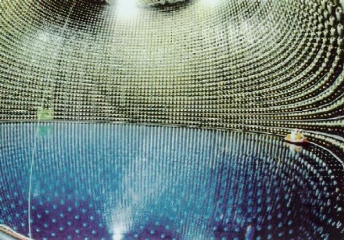
Background: Neutrinos

Slide 6
Background: Flavor Oscillation
In the late 1960s, an experiment to detect solar neutrinos found only a third of the expected e-flavor neutrinos coming from the sun
This deficit was explained by the theory that a neutrino observed to have one flavor can later be observed to have a different flavor
The probabilities of a neutrino having each of the three flavors oscillate over time (always totaling 1 of course)
While neutrinos were originally thought to be massless, this implies that there are 3 different neutrino mass states, which are not equivalent to the 3 flavor states

Slide 7

Background: Flavor Oscillation
The probability of a neutrino being observed to have a given flavor obeys the Schrödinger Equation:
$$iħ\frac{∂}{∂t}\left[\begin{aligned}ψ_{e}(t) \\ ψ_{μ}(t) \\ ψ_{τ}(t)\end{aligned}\right]=H\left[\begin{aligned}ψ_{e}(t) \\ ψ_{μ}(t) \\ ψ_{τ}(t)\end{aligned}\right]$$
${\left|ψ_{e}\right|}^{2}=P({\text{ν}}_{e})$ ${\left|ψ_{e}\right|}^{2}+{\left|ψ_{e}\right|}^{2}+{\left|ψ_{e}\right|}^{2}=1$
Here the vector $\overset{⃑}{ψ}$ depends on the initial flavor conditions
$\overset{⃑}{ψ}$ can alternatively be written as $\overset{⃑}{ψ}=S{\overset{⃑}{ψ}}_{0}$
${\left|S_{eu}\right|}^{2}=P({\text{ν}}_{e}→{\text{ν}}_{μ})$
${\overset{⃑}{ψ}}_{0}=\left[\begin{aligned}1 \\ 0 \\ 0\end{aligned}\right]$, $\left[\begin{aligned}0 \\ 1 \\ 0\end{aligned}\right]$, $\left[\begin{aligned}0 \\ 0 \\ 1\end{aligned}\right]$

Slide 8

Supernova Neutrino Oscillation
In a supernova, it is more relevant to keep track of a neutrino’s radial position than the time
$$r≈ct$$
Using natural units removes $c$ and $ħ$ from the equation
When the $S$ matrix representation of $\overset{⃑}{ψ}$ is used in the Schrödinger Equation, ${\overset{⃑}{ψ}}_{0}$ cancels out as a constant, giving the equation as:
$$i\frac{∂S}{∂r}=HS$$

Slide 9

Vacuum Oscillation
$H$ is called the Hamiltonian, in this case a $3×3$ matrix
$H=H_{vacuum}+V_{matter}+V_{self−interaction}$
$H_{vacuum}$ is the vacuum Hamiltonian, given by
$H_{vacuum}=UKU^{†}$
$K$ is a diagonal matrix of the energies of each mass state
The mass states are rotated by $U$, the 3-flavor mixing matrix, into the basis of flavor probabilities
$H_{vacuum}$ represents the instability of the observable flavor and mass states
With no other matter or neutrinos present, $H=H_{vacuum}$

Slide 10

The Matter Potential
$V_{matter}$ is the matter potential (or MSW potential)
It accounts for the effect of matter on flavor evolution
The potential for flavor depends only on the relative amounts of each lepton, so the terms for muon and tau particles cancel out
$$V_{matter}=\left[\begin{matrix}\sqrt{2}G_{F}n_{e}(r) & 0 & 0 \\ 0 & 0 & 0 \\ 0 & 0 & 0\end{matrix}\right]$$
$n_{e}$ is the number density of electrons, decreasing as the neutrino propagates further out from the core
$G_{F}$ is the Fermi coupling constant

Slide 11

The Self-Interaction Potential
$V_{self−interaction}$ represents the potential for flavor change from other neutrinos propagating through the supernova
Using a simplifying single-angle approximation:
$$V_{self−interaction}∝\int{Sρ_{0}S^{†}dE}−\int{{\overline{S}{\overline{ρ}}_{0}{\overline{S}}^{†}dE}^{∗}}$$
$ρ_{0}$ is a matrix representing the initial neutrino densities, which are then modified by S to account for flavor change
The integrals are with respect to different energy levels
The dependence of $V_{self−interaction}$ on $S$ makes this a nonlinear problem (and a complicated one at that)

Slide 12
Non-Standard Interactions (NSI)
There is significant evidence that the Standard Model of particle physics is incomplete
For example, phenomena such as dark matter and dark energy have yet to be explained
There could possibly be particle interactions outside the Standard Model that affect neutrino oscillations
If a relationship between the strength of NSI and flavor probabilities of supernova neutrinos were determined, data from modern neutrino detectors could be used to measure the strength of NSI from the next galactic supernova

Slide 13

Neutrino Oscillations with NSI
NSI with matter is incorporated into the equation as a $3×3$ complex matrix called $ε$ added to the Hamiltonian
$H=H_{vacuum}+V_{matter}+\sqrt{2}G_{F}n_{e}\left(r\right)ε+V_{self−interaction}$
The goal is to find how the solution for $S$ relates to $ε$
Such a relationship could normally be found easily using perturbation analysis, perturbing the solution to the equation without NSI with $\sqrt{2}G_{F}n_{e}\left(r\right)ε$
However, $V_{self−interaction}$ makes the problem nonlinear, so adding $ε$ affects $S$ which then affects $V_{self−interaction}$, making perturbation analysis much more difficult

Slide 14
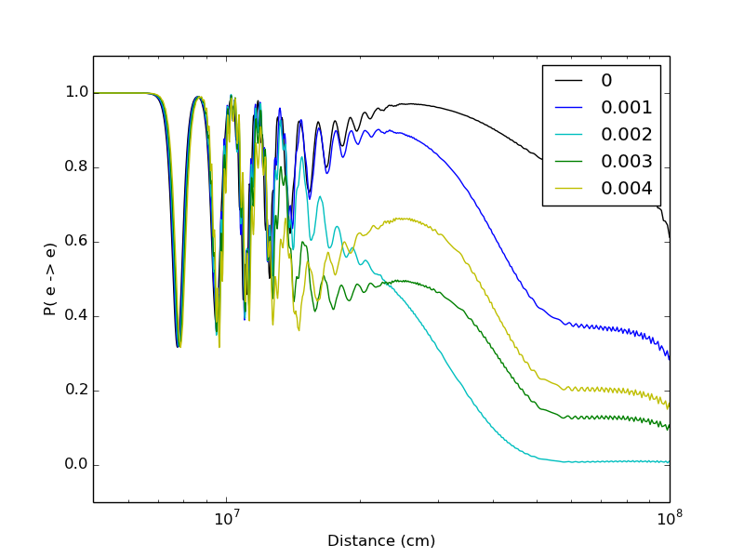

Simulated Results
$P({\text{ν}}_{e}→{\text{ν}}_{e})$ vs Distance at 20 MeV for multiple values of $ε_{eμ}$

Slide 15
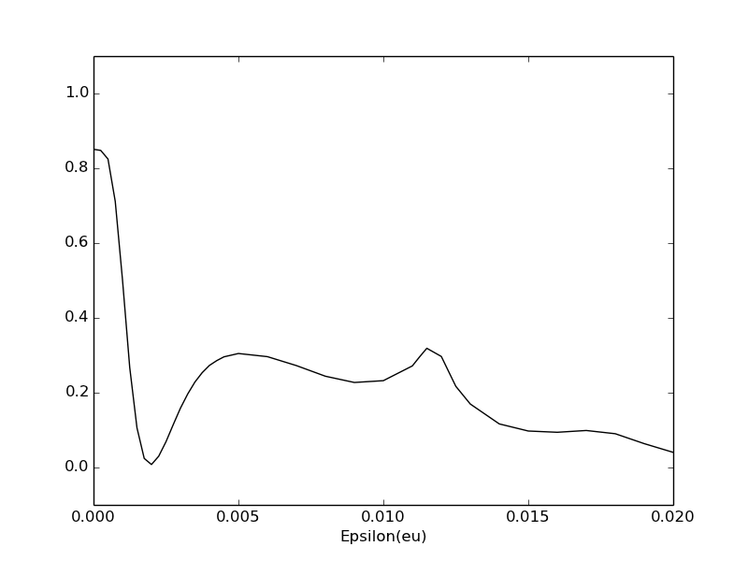

Simulated Results
Final $P({\text{ν}}_{e}→{\text{ν}}_{e})$ vs $ε_{eμ}$

Slide 16
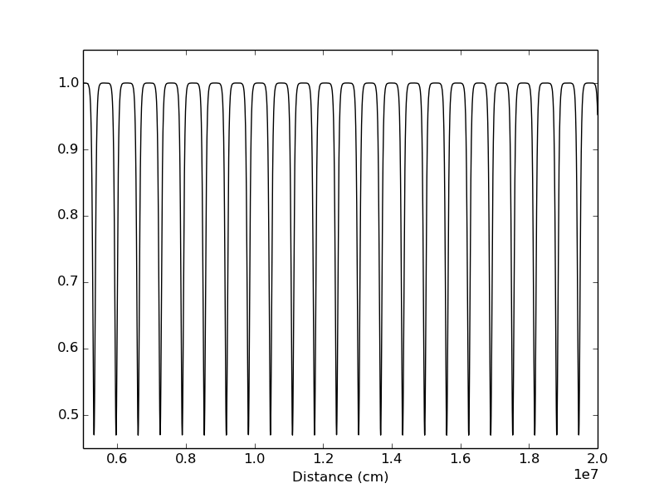
Simplified Case
NSI showed a significant but difficult to measure effect
A supernova density profile and vast energy spectrum is too complicated a problem to notice a pattern
Constant Density, Single Energy Results

Slide 17
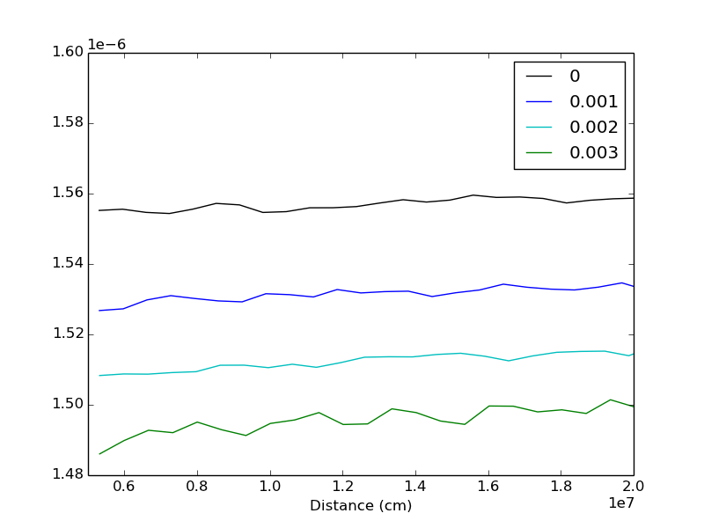

Simplified Case
Results for varied values of $ε_{eμ}$ all looked similar, but with different frequencies
Frequency vs Distance for multiple values of $ε_{eμ}$

