Slide 1
Neutrinos & The Unknown
Brandon Shapiro

Slide 2
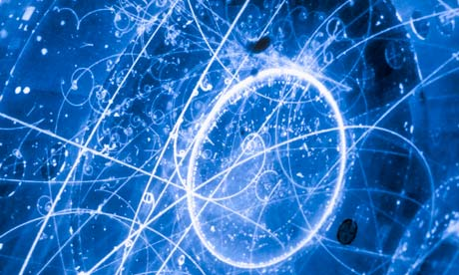
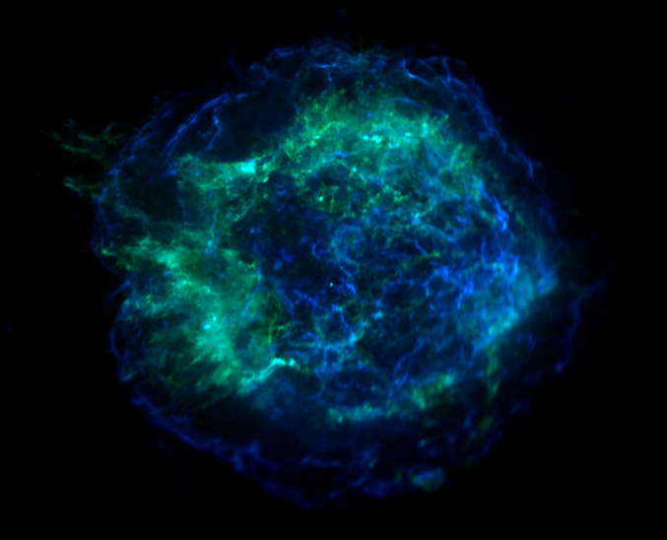
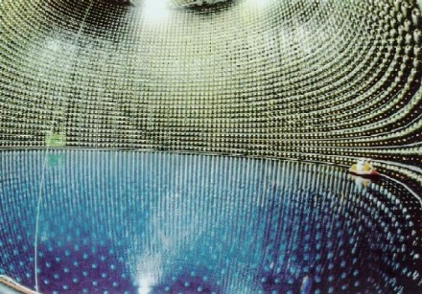
What are Neutrinos?
Very tiny particles all around us
Rarely interact with other particles
Fly out from supernova core
3 flavors (e, mu, tau)

Slide 3
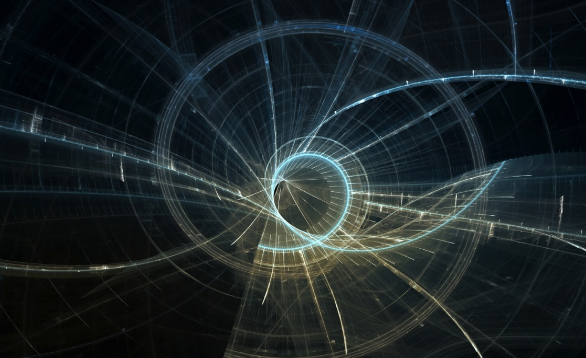
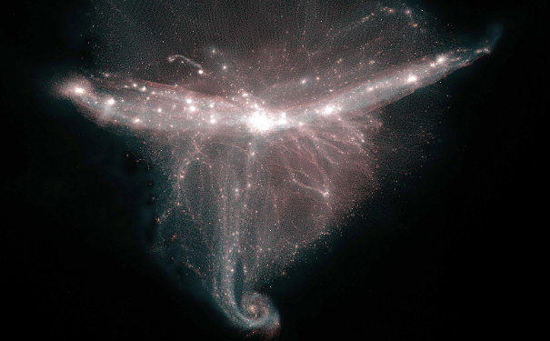
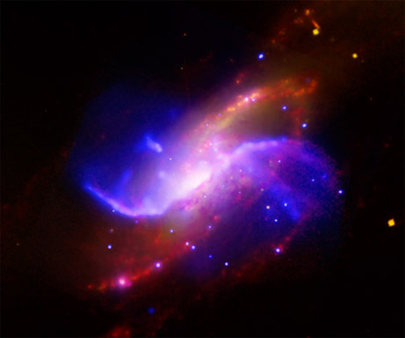
?
We don’t yet understand everything in the universe
There is evidence for all kinds of physics that we have no explanation for (dark matter, dark energy, gravity, and more)
Unknown forces could affect neutrinos

Slide 4
Flavor Change

