Slide 1
Topological Methods for the Analysis of High Dimensional Data Sets and 3D Object Recognition
Brandon Shapiro
Jigyasa Gaurav

Slide 2
Objective
Introduce a computational method for extracting simple descriptions of high dimensional data sets in the form of simplicial complexes
Applications

Slide 3
Motivation
Real application data is massive and it is impossible to visualize and discern structure even in low dimensional projections.
Visualization of these high dimensional data sets
Qualitative analysis of these data sets and also the functions defined on them

Slide 4
Significance
Already existing methods
Projection pursuit method
Isomap
Locally linear embedding
Multidimensional scaling
Drawbacks
sensitive to chosen metric
can not produce simplicial complexes directly
Size of simplicial complexes is not small

Slide 5
Significance
Our method : Mapper
reduces high dimensional data sets into a more discrete and combinatorial object, simplicial complexes, with far fewer points capturing topological and geometrical information at a specified resolution
Advantages
less sensitive to chosen distance metric
achieves substantial simplifications
simplicial complexes preserves certain topological structures of the original data set
does not depend upon the clustering algorithms

Slide 6
Underlying theoretical framework of Mapper
Given a topological space X and a finite covering U={Uα}α∈A of X.
Definition 1: Nerve of the covering U
The simplicial complex N(U) which has A as its vertex set, is called the nerve of the covering U if a family {α0, α1,…, αk} spans a k-simplex in N(U) iff Uα0∩ Uα0∩… ∩ Uα0 ≠ ϕ.

Slide 7
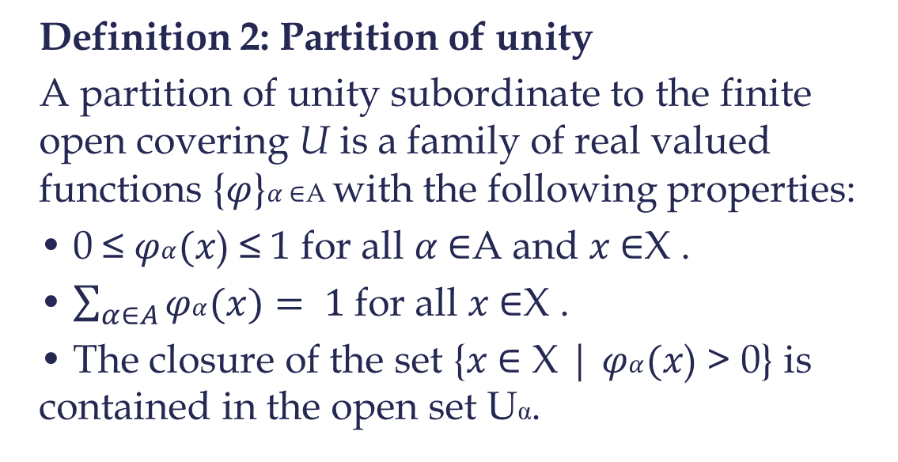
Underlying theoretical framework of Mapper
Definition 2: Partition of unity
A partition of unity subordinate to the finite open covering U is a family of real valued functions {$φ$}$α$∈A with the following properties:
• 0 ≤ $φα(x$) ≤ 1 for all $α$∈A and $x$∈X .
• $\sum_{α∈A}{φα(x)}= 1$for all $x$∈X .
• The closure of the set {$x$∈ X | $φα(x$) > 0} is contained in the open set Uα.

Slide 8
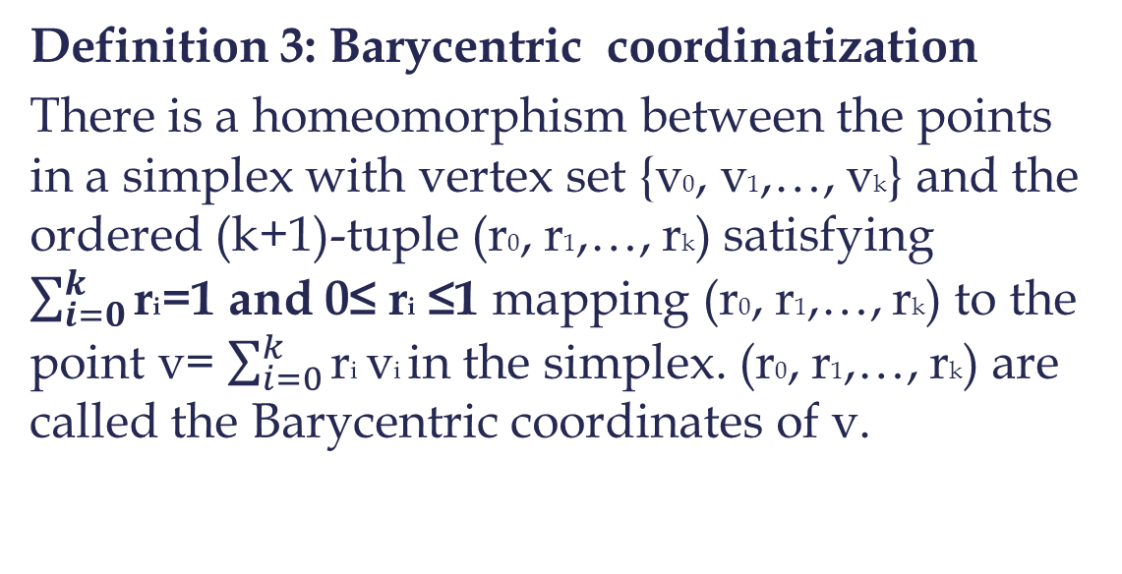
Underlying theoretical framework of Mapper
Definition 3: Barycentric coordinatization
There is a homeomorphism between the points in a simplex with vertex set {v0, v1,…, vk} and the ordered (k+1)-tuple (r0, r1,…, rk) satisfying $\sum_{i=0}^{k}{\text{r}\text{i}}$=1 and 0≤ $\text{r}\text{i}$ ≤1 mapping (r0, r1,…, rk) to the point v= $\sum_{i=0}^{k}{\text{r}\text{i}}\text{v}\text{i}$in the simplex. (r0, r1,…, rk) are called the Barycentric coordinates of v.

Slide 9
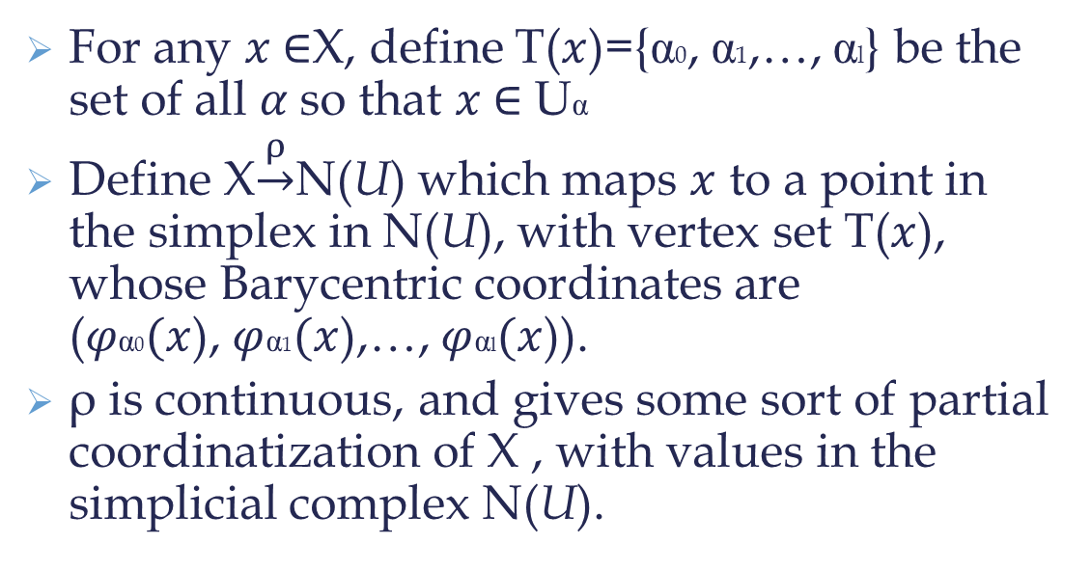
Underlying theoretical framework of Mapper
For any $x$∈X, define T($x$)={α0, α1,…, αl} be the set of all $α$so that $x$∈ Uα
Define X$\underset{→}{ρ}$N(U) which maps $x$ to a point in the simplex in N(U), with vertex set T($x$), whose Barycentric coordinates are ($φ\text{α}\text{0}(x$), $φ$α1$(x$),…, $φ$αl$(x$)).
ρ is continuous, and gives some sort of partial coordinatization of X , with values in the simplicial complex N(U).

Slide 10
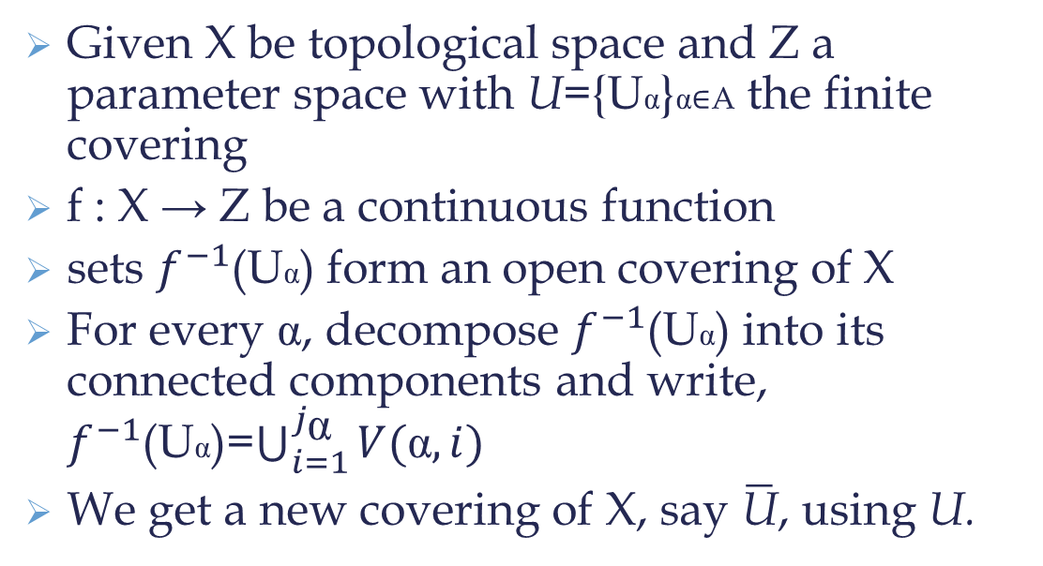
Underlying theoretical framework of Mapper
Given X be topological space and Z a parameter space with U={Uα}α∈A the finite covering
f : X → Z be a continuous function
sets $f^{−1}$(Uα) form an open covering of X
For every α, decompose $f^{−1}$(Uα) into its connected components and write, $f^{−1}$(Uα)=$\bigcup_{i=1}^{j_{\text{α}}}{V(\text{α}, i)}$
We get a new covering of X, say $\overline{\text{U}}$, using U.

Slide 11
Mapper for point cloud data
Key idea is to regard clustering of point cloud data analogous to partitioning of a space into its connected components in topological version.
The Mapper construction as input requires, a parameter space defined by the functions and a covering of this space. Any covering of the parameter space can be used.

Slide 12
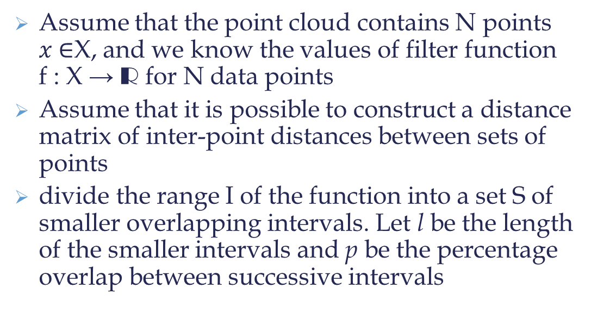
Implementation
Assume that the point cloud contains N points $x$∈X, and we know the values of filter function f : X → R for N data points
Assume that it is possible to construct a distance matrix of inter-point distances between sets of points
divide the range I of the function into a set S of smaller overlapping intervals. Let l be the length of the smaller intervals and p be the percentage overlap between successive intervals

Slide 13
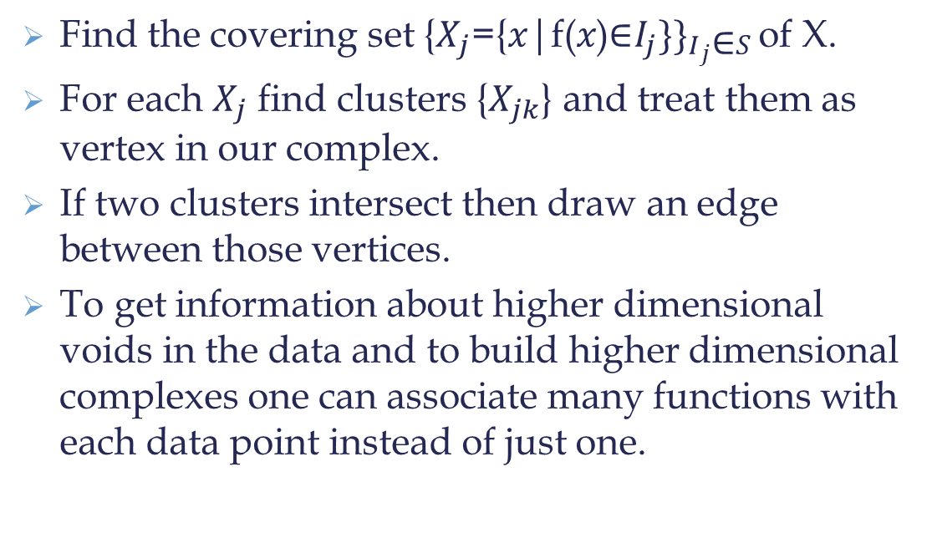
Implementation
Find the covering set ${\text{\{}X_{j}\text{=\{}x\text{|}\text{f}\text{(}x\text{)∈}I_{j}\}\}}_{I_{j}\text{∈}S}$of X.
For each $X_{j}$ find clusters {$X_{jk}$} and treat them as vertex in our complex.
If two clusters intersect then draw an edge between those vertices.
To get information about higher dimensional voids in the data and to build higher dimensional complexes one can associate many functions with each data point instead of just one.

Slide 14
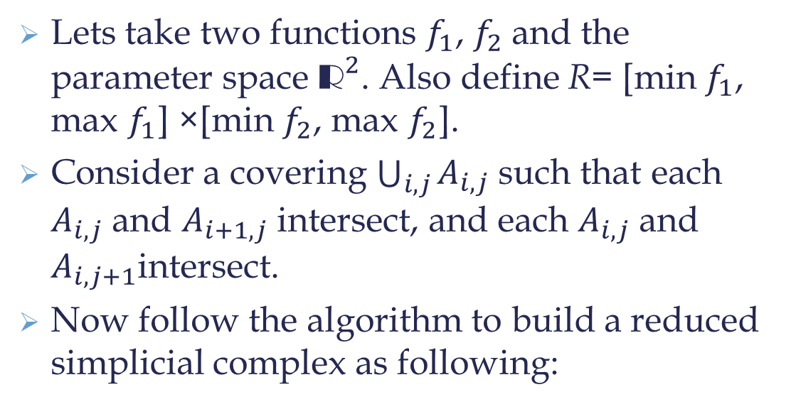
Algorithm
Lets take two functions $f_{1}$, $f_{2}$and the parameter space ${\text{R}}^{2}$. Also define R= [min $f_{1}$, max $f_{1}$] ×[min $f_{2}$, max $f_{2}$].
Consider a covering $\bigcup_{i, j}{A_{i, j}}$such that each $A_{i, j}$ and $A_{i+1, j}$ intersect, and each $A_{i, j}$ and $A_{i, j+1}$intersect.
Now follow the algorithm to build a reduced simplicial complex as following:

Slide 15
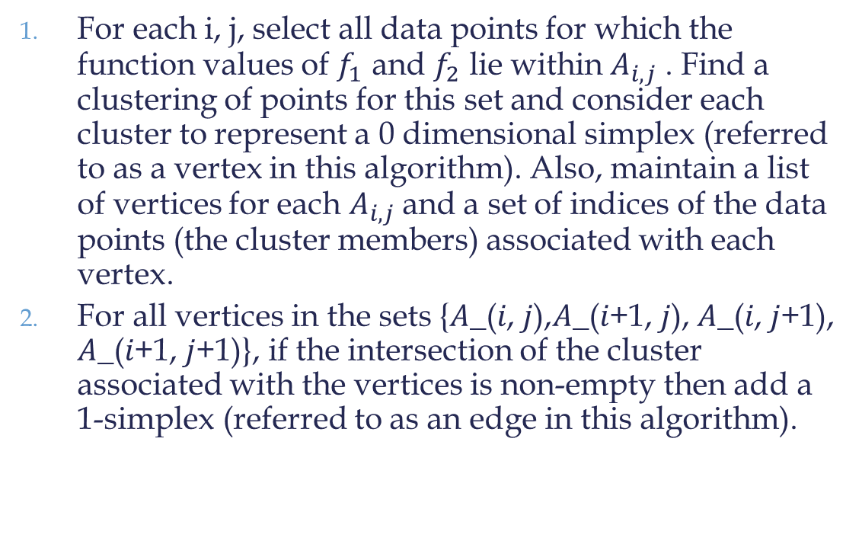
Algorithm
For each i, j, select all data points for which the function values of $f_{1}$ and $f_{2}$ lie within $A_{i, j}$ . Find a clustering of points for this set and consider each cluster to represent a 0 dimensional simplex (referred to as a vertex in this algorithm). Also, maintain a list of vertices for each $A_{i, j}$and a set of indices of the data points (the cluster members) associated with each vertex.
For all vertices in the sets {𝐴_(𝑖, 𝑗),𝐴_(𝑖+1, 𝑗), 𝐴_(𝑖, 𝑗+1), 𝐴_(𝑖+1, 𝑗+1)}, if the intersection of the cluster associated with the vertices is non-empty then add a 1-simplex (referred to as an edge in this algorithm).

Slide 16
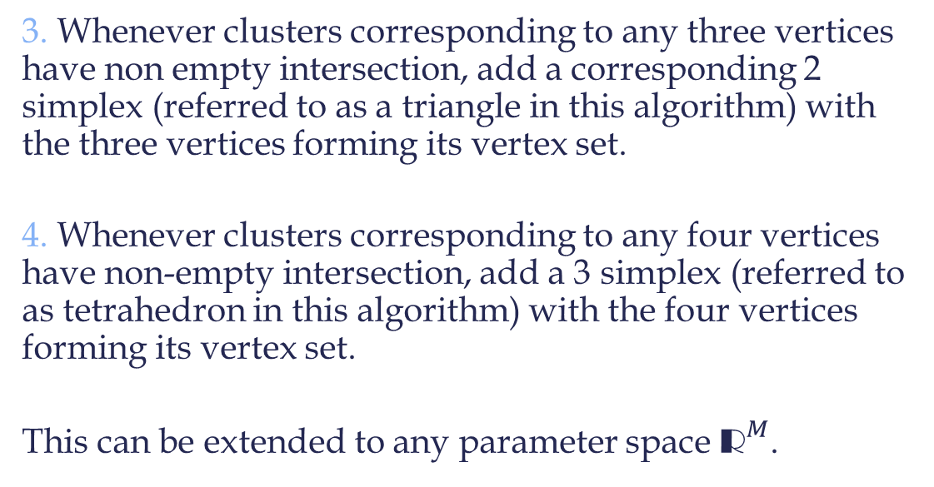
Algorithm
3. Whenever clusters corresponding to any three vertices have non empty intersection, add a corresponding 2 simplex (referred to as a triangle in this algorithm) with the three vertices forming its vertex set.
4. Whenever clusters corresponding to any four vertices have non-empty intersection, add a 3 simplex (referred to as tetrahedron in this algorithm) with the four vertices forming its vertex set.
This can be extended to any parameter space ${\text{R}}^{M}$.

Slide 17
Some Special Functions
The Mapper algorithm is dependent on the choice of filter function
Applications often require carefully chosen filters
Some functions are useful in general contexts
These functions usually convey information about the geometry of the data

Slide 18
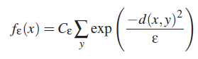
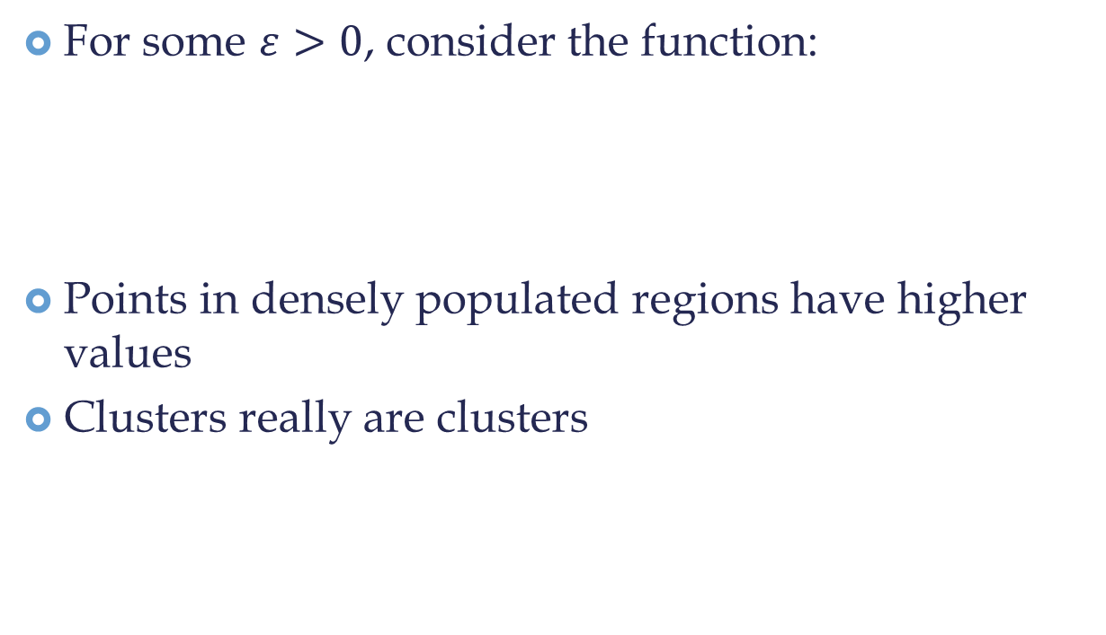
Density
For some $ε>0$, consider the function:
Points in densely populated regions have higher values
Clusters really are clusters

Slide 19
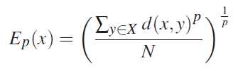
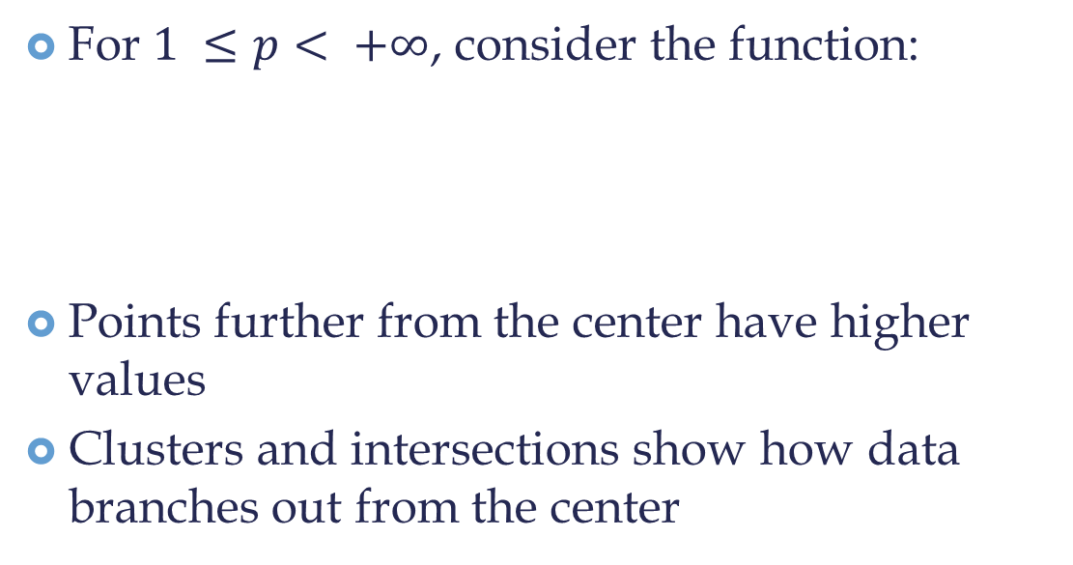
Eccentricity
For $1 ≤p< +∞$, consider the function:
Points further from the center have higher values
Clusters and intersections show how data branches out from the center

Slide 20
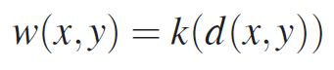
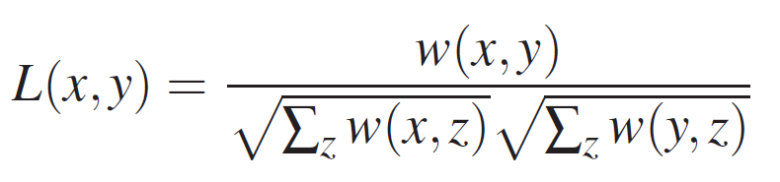
Graph Laplacians
Consider the graph with the points of the data set X as vertices
The weights of edges are given by:
The normalized Laplacian matrix of the graph is defined by:
Eigenvectors of L are functions of X

Slide 21
Tests and Applications
Given a specially crafted data set, can Mapper reproduce a desired shape?
How is Mapper useful for analyzing real data?

Slide 22
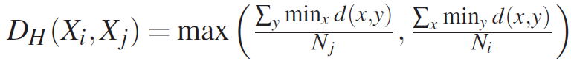
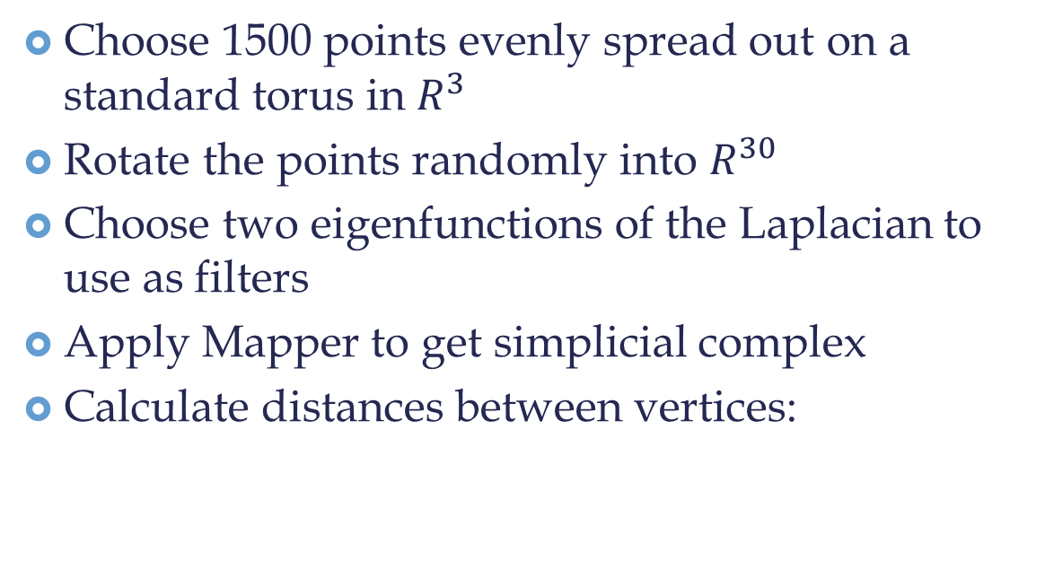
Torus Reconstruction
Choose 1500 points evenly spread out on a standard torus in $R^{3}$
Rotate the points randomly into $R^{30}$
Choose two eigenfunctions of the Laplacian to use as filters
Apply Mapper to get simplicial complex
Calculate distances between vertices:

Slide 23
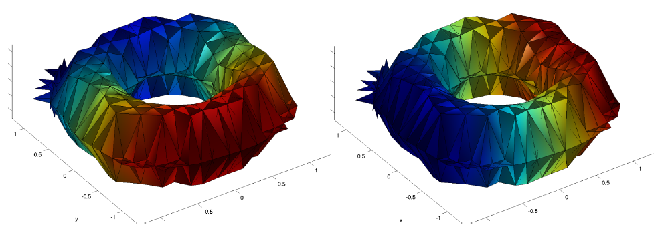

Torus Reconstruction
Use Multidimensional Scaling (MDS) to embed the vertices in $R^{3}$
Betti numbers can be checked as well

Slide 24
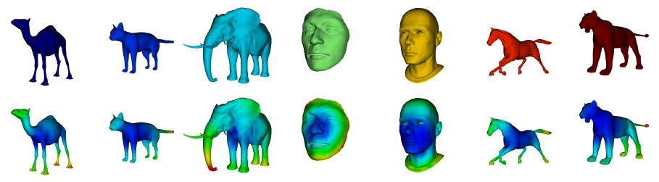
Real Data Sets
Mapper was applied to a database of 3-d shapes, and provides an improved means of classifying such objects

Slide 25
Conclusion
Simplifies large high-dimensional data
Preserves geometric properties
Allows for easy analysis of topological properties and comparison
Generalizes the Reeb graph
Has proven effective and useful

