Slide 1

“Round Trip” Desired State Configuration
Tim Warner
tim-warner@pluralsight.com
Notes:
DSC
Monday, May 22, 2017
11:45a – 12:45pm
AZURE AD SSO
Tuesday, May 23, 2017
10:00a – 11:00a
AZURE NETWORKING
3:00p – 4:00p
PAAS vs IAAS
4:30p – 5:30p

Slide 2

Learning Objectives
Gain a holistic view of the PowerShell Desired State Configuration (DSC) lifecycle
Local Configuration Manager (LCM)
Resources
Configurations
Pull server with Azure Automation DSC
Monitoring and troubleshooting

Slide 3

Session Materials
timw.info/itt

Slide 4
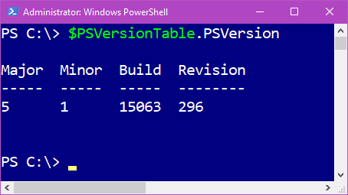
Today’s Assumption

Slide 5
DSC from the Highest Level

Slide 6

Server Configuration Drift = BAD

Slide 7
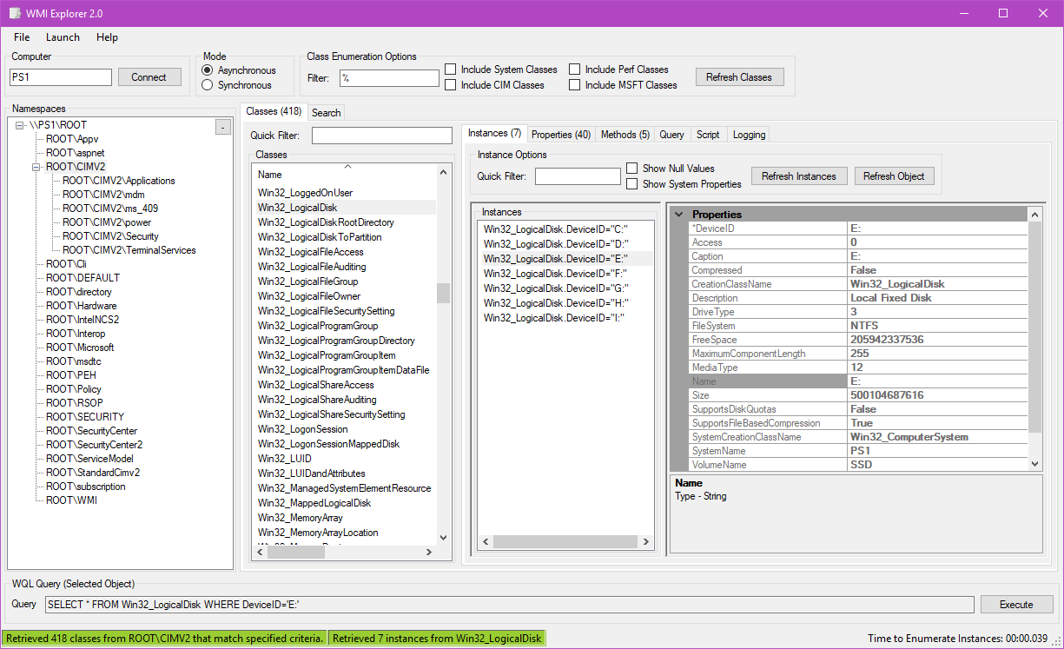
IETF, WMI, CIM, WS-Man
IETF developed the CIM standard
WMI is Windows’ CIM server
OMI is Linux’ CIM server
OMI is Linux’ CIM server
WinRM is Windows’ WS-Man provider

Slide 8
What “Round Trip” DSC Means
Troubleshooting
LCM config
Deployment
Resources
Configurations

Slide 9
Local Configuration Manager (LCM)

Slide 10
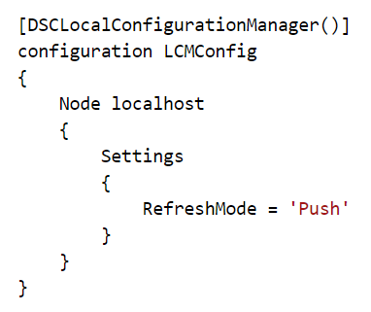
Local Configuration Manager (LCM)
The engine of DSC
Node “meta configuration”
Push or pull mode
Configuration policy

Slide 11
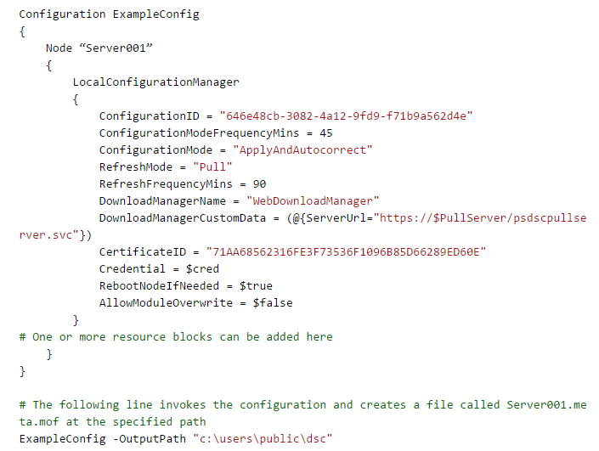
Local Configuration Manager (LCM)

Slide 12
Resources

Slide 13
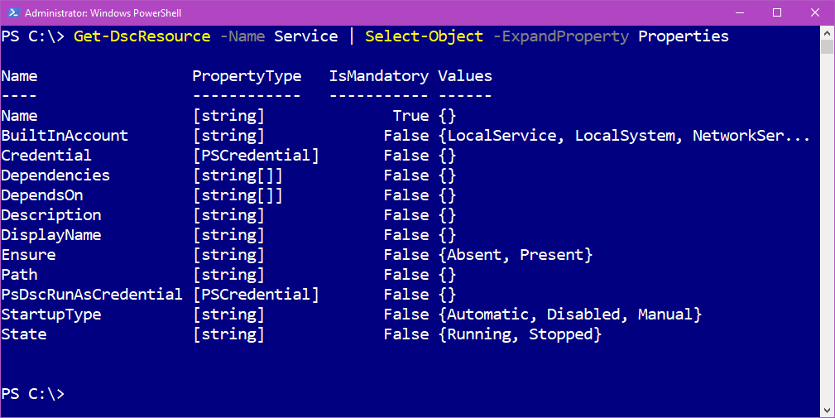
Resources
Building blocks of DSC
A PowerShell module
MOF schema; PS1 implementation

Slide 14
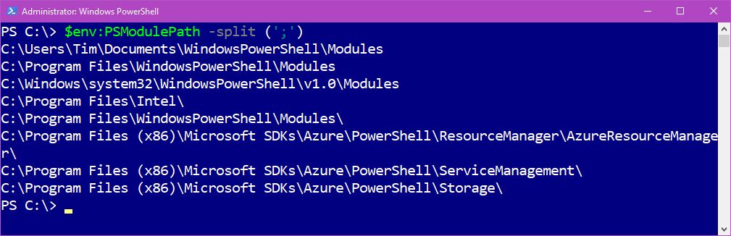
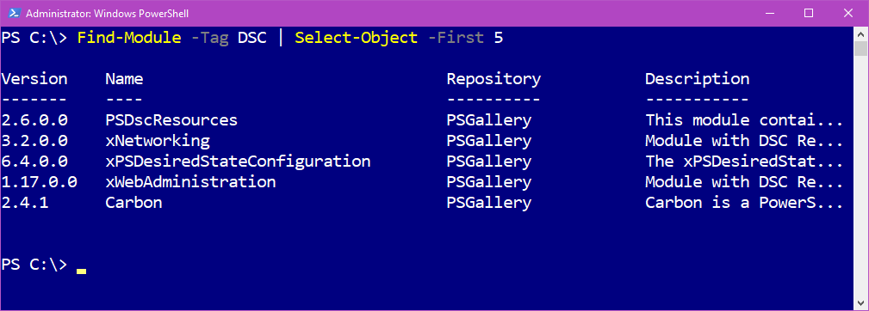
Resources

Slide 15
Resources
Built-in resources
x and c resources
Your own resources

Slide 16
Resources
MOF
xDscResourceDesigner
PowerShell classes
C#

Slide 17
Configurations

Slide 18
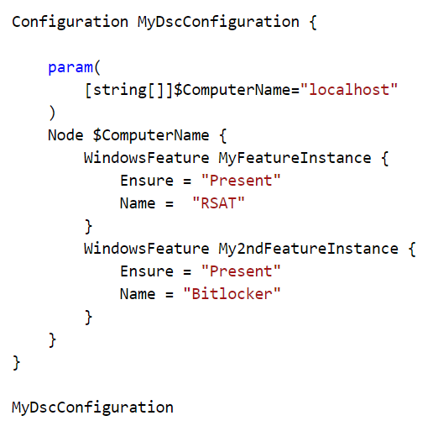
Configurations
Configuration block (like a function)
Parameter declarations
Node block (>=1)
Resource block (>=1)

Slide 19
Azure Automation DSC Monitoring and Troubleshooting

Slide 20
Troubleshooting DSC: Jump Start

Slide 21



Demo: Tying it all Together

Slide 22

Review
DSC presents a low (cost) entry point for server configuration management (Windows + Linux)
If you already use Azure, you can’t beat Azure Automation DSC
Microsoft’s hybrid cloud strategy means it doesn’t matter where your servers are

Slide 23
Questions?
Please use Events XD (EventBoard) to fill out a session evaluation.
Thank you!
timw.info/itt
@TechTrainerTim

