Slide 1

Azure Networking Deep Dive
Tim Warner
tim-warner@pluralsight.com
Notes:
DSC
Monday, May 22, 2017
11:45a – 12:45pm
AZURE AD SSO
Tuesday, May 23, 2017
10:00a – 11:00a
AZURE NETWORKING
3:00p – 4:00p
PAAS vs IAAS
4:30p – 5:30p

Slide 2

Learning Objectives
Preliminary knowledge
Connect Azure resources
Connect virtual networks
Connect to on-premises networks
Route and filter network traffic
Monitor and troubleshoot Azure networks

Slide 3

Session Materials
timw.info/itt

Slide 4
Preliminary Knowledge

Slide 5

Preliminary Knowledge
What You Should Know
How to Address Gaps
TCP/IP internetworking
IPv4 addressing and subnetting
Network devices (routers, load balancers, firewalls)
Network troubleshooting
Network security
Exam 98-366: Networking Fundamentals

Slide 6
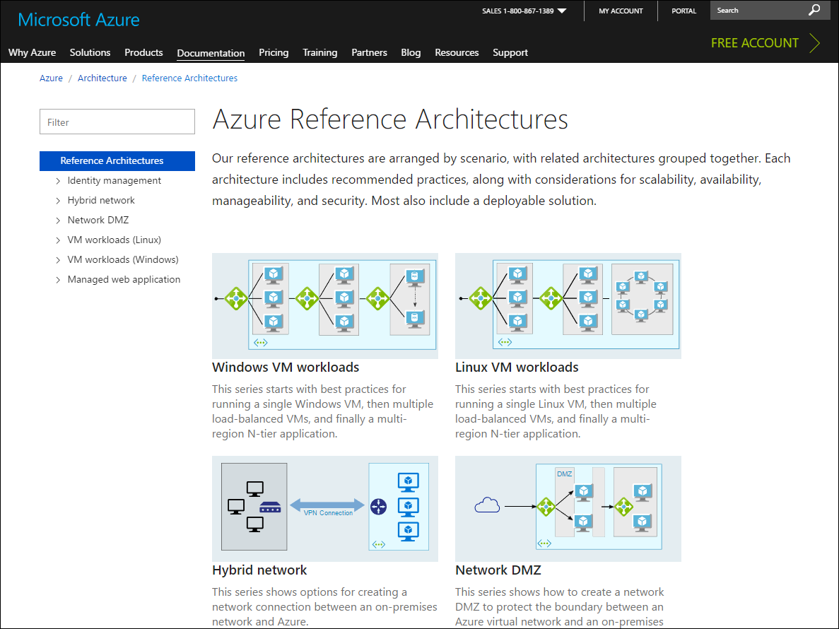
Azure Architecture Center
timw.info/acz

Slide 7
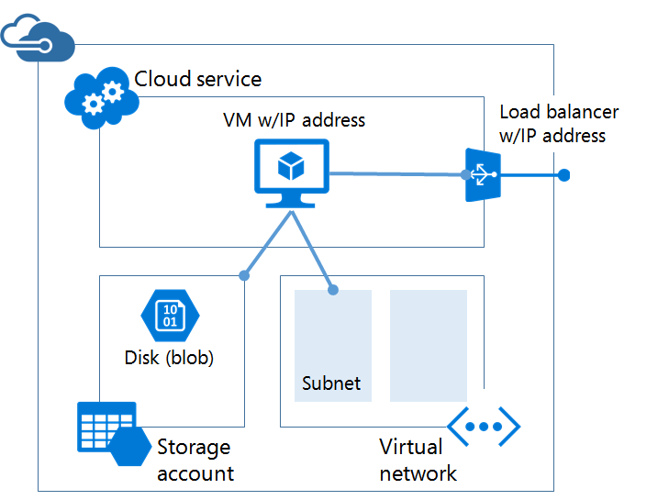
Azure Service Management (IaaS v1)
timw.info/asmz

Slide 8
Connect Azure Resources

Slide 9
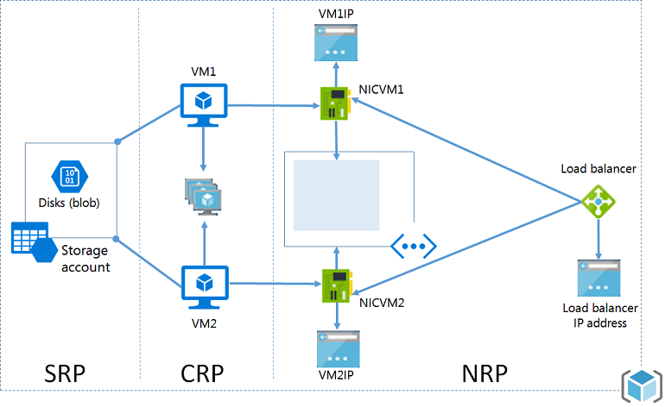
Azure Resource Manager (ARM) Architecture
timw.info/aa1

Slide 10
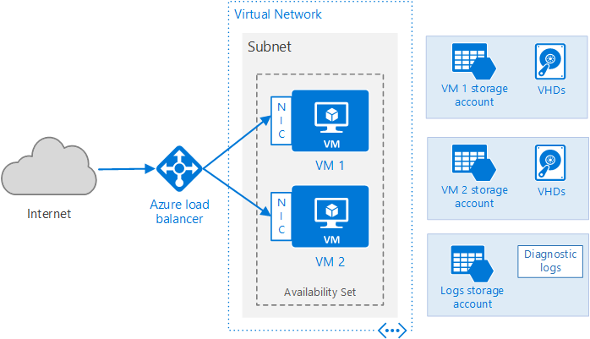
Azure Public Cloud Networking Architecture
timw.info/vmz

Slide 11
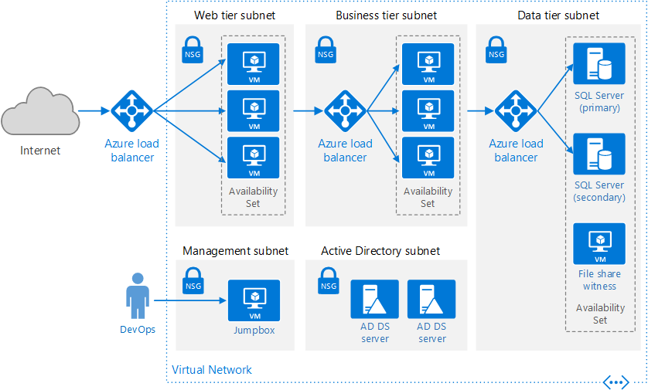
Virtual IP Addresses and Name Resolution
timw.info/dnsz

Slide 12
Connect Virtual Networks

Slide 13
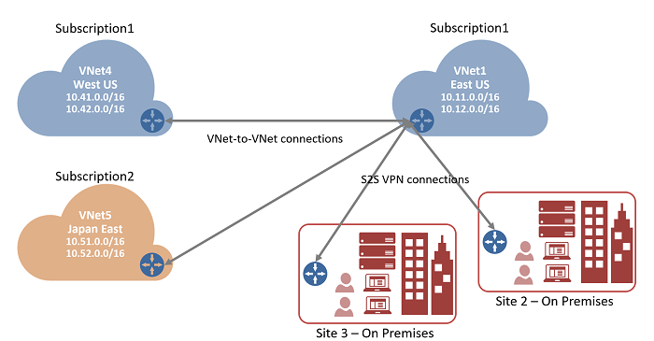
Vnet-to-Vnet VPN
timw.info/vn22

Slide 14
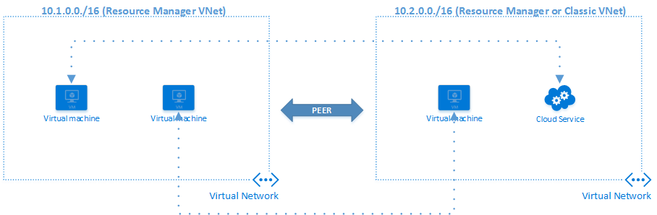
Vnet Peering
timw.info/vp1

Slide 15
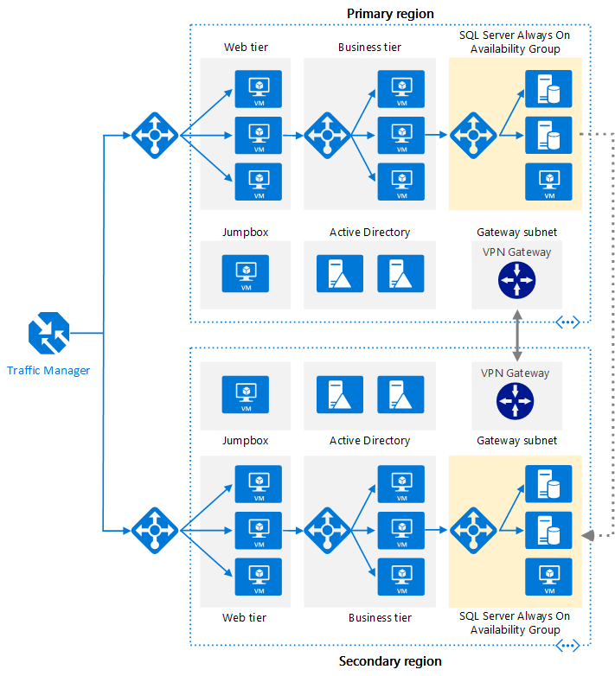
Multi-Region IaaS
timw.info/mrz

Slide 16
Connect to On-Premises Networks

Slide 17
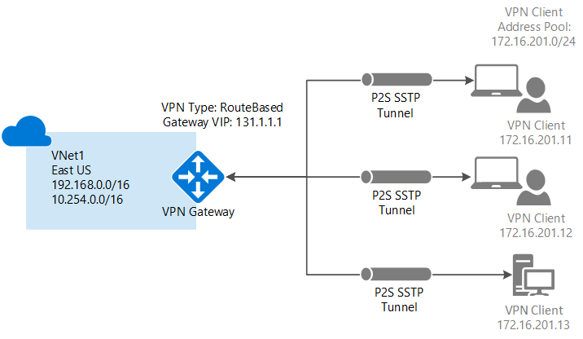
Point-to-Site VPN
timw.info/p2ss

Slide 18
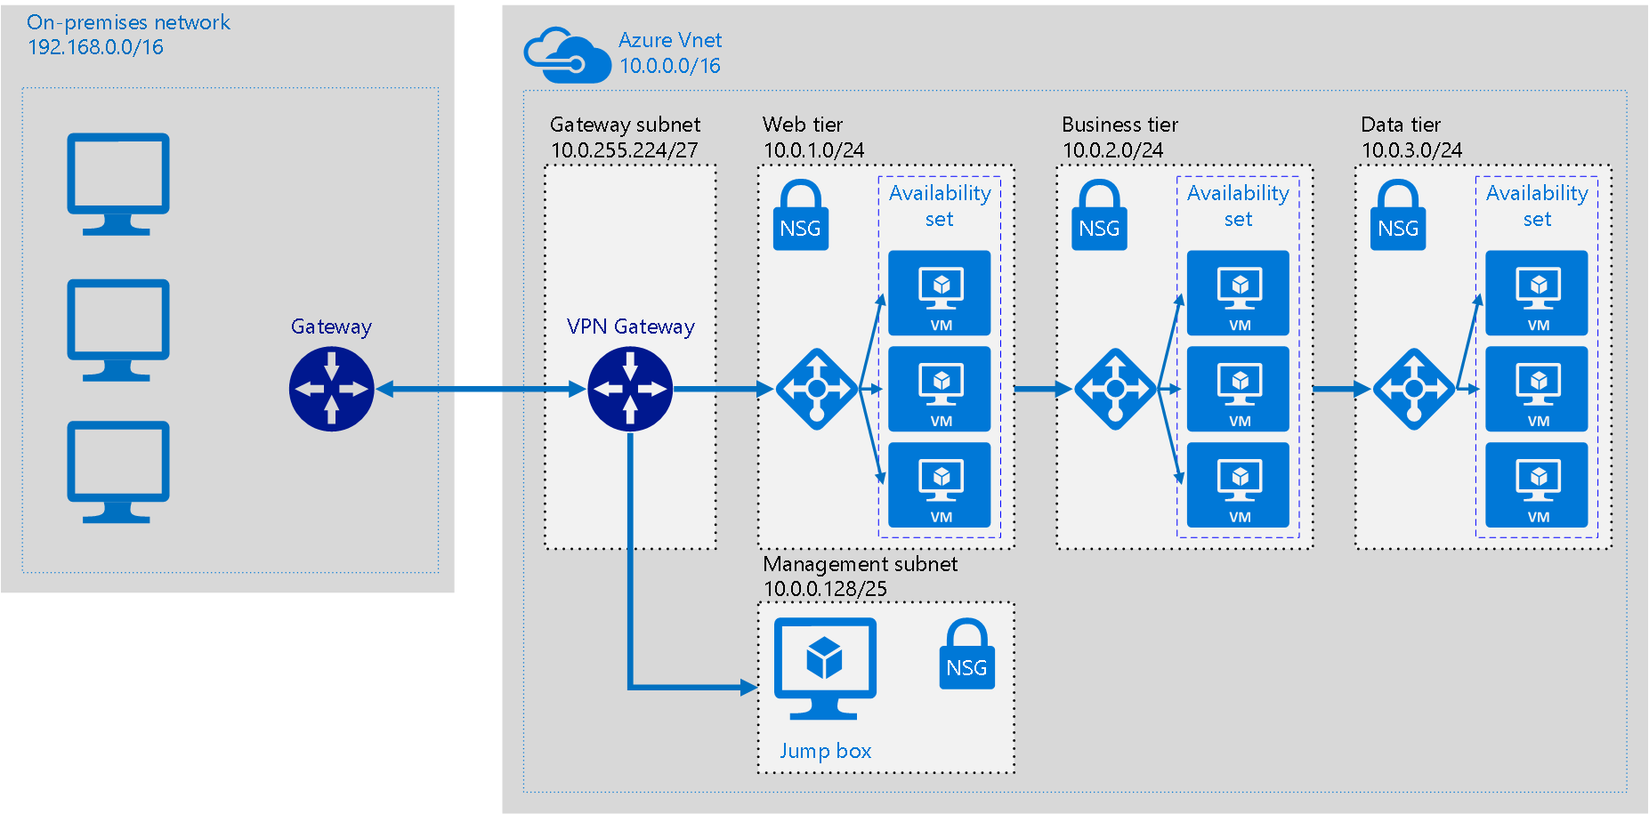
Site-to-Site VPN
timw.info/hbz

Slide 19
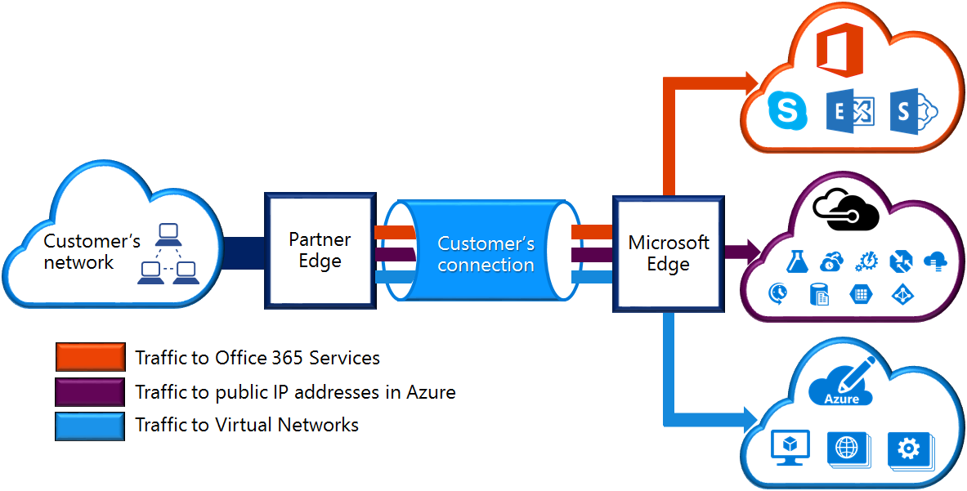
ExpressRoute
timw.info/er1

Slide 20
Route and Filter Network Traffic

Slide 21
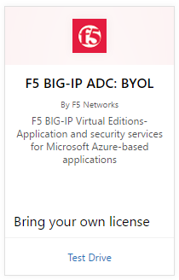
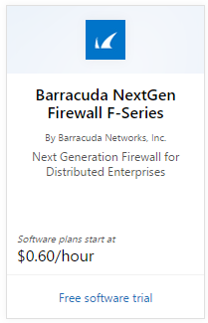
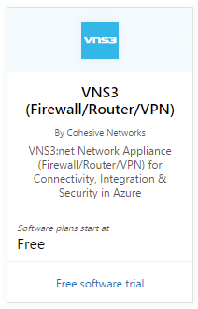
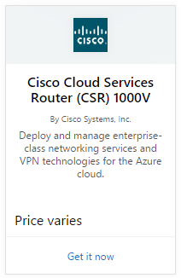
Azure Network Virtual Appliances
timw.info/

Slide 22
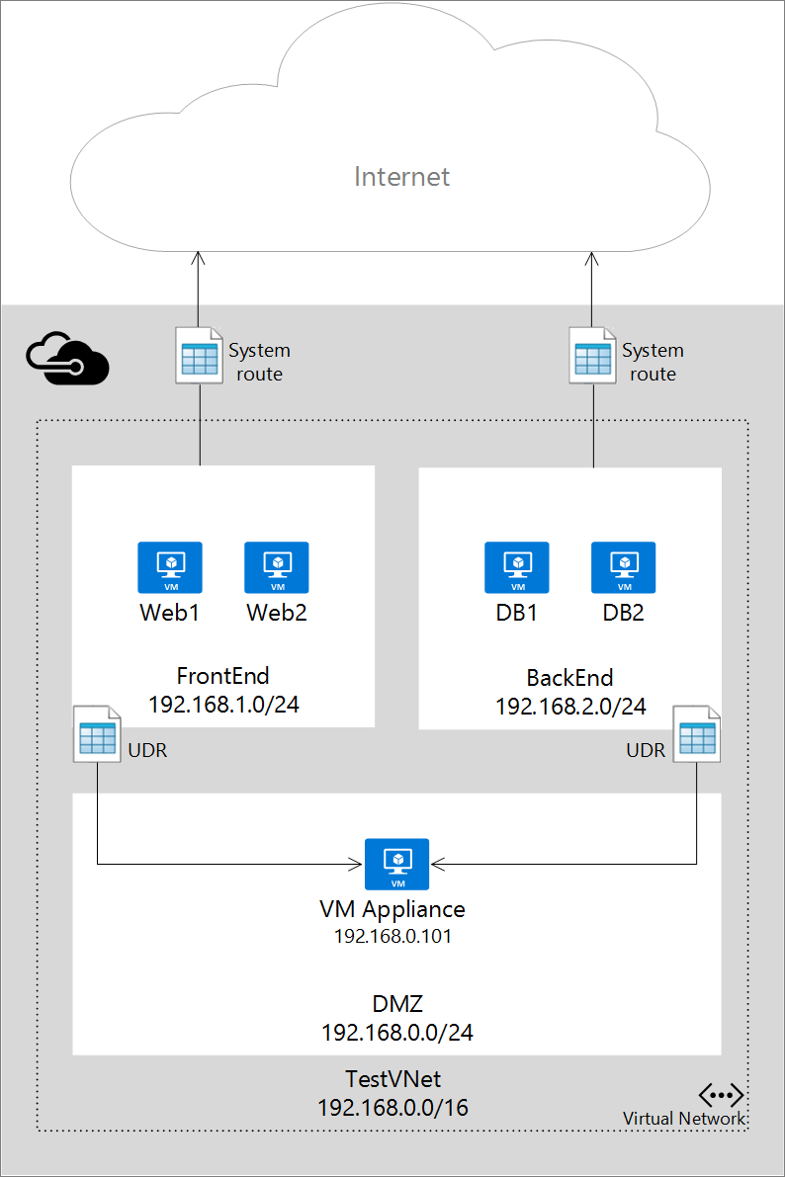
User-Defined Routes and IP Forwarding
timw.info/udr1

Slide 23
Monitor and Troubleshoot Azure Networks

Slide 24
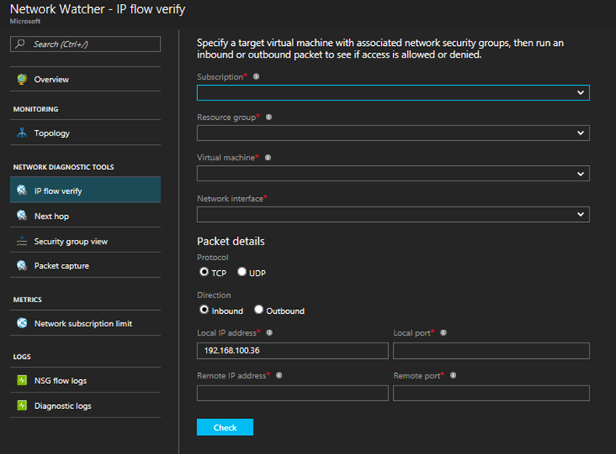
Network Watcher
timw.info/nw1

Slide 25
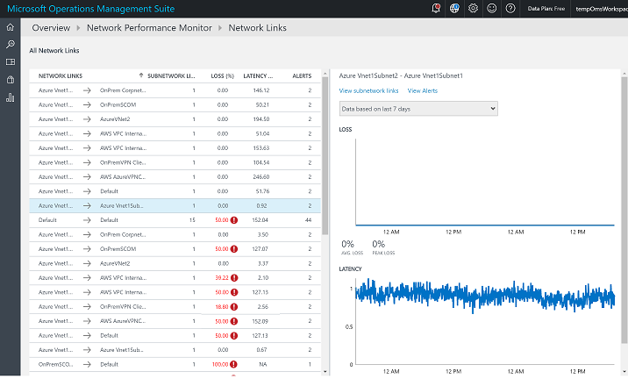
Network Performance Monitor
timw.info/npm1

Slide 26

Review
Azure networking is tough because the stakes are high and the skill set is broad
Plan, plan, plan
IP address ranges
VPN hardware purchases
Azure advisory frameworks:
Azure Advisor
Azure Security Center (ASC)

Slide 27
Questions?
Please use Events XD (EventBoard) to fill out a session evaluation.
Thank you!
timw.info/itt
@TechTrainerTim

