Slide 1
PC BUILDER
Lorenzo
Brandon
Ethan

Slide 2
Introduction of the Project
Project Description
A java program that allows a user to select their own parts for each PC component from scratch
Each PC Component has its own
product name
Price
Guest User
name
email
session id (uuid)

Slide 3
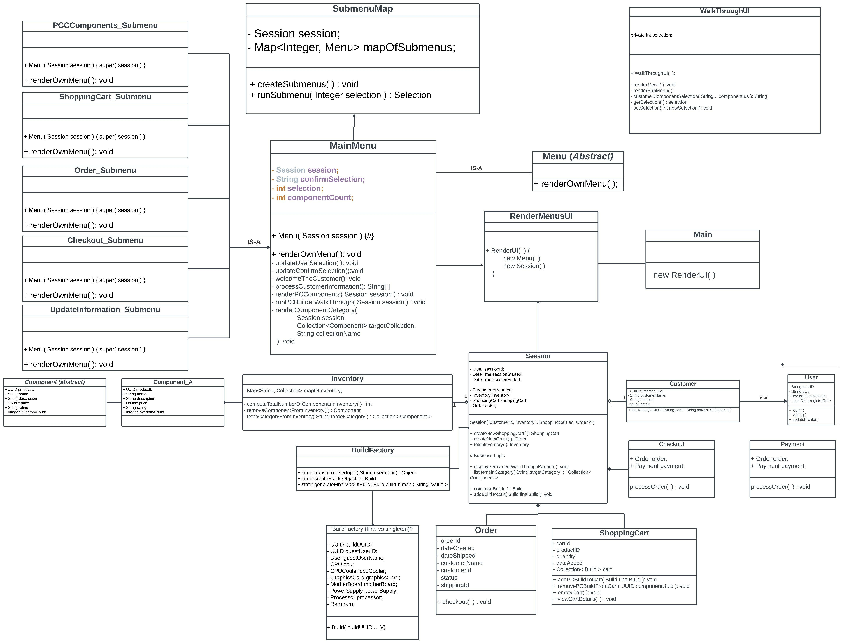
UML diagram

Slide 4
Project Demo
https://github.com/brandonyrigan/pcbuilder

Slide 5
Reflections on the Project
Implemented OO concepts such as Encapsulation, Abstraction, Inheritance, Composition, Delegation, Polymorphism
Clean code practices
Design principles and patterns
Technical challenges
Code fragments that we feel proud of
Extra features you want to add if you have extra time

