Slide 1
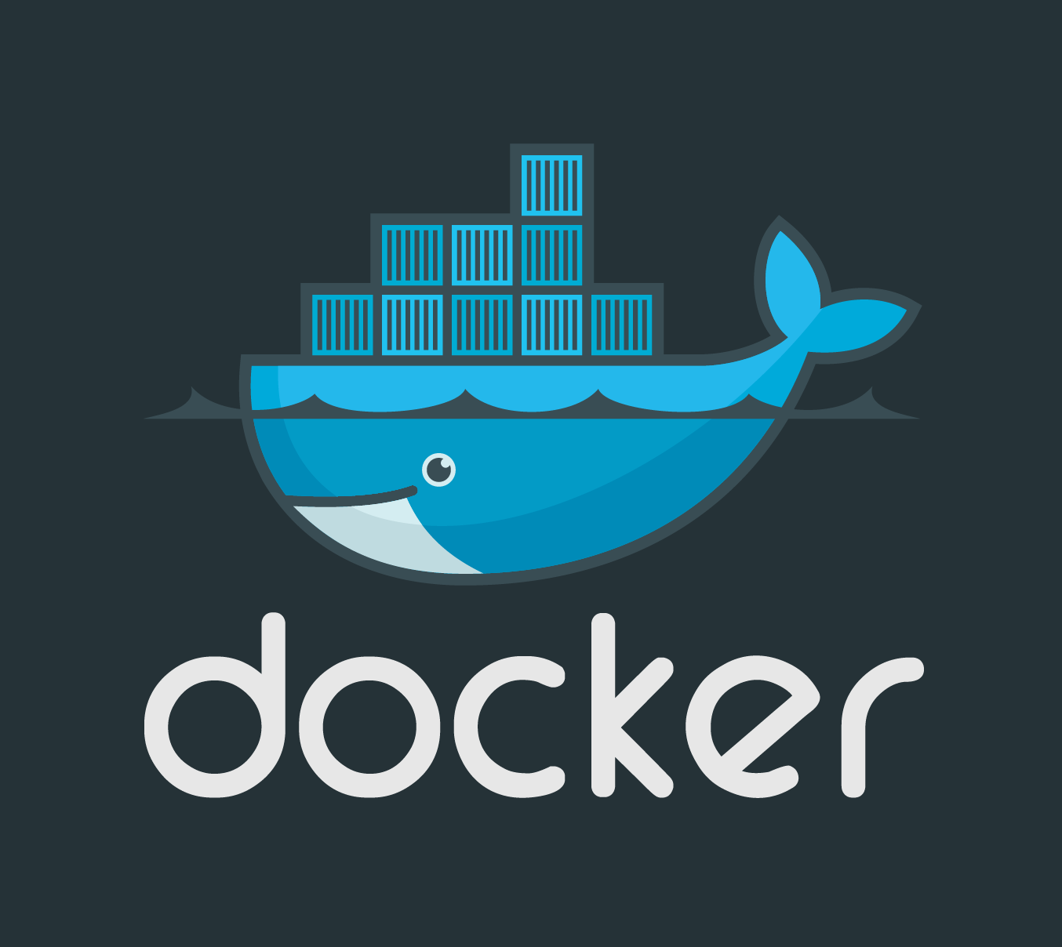

Docker Rocker
Docker Rocker Snocker Cock Blocker!

Slide 2
D0ck3r::Intro_Importance
Overview of Docker

Slide 3
D0ck3r::Origin_Story
History and Origin
Importance in Cybersecurity

Slide 4
D0ck3r::Whale_withBenifits
Portability
Consistency
Isolation
Cost Efficiency
Secure

Slide 5
D0ck3r::Pull_thisWhale
Installation on Ubutunu VMs or whatever we have
Set up tips and Troubleshooting if issues happen

Slide 6
D0ck3r::Whale_Whisperer
Basic Docker Commands
docker –version
docker pull
docker run
docker ps

Slide 7
D0ck3r::HarborHacker
Hands-On Activity: Running Hello World
Step-by-Step Instructions
Screenshots/Examples

Slide 8
Docker's Harbor and containers
Day Two of Whale Hunting!!

Slide 9
D0ck3r::Images
Docker Images Overview
What is a Docker Image?
Image Structure

Slide 10
D0ck3r::Creating_images
Creating Docker Images
Writing Dockerfiles
Basic Dockerfile Commands (FROM, RUN, COPY, etc.)

Slide 11
D0ck3r::Harbor_Containers
Working with Containers
Creating Containers from Images
Managing Containers (docker start, docker stop, docker rm)

Slide 12
D0ck3r::dockerContainers
Hands-On Activity: Creating and Running Containers
Step-by-Step Instructions
Sample Dockerfile

Slide 13
Q&A

Slide 14
Docker Compose up -d
Day Three of Whale Hunting!!

Slide 15
Docker_Harbor

Slide 16
D0ck3r::dockerContainers

