Slide 1





03 March 2026
14:30 – 17:30 CET
Discord Online
agentcamp.city/milan
Sponsored by:
COMMUNITY SPONSORED
Notes:
[Customize with your event details]

Slide 2
AGENDA
Global AI Community Keynote
Building Intelligent Agents with GitHub Copilot, Agent Builder, and Microsoft Foundry – Anna Fabris
Developing Multimodal Agents: A Hands-On Workshop with Microsoft Foundry & AI Toolkit – Sergio Mancini
Orchestrating a Multi-Agent Architecture with Copilot Studio – Vittoria Marano
Building Agentic AI Systems with Microsoft Agent Framework in .NET – Andrea Beghini

Slide 3
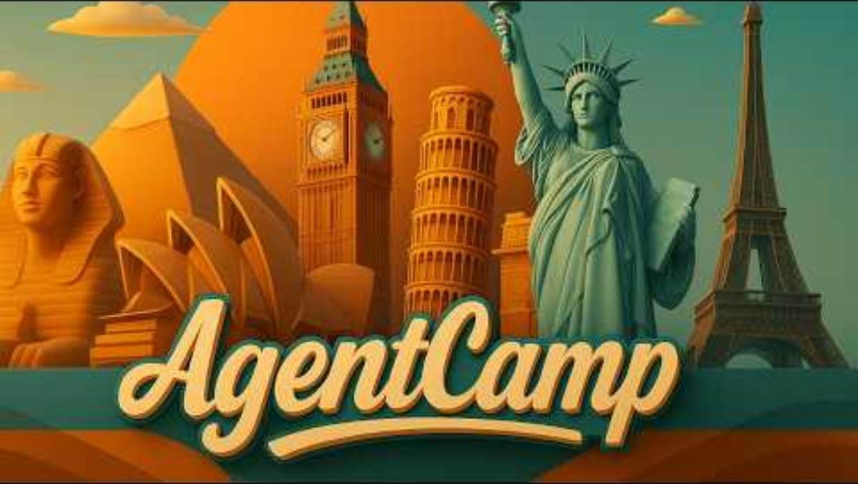

Slide 4
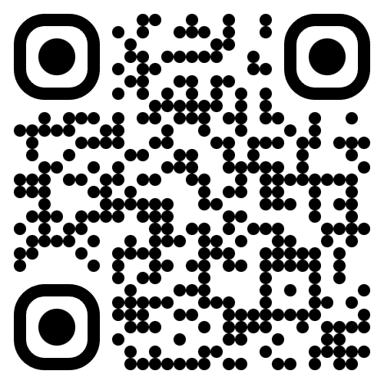
Join the AI Conversation on Discord
gaic.io/discord

