Slide 1

TutorHub
Creators:

Slide 2

Introduction
Has there ever been a college class that is so deep into a subject that not even google could give you a straight answer. The only people that would be able really help you would be the people that have already taken the class but the problem is that is no way to communicate with them.
Why can’t there be a simple application that helps college students find and communicate with tutors who have experience with the subjects?

Slide 3


The Solution is TutorHub!
Tutorhub can be the first solution for tutors and students to easily access a site and quickly find help from tutors only at LSU. Tutorhub can be used on Iphones or computers and will have many options of tutors located in different categories of our system. Students would just have to login, browse through the system for the specific tutor and schedule a time to meet up via online or in person. But not only will Tutorhub just be for locating tutors but also a site that provides handwritten notes from the tutors that took the class so that students can be given former-student notes.

Slide 4





Technological Support
Using the VS as our code editor, we created a sophisticated application with Javascript as our code.
For our front-end team to visually see our progress, the open-source platform Expo(specifically expo cli) was used along with React Native. Expo and React Native was easy for all our group members to understand and utilize in our app.
For our back-end team we decided to have our API run a nodemon Javascript server which the data was stored using MongoDB. Our team was already familiar with SQL so they wanted to use a non-SQL database inorder to gain more experience in another area.
Lastly, we used GitHub as our main repository so that each member can individually work on a specific area that they were instructed to work on in a safe, easy way. Through GitHub each member was able to create their own ideas on how the app could work and with support from all the members of the group would me implemented in the main code. If someone created an error in their code

Slide 5
Core Features
The applications is made up of 3 sections.
User-Posting
Search And Add Friends
The Profile Screen

Slide 6
Home Screen Setup
From the Home Screen, the user can view the user IDs of all the people they’ve contacted, the messages they’ve sent them, and the subject tags that tutor is affiliated with.

Slide 7
The many usages of the chat room!
There is none

Slide 8
A Profile Screen that helps a person be identified for the right Tutor/student
From the Profile Screen, the user can see their profile picture and username. They also have the option to directly message a tutor from here, as well as edit their profile.

Slide 9
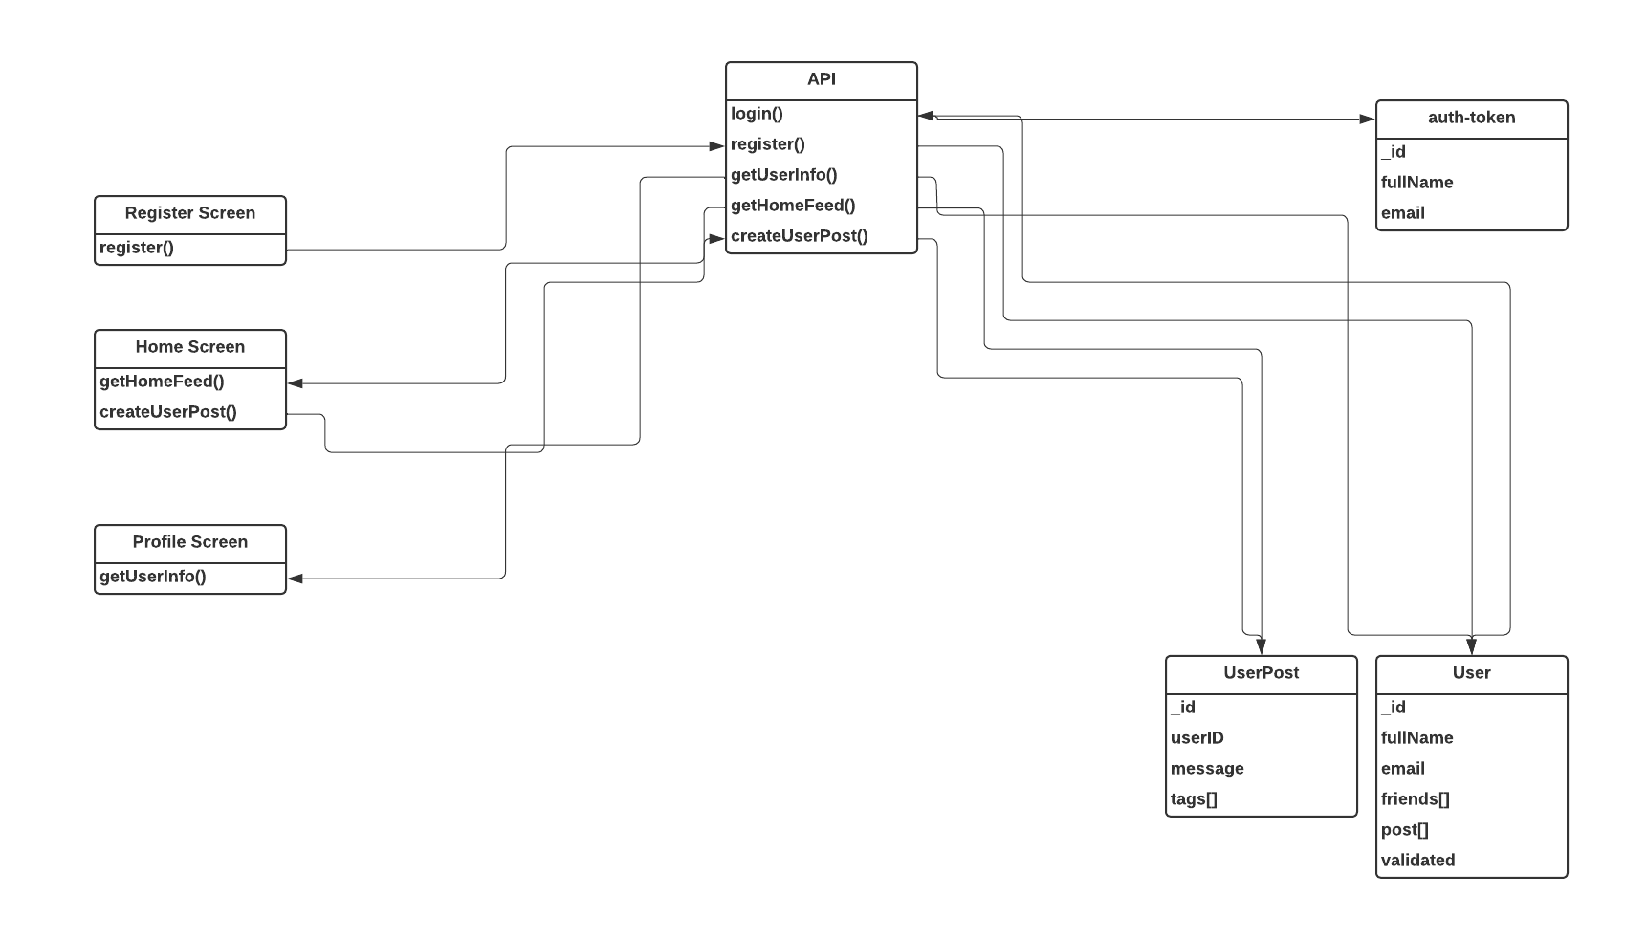
Data Flow Diagram

Slide 10
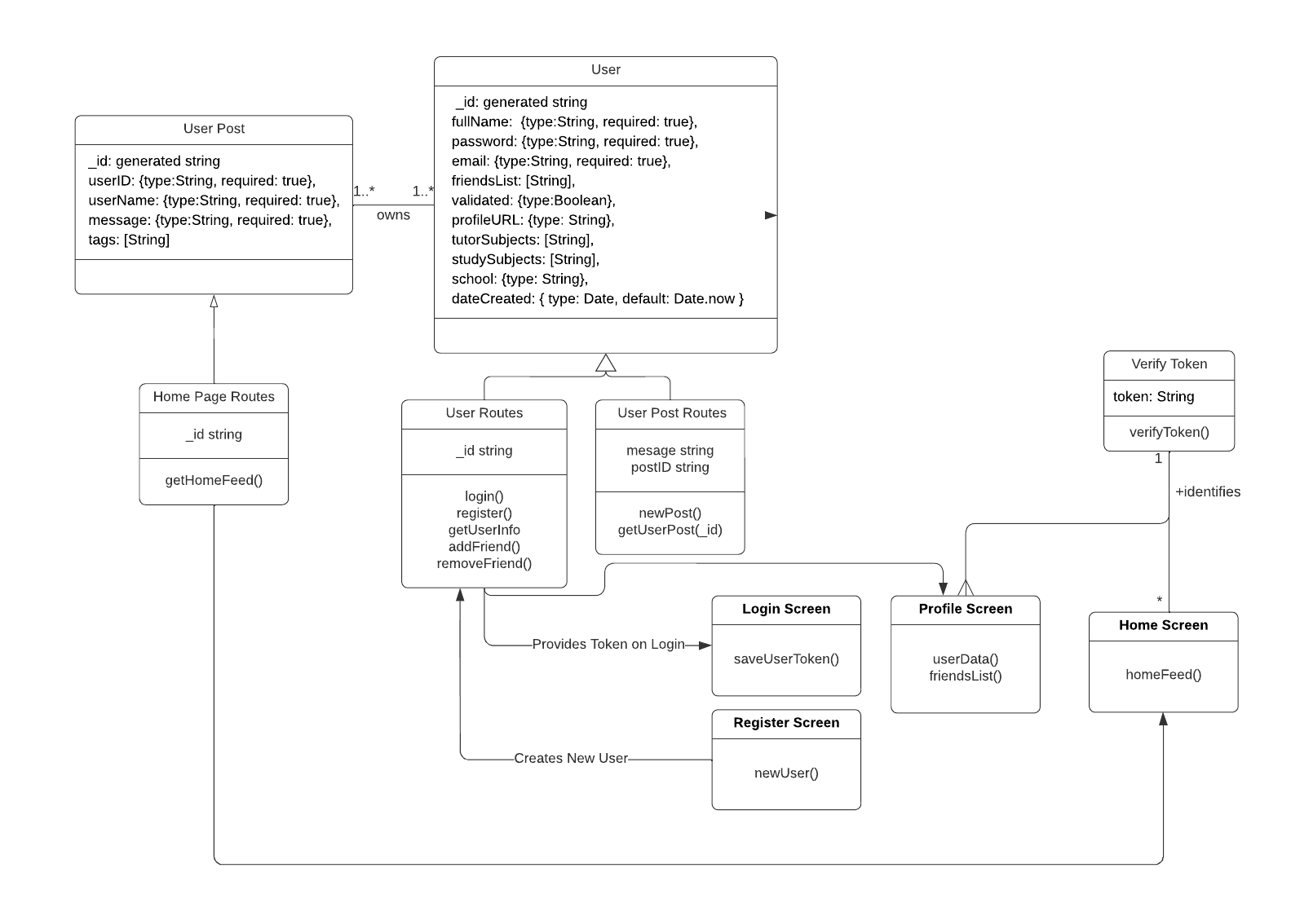
The Design Pattern Class diagram

Slide 11
What the future of TutorHub looks like:
There is no future for TutorHub

