Slide 1
Term Project
CSC 308: Mobile App Development
Dustin Peerce, Brandyn Shepherd, Travis Todd

Slide 2
Purpose
App Name: Dolphin Defense
A Gaming Application
A simple, yet challenging arcade experience

Slide 3
Overview
A dolphin that shoots lasers, because reasons
Side-scrolling shooter
Horizontal scrolling with vertical movement

Slide 4
Overview cont'd
Sharks enter from the right
Shoot sharks for points
The game ends when the dolphin touches a shark

Slide 5
Interface
Main Menu Scene
“Play” Button
Gameplay Scene
Avoid sharks and kill as many as possible
“Restart Button”

Slide 6
Controls
Vertical movement through Accelerometers
Tap to shoot

Slide 7
Objective/Gameplay
Shoot for the high score
Sharks will move faster as your score increases
Sharks will spawn faster as your score increases

Slide 8
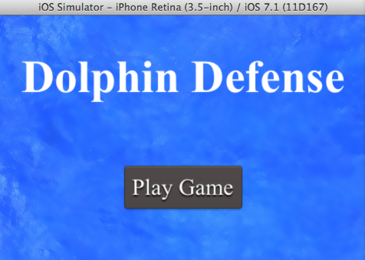
Main Menu

Slide 9
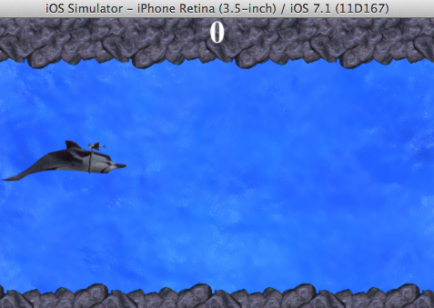
Gameplay Scene 1

Slide 10
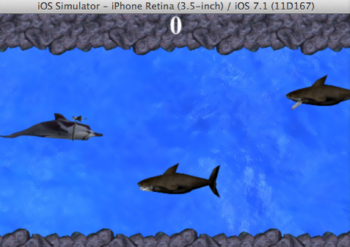
Gameplay Scene 2

Slide 11
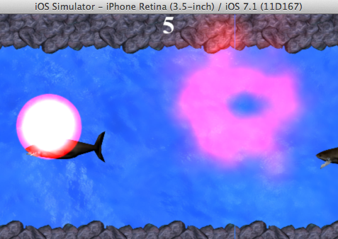
Gameplay 3

Slide 12
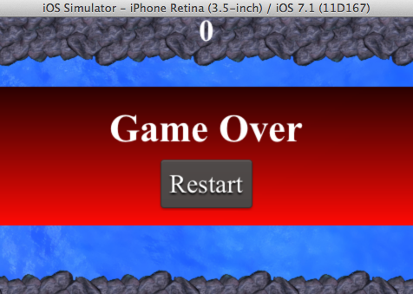
Game Over UI

