Slide 1
Which is my next dream foundation?
Wanying Wang

Slide 2
Problem Statement
Can we make a convenient recommendation system based on the tons of foundation reviews?
Are the reviews reliable? Are they able to show different aspects of the foundations?
How do we recommend?
Text Analysis of Reviews
Recommendation System
Data Overview
Number of Reviews
Number of Brands
Overview of Reviewers
Text Cleaning
Comparison Wordcloud
Topic Modeling
DocumentTermMatrix
Feature Reduction
Cosine Similarity

Slide 3
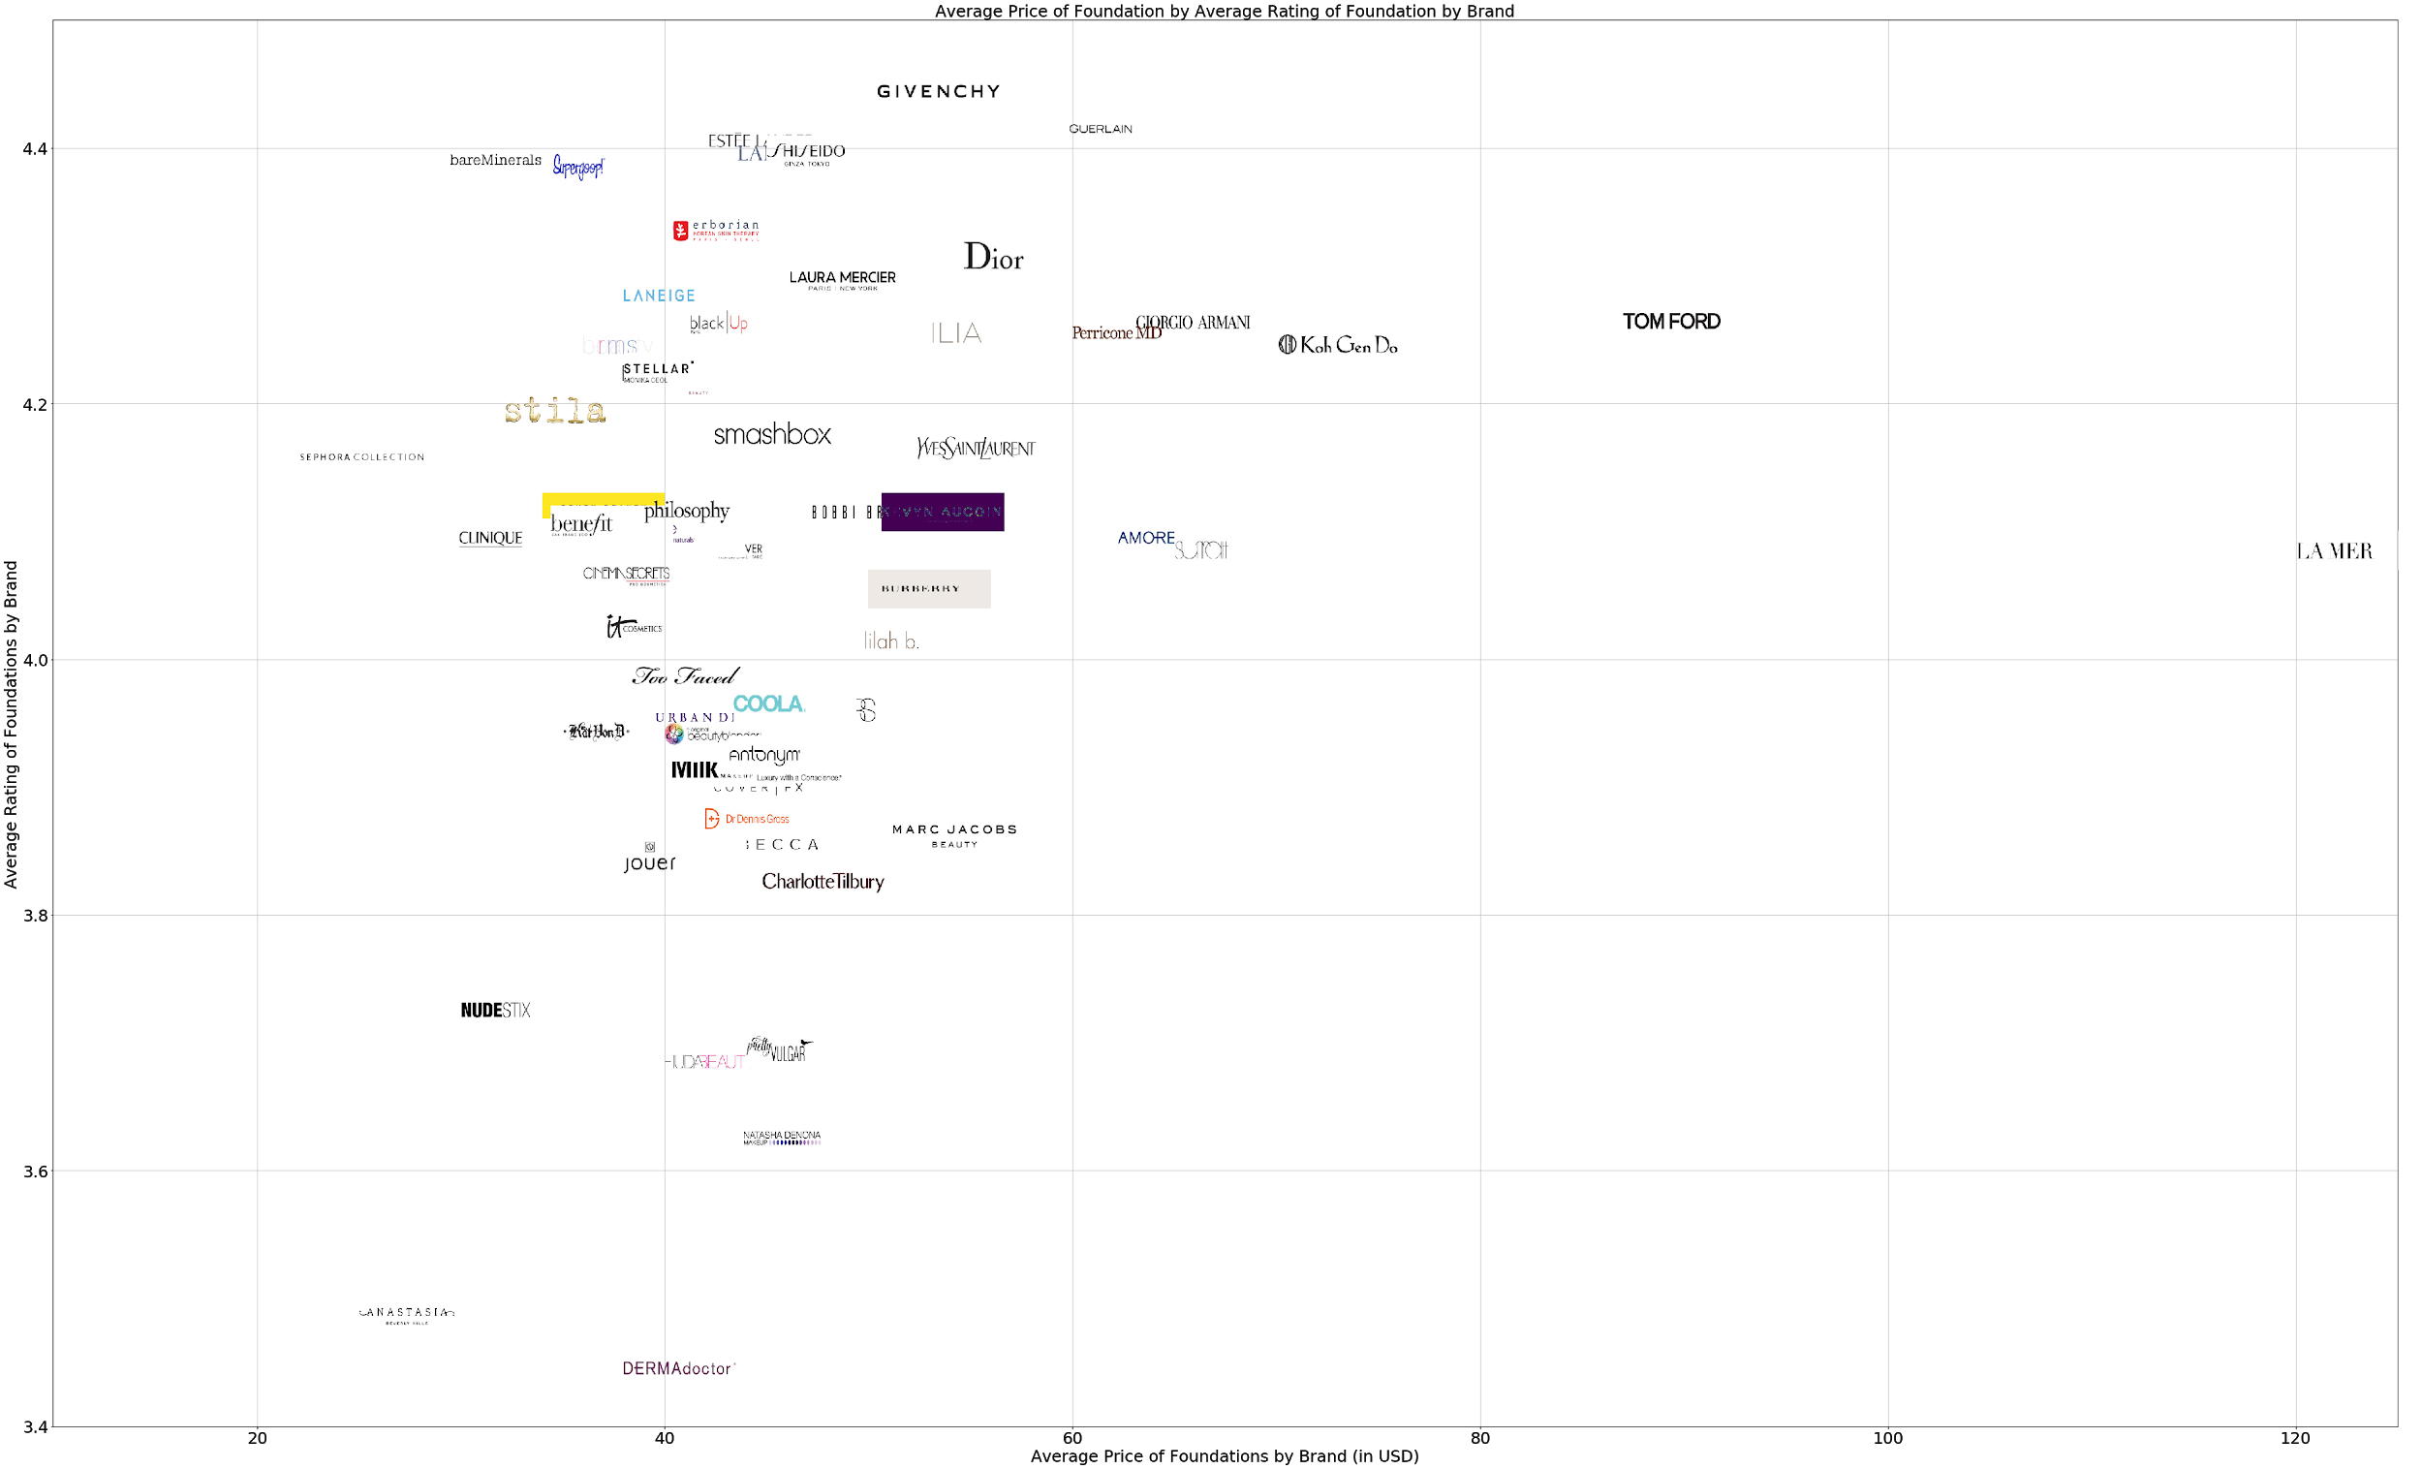
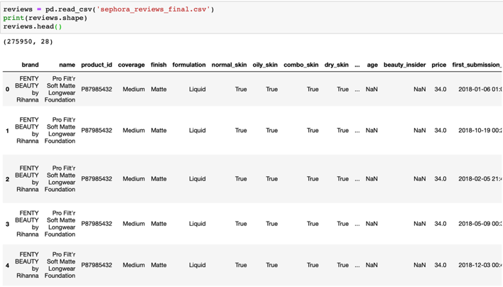
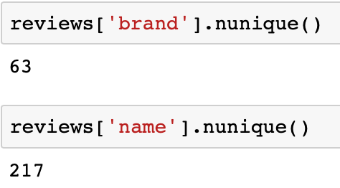
Data Overview
Data source: sephora.com ——Thanks san2797 for the clean dataset
Product: brand, name, product id, coverage, finish, formulation, normal_skin, dry_skin, oily_skin, combo_skin, SPF, price
Reviewer: user Name, rating, recommended, skin_type, Eye_color, skin_tone, skin_concern, age

Slide 4
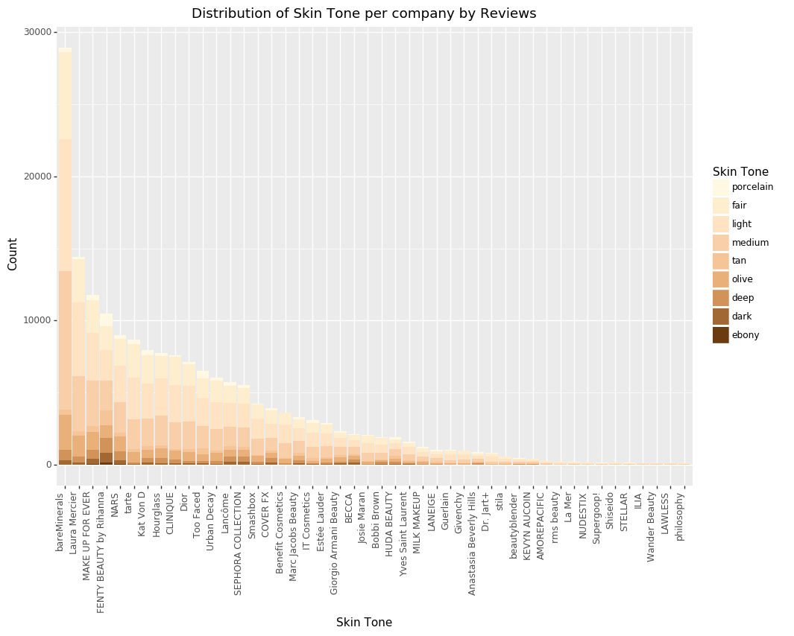
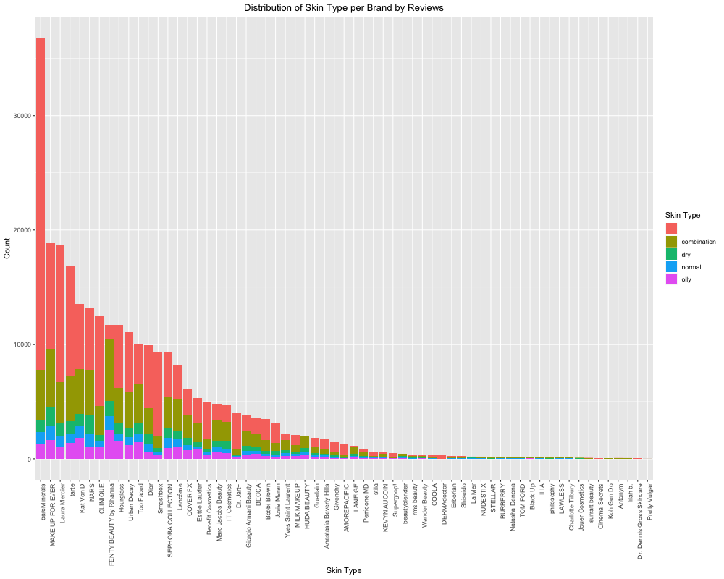
Review Overview
Skin Tone
Skin Type

Slide 5
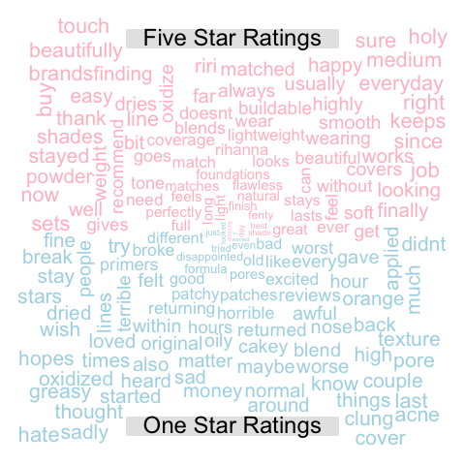
Text Analysis of Reviews
Pre-Processing:
✅ Tokenize, lowercase, remove stopwords (customize the stopword dictionary), remove numbers and punctuation
✅ TermDocumentMatrix
✅ Comparison Wordcloud

Slide 6
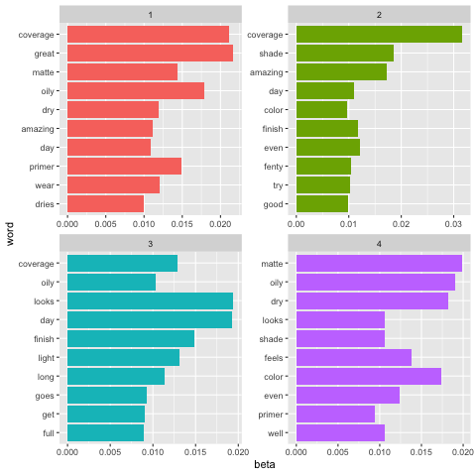
Topic Modeling
💄 Coverage
💄 Finish (Matte, Natural, Radiant)
💄 Suitable Skin Type (Dry, Oily)
💄 Shade/ Tone/ Color
💄 Long-stay
💄Primer

Slide 7
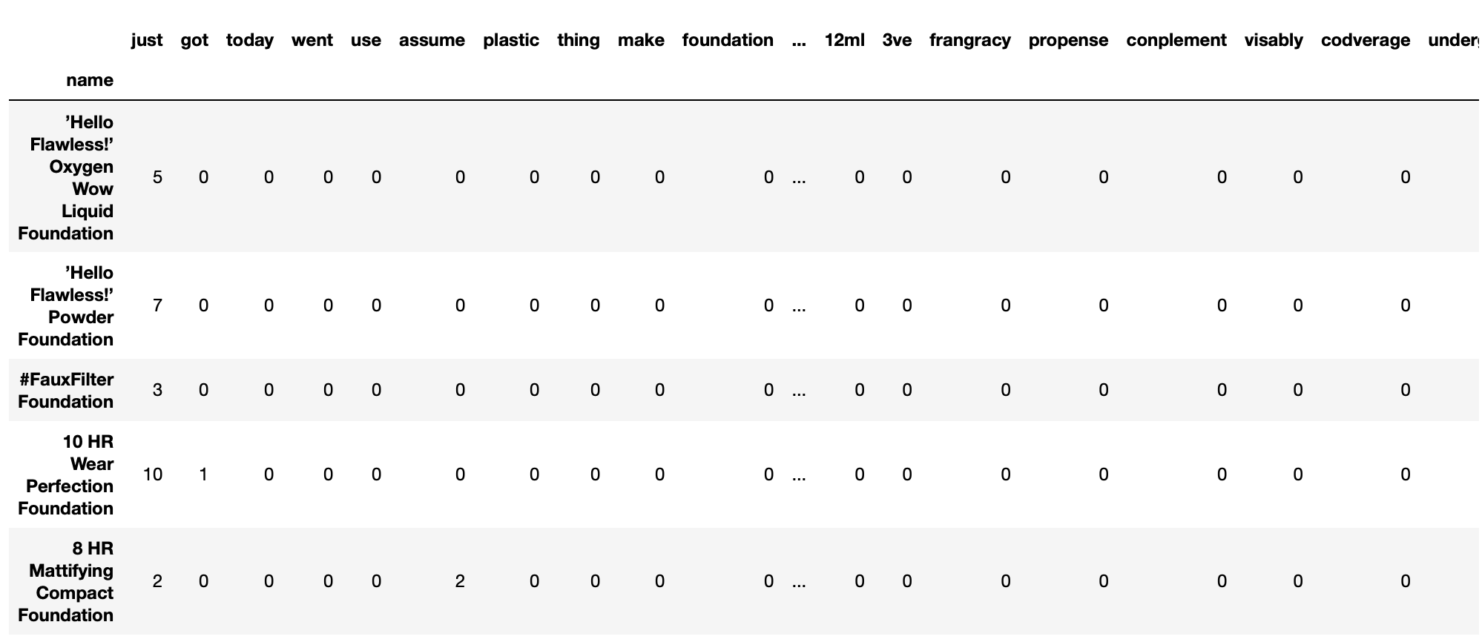
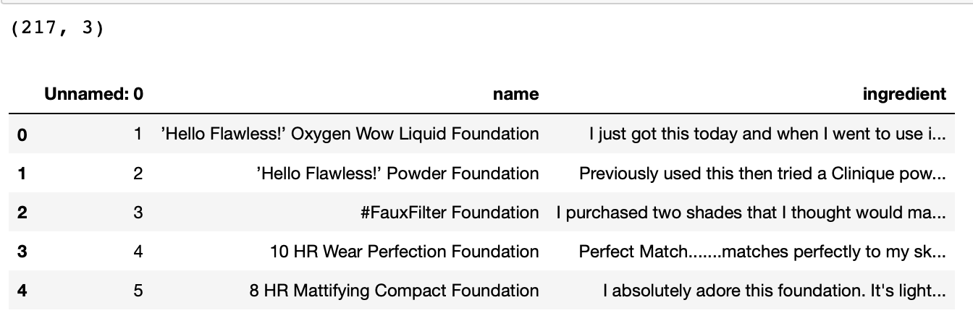
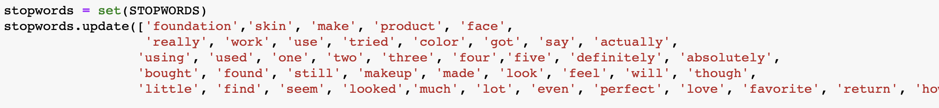
Recommendation System
43697 features ➡️ Dimension Reduction: TruncatedSVD

Slide 8
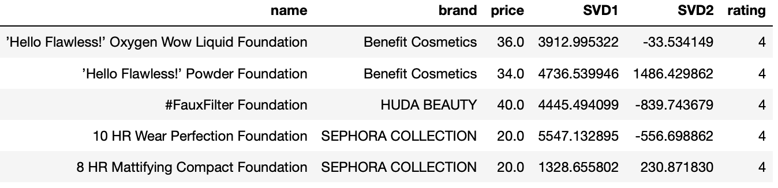
Recommendation System
Similarity Distribution Plot

Slide 9
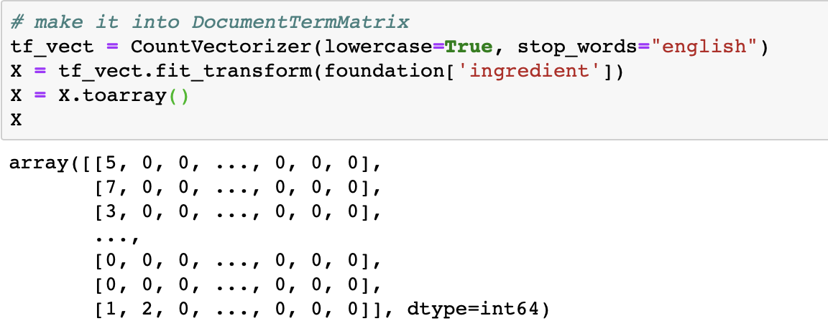
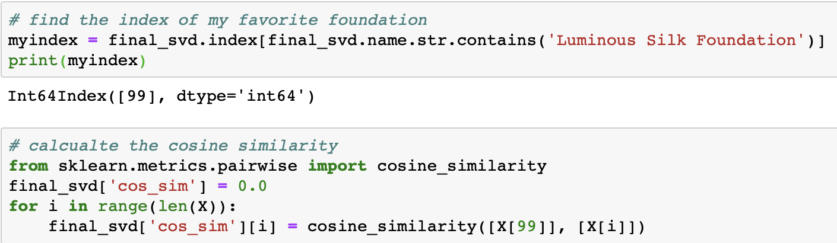
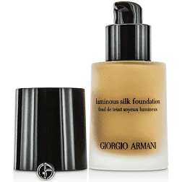
Recommendation System

Slide 10
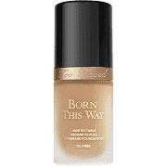
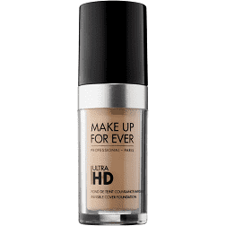
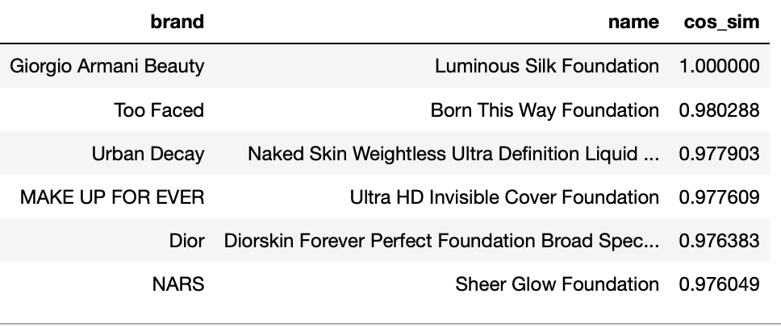
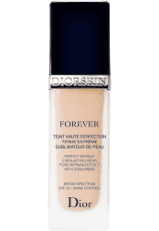
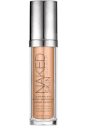
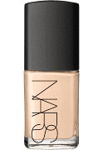
Which is my next dream foundation?

Slide 11
Conclusion
High rating reviews and low rating reviews together can describe different aspects of foundation products. They can help us to extract features of different foundations.
Customers focus on the coverage, finish, shade, the skin type that certain foundations suitable for, whether long-stay and whether lightweight.
It is practical to make recommendations using the cosine similarities among foundations based on the reviews of each foundation, which can save more time for customers to read reviews and make their choice.

Slide 12
Limitation
Data limitation: unbalanced distribution of reviews among brands and products
Review limitation: reviews tend to be subjective, they may not be able to give a thorough description of foundation. Representativeness of feature.
Text process limitation: should remove more meaningless words and try to keep the adjective words and nouns related to features of foundation

Slide 13
Future
Collect more data to make it more balanced across brand and products
Add product ingredients as important complement features for the basis of recommendation, make it more reliable
Apply more advanced similarity algorithm to make it more accurate
Make recommendations for different types of skin and ages based on the reviews from different groups of reviewers

Slide 14
Thanks for listening!
Questions?

