Slide 1
Thesis Presentation:
Forecasting with Linear Augmented Information Combination
Branesh Prakash
EBS Honours/Masters Presentation
23 October 2026
Supervisors:
Dr. Shanika L Wickramasuriya &
Prof. George Athanasopoulos

Slide 2
Outline
Part 1. Research Question and Method
1.2 Multivariate regression framework with flexible predictor set
1.1 Forecast reconciliation
Forecasting with Linear Augmented Information Combination
1.3 Linear components (FLAP idea) augmented in predictor set
Part 2. Empirical Investigation

Slide 3


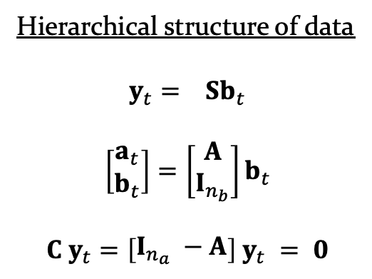
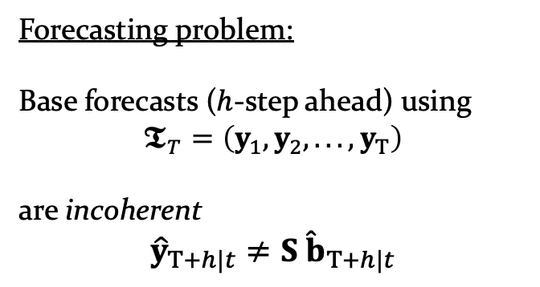




1.1 What is forecast reconciliation problem?
Levels
1
Total
2
States
3
Zones
4
regions
Domestic tourism hierarchy (n=112 series)
Hierarchical structure of data
$$y_{t}= Sb_{t}$$
$$\left[\begin{matrix}a_{t} \\ b_{t}\end{matrix}\right]=\left[\begin{matrix}A \\ I_{n_{b}}\end{matrix}\right]b_{t}$$
$$C y_{t}=\left[\begin{matrix}I_{n_{a}} −A\end{matrix}\right] y_{t} = 0$$
$$Aggregation$$
$$Constraints$$
AUS
VIC
$⋯$ $⋯$ $⋯$
NT
$⋯$ $⋯$ $⋯$
$⋯$
Central
NT
Forecasting problem:
Base forecasts ($h$-step ahead) using
$$𝕿_{T}=\left(y_{1},y_{2},...,y_{T}\right)$$
are incoherent
$${\hat{y}}_{T+h|t}≠S {\hat{b}}_{T+h|t}$$
Metro
VIC
$⋯$ $⋯$ $⋯$ $⋯$
$⋯$ $⋯$ $⋯$ $⋯$
$⋯$
$⋯$
Mel
$⋯$ $⋯$ $⋯$ $⋯$ $⋯$
Alice Springs
Base forecasts ${\hat{y}}_{T+h|t}$ $⟶$ Reconciliation $⟶$ Coherent ${\tilde{y}}_{T+h|t}$
3/21 | Part 1.1.

Slide 4
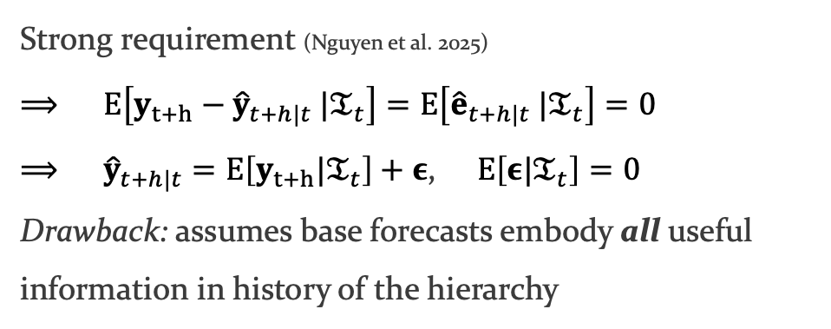
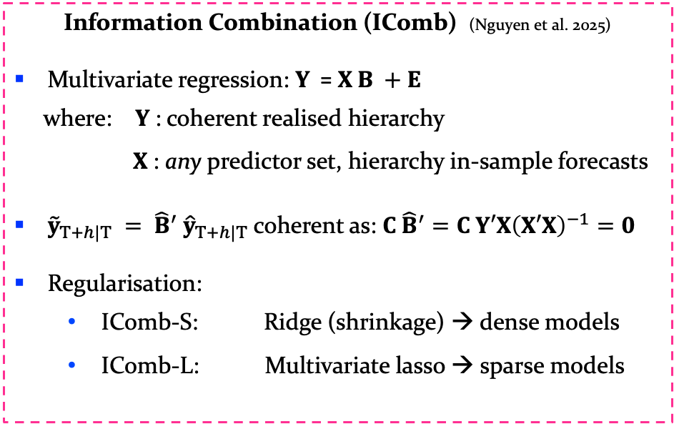
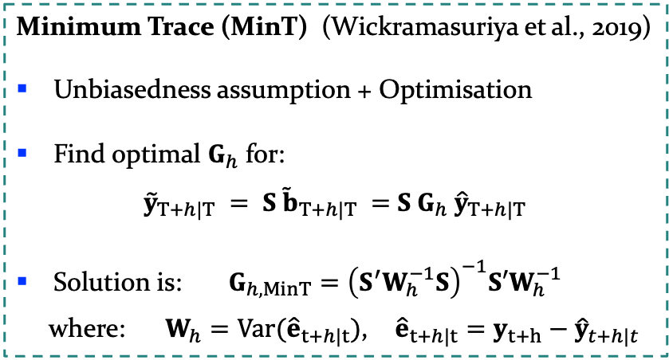
1.2 How has the literature approached reconciliation?
Strong requirement (Nguyen et al. 2025)
$$⟹ E\left[y_{t+h}−{\hat{y}}_{t+h|t} |𝔗_{t}\right]=E\left[{\hat{e}}_{t+h|t} |𝔗_{t}\right]=0$$
$⟹ {\hat{y}}_{t+h|t}=E\left[y_{t+h}|𝔗_{t}\right]+ε$, $E\left[ε|𝔗_{t}\right]=0$
Drawback: assumes base forecasts embody all useful information in history of the hierarchy
Unbiasedness of base forecasts assumption:
$$E\left[{\hat{y}}_{t+h|t}|𝔗_{t}\right]=E\left[y_{t+h}|𝔗_{t}\right]$$
Minimum Trace (MinT) (Wickramasuriya et al., 2019)
Unbiasedness assumption + Optimisation
Find optimal $G_{h}$ for:
${\tilde{y}}_{T+h|T} = S{ \tilde{b}}_{T+h|T} =$ $S G_{h}$ ${\hat{y}}_{T+h|T}$
Solution is: $G_{h,MinT}={\left(S^{′}W_{h}^{−1}S\right)}^{−1}S′W_{h}^{−1}$
where: $W_{h}=Var({\hat{e}}_{t+h|t})$, ${\hat{e}}_{t+h|t}=y_{t+h}−{\hat{y}}_{t+h|t}$
Information Combination (IComb) (Nguyen et al. 2025)
Multivariate regression: $Y \text{=} X B +E$
where: $Y$: coherent realised hierarchy
$X$: any predictor set, hierarchy in-sample forecasts
${\tilde{y}}_{T+h|T} = {\hat{B}}^{′}$ ${\hat{y}}_{T+h|T}$ coherent as: ${C \hat{B}}^{′}=C Y′X{\left(X′X\right)}^{−1}=0$
Regularisation:
  IComb-S: Ridge (shrinkage) → dense models
  IComb-L: Multivariate lasso → sparse models
4/21 | Part 1.2.

Slide 5
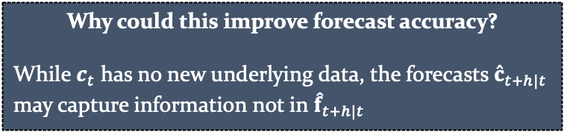
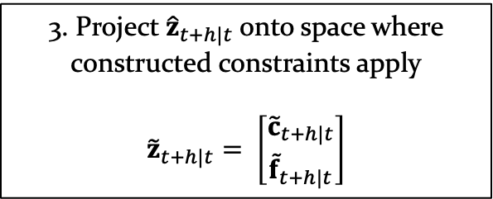
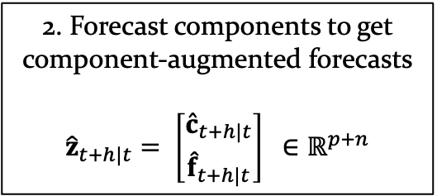
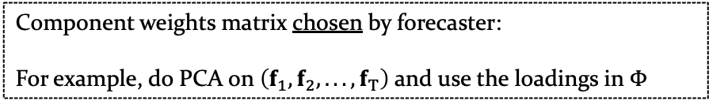
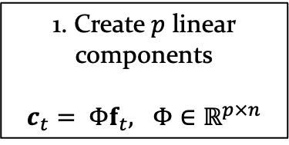
1.3 Gap: how to expand the predictor set beyond forecasts of $y_{t}$?
Forecast Linear Augmented Projection (FLAP) (Yang et al., 2024) says you can improve forecast accuracy of a multivariate series $f_{t}∈ℝ^{n}$ by creating linear components from it and forecasting them too
2. Forecast components to get component-augmented forecasts
$${\hat{z}}_{t+h|t}= \left[{{\hat{c}}_{t+h|t} \atop {\hat{f}}_{t+h|t}}\right] ∈ℝ^{p+n}$$
3. Project ${\hat{z}}_{t+h|t}$onto space where constructed constraints apply
$${\tilde{z}}_{t+h|t}= \left[{{\tilde{c}}_{t+h|t} \atop {\tilde{f}}_{t+h|t}}\right]$$
1. Create $p$ linear components
$c_{t}= Φf_{t},$ $Φ∈ℝ^{p×n}$
Component weights matrix chosen by forecaster:
For example, do PCA on $\left(f_{1},f_{2},...,f_{T}\right)$ and use the loadings in $Φ$
Why could this improve forecast accuracy?
While $c_{t}$ has no new underlying data, the forecasts ${\hat{c}}_{t+h|t}$ may capture information not in ${\hat{f}}_{t+h|t}$
Research Question: To what extent can forecasts based on constructed linear components improve the accuracy of hierarchical forecasts when incorporated into the Information Combination framework?
5/21 | Part 1.3.

Slide 6
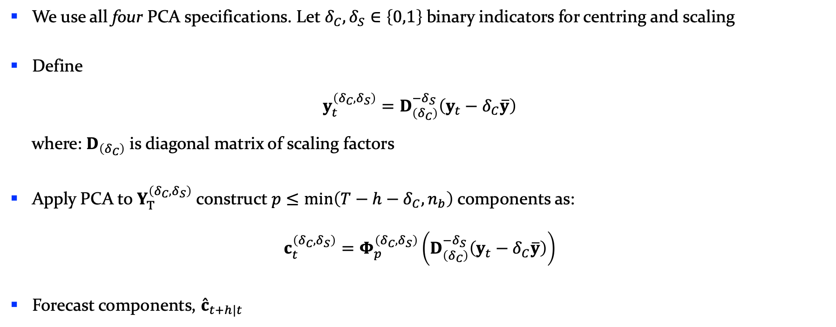



Forecasting with Linear Augmented Information Combination
1. Create $p$ linear component series from $𝕿_{T}$ using PCA and forecast them
2. Apply IComb framework on set of augmented predictors, to get FLAIC coefficient matrix
3. Use obtained coefficients to reconcile base forecast
We use all four PCA specifications. Let $δ_{C},δ_{S}∈\left\{0,1\right\}$binary indicators for centring and scaling
Define
$$y_{t}^{\left(δ_{C},δ_{S}\right)}=D_{\left(δ_{C}\right)}^{−δ_{S}}\left(y_{t}−δ_{C}\overline{y}\right)$$
where: $D_{\left(δ_{C}\right)}$ is diagonal matrix of scaling factors
Apply PCA to $Y_{T}^{\left(δ_{C},δ_{S}\right)}$ construct $p≤\min\left(T−h−δ_{C},n_{b}\right)$ components as:
$$c_{t}^{\left(δ_{C},δ_{S}\right)}=Φ_{p}^{\left(δ_{C},δ_{S}\right)}\left(D_{\left(δ_{C}\right)}^{−δ_{S}}\left(y_{t}−δ_{C}\overline{y}\right)\right)$$
Forecast components, ${\hat{c}}_{t+h|t}$
$$PC scores$$
$$PC Loadings$$
6/21 | Part 1.4.

Slide 7
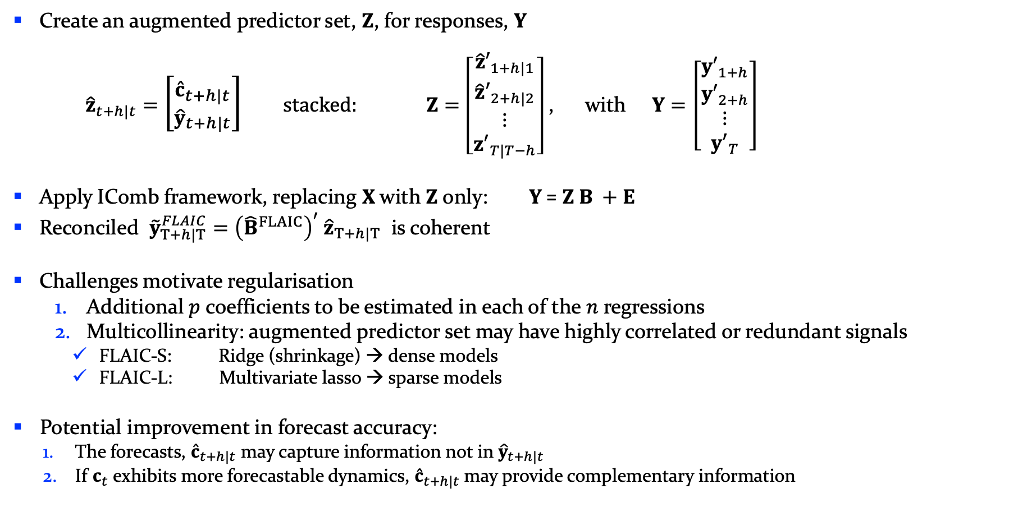
Forecasting with Linear Augmented Information Combination …(cont’d)
Create an augmented predictor set, $Z$, for responses, $Y$
${\hat{z}}_{t+h|t}=$ $\left[{{\hat{c}}_{t+h|t} \atop {\hat{y}}_{t+h|t}}\right]$ $stacked: Z=\left[\begin{matrix}{\hat{z}′}_{1+h|1} \\ {\hat{z}′}_{2+h|2} \\ ⋮ \\ {z′}_{T|T−h}\end{matrix}\right]$, with $Y=\left[\begin{matrix}{y′}_{1+h} \\ {y′}_{2+h} \\ ⋮ \\ {y′}_{T}\end{matrix}\right]$
Apply IComb framework, replacing $X$ with $Z$ only: $Y \text{=} Z B +E$
Reconciled ${\tilde{y}}_{T+h|T}^{FLAIC}={\left({\hat{B}}^{FLAIC}\right)}^{′} {\hat{z}}_{T+h|T}$ is coherent
Challenges motivate regularisation
  Additional $p$ coefficients to be estimated in each of the $n$ regressions
  Multicollinearity: augmented predictor set may have highly correlated or redundant signals
    FLAIC-S: Ridge (shrinkage) → dense models
    FLAIC-L: Multivariate lasso → sparse models
Potential improvement in forecast accuracy:
  The forecasts, ${\hat{c}}_{t+h|t}$ may capture information not in ${\hat{y}}_{t+h|t}$
  If $c_{t}$ exhibits more forecastable dynamics, ${\hat{c}}_{t+h|t}$may provide complementary information
7/21 | Part 1.4.

Slide 8
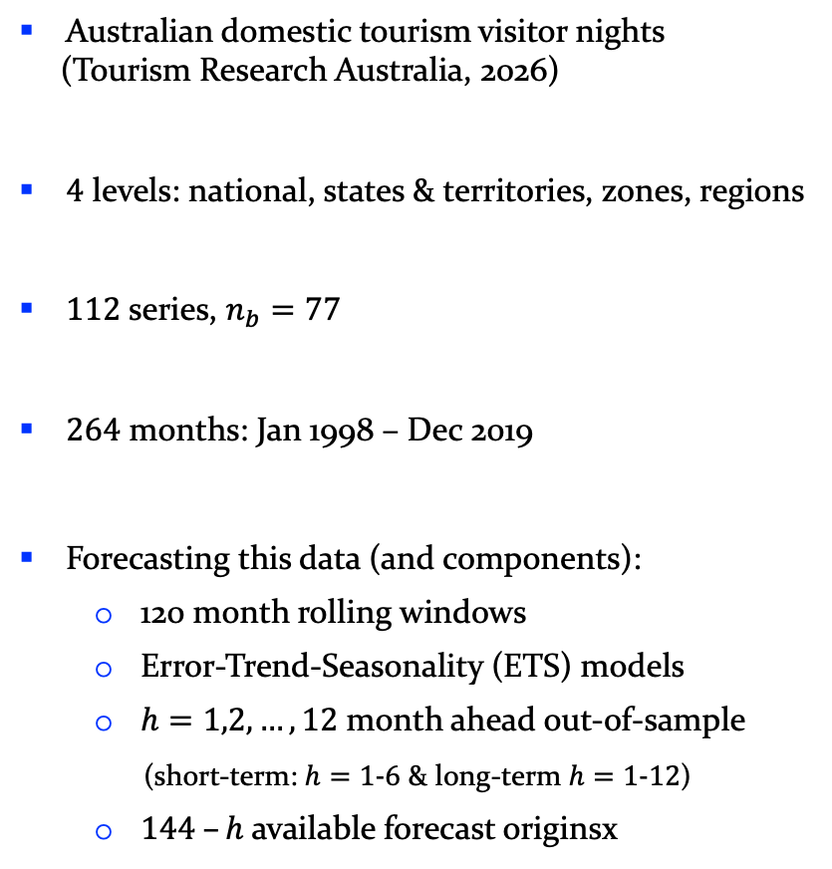
2.0 Empirical Investigation
2.1 Data | Components | Reconciliation | Evaluation
Australian domestic tourism visitor nights
(Tourism Research Australia, 2026)
$4$ levels: national, states & territories, zones, regions
$112$ series, $n_{b}=77$
$264$ months: Jan 1998 – Dec 2019
Forecasting this data (and components):
  120 month rolling windows
  Error-Trend-Seasonality (ETS) models
  $h=1,2,…,12$ month ahead out-of-sample
  (short-term: $h=1-6$ & long-term $h=1-12$)
  $144 –h$ available forecast originsx
Figure. Australian domestic tourism series and seasonal profiles
8/21 | Part 2.1.

Slide 9
Components created for all
four PCA (centre, scale) specifications
Data | 2.2 Components | Reconciliation | Evaluation
Table: Median [2.5th, 97.5th percentiles] across rolling origins. Share denotes percentage of total sum of squares. Seasonal $R^{2}$ is from month-of-year regressions.
Figure: Illustrative patterns from centred, unscaled PCA using the initial training window. Series are standardised for visual comparison.
9/21 | Part 2.2.

Slide 10

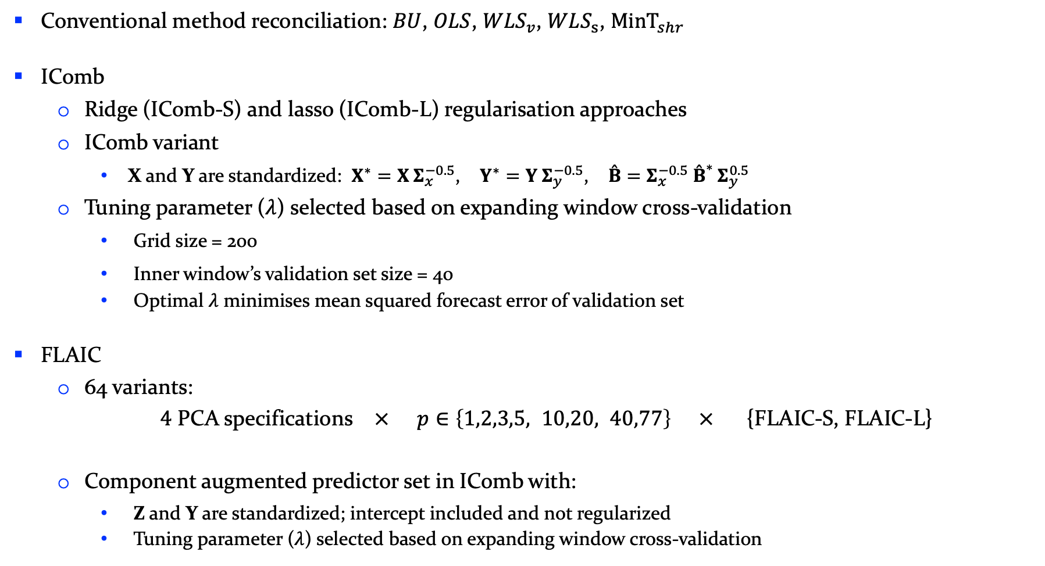
Data | Components | 2.3 Reconciliation | Evaluation
Each rolling training window:
Conventional method reconciliation: $BU$, $OLS$, $WLS_{v}$, $WLS_{s}$, ${MinT}_{shr}$
IComb
  Ridge (IComb-S) and lasso (IComb-L) regularisation approaches
  IComb variant
    X and Y are standardized: $X^{∗}=X Σ_{x}^{−0.5}$, $Y^{∗}=Y Σ_{y}^{−0.5}$, $\overset{ˆ}{B}=Σ_{x}^{−0.5} {\overset{ˆ}{B}}^{*} Σ_{y}^{0.5}$
  Tuning parameter ($λ$) selected based on expanding window cross-validation
    Grid size = 200
    Inner window’s validation set size = 40
    Optimal $λ$ minimises mean squared forecast error of validation set
FLAIC
  64 variants:
  $4$ PCA specifications $×$ $p∈\left\{1,2,3,5, 10,20, 40,77\right\}$ $×$ {FLAIC-S, FLAIC-L}
  Component augmented predictor set in IComb with:
    Z and Y are standardized; intercept included and not regularized
    Tuning parameter ($λ$) selected based on expanding window cross-validation
$low$ $moderate$ $high$
10/21 | Part 2.3.

Slide 11
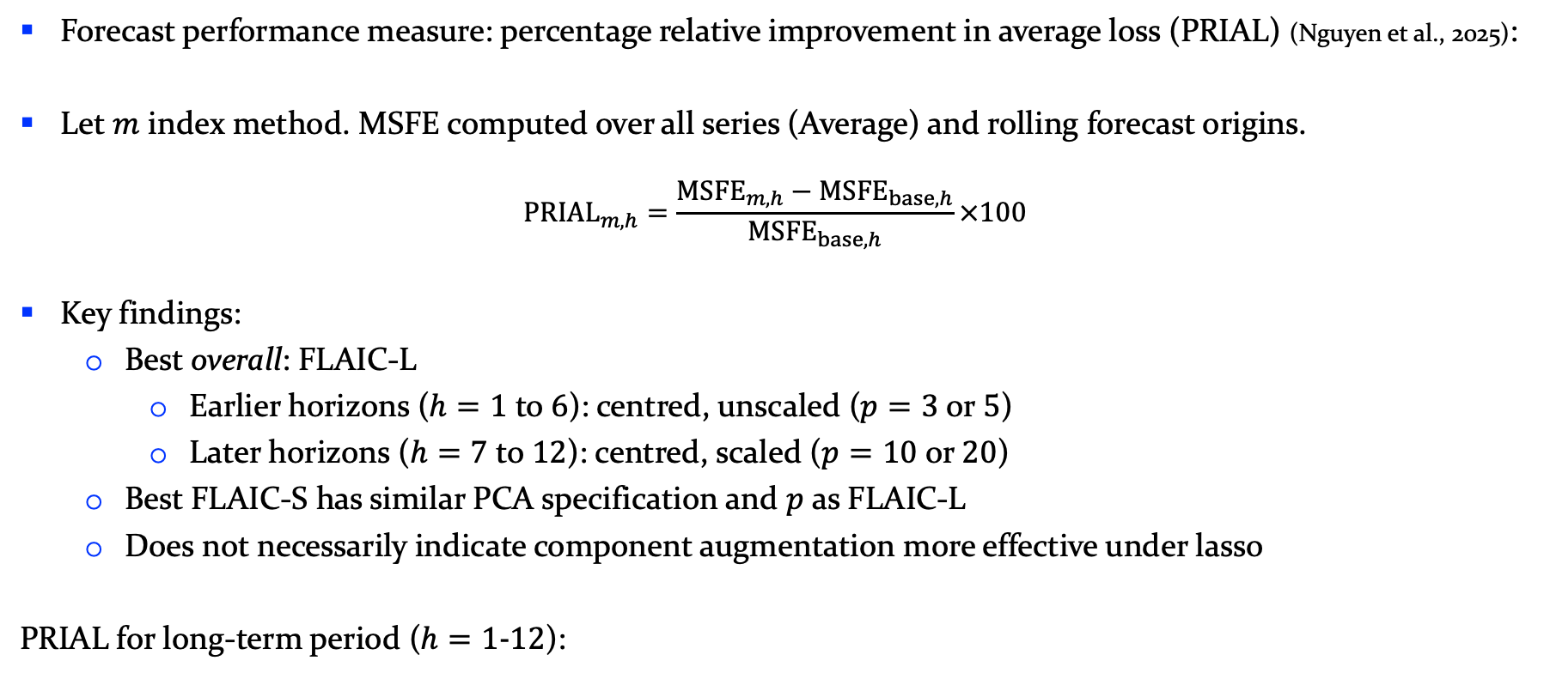
2.4.1 PRIAL
Data | Components | 2.3 Reconciliation | 2.4 Evaluation
Forecast performance measure: percentage relative improvement in average loss (PRIAL) (Nguyen et al., 2025):
Let $m$ index method. MSFE computed over all series (Average) and rolling forecast origins.
$${PRIAL}_{m,h}=\frac{{MSFE}_{m,h}−{MSFE}_{base,h}}{{MSFE}_{base,h}}×100$$
Key findings:
  Best overall: FLAIC-L
    Earlier horizons ($h=1$ to $6$): centred, unscaled ($p=3$ or $5$)
    Later horizons ($h=7$ to $12$): centred, scaled ($p=10$ or $20$)
  Best FLAIC-S has similar PCA specification and $p$ as FLAIC-L
  Does not necessarily indicate component augmentation more effective under lasso
PRIAL for long-term period ($h=1-12$):
Regularisation/Method | IComb | FLAIC | Difference
Ridge | -4.65% | -5.82% | 1.17 pp
Lasso | -6.25% | -6.67% | 0.42 pp
Difference | 1.6 pp | 0.85 pp
* Best FLAIC-L: centred, unscaled, p=5
* Best FLAIC-S: centred, scaled, p=10
11/21 | Part 2.4.1.

Slide 12
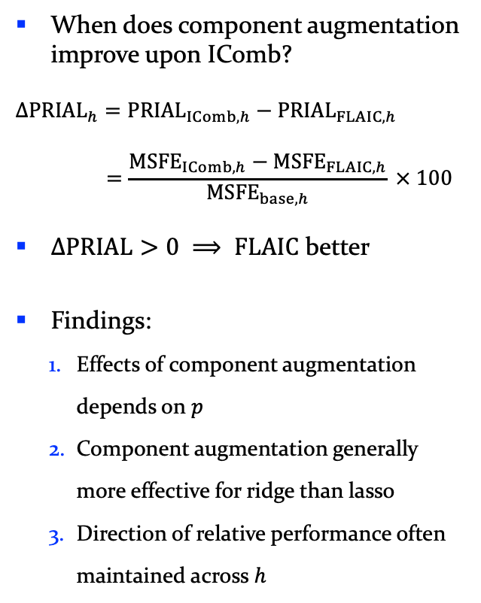
2.4.2 $Δ$ PRIAL
Data | Components | 2.3 Reconciliation | 2.4 Evaluation
When does component augmentation improve upon IComb?
$$Δ{PRIAL}_{h}={PRIAL}_{IComb,h}−{PRIAL}_{FLAIC,h}$$
$$=\frac{{MSFE}_{IComb,h}−{MSFE}_{FLAIC,h}}{{MSFE}_{base,h}} × 100$$
$ΔPRIAL>0 ⟹ FLAIC$ better
Findings:
  Effects of component augmentation depends on $p$
  Component augmentation generally more effective for ridge than lasso
  Direction of relative performance often maintained across $h$
Figure: $ΔPRIAL$: FLAIC relative to matched IComb: Average across 112 hierarchy series. FLAIC-S and FLAIC-L are compared against matching IComb-S and IComb-L.
12/21 | Part 2.4.2.

Slide 13
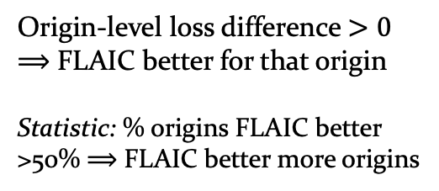
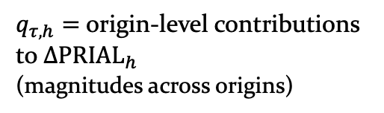
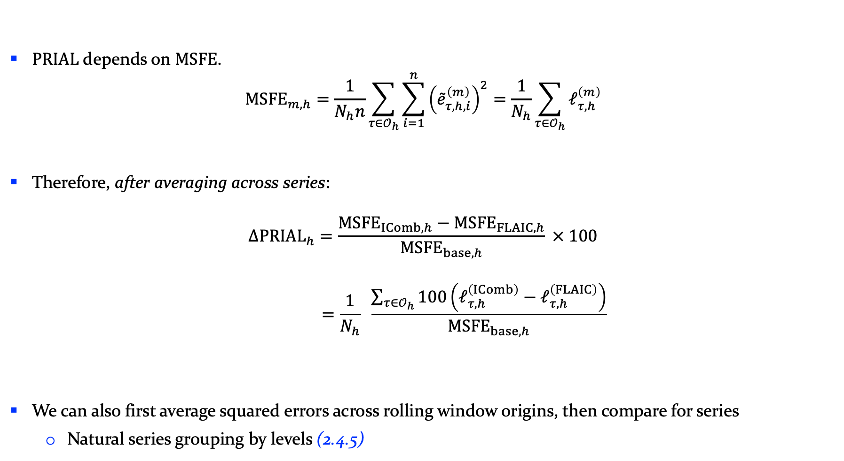
Data | Components | 2.3 Reconciliation | 2.4 Evaluation
2.4.2 $Δ$ PRIAL (decomposed)
$PRIAL$depends on $MSFE$.
$${MSFE}_{m,h}=\frac{1}{N_{h}n}\sum_{τ∈𝒪_{h}}{\sum_{i=1}^{n}{{\left({\overset{˜}{e}}_{τ,h,i}^{\left(m\right)}\right)}^{2}}}=\frac{1}{N_{h}}\sum_{τ∈𝒪_{h}}{ℓ_{τ,h}^{\left(m\right)}}$$
Therefore, after averaging across series:
$$Δ{PRIAL}_{h}=\frac{{MSFE}_{IComb,h}−{MSFE}_{FLAIC,h}}{{MSFE}_{base,h}} × 100$$
$$=\frac{1}{N_{h}} \frac{\sum_{τ∈𝒪_{h}}{100\left(ℓ_{τ,h}^{\left(IComb\right)}−ℓ_{τ,h}^{\left(FLAIC\right)}\right)}}{{MSFE}_{base,h}}$$
We can also first average squared errors across rolling window origins, then compare for series
  Natural series grouping by levels (2.4.5)
(2.4.3)
Origin-level loss difference $>0$
$⟹$ FLAIC better for that origin
Statistic: % origins FLAIC better
>50% $⟹$ FLAIC better more origins
(2.4.4)
$q_{τ,h}=$ origin-level contributions to $Δ{PRIAL}_{h}$
(magnitudes across origins)
13/21 | Part 2.4.2.

Slide 14
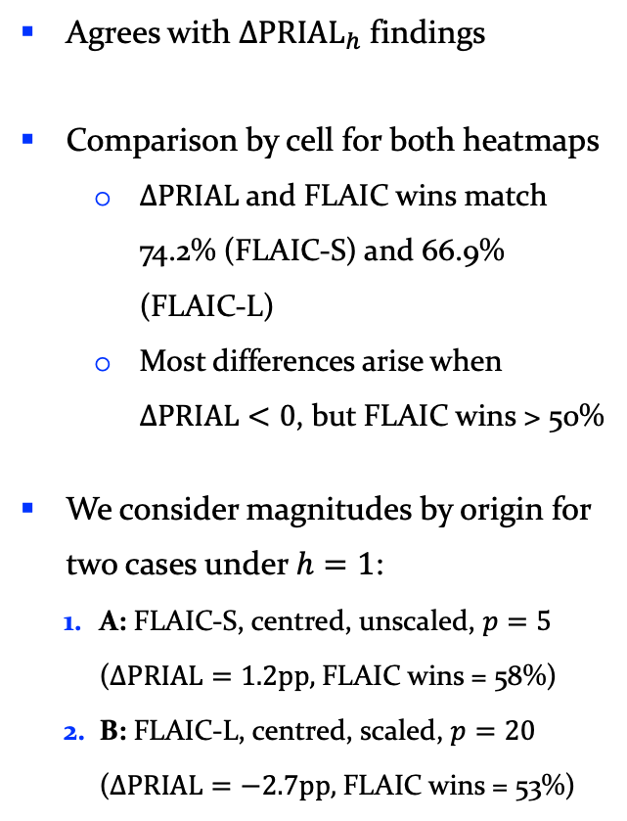
2.4.3 Rolling forecast origin
wins (FLAIC v IComb)
Data | Components | 2.3 Reconciliation | 2.4 Evaluation
Agrees with $Δ{PRIAL}_{h}$ findings
Comparison by cell for both heatmaps
  $ΔPRIAL$ and FLAIC wins match 74.2% (FLAIC-S) and 66.9% (FLAIC-L)
  Most differences arise when $ΔPRIAL<0$, but FLAIC wins > 50%
We consider magnitudes by origin for two cases under $h=1$:
  A: FLAIC-S, centred, unscaled, $p=5$ ($ΔPRIAL=1.2pp,$FLAIC wins = 58%)
  B: FLAIC-L, centred, scaled, $p=20$
  ($ΔPRIAL=−2.7pp,$FLAIC wins = 53%)
Figure: Percentage of rolling forecast origins at which FLAIC has a lower average squared-error loss than matched IComb, averaged across the 112 hierarchy series. FLAIC-S and FLAIC-L are compared with IComb-S and IComb-L, respectively. Percentages are rounded to integers.
14/21 | Part 2.4.3.

Slide 15
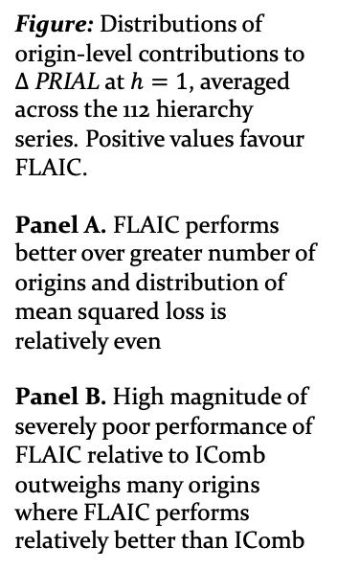
Data | Components | 2.3 Reconciliation | 2.4 Evaluation
2.4.4 Origin–level contributions to $Δ$ PRIAL
Figure: Distributions of origin-level contributions to $Δ$ PRIAL at $h=1$, averaged across the 112 hierarchy series. Positive values favour FLAIC.
Panel A. FLAIC performs better over greater number of origins and distribution of mean squared loss is relatively even
Panel B. High magnitude of severely poor performance of FLAIC relative to IComb outweighs many origins where FLAIC performs relatively better than IComb
15/21 | Part 2.4.4.

Slide 16
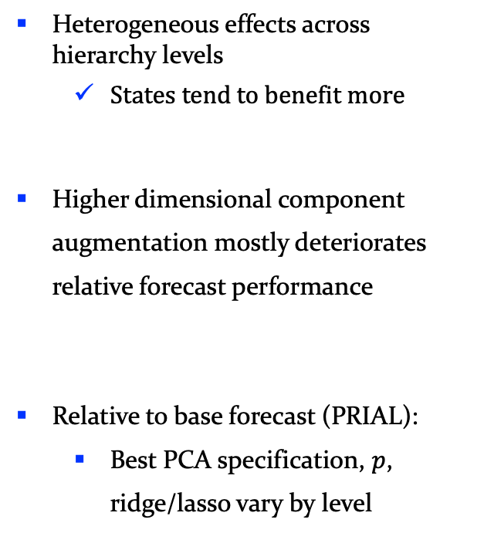
2.4.5 $Δ$ PRIAL and PRIAL
by hierarchy level
Data | Components | 2.3 Reconciliation | 2.4 Evaluation
Heterogeneous effects across hierarchy levels
  States tend to benefit more
Higher dimensional component augmentation mostly deteriorates relative forecast performance
Relative to base forecast (PRIAL):
  Best PCA specification, $p$, ridge/lasso vary by level
Figure: $ΔPRIAL$: FLAIC relative to matched IComb (using centred, unscaled PCA), computed for each hierarchy level. FLAIC-S and FLAIC-L are compared against matching IComb-S and IComb-L, and positive values favour FLAIC over matched IComb.
16/22 | Part 2.4.5.

Slide 17
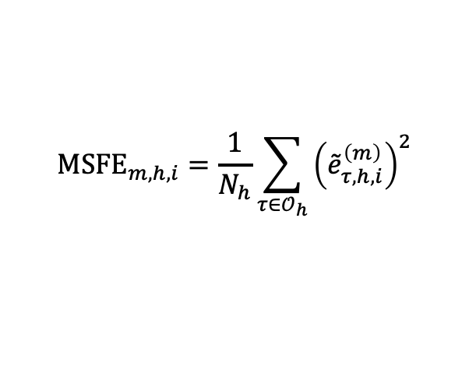
2.4.6 Statistical significance
visualised via MCB
Data | Components | 2.3 Reconciliation | 2.4 Evaluation
$${MSFE}_{m,h,i}=\frac{1}{N_{h}}\sum_{τ∈𝒪_{h}}{{\left({\overset{˜}{e}}_{τ,h,i}^{\left(m\right)}\right)}^{2}}$$
Rank each series across methods to get a distribution of ranks for each method. Each method is summarised by its average rank across series.
(Friedman 1937, 1939; Nemenyi 1963; Hollander et al. 2013; Koning et al. 2005)
Considering other 3 PCA specs too:
Best-ranked method generally has low component augmentation
Limited evidence that improvement in forecast accuracy under FLAIC is statistically significant (especially lasso)
High-dimensional component augmentation is typically statistically significantly worse (especially ridge)
Figure: Multiple comparison with best (MCB): comparison of average ranks against best-rank method. Uses average MSFE ranks across 112 hierarchy series at $h=1,6,12$ for centred, unscaled PCA specification.
17/22 | Part 2.4.6.

Slide 18
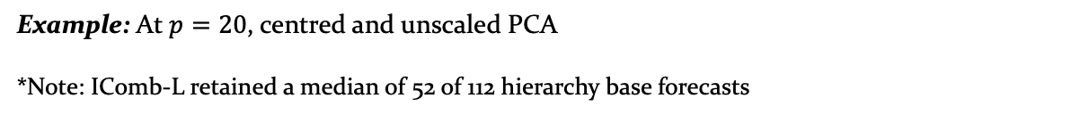
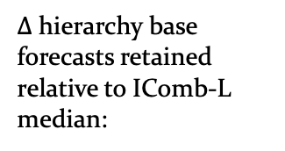
2.4.7 Lasso diagnostics
Data | Components | 2.3 Reconciliation | 2.4 Evaluation
Findings for component forecast retention:
PC1 and PC2 rarely retained while
higher order PCs frequently kept
Component forecast retention is not accompanied by a comparable reduction in hierarchy base forecasts.
Retention does not consistently translate into accuracy gains.
Figure: Cells report the percentage of 144 rolling forecast origins at which each PC forecast is retained by FLAIC-L. Retention means at least one non-zero coefficient across the 112 response equations.
Component forecasts retained (median) by FLAIC-L:
(number, %)
$Δ$ hierarchy base forecasts retained relative to IComb-L median:
16 / 20
(80%)
– 2
Example: At $p=20$, centred and unscaled PCA
*Note: IComb-L retained a median of 52 of 112 hierarchy base forecasts
18/22 | Part 2.4.7.

Slide 19
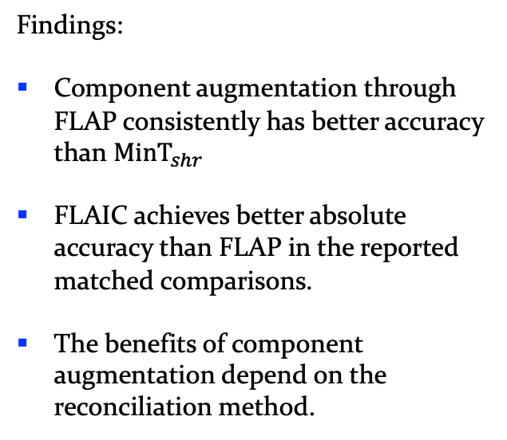
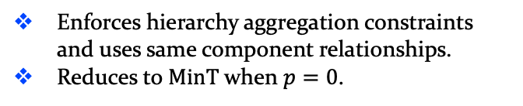
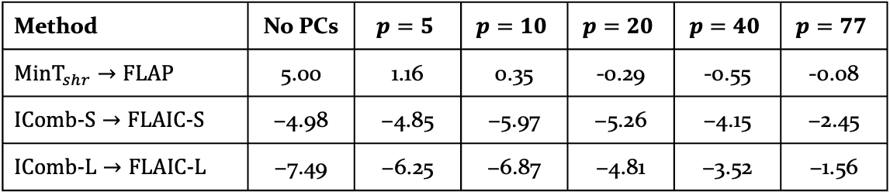
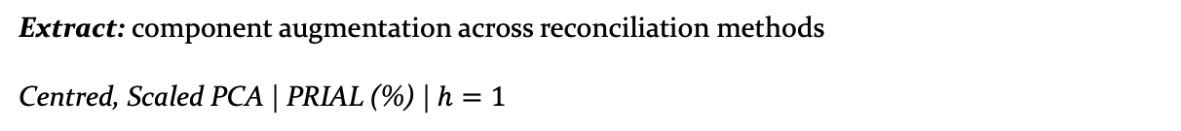
2.4.8 Hierarchy-adapted
FLAP benchmark
Data | Components | 2.3 Reconciliation | 2.4 Evaluation
Same base + component
forecasts
Hierarchy adapted FLAP benchmark*
Covariance-based oblique projection
Coherent
forecasts
Enforces hierarchy aggregation constraints and uses same component relationships.
Reduces to $MinT$ when $p=0$.
Findings:
Component augmentation through FLAP consistently has better accuracy than ${MinT}_{shr}$
FLAIC achieves better absolute accuracy than FLAP in the reported matched comparisons.
The benefits of component augmentation depend on the reconciliation method.
Extract: component augmentation across reconciliation methods
Centred, Scaled PCA | PRIAL (%) | $h=1$
Method | No PCs | $$p=5$$ | $$p=10$$ | $$p=20$$ | $$p=40$$ | $$p=77$$
$${MinT}_{shr}→FLAP$$ | 5.00 | 1.16 | 0.35 | -0.29 | -0.55 | -0.08
$$IComb-S→FLAIC-S$$ | −4.98 | −4.85 | −5.97 | −5.26 | −4.15 | −2.45
$$IComb-L→FLAIC-L$$ | −7.49 | −6.25 | −6.87 | −4.81 | −3.52 | −1.56
Notes: Lower PRIAL = better forecast accuracy. No PCs identifies the corresponding MinT or IComb benchmark.
* More details in appendix slides
19/22 | Part 2.4.8

Slide 20
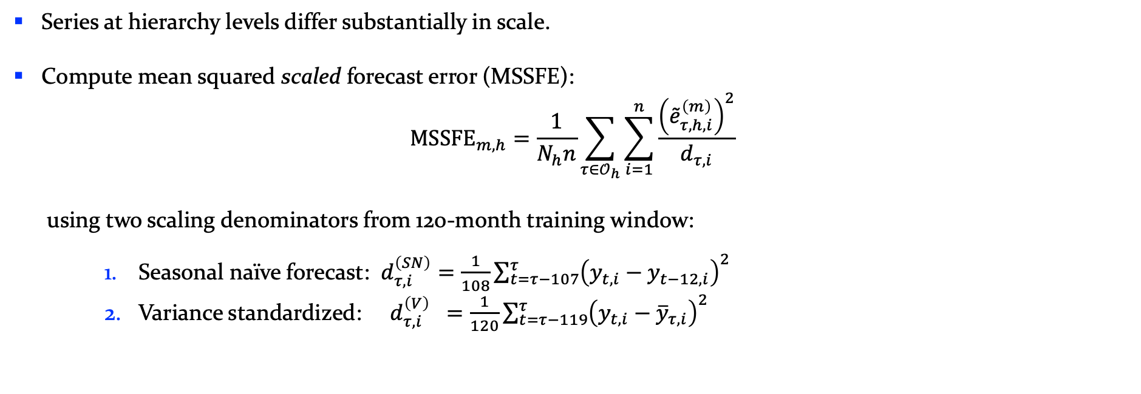
2.4.9 Robustness:
Using scaled errors
Data | Components | 2.3 Reconciliation | 2.4 Evaluation
Series at hierarchy levels differ substantially in scale.
Compute mean squared scaled forecast error (MSSFE):
$${MSSFE}_{m,h}=\frac{1}{N_{h}n}\sum_{τ∈𝒪_{h}}{\sum_{i=1}^{n}{\frac{{\left({\overset{˜}{e}}_{τ,h,i}^{\left(m\right)}\right)}^{2}}{d_{τ,i}}}}$$
using two scaling denominators from 120-month training window:
    Seasonal naïve forecast: $d_{τ,i}^{\left(SN\right)}=\frac{1}{108}\sum_{t=τ−107}^{τ}{{\left(y_{t,i}−y_{t−12,i}\right)}^{2}}$
    Variance standardized: $d_{τ,i}^{\left(V\right)} =\frac{1}{120}\sum_{t=τ−119}^{τ}{{\left(y_{t,i}−{\overline{y}}_{τ,i}\right)}^{2}}$
Finding | Raw error measure | Both scaled-errors measures
Low/moderate augmentation can help | Yes | Yes (smaller than raw squared errors)
High augmentation generally hurts | Yes | Yes
Best-performing FLAIC variant | Lasso | Ridge
20/22 | Part 2.4.9.

Slide 21
Concluding remarks: contribution & significance
Research question: To what extent can forecasts based on constructed linear components improve the accuracy of hierarchical forecasts when incorporated into the Information Combination framework?
Answer: It can, under selected specifications — but improvements in forecast accuracy are not consistently statistically significant.
Our contribution is mainly methodological:
  Propose FLAIC: incorporates separately forecast principal components into IComb framework, while maintaining coherence and without requiring additional underlying data.
  Develop a hierarchy-adapted FLAP benchmark, incorporating both component and aggregation constraints.
Implications – established via empirical investigation
  Low/moderate augmentation can improve accuracy of FLAIC relative to IComb, particularly under ridge; very high augmentation generally deteriorates FLAIC’s relative forecast performance.
  Benefits of component augmentation depend on PCA specification, regularisation, and reconciliation method.
21/22 | Part 3.1.

Slide 22
Limitations and future research
Limitations of our research:
One empirical dataset (Australian domestic tourism) and ETS forecasts
Unclear when component forecasts offer genuinely useful complementary information
Predefined PCA specification, component augmentation dimension and one IComb implementation.
Identifying the conditions under which component augmentation provides a reliable improvement in forecast accuracy relative to IComb is an important direction for future research:
Monte Carlo simulations varying hierarchy structure, base forecasting models, common signals, forecast error correlation and dimensionality
Use different IComb framework variants
(example, without standardisation)
If best FLAIC variant is an empirical question, then may need data-driven selection for PCA, augmentation dimension and regularisation method
22/22 | Part 3.2.

Slide 23
Appendix

Slide 24
2.0 Empirical Investigation
2.1 Data | Components | Reconciliation | Evaluation
Figure. Australian domestic tourism series and seasonal profiles
Appendix

Slide 25
2.4.4 $Δ$ PRIAL and PRIAL
by hierarchy level
Data | Components | 2.3 Reconciliation | 2.4 Evaluation
Heterogeneous effects across hierarchy levels
  States tend to benefit more
Higher dimensional component augmentation mostly deteriorates relative forecast performance
Relative to base forecast (PRIAL):
  Best PCA specification, $p$, ridge/lasso vary by level
Figure: $ΔPRIAL$: FLAIC relative to matched IComb (using centred, scaled PCA), computed for each hierarchy level. FLAIC-S and FLAIC-L are compared against matching IComb-S and IComb-L, and positive values favour FLAIC over matched IComb.
Appendix

Slide 26
2.4.4 $Δ$ PRIAL and PRIAL
by hierarchy level
Data | Components | 2.3 Reconciliation | 2.4 Evaluation
Heterogeneous effects across hierarchy levels
  States tend to benefit more
Higher dimensional component augmentation mostly deteriorates relative forecast performance
Relative to base forecast (PRIAL):
  Best PCA specification, $p$, ridge/lasso vary by level
Figure: $ΔPRIAL$: FLAIC relative to matched IComb (using uncentred, unscaled PCA), computed for each hierarchy level. FLAIC-S and FLAIC-L are compared against matching IComb-S and IComb-L, and positive values favour FLAIC over matched IComb.
Appendix

Slide 27
2.4.4 $Δ$ PRIAL and PRIAL
by hierarchy level
Data | Components | 2.3 Reconciliation | 2.4 Evaluation
Heterogeneous effects across hierarchy levels
  States tend to benefit more
Higher dimensional component augmentation mostly deteriorates relative forecast performance
Relative to base forecast (PRIAL):
  Best PCA specification, $p$, ridge/lasso vary by level
Figure: $ΔPRIAL$: FLAIC relative to matched IComb (using uncentred, scaled PCA), computed for each hierarchy level. FLAIC-S and FLAIC-L are compared against matching IComb-S and IComb-L, and positive values favour FLAIC over matched IComb.
Appendix

Slide 28
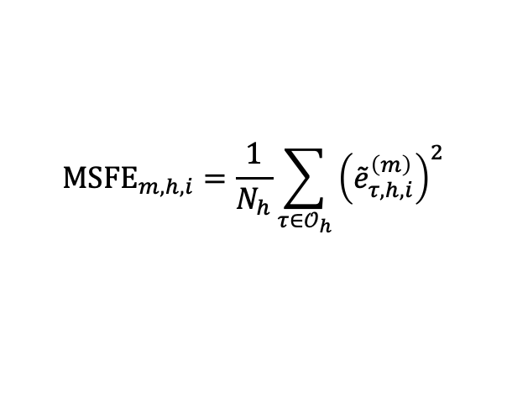
2.4.5 Statistical significance
visualised via MCB
Data | Components | 2.3 Reconciliation | 2.4 Evaluation
$${MSFE}_{m,h,i}=\frac{1}{N_{h}}\sum_{τ∈𝒪_{h}}{{\left({\overset{˜}{e}}_{τ,h,i}^{\left(m\right)}\right)}^{2}}$$
Rank each series across methods to get a distribution of ranks for each method. Each method is summarised by its average rank across series.
(Friedman 1937, 1939; Nemenyi 1963; Hollander et al. 2013; Koning et al. 2005)
Considering other 3 PCA specs too:
Best-ranked method tends to be low augmentation
Limited evidence that improvement in forecast accuracy under FLAIC is statistically significant (especially lasso)
High-dimensional component augmentation typically statistically significantly worse (especially ridge)
Figure: Multiple comparison with best (MCB): comparison of average ranks against best-rank method. Uses average MSFE ranks across 112 hierarchy series at $h=1,6,12$ for centred, scaled PCA specification.
Appendix

Slide 29
2.4.5 Statistical significance
visualised via MCB
Data | Components | 2.3 Reconciliation | 2.4 Evaluation
$${MSFE}_{m,h,i}=\frac{1}{N_{h}}\sum_{τ∈𝒪_{h}}{{\left({\overset{˜}{e}}_{τ,h,i}^{\left(m\right)}\right)}^{2}}$$
Rank each series across methods to get a distribution of ranks for each method. Each method is summarised by its average rank across series.
(Friedman 1937, 1939; Nemenyi 1963; Hollander et al. 2013; Koning et al. 2005)
Considering other 3 PCA specs too:
Best-ranked method tends to be low augmentation
Limited evidence that improvement in forecast accuracy under FLAIC is statistically significant (especially lasso)
High-dimensional component augmentation typically statistically significantly worse (especially ridge)
Figure: Multiple comparison with best (MCB): comparison of average ranks against best-rank method. Uses average MSFE ranks across 112 hierarchy series at $h=1,6,12$ for uncentred, unscaled PCA specification.
Appendix

Slide 30
2.4.5 Statistical significance
visualised via MCB
Data | Components | 2.3 Reconciliation | 2.4 Evaluation
$${MSFE}_{m,h,i}=\frac{1}{N_{h}}\sum_{τ∈𝒪_{h}}{{\left({\overset{˜}{e}}_{τ,h,i}^{\left(m\right)}\right)}^{2}}$$
Rank each series across methods to get a distribution of ranks for each method. Each method is summarised by its average rank across series.
(Friedman 1937, 1939; Nemenyi 1963; Hollander et al. 2013; Koning et al. 2005)
Considering other 3 PCA specs too:
Best-ranked method tends to be low augmentation
Limited evidence that improvement in forecast accuracy under FLAIC is statistically significant (especially lasso)
High-dimensional component augmentation typically statistically significantly worse (especially ridge)
Figure: Multiple comparison with best (MCB): comparison of average ranks against best-rank method. Uses average MSFE ranks across 112 hierarchy series at $h=1,6,12$ for uncentred, scaled PCA specification.
Appendix

Slide 31
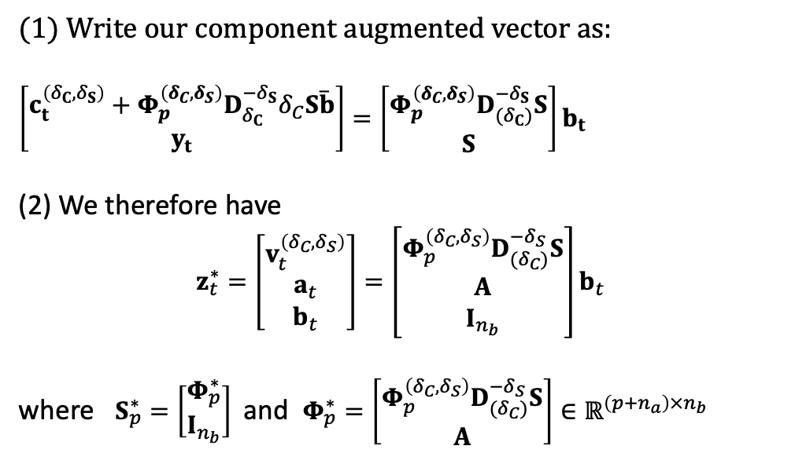
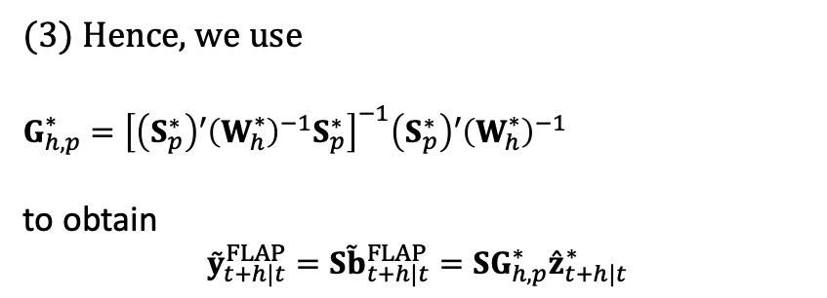
2.4.7 Hierarchy-adapted
FLAP benchmark
Data | Components | 2.3 Reconciliation | 2.4 Evaluation
Same base + component
forecasts
Hierarchy adapted FLAP benchmark
Covariance-based oblique projection
Coherent
forecasts
Enforces hierarchy aggregation constraints and uses same component relationships.
Reduces to $MinT$ when $p=0$.
(1) Write our component augmented vector as:
$$\left[\begin{matrix}c_{t}^{\left(δ_{C},δ_{S}\right)}+Φ_{p}^{\left(δ_{C},δ_{S}\right)}D_{δ_{C}}^{−δ_{S}}δ_{C}S\overline{b} \\ y_{t}\end{matrix}\right]=\left[\begin{matrix}Φ_{p}^{\left(δ_{C},δ_{S}\right)}D_{(δ_{C})}^{−δ_{S}}S \\ S\end{matrix}\right]b_{t}$$
(2) We therefore have
$$z_{t}^{∗}=\left[\begin{matrix}v_{t}^{\left(δ_{C},δ_{S}\right)} \\ a_{t} \\ b_{t}\end{matrix}\right]=\left[\begin{matrix}Φ_{p}^{\left(δ_{C},δ_{S}\right)}D_{(δ_{C})}^{−δ_{S}}S \\ A \\ I_{n_{b}}\end{matrix}\right]b_{t}$$
where $S_{p}^{∗}=\left[\begin{matrix}Φ_{p}^{∗} \\ I_{n_{b}}\end{matrix}\right]$ and $Φ_{p}^{∗}=\left[\begin{matrix}Φ_{p}^{\left(δ_{C},δ_{S}\right)}D_{(δ_{C})}^{−δ_{S}}S \\ A\end{matrix}\right]∈ℝ^{\left(p+n_{a}\right)×n_{b}}$
(3) Hence, we use
$$G_{h,p}^{∗}={\left[\left(S_{p}^{∗}\right)′{\left(W_{h}^{∗}\right)}^{−1}S_{p}^{∗}\right]}^{−1}\left(S_{p}^{∗}\right)′{\left(W_{h}^{∗}\right)}^{−1}$$
to obtain
$${\overset{˜}{y}}_{t+h|t}^{FLAP}=S{\overset{˜}{b}}_{t+h|t}^{FLAP}=SG_{h,p}^{∗}{\overset{ˆ}{z}}_{t+h|t}^{∗}$$
Appendix

Slide 32
2.4.8 Robustness:
Using scaled errors
Data | Components | 2.3 Reconciliation | 2.4 Evaluation
Figure: PRIAL of FLAIC relative to IComb: Average across 112 hierarchy series. FLAIC-S and FLAIC-L are compared against matching IComb-S and IComb-L. Uses seasonal-naïve scaled errors to compute MSSFE, the PRIAL
Appendix

Slide 33
2.4.8 Robustness:
Using scaled errors
Data | Components | 2.3 Reconciliation | 2.4 Evaluation
Figure: PRIAL of FLAIC relative to IComb: Average across 112 hierarchy series. FLAIC-S and FLAIC-L are compared against matching IComb-S and IComb-L. Uses variance standardised scaled errors to compute MSSFE, the PRIAL
Appendix

Slide 34
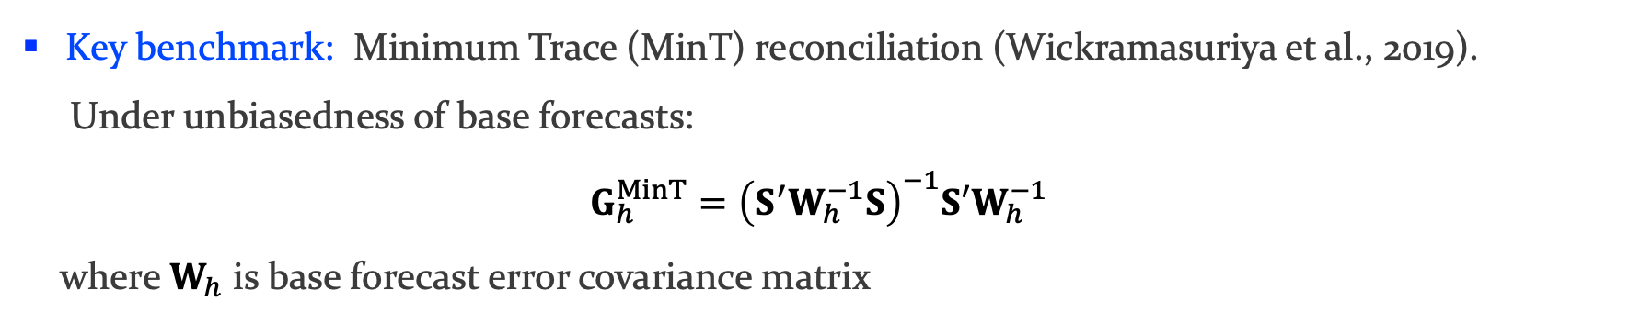
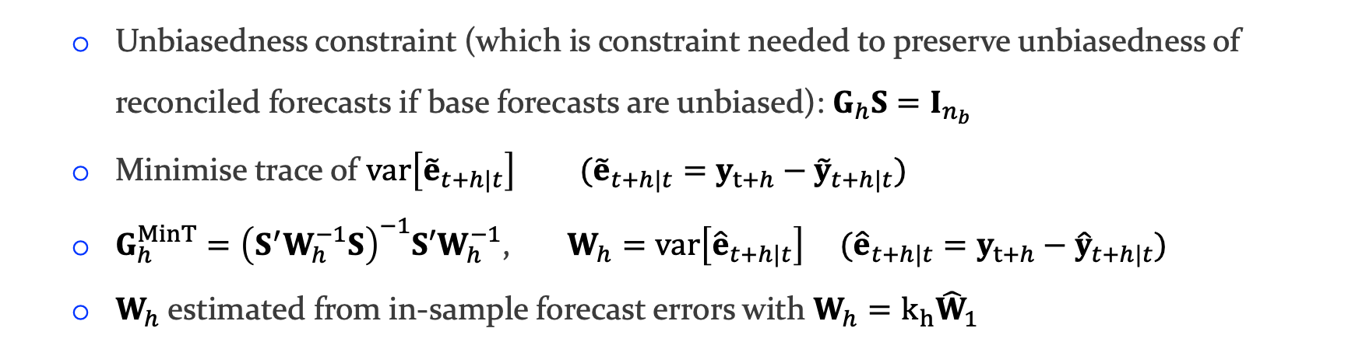
MinT details
Key benchmark: Minimum Trace (MinT) reconciliation (Wickramasuriya et al., 2019).
Under unbiasedness of base forecasts:
$$G_{h}^{MinT}={\left(S^{′}W_{h}^{−1}S\right)}^{−1}S′W_{h}^{−1}$$
where $W_{h}$ is base forecast error covariance matrix
  Unbiasedness constraint (which is constraint needed to preserve unbiasedness of reconciled forecasts if base forecasts are unbiased): $G_{h}S=I_{n_{b}}$
  Minimise trace of $var\left[{\tilde{e}}_{t+h|t}\right] ({\tilde{e}}_{t+h|t}=y_{t+h}−{\tilde{y}}_{t+h|t})$
  $G_{h}^{MinT}={\left(S^{′}W_{h}^{−1}S\right)}^{−1}S′W_{h}^{−1}$, $W_{h}=var\left[{\hat{e}}_{t+h|t}\right] ({\hat{e}}_{t+h|t}=y_{t+h}−{\hat{y}}_{t+h|t})$
  $W_{h}$estimated from in-sample forecast errors with $W_{h}=k_{h}{\hat{W}}_{1}$

Slide 35
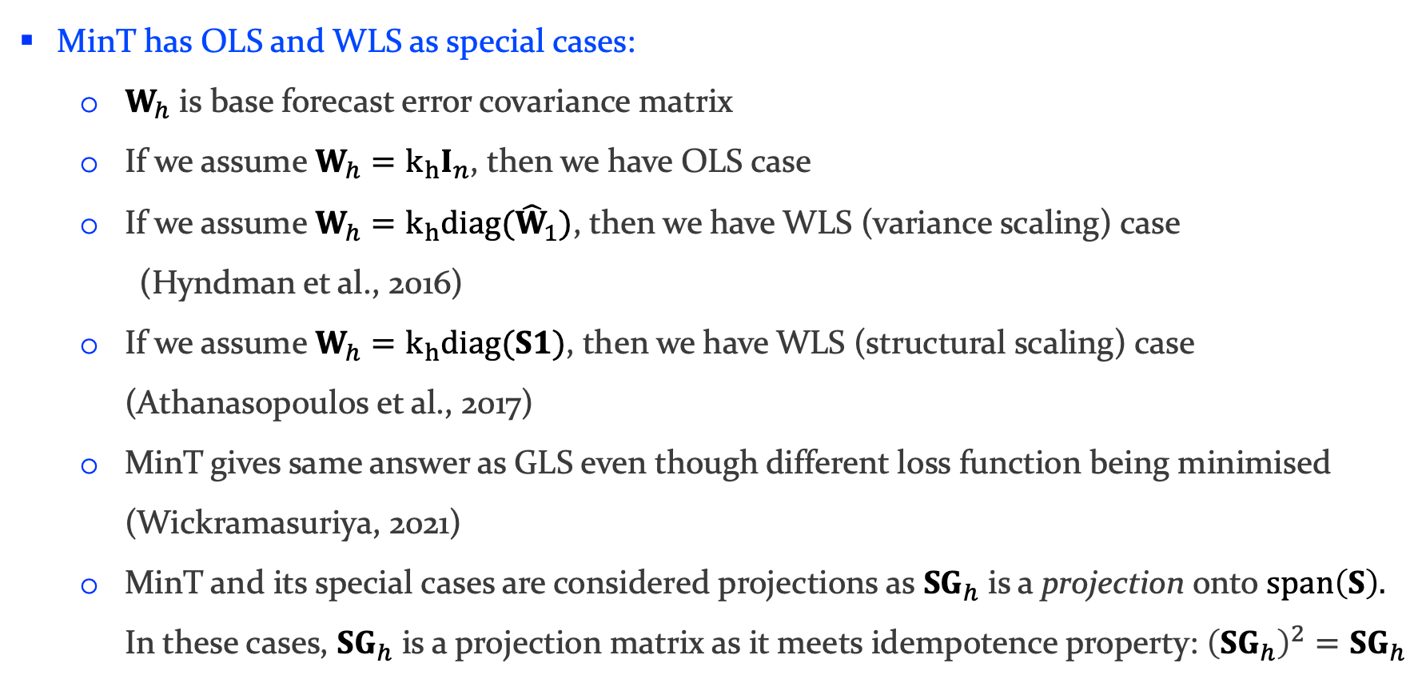
MinT details (cont.)
MinT has OLS and WLS as special cases:
  $W_{h}$ is base forecast error covariance matrix
  If we assume $W_{h}=k_{h}I_{n}$, then we have OLS case
  If we assume $W_{h}=k_{h}diag({\hat{W}}_{1})$, then we have WLS (variance scaling) case
  (Hyndman et al., 2016)
  If we assume $W_{h}=k_{h}diag(S1)$, then we have WLS (structural scaling) case (Athanasopoulos et al., 2017)
  MinT gives same answer as GLS even though different loss function being minimised (Wickramasuriya, 2021)
  MinT and its special cases are considered projections as $SG_{h}$ is a projection onto $span\left(S\right).$ In these cases, $SG_{h}$ is a projection matrix as it meets idempotence property: ${\left(SG_{h}\right)}^{2}=SG_{h}$

Slide 36
EXTRAS / WORKSPACE – please ignore
8/XX | Part 2.1.

Slide 37



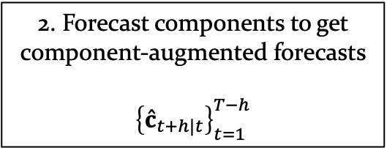


2. Forecast components to get component-augmented forecasts
$${\left\{{\hat{c}}_{t+h|t}\right\}}_{t=1}^{T−h}$$
AUS
VIC
$⋯$ $⋯$ $⋯$
NT
$⋯$ $⋯$ $⋯$
$⋯$
Metro
VIC
$⋯$ $⋯$ $⋯$ $⋯$
Central
NT
$⋯$ $⋯$ $⋯$ $⋯$
$⋯$
$⋯$
Mel
$⋯$ $⋯$ $⋯$ $⋯$ $⋯$
Alice Springs

