Slide 1
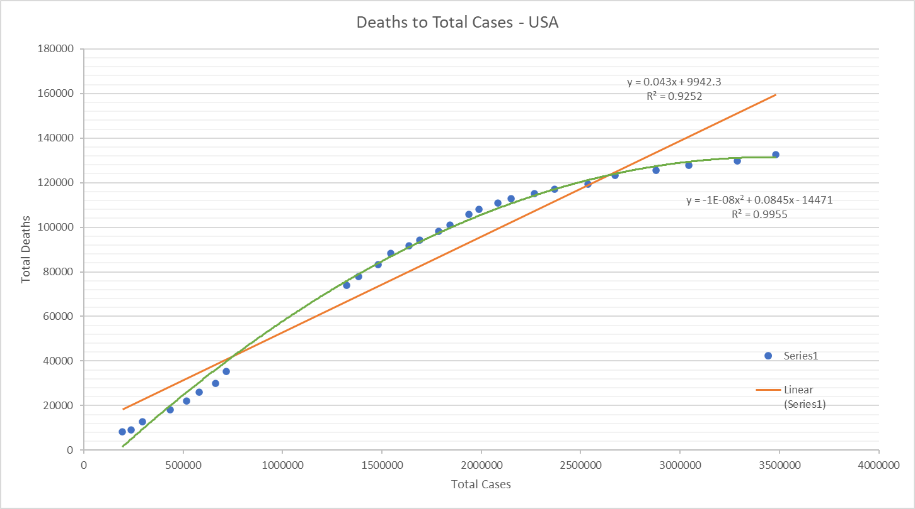
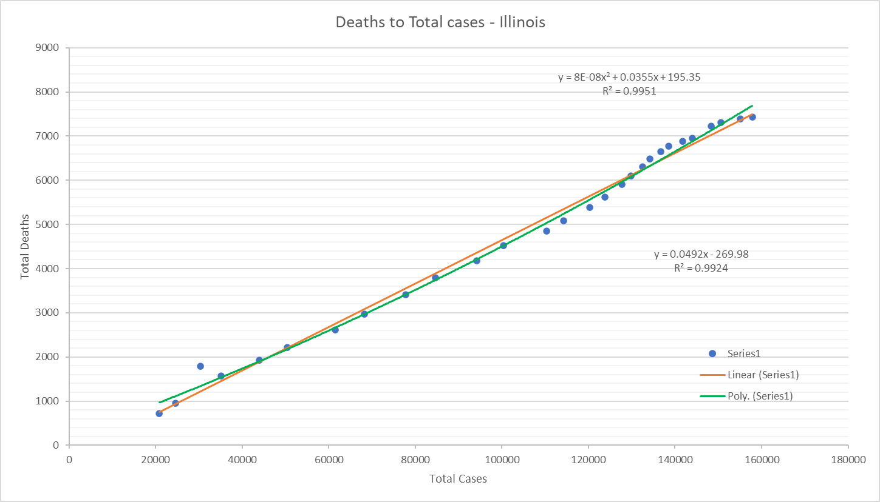
Illinois follows a different behavior than USA. Deaths are growing faster in Illinois
Poly-line describes better the behavior of the real data
R² = 0.9955

Slide 2
Impact of race/ethnicity on the number of COVID-19 infection and death rates
State of Illinois
Main findings – Tendencies, correlation and behavior
Each race tells a different story on COVID-19 infection and death rates.
WHITES:
.- % of cases were decreasing but suddenly began to rise – average: 21.3%
.- % of deaths is growing faster –from 1.2% to 2.2%
BLACKS:
.- % of cases is decreasing and seems to stabilize – average: 18.7%
.- % of deaths are stabilizing – average: 1.4%
LATIN:
.- % of cases are growing – from 12.1% to 32.6%
.- % of deaths are growing – from 0.3% to 1%
ASIAN:
.- % of cases are decreasing – from 3.3% to 2.8%
.- % of deaths are stable – average: 0.2%

Slide 3
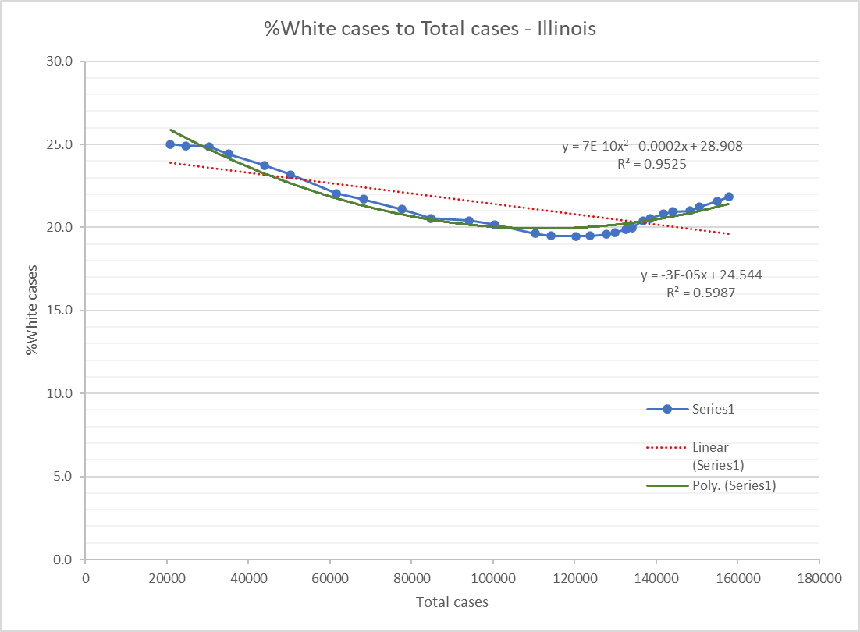
WHITES:
.- % of cases were decreasing but suddenly began to rise – average: 21.3%
.- % of deaths is growing faster –from 1.2% to 2.2%

Slide 4
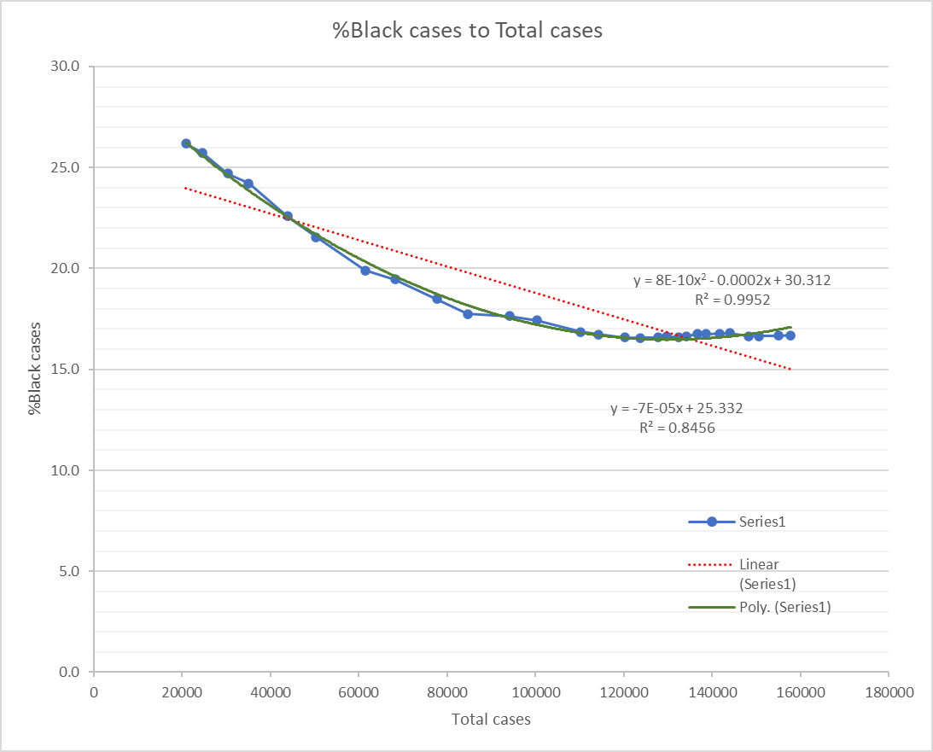
BLACKS:
.- % of cases is decreasing and seems to stabilize – average: 18.7%
.- % of deaths are stabilizing – average: 1.4%

Slide 5
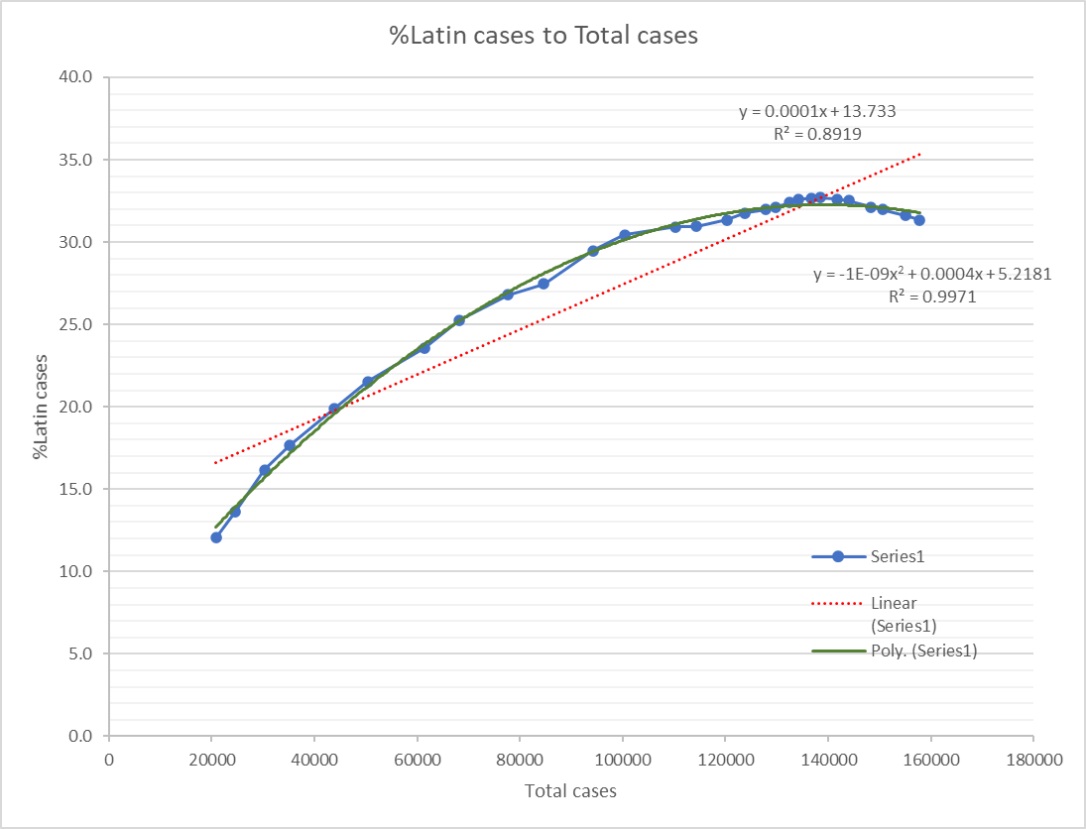
LATIN:
.- % of cases are growing – from 12.1% to 32.6%
.- % of deaths are growing – from 0.3% to 1%

Slide 6
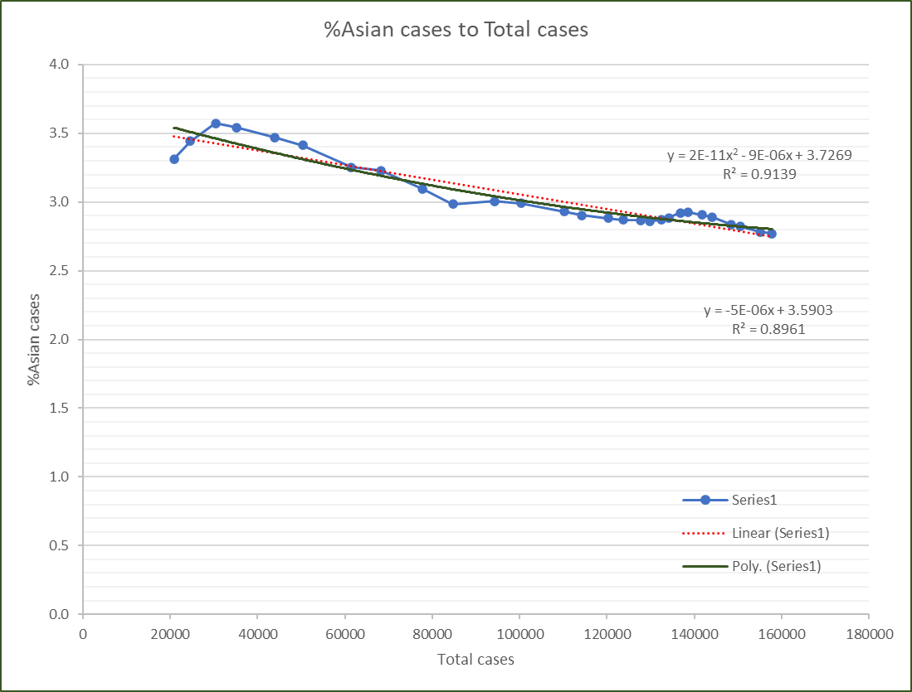
ASIAN:
.- % of cases are decreasing – from 3.3% to 2.8%
.- % of deaths are stable – average: 0.2%

