Slide 1
Exploring a million songs
Parallel Regression Trees in Ufora
Ronen Hilewicz, VP of Engineering
Ronen@Ufora.com
Notes:
Hi everyone and thanks for coming. I’m Ronen Hilewicz, programmer and engineering manager at Ufora.
I’m excited about tonight’s event. We have two new languages that represent new approaches to what data-science can look like in the near future.

Slide 2
Agenda
Ufora – language and distributed runtime
Million Song Database
The Problem - Year Prediction
Prior Approaches
Regression Trees Refresher
Demo
Performance and Scalability

Slide 3

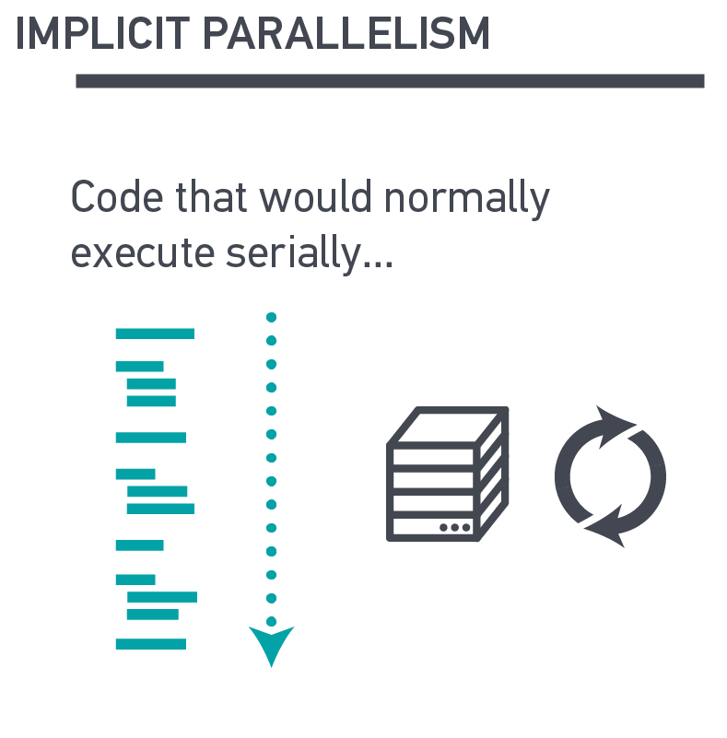
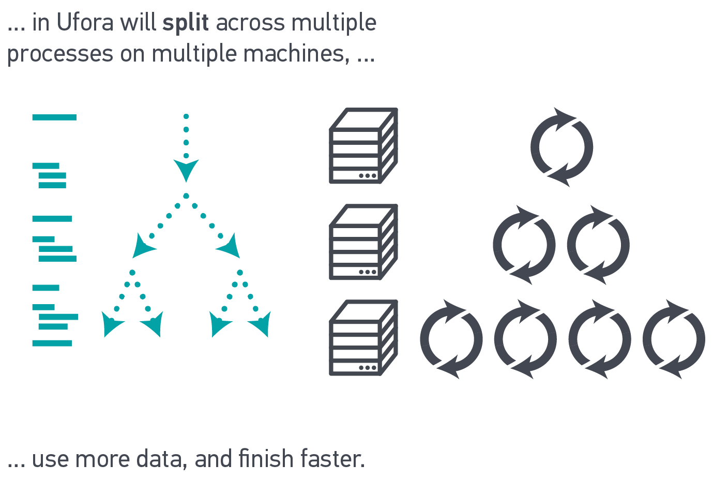
What is ?
An implicitly parallel language and runtime for data science
Notes:
Adaptive Placement of Computations and Data
Memoized Results
Dynamically Typed
Just-In-Time (JIT) Compilation
Purely Functional

Slide 4


Million Song Database
A 280GB free collection of audio features and metadata for a million contemporary popular music tracks
Does not contain any audio – only the derived features
Provided by Columbia’s LabROSA (Recognition and Organization of Speech and Audio)
Created by The Echo Nest

Slide 5
The Data
Static Metadata:
Title • Artist • Album • Genre • Year • Artist Location • etc.
Dynamic Metadata (from EchoNest API):
Song/Artist Hotttness • Familiarity • Similar Artists • Artist Keywords
Audio Features:
Key • Mode • Time-Signature • Tempo
Loudness • Energy
sections ⊆ bars ⊆ beats ⊆ tatums ⊆ segments
For each segment:
Timbre (a.k.a. sound-color, texture, or tone quality)
Pitches (“chroma” vector)
Loudness (dB at onset, dB at peak, peak offset)
Confidence Values
Notes:
Show summary stats in the Ufora

Slide 6
Demo
Exploring the Dataset

Slide 7






Year Prediction
From audio features, try to predict the year when the song was released
Timbre:
Coefficients in a linear combination of 12 basis functions that correspond to spectral characteristics like: average loudness, “brightness”, “flatness”, attack, etc.

Slide 8
Year Prediction - Prior Approaches
The Million Song Dataset, T. Bertin-Mahieux, D. Ellis, B. Whitman and P. Lamere, ISMIR '11
Methods:
Baseline: Uniform prediction
k nearest neighbors (k-NN)
Vowpal Wabbit – linear regression using gradient descent
Challenges:
Only half the dataset has year info
Highly non-uniform distribution of songs by year
Split train and test sets based on artists and not songs to avoid the “producer effect”

Slide 9
Prior Results
Method | Diff (MAD) | Sq. Diff (RMSE)
Constant | 8.13 | 10.80
1-NN | 9.81 | 13.99
50-NN | 7.58 | 10.20
VW | 6.14 | 8.76

Slide 10
Our Approach
Regression Trees
Highly parallelizable
Have been implemented at scale using MapReduce (PLANET)
Recently implemented a regression and classification tree library in Ufora

Slide 11
Regression Trees Refresher
X₃ < v₃
|D| = 10
|D| = 40
X₁ < v₁
0.335
|D| = 20
|D| = 20
X₂ < v₂
X₃ < v₄
0.101
0.666
0.03
0.79

Slide 12
Learning The Model
Using a greedy top-down approach
Partition D* along the split predicate, and proceed recursively on the partitions to build child nodes.
We select split predicates that minimize the impurity in Y values of the training records that are passed to the node. In other words, we want to maximize |D| × Var(Y_{D}) – (|D_{L}| × Var(Y_{DL}) + |D_{R}| × Var(Y_{DR})) Where Y_{DL} and Y_{DR} are the Y values in the partitions D_{L} and D_{R} of D

Slide 13
Demo
Building the Model

Slide 14
Results
Method | Diff | Sq. Diff
Constant | 8.13 | 10.80
1-NN | 9.81 | 13.99
50-NN | 7.58 | 10.20
Tree Model | 6.87 | 9.66
VW | 6.14 | 8.76

Slide 15
Performance (in seconds)
Depth | SciKit | Ufora
1 | 7.02 | 1.4
5 | 35.14 | 6.43
8 | 56.21 | 10.7
10 | 85.16 | 17.18

Slide 16
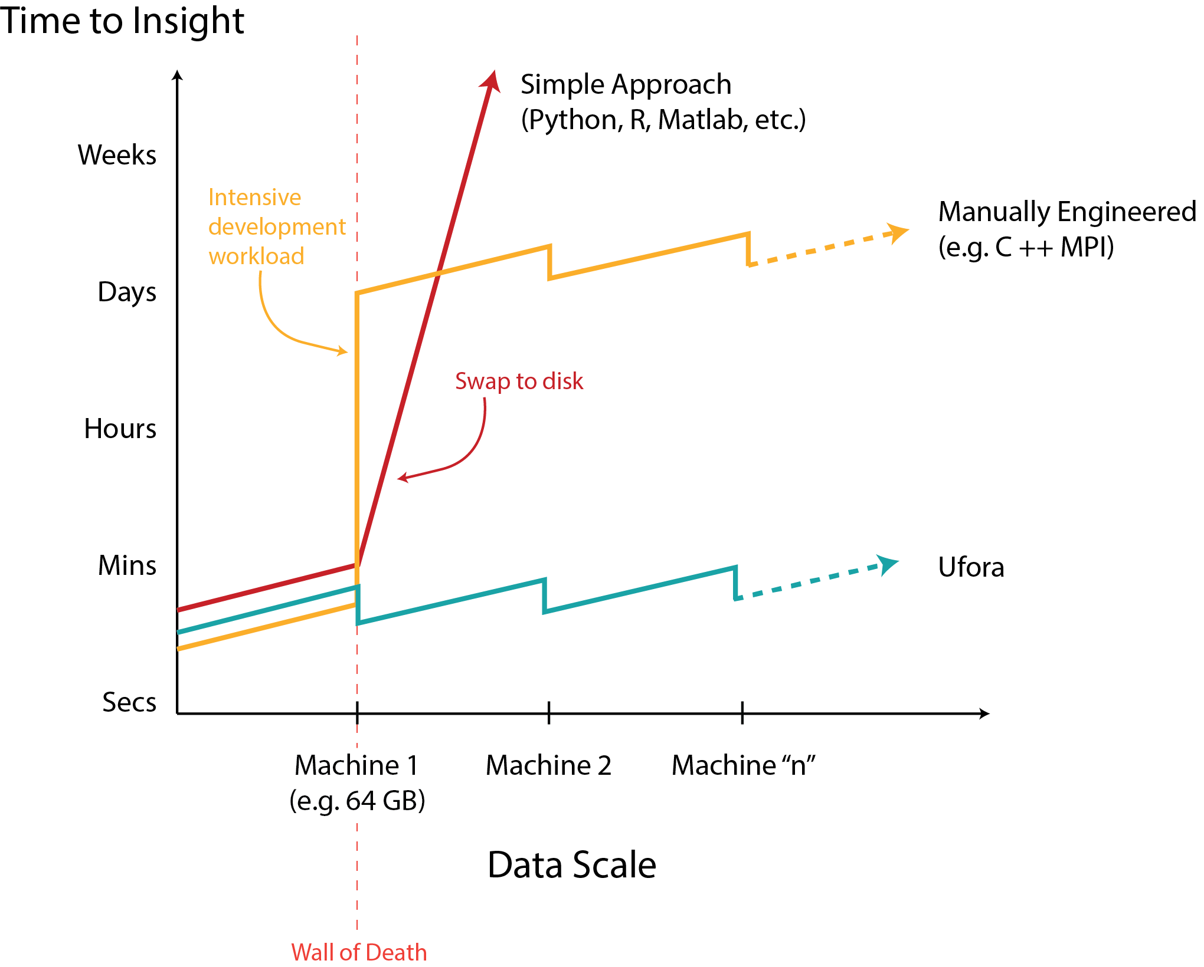
Comparison of Approaches

Slide 17
Resources
http://labrosa.ee.columbia.edu/millionsong/
Thierry Bertin-Mahieux, Daniel P.W. Ellis, Brian Whitman, and Paul Lamere.
The Million Song Dataset. In Proceedings of the 12th International Society
for Music Information Retrieval Conference (ISMIR 2011), 2011.
Vowpal Wabbit - https://github.com/JohnLangford/vowpal_wabbit/wiki
SciKit Learn - http://scikit-learn.org/
Biswanath Panda, Joshua S. Herbach, Sugato Basu, Roberto J. Bayardo
PLANET: Massively Parallel Learning of Tree Ensembles with MapReduce
Proceedings of the 35th International Conference on Very Large Data Bases (VLDB-2009)

Slide 18
We’re Hiring!
Lead Front End Engineer – Javascript, node.js, Angular.js
Senior C++ Engineer – C++, boost, Python
info@ufora.com
ronen@ufora.com

